Slide 1

South Carolina Office of
RESILIENCE
Programs and Resources
Lessening the impact of disasters on the communities and citizens of South Carolina by planning and coordinating statewide resilience, long term recovery, and hazard mitigation.
South Carolina
Office of Resilience

Slide 2




History
2015
2016
2018
2018
2020
2021
SC Disaster Recovery Office was created following Historic Floods of 2015, which resulted from Hurricane Joaquin
Hurricane Matthew
Hurricane Florence
Floodwater Commission established
Disaster Relief and Resilience Act was signed, creating the Office of Resilience
Officially began operation at the start of FY 2022

Slide 3

What We Do
DISASTER RECOVERY
Long-term recovery: rebuild and replace homes damaged by hurricanes and flooding in FEMA-declared counties; funded by HUD CDBG-DR
MITIGATION
Buyouts: Voluntary acquisitions of repetitively flooded land and property in order to return it to green space
Infrastructure: Traditional “Gray” and Nature-based “Green” Infrastructure
Plans & Studies: Funding for local governments and state agencies to develop and/or update hazard mitigation plans, stormwater plans, and more
Matching Grants: Provide the local cost share for other federal flood mitigation programs
RESILIENCE
Development and management of the Strategic Statewide Resilience & Risk Reduction Plan
Management of the Disaster Relief and Resilience Reserve Fund and the SC Resilience Revolving Fund
PREPAREDNESS
RESPONSE
RECOVERY
MITIGATION
DISASTER CYCLE

Slide 4
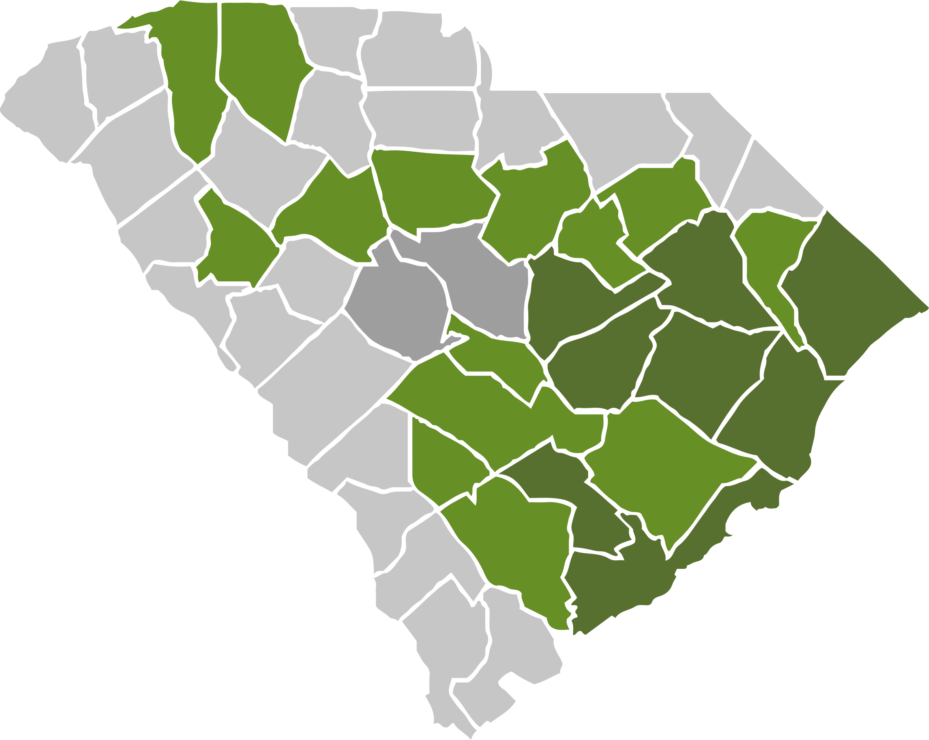
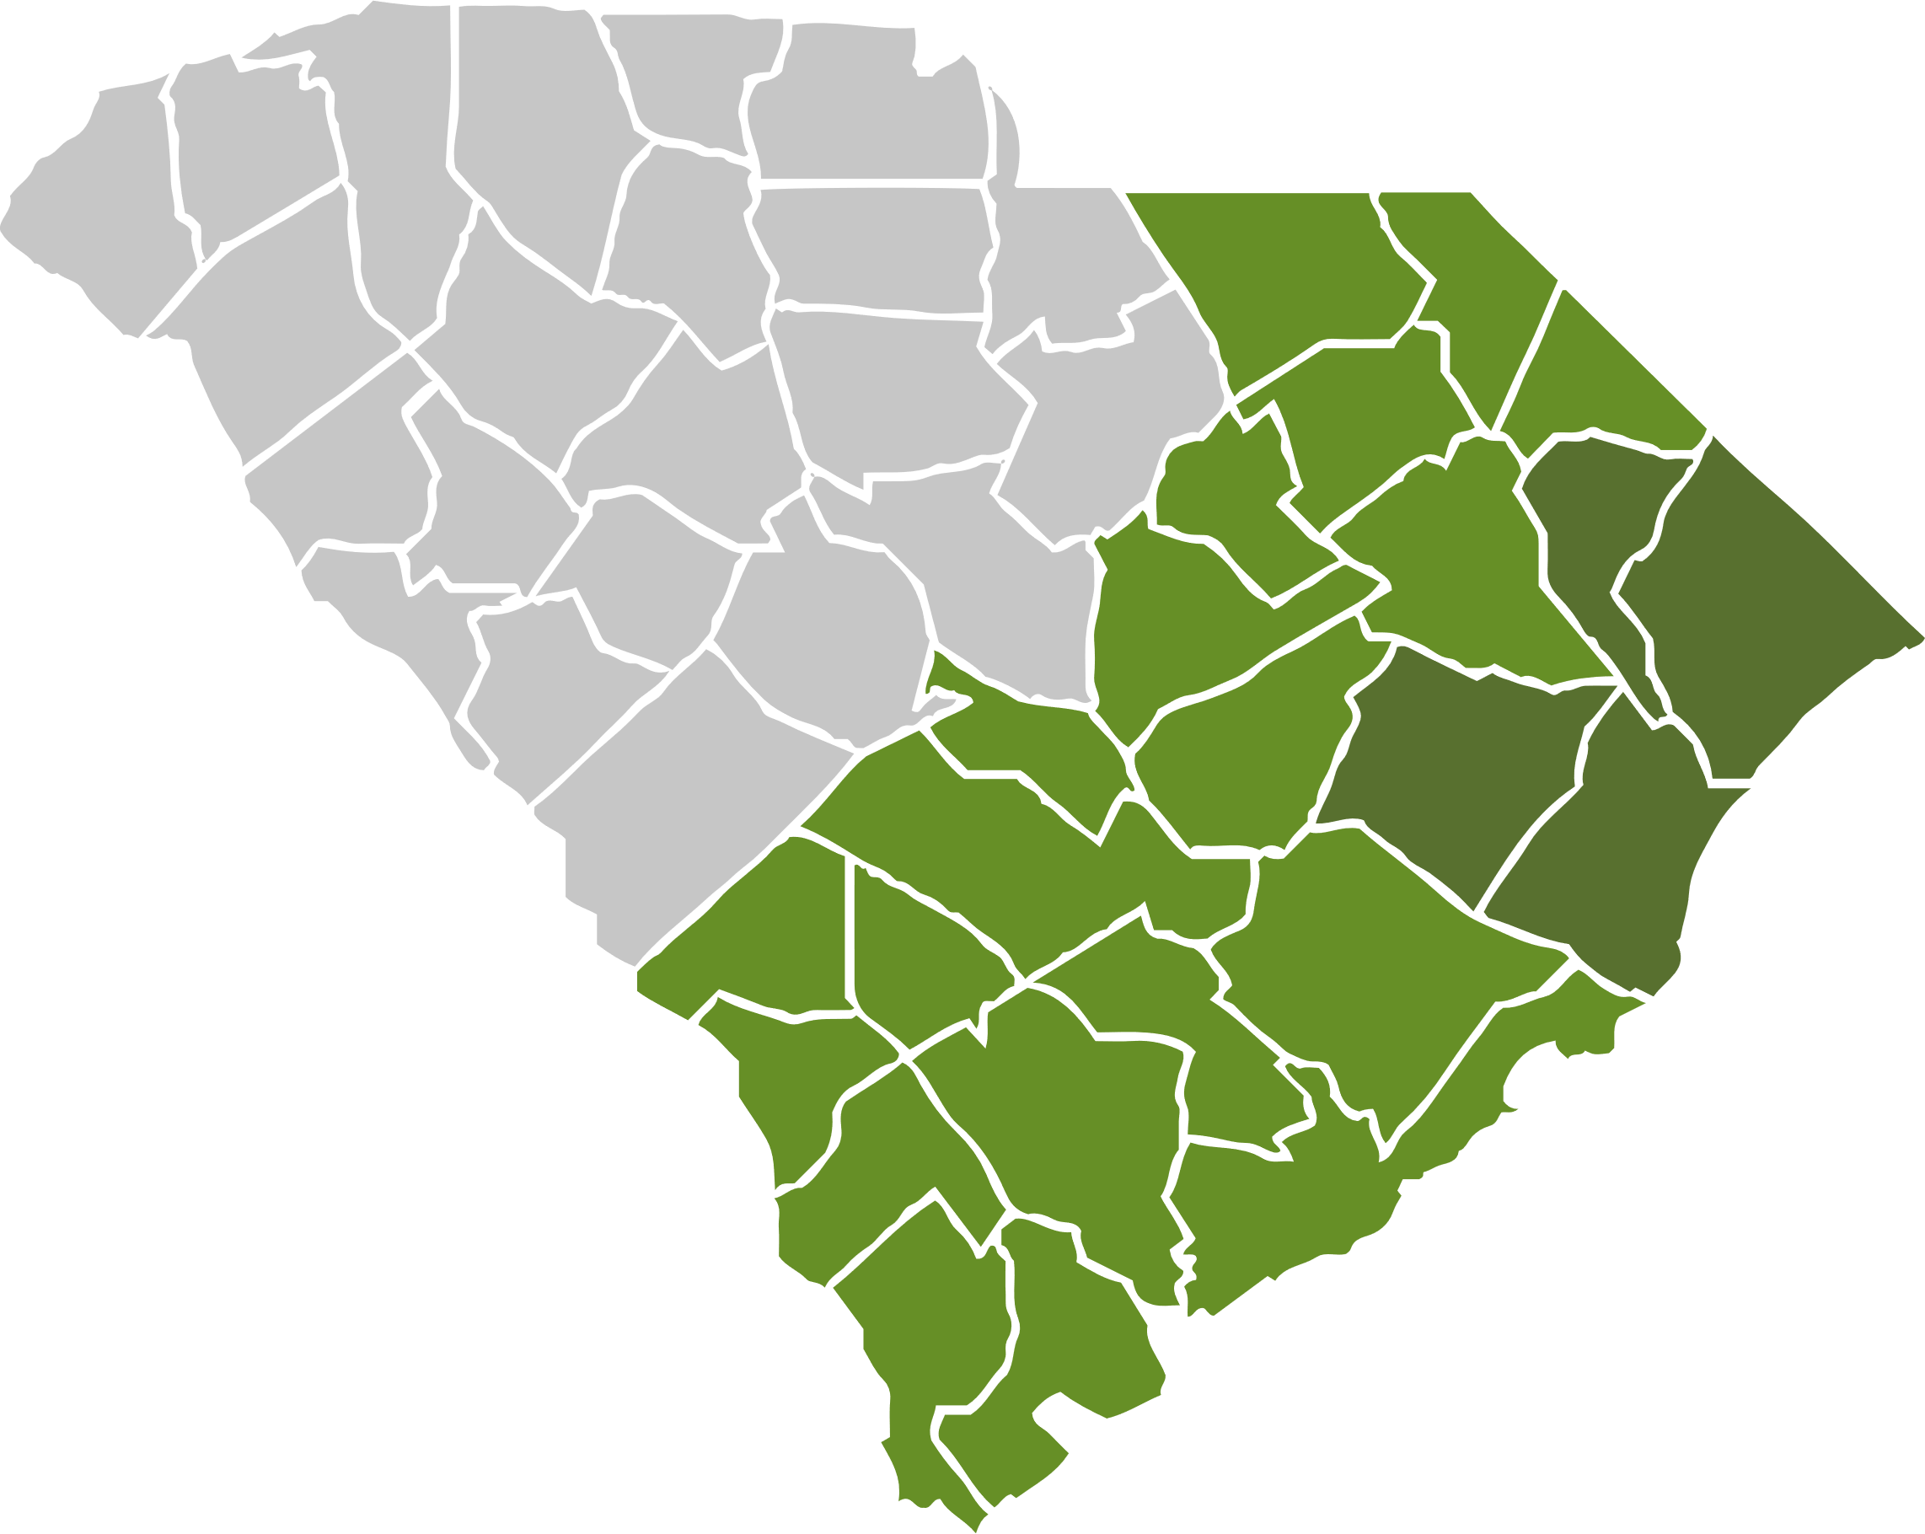
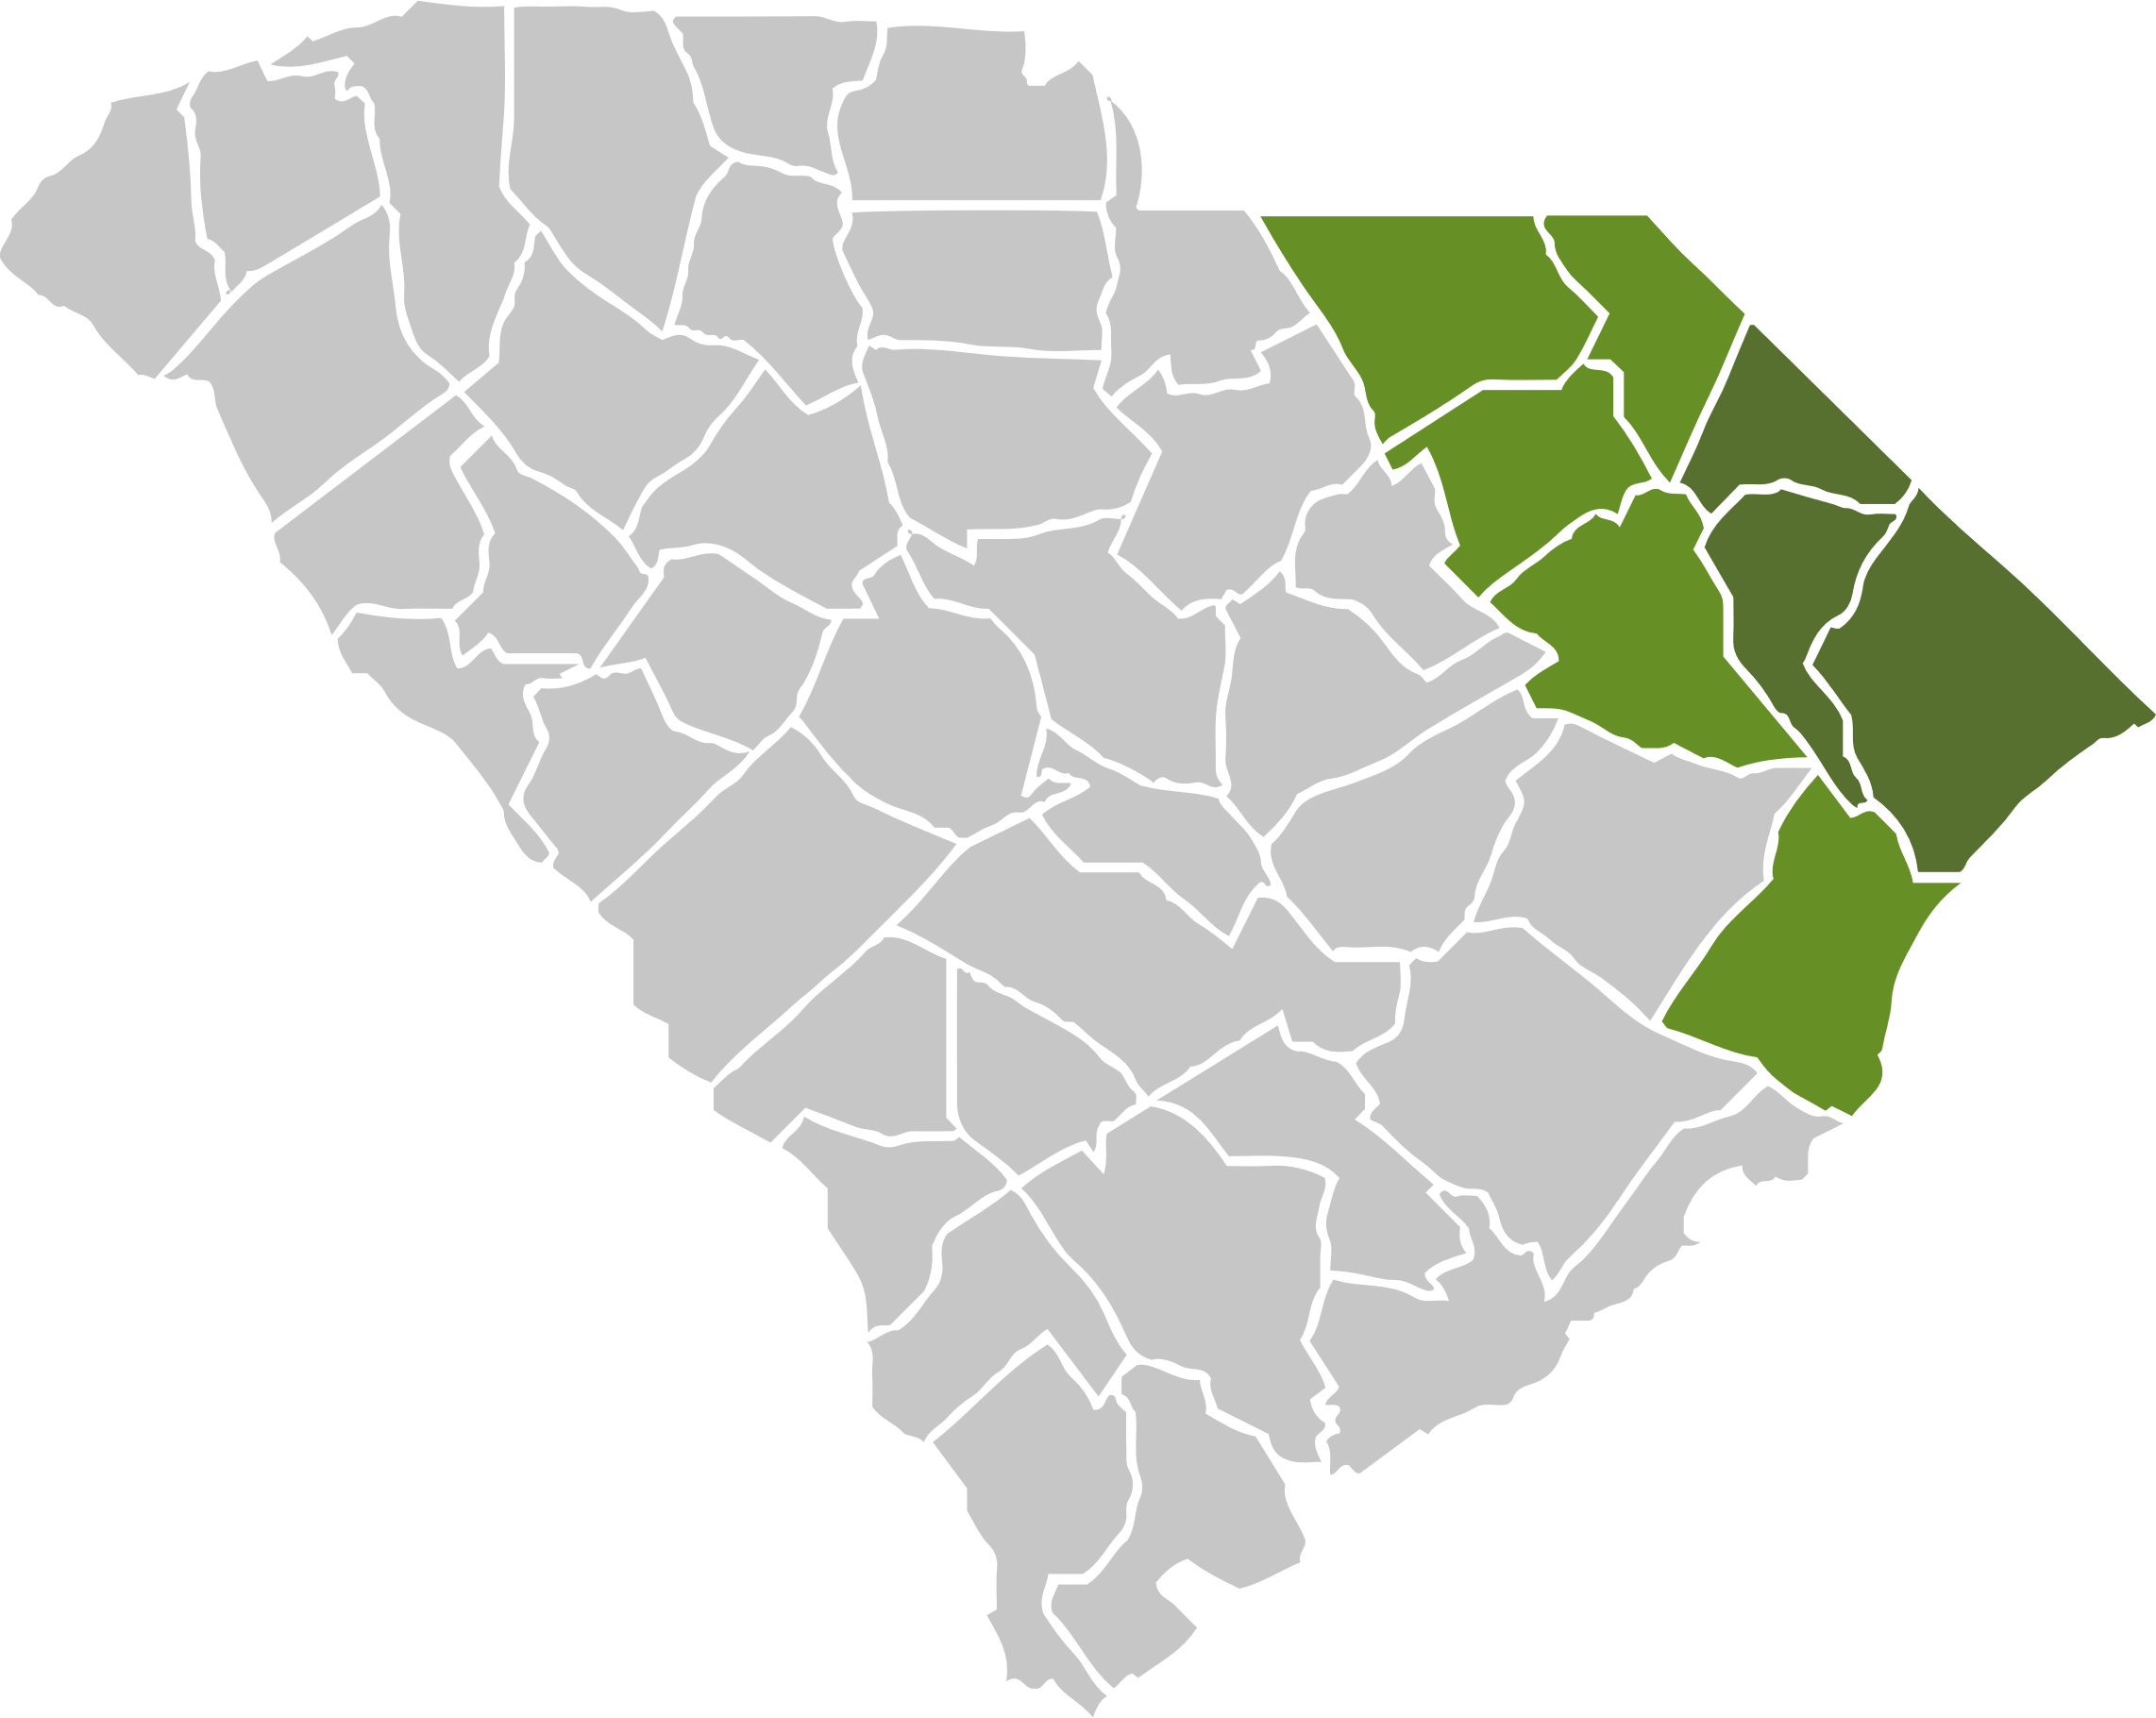
Disaster Recovery: HUD CDBG-DR
$293 million | 3,285 homes complete
2015 SEVERE STORM
$126 million | Complete
2016 HURRICANE MATTHEW
$95 million | Complete
2018 HURRICANE FLORENCE
$72 million | In process
1,829
1,138
318
/ 1,829 homes
/ 1,138 homes
/ ~434 homes
Completion date: September 2021
Completion date: December 2022
Expected completion date: 2023
Within 6-year allotment
Within 6-year allotment
Within 6-year allotment
*Note: Richland & Lexington counties received CDBG-DR grants for the 2015 Severe Storm and therefore were not served by our programs.

Slide 5
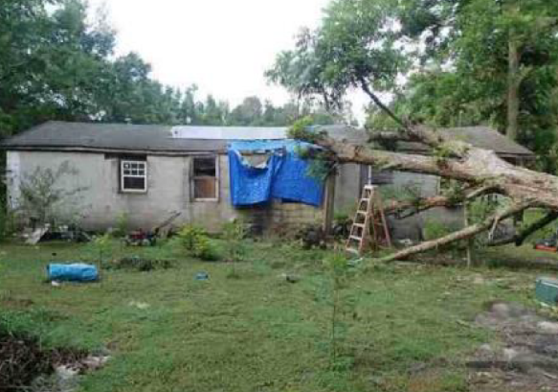
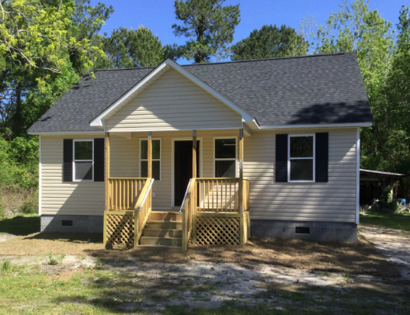
Housing Recoveries: Before & After
BEFORE
AFTER

Slide 6
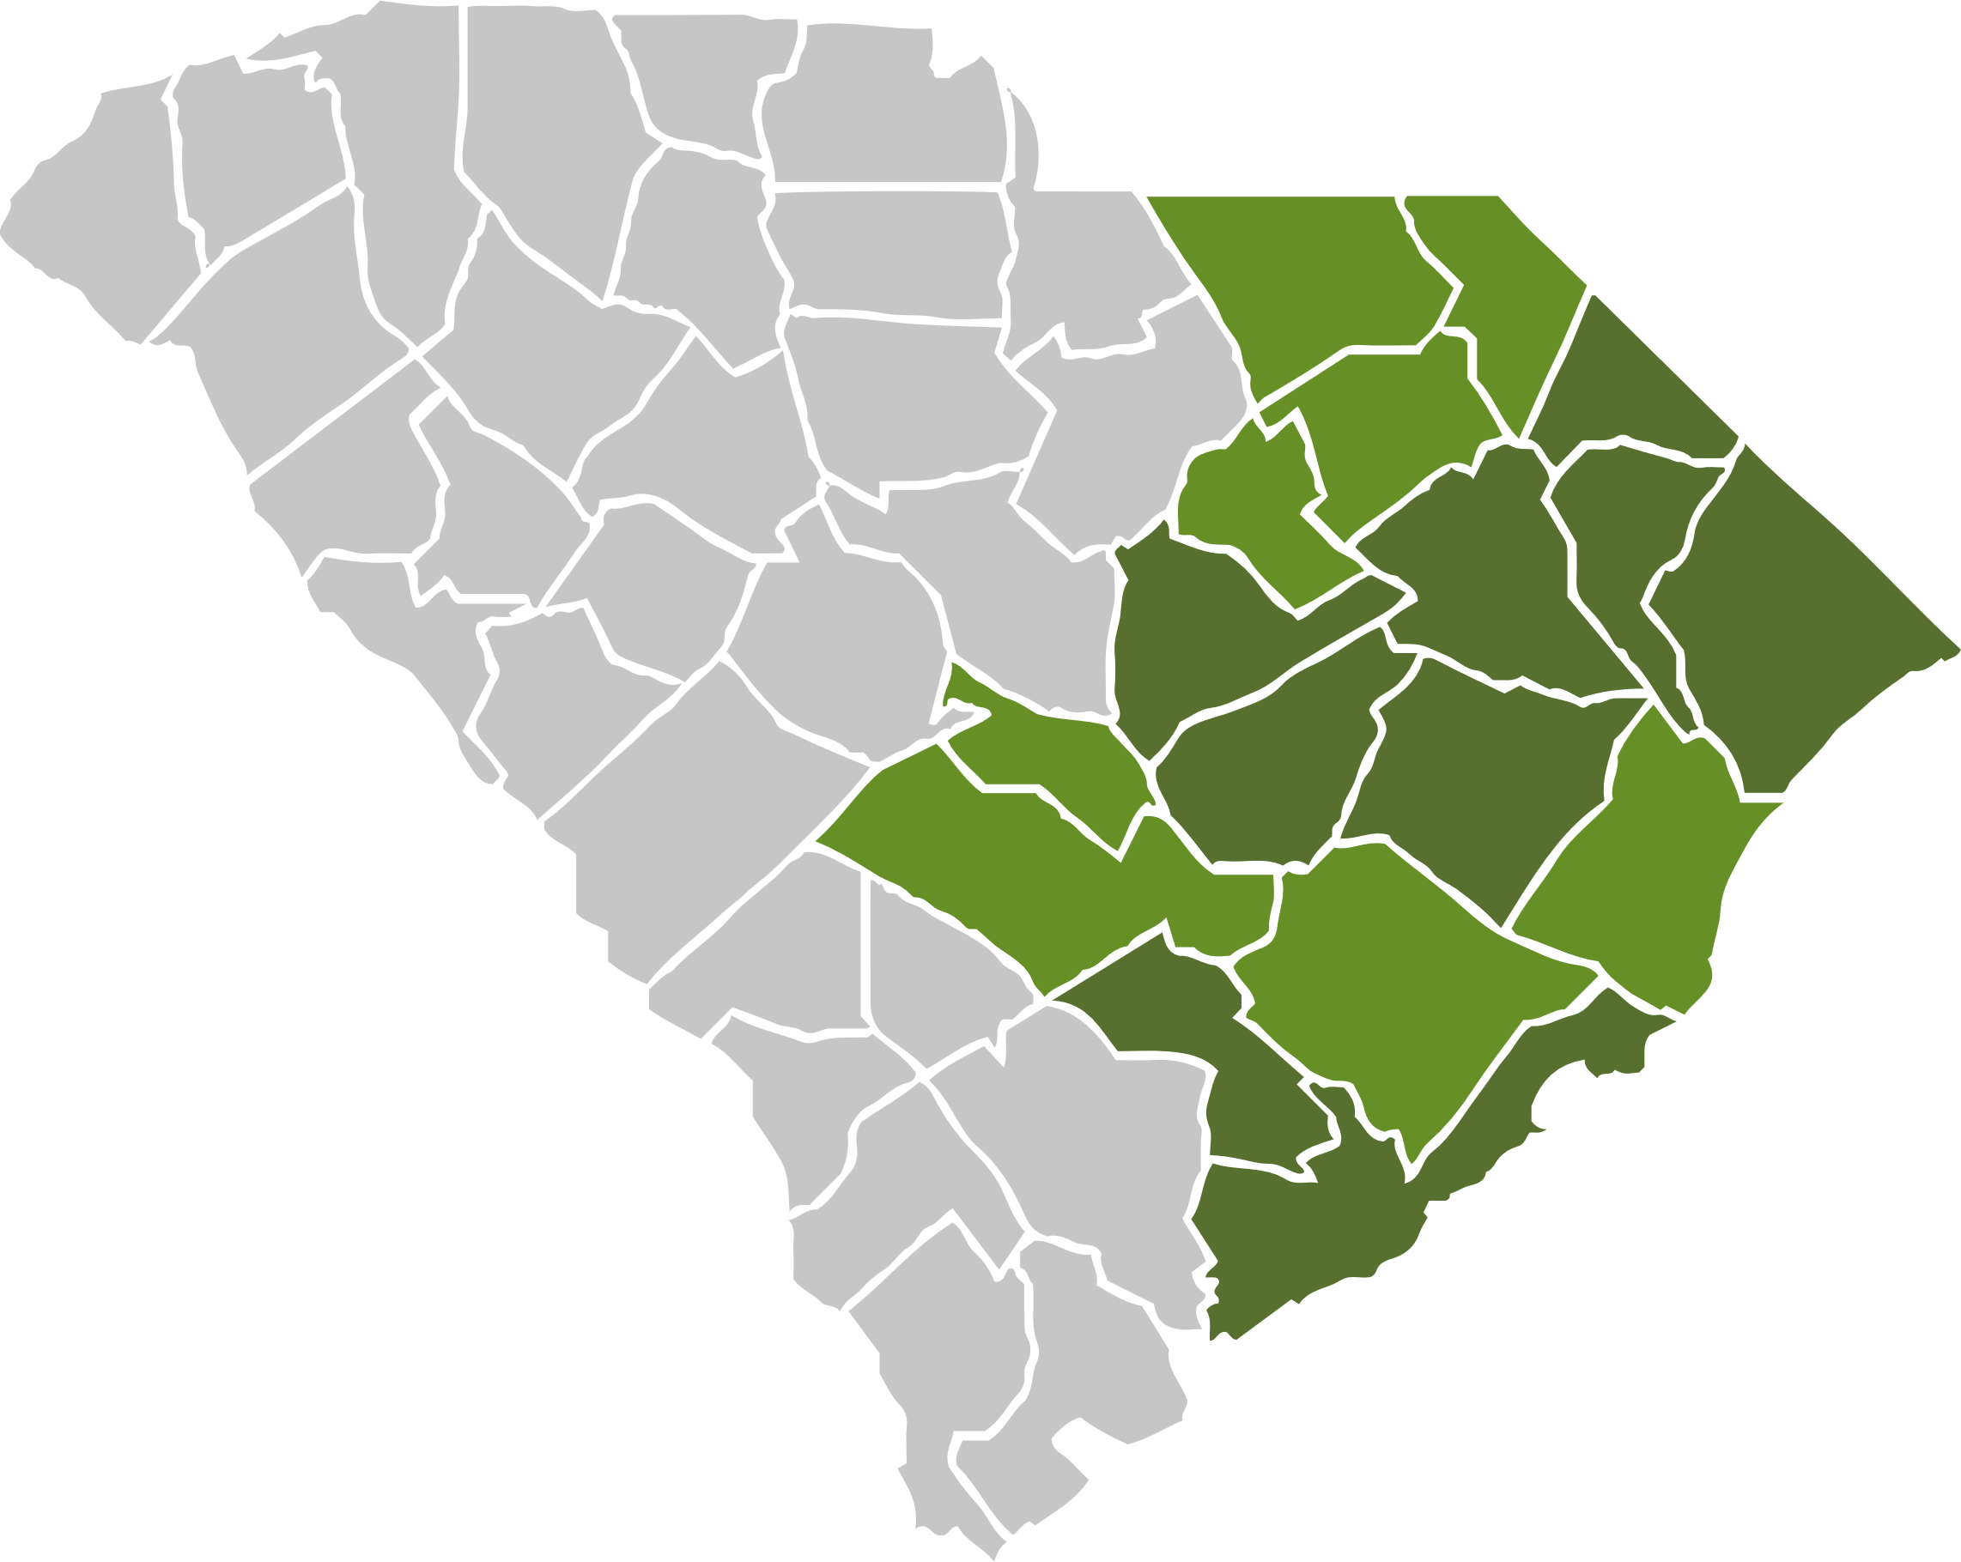
Mitigation: HUD CDBG-MIT
MITIGATION
$162 million | 65% obligated
Infrastructure
$62 million / $100 million
20 projects
Plans & Studies
$6.1 million / $14 million
20 projects
Expected completion NLT 2032
Studies to assist communities in determining the cause of flooding in their area; assistance with or completion of various types of plans relating to flood mitigation. Plans and studies are meant to produce shovel-ready projects which can be submitted for funding under SCOR’s Infrastructure program.
Projects to reduce flooding – stormwater improvements, drainage tunnels, etc.
62%
46%
Buyouts
$34 million / $37 million
6 projects
Matching Grants
$2.5 million / $2.7 million
8 projects
Acquisition of properties in the floodplain that have been repetitively flooded. The purpose of this program is to move citizens out of harm’s way and return the land to green space so that the natural function of the floodplain is restored.
Provides the local cost-share portion for various federal flood mitigation grants
91%
95%

Slide 7
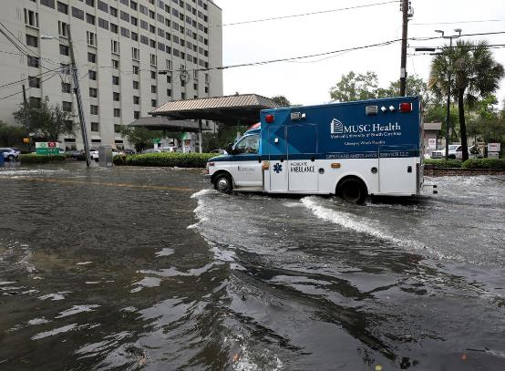
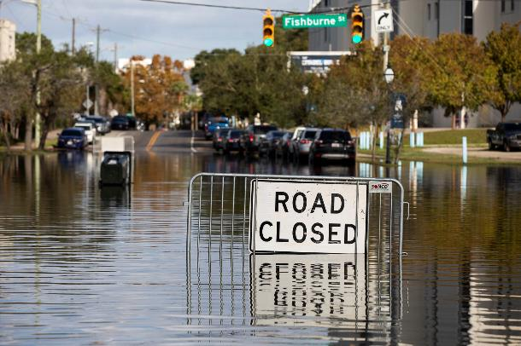
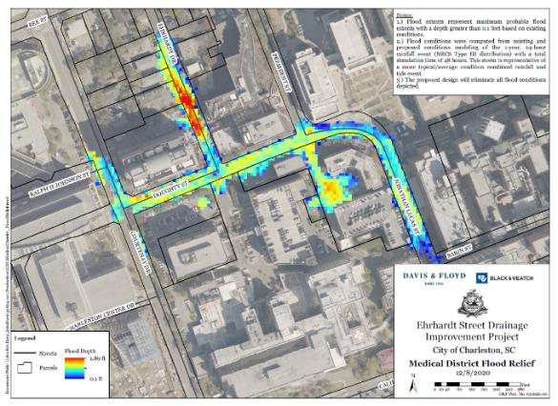
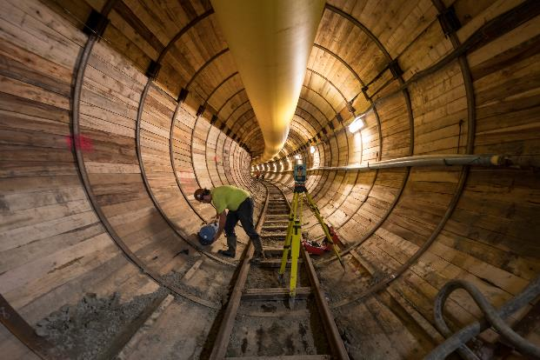
Charleston Medical District: Ehrhardt Tunnel
The proposed design will eliminate the flood conditions depicted in the bottom left image. The map depicts a typical/average combined rainfall and tide event.

Slide 8
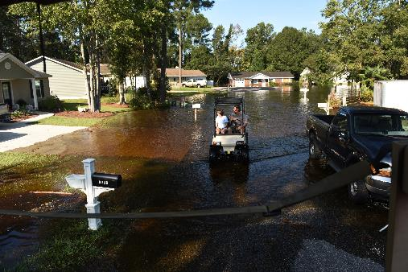
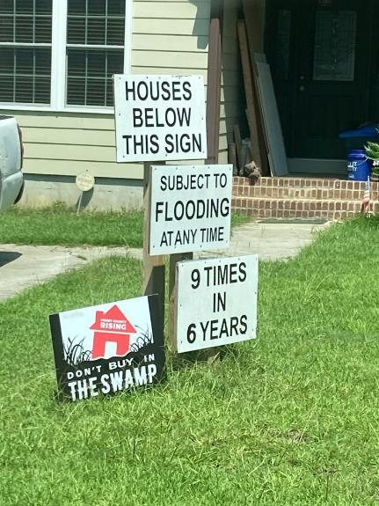
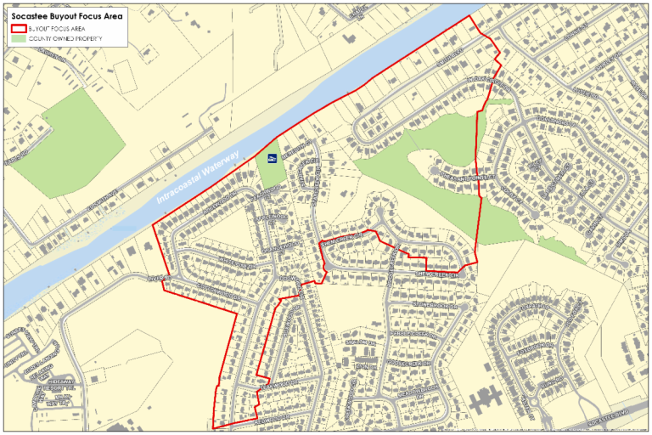
Buyouts
The project will buyout and demolish homes and their associated non-porous surfaces from the community.

Slide 9
Strategic Statewide Resilience and Risk Reduction Plan

Slide 10
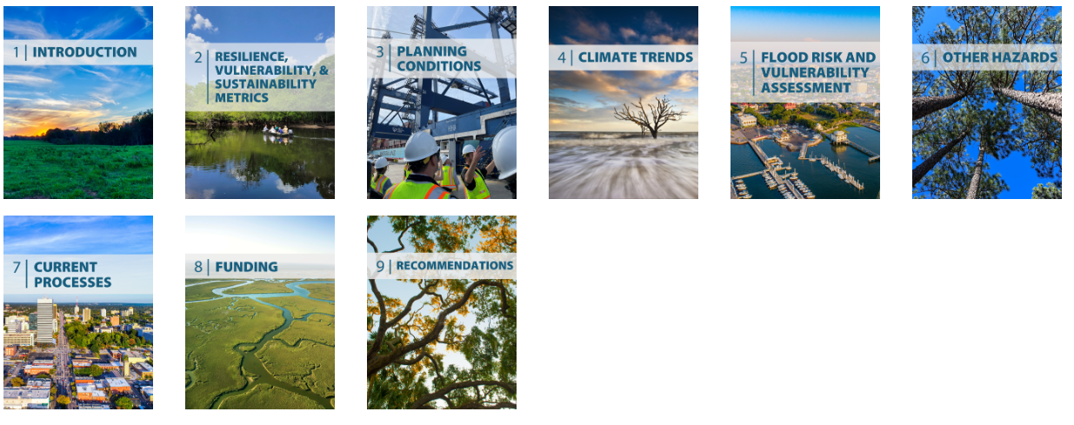
Resilience Planning
The South Carolina Office of Resilience is responsible for developing and implementing a Strategic Statewide Resilience and Risk Reduction Plan (Resilience Plan). The Plan identifies major flood risks around the state and potential losses that could occur as a result of extreme weather events. The Plan provides strategies for local governments to implement resilience into their communities in order to mitigate potential flood risks.

Slide 11


Slide 12
Legislative Guidance
  The Act stated that the plan should be developed with the principles recommended in the South Carolina Floodwater Commission Report.
  Intended to serve as a framework to guide state investment in flood mitigation projects. adopts programs and policies to protect the people and property of South Carolina from damage and destruction of extreme weather events.
  The Act directed that the initial version of the plan be completed by July 1, 2022. * (Extended to July 1, 2023)

Slide 13
Floodwater Commission Principles
• Flood management plans and actions should be based on watershed boundaries.
• Decisions and actions should be based on high-quality, shared and integrated hydrologic and hydrographic models that are derived from increased data collection; the data and models should be transparent and freely accessible to all stakeholders.
• Building the capacity of local governments to develop science-based and actionable flood management plans and hazard mitigation plans should be a priority, especially for under-resourced communities. It does little good for one local jurisdiction to have high-quality plans if the upstream jurisdiction does not.
• Success will depend on collaboration.
Flood management programs should recognize the beneficial functions of natural floodplains, salt marshes, beach dunes, forests, living shorelines and other natural features to reduce flood risk, as well as the co-benefits they deliver for recreation, forestry, tourism, fisheries, and wildlife. “Nature-based solutions” should be considered included in the design of flood control projects whenever possible in order to increase resilience and be cost-effectiveness.

Slide 14
Resilience Planning Assumptions
The plan will not try to provide solutions to prevent changes to the climate but will offer recommendations for how the state may minimize the impacts that are expected to occur.
Resilience Planning utilizes an adaptive management approach so that it can adjust to changing conditions and integrate new data sources as they become available.
Initial Plan recommendations focuses flooding.
  Other extreme weather events /disasters to be addressed in more detail in subsequent versions of the plan.

Slide 15
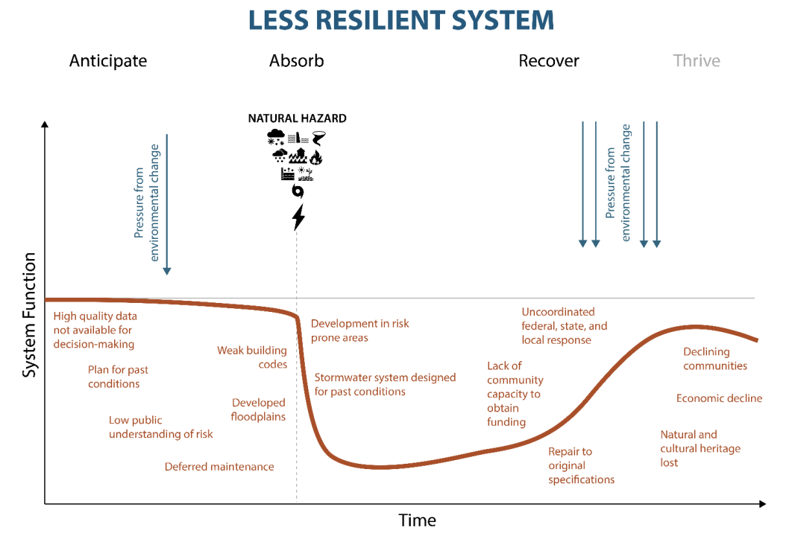
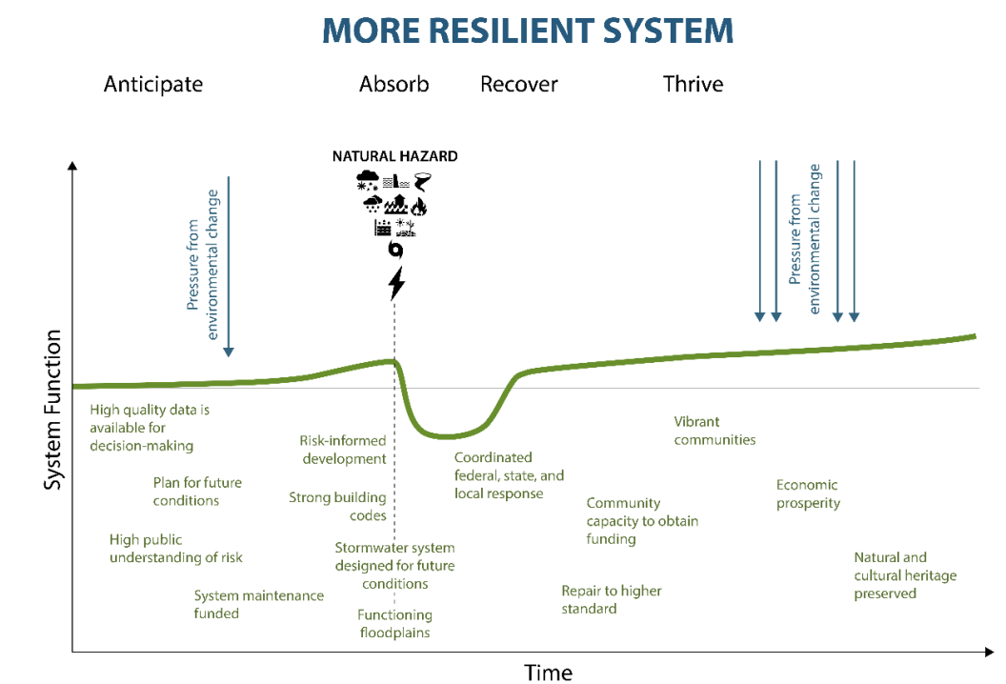
Resilience Definition
The ability of communities, economies, and ecosystems within South Carolina to anticipate, absorb, recover, and thrive when presented with environmental change and natural hazards.

Slide 16





Slide 17


Slide 18






Slide 20




Slide 21




Slide 22







Slide 23




Slide 24


Slide 25


Slide 26
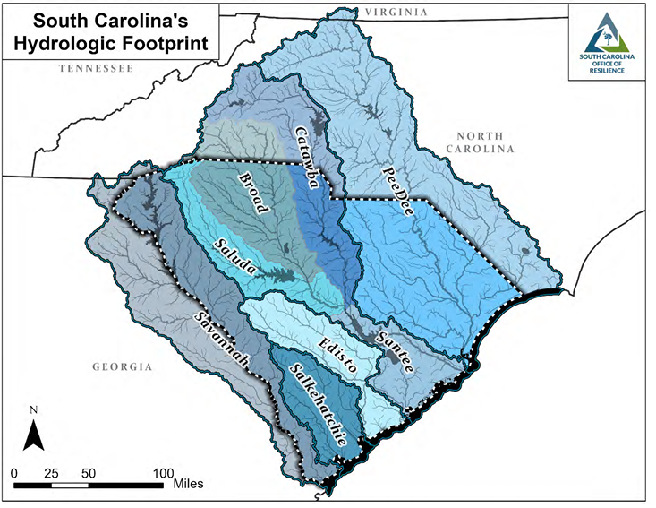
Planning Scale
Water doesn’t follow
political boundaries.

Slide 28
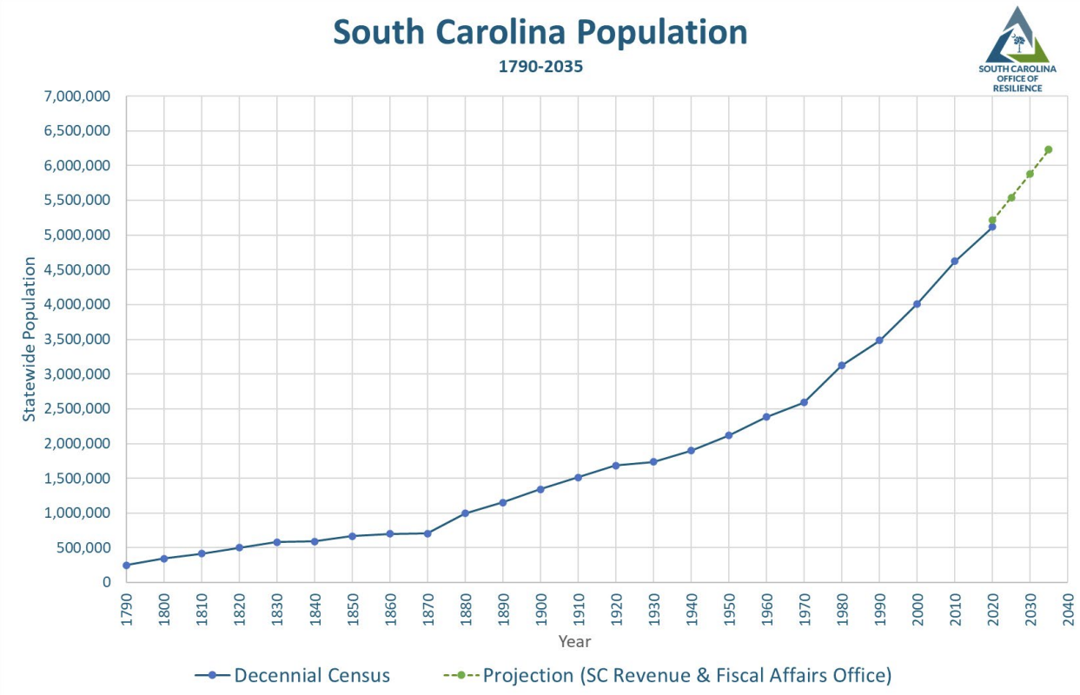

Slide 29
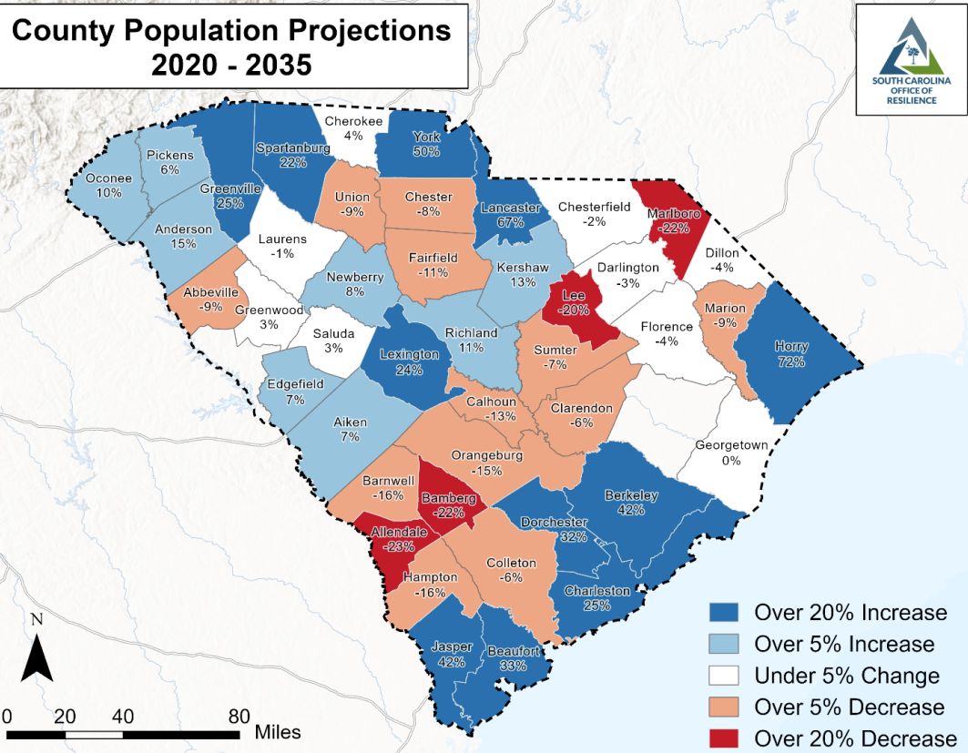
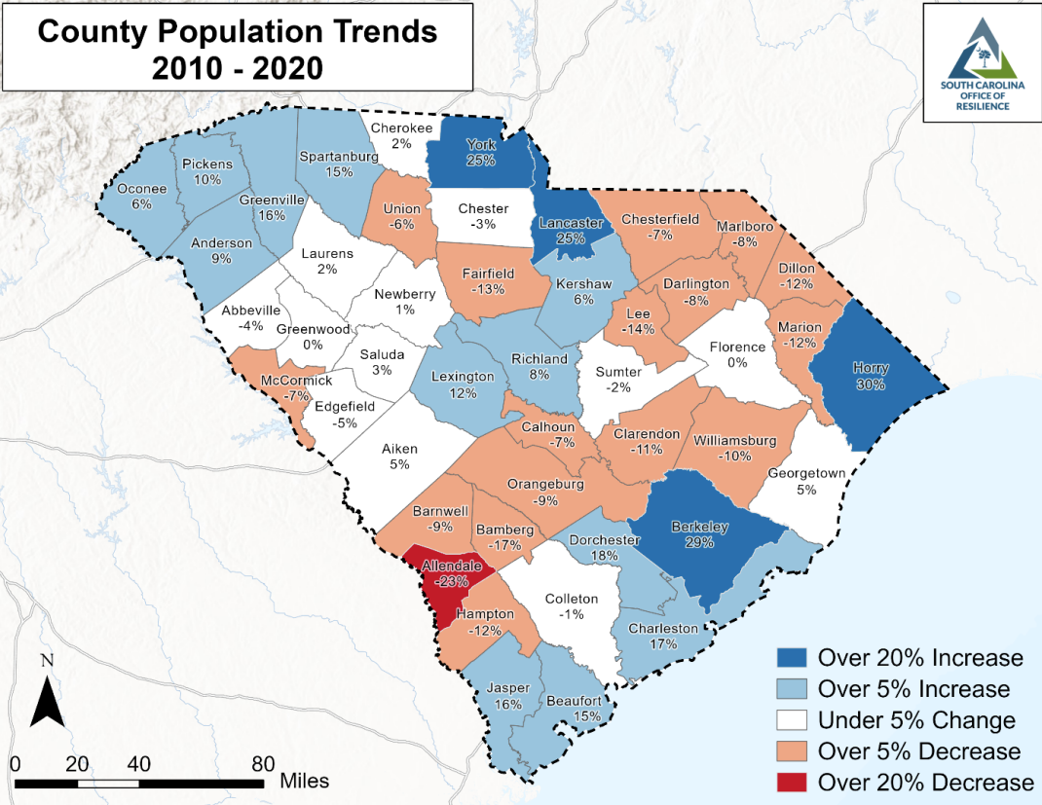

Slide 30


Slide 31
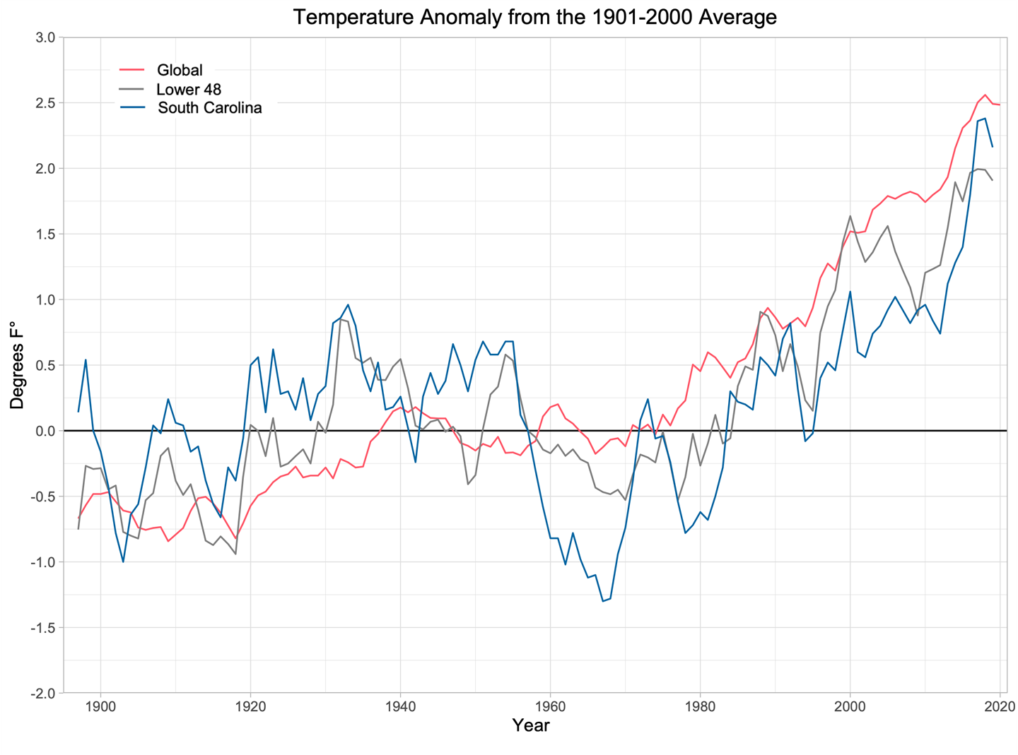
SC Temperature Trends
Since 1895, average annual temperature has increased by approximately 1°F, lower than the average global increase of approximately 2°F. However, the rise during the past 60 years has matched or exceeded global increases and the past 30 years have been warmer than any other consecutive 30-year period.
Climate models project South Carolina temperature increases of 5° to 10°F by the year 2100, depending on future greenhouse gas emissions.

Slide 32
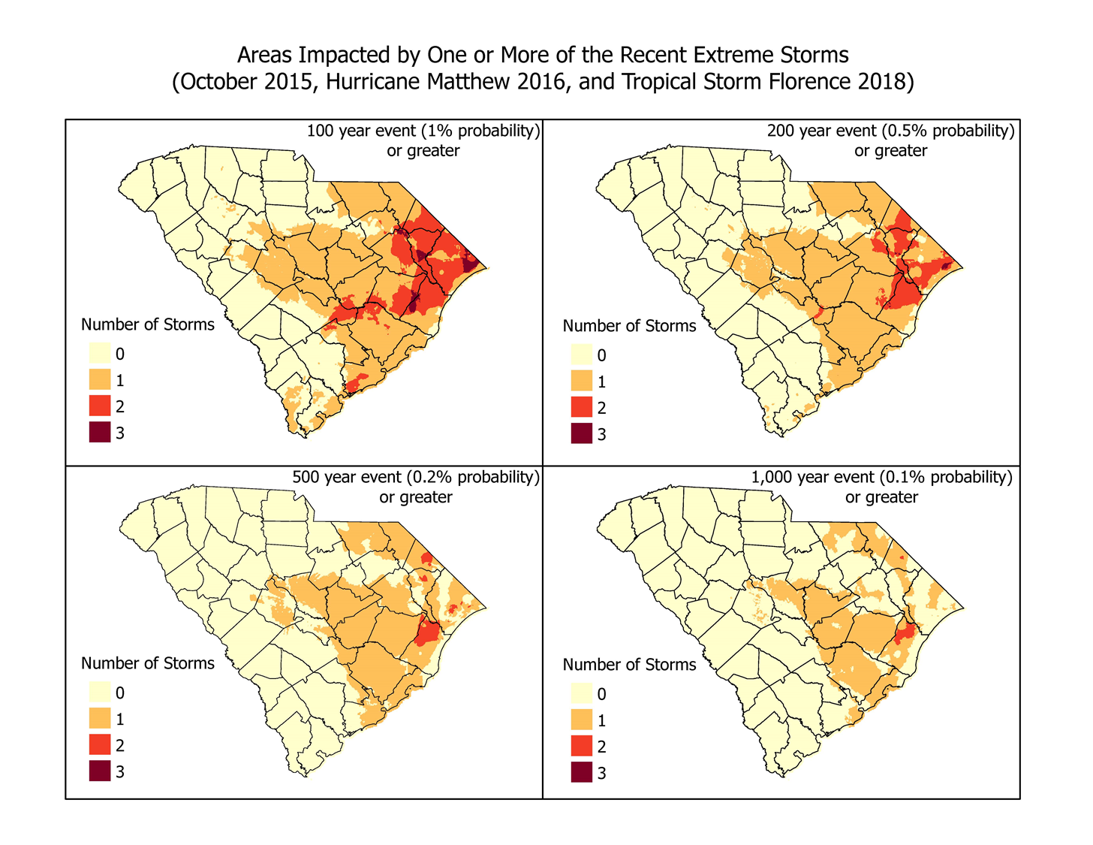
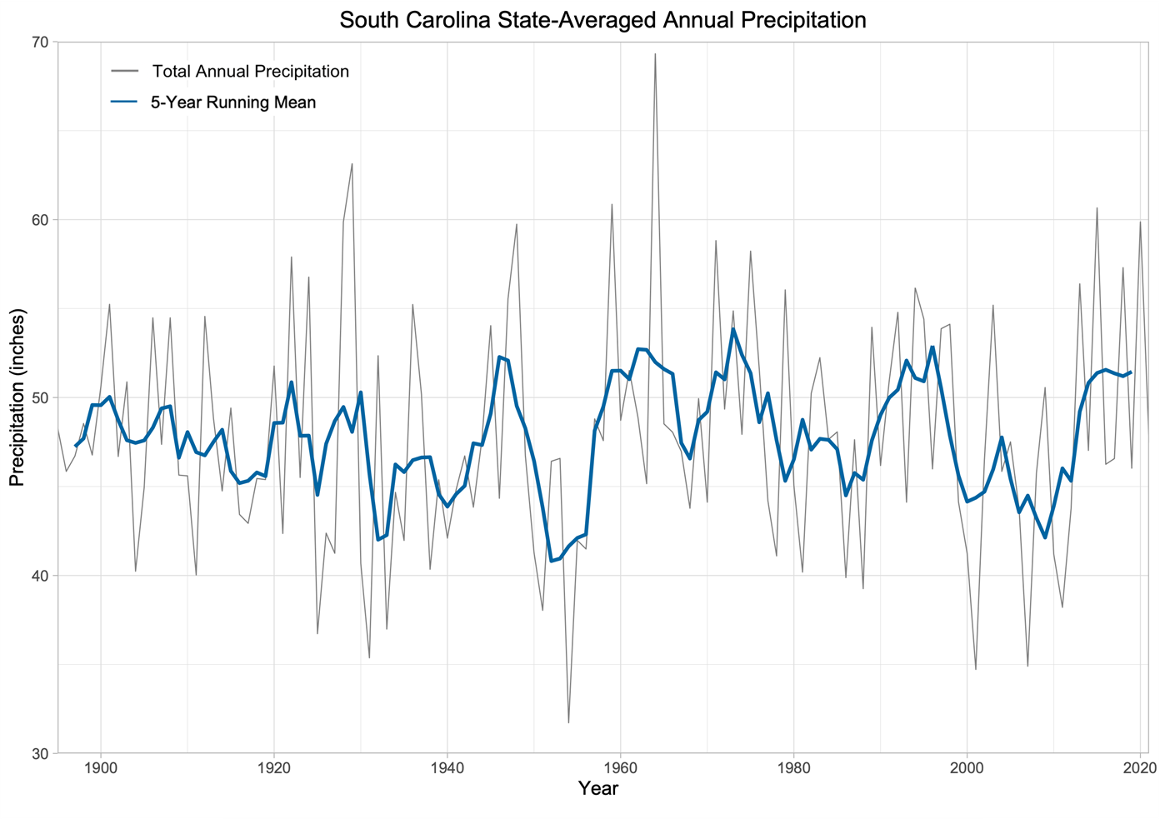
SC Precipitation Trends

Slide 33
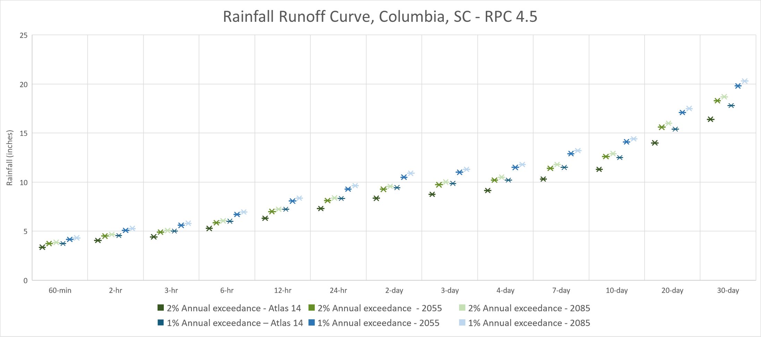
SC Precipitation Projections
Source: Strategic Environmental Research and Development Program (SERDP/Department of Defense)

Slide 34
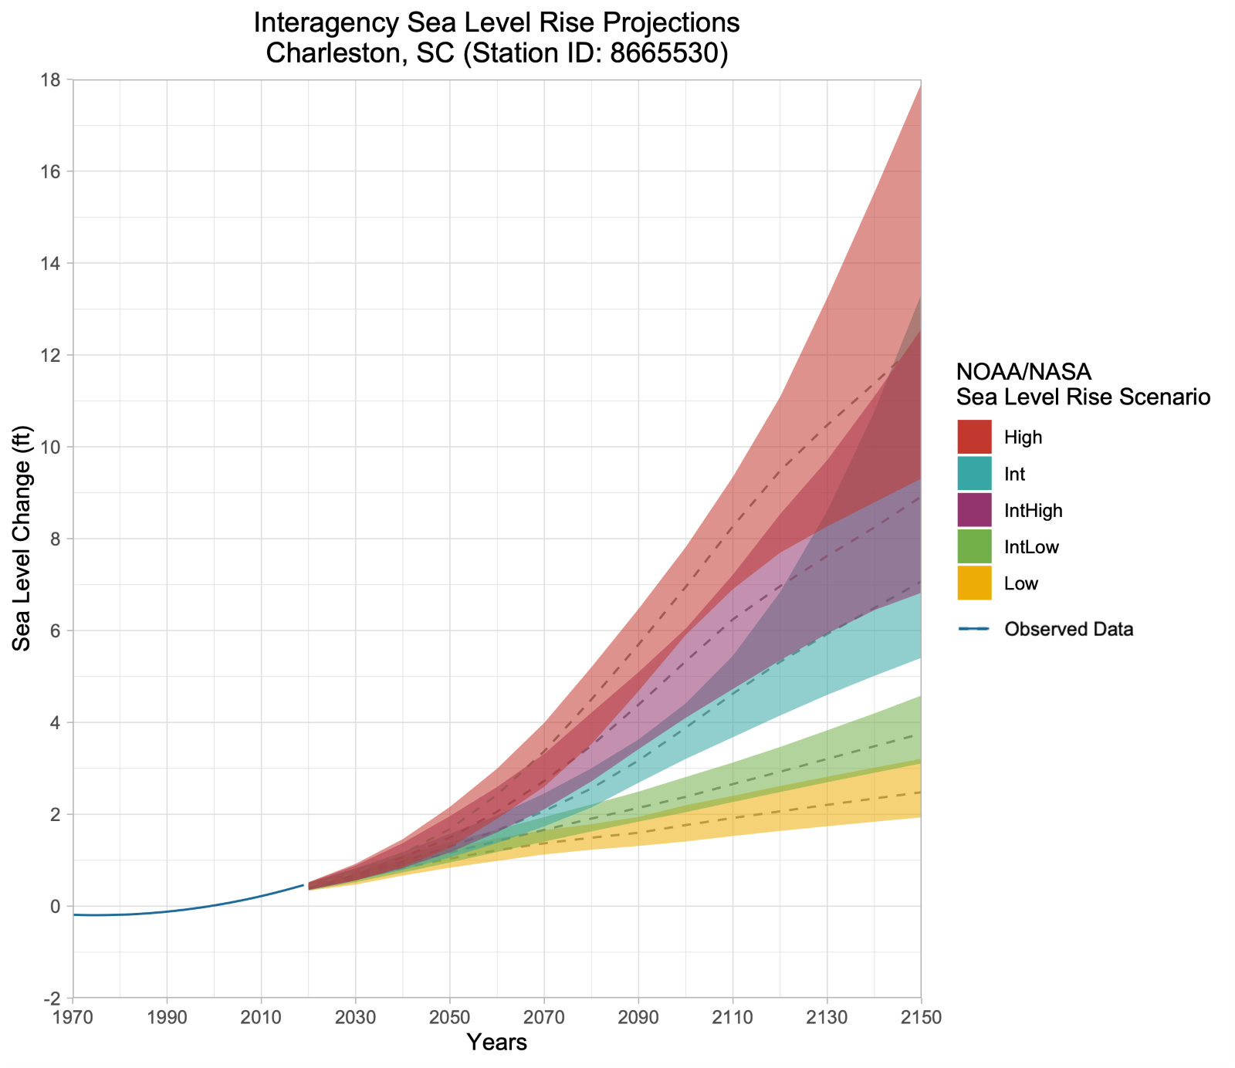
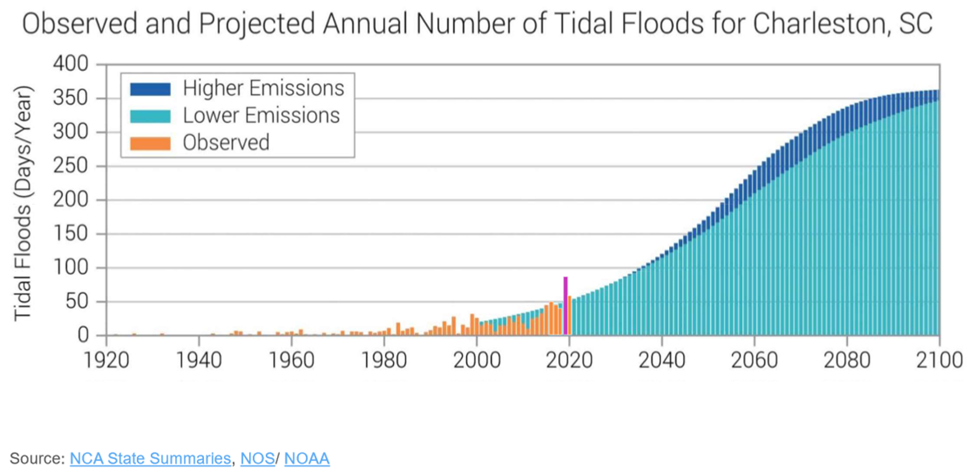
Sea Level Rise Projections

Slide 35
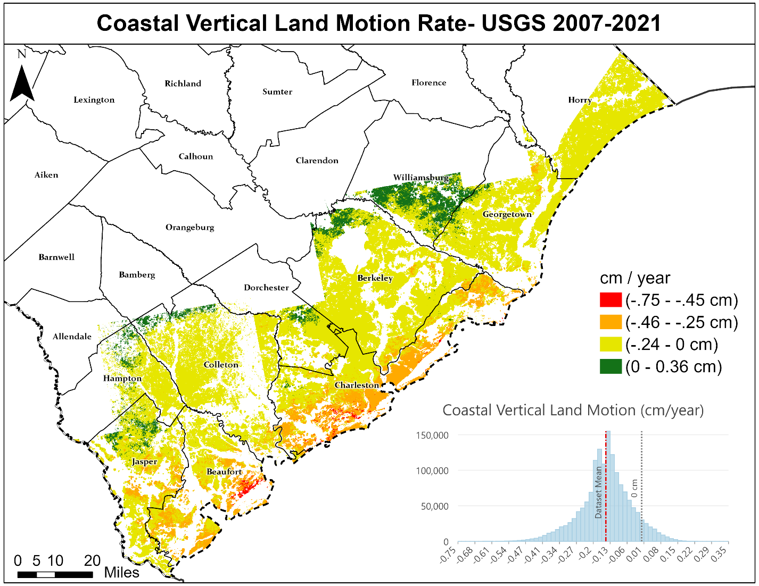

Slide 36
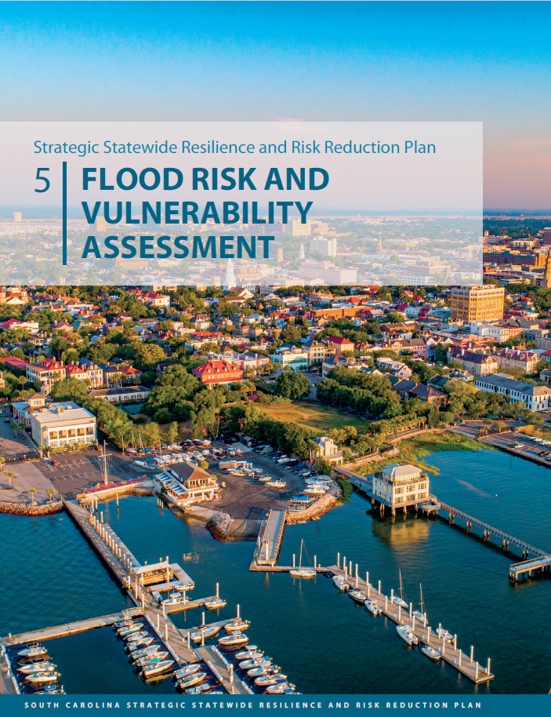

Slide 37
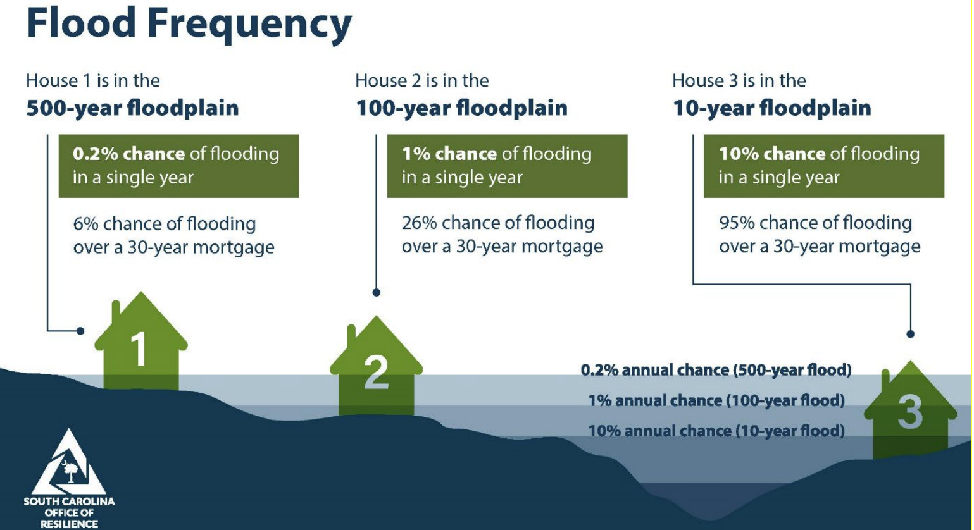

Slide 38
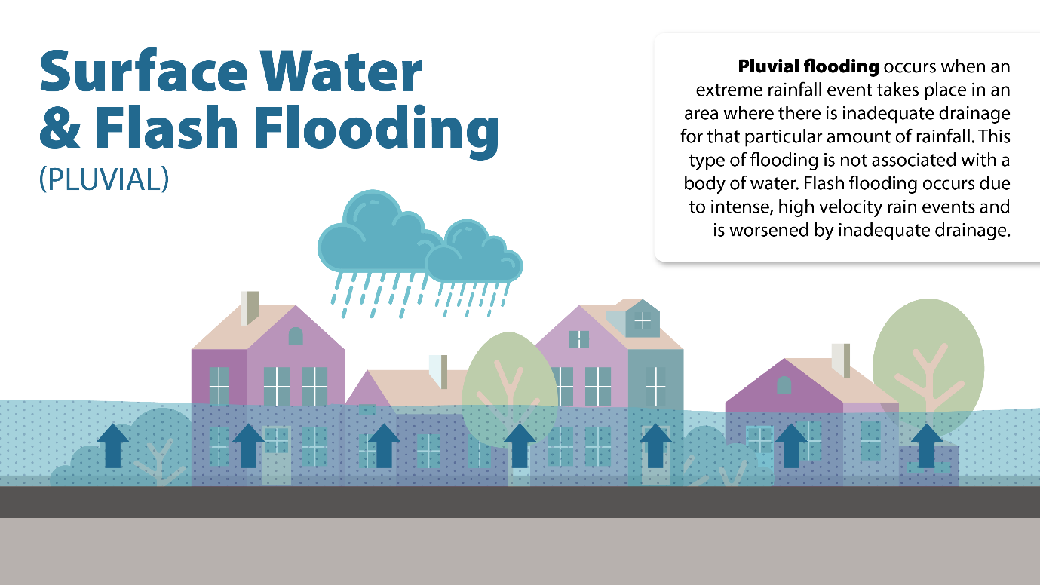
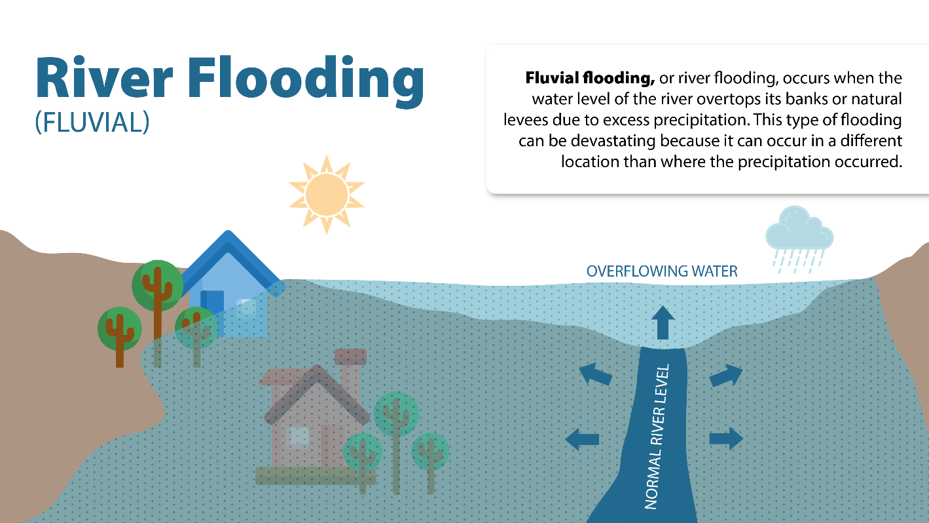
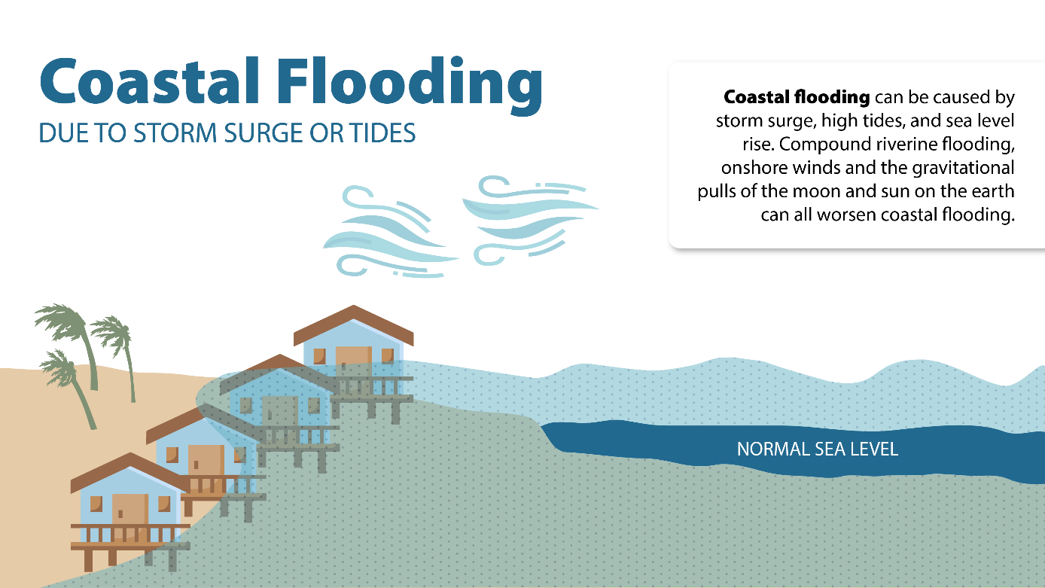

Slide 39
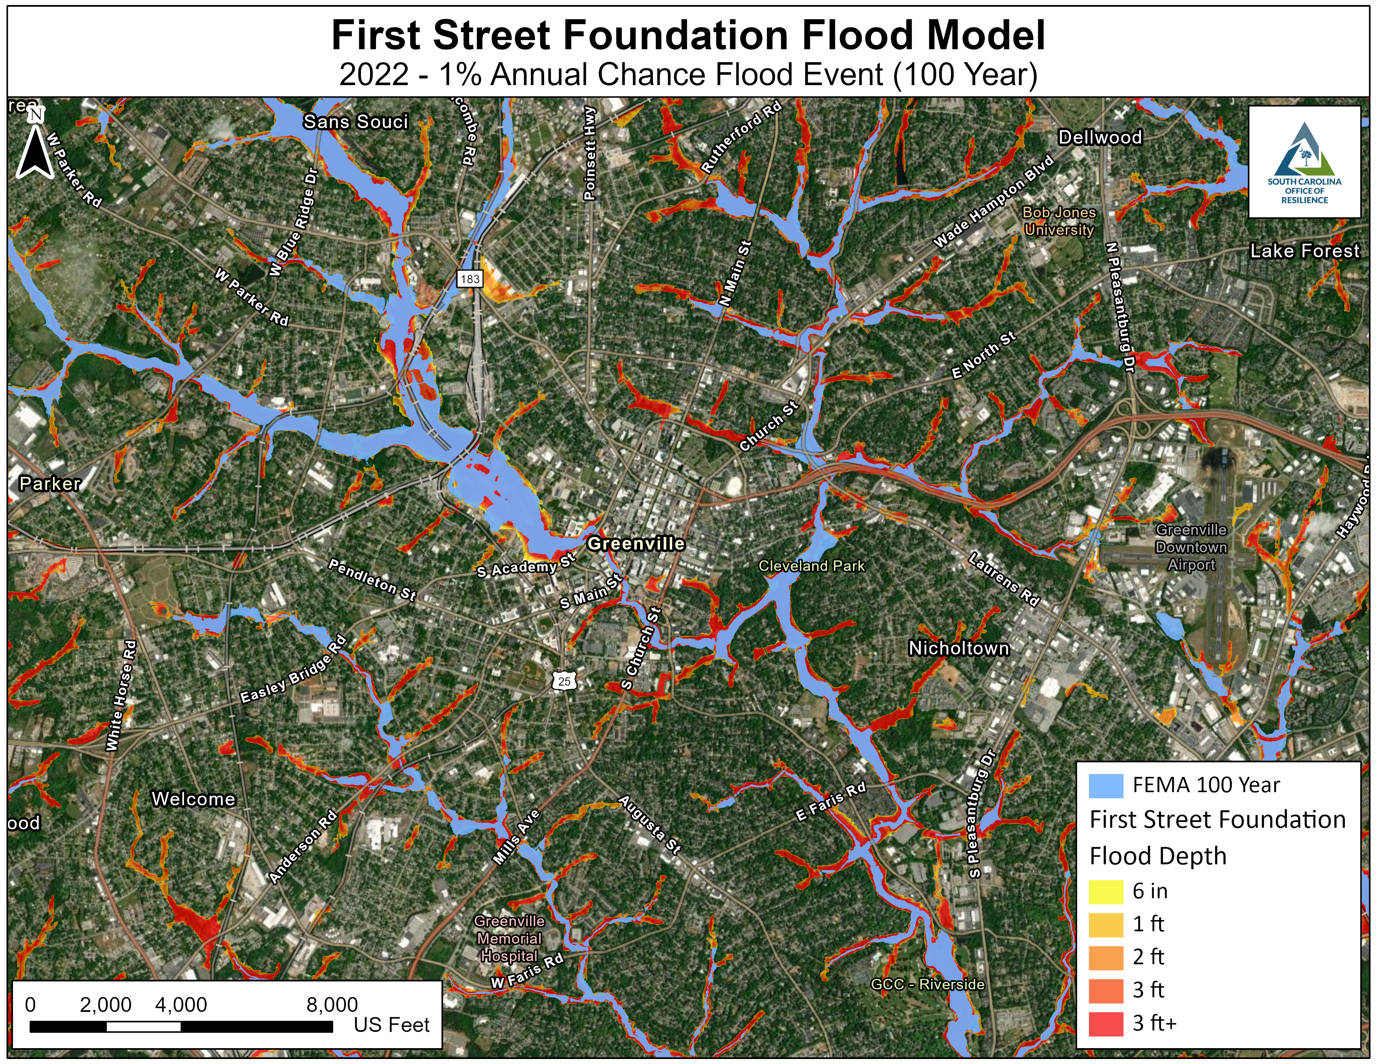

Slide 40
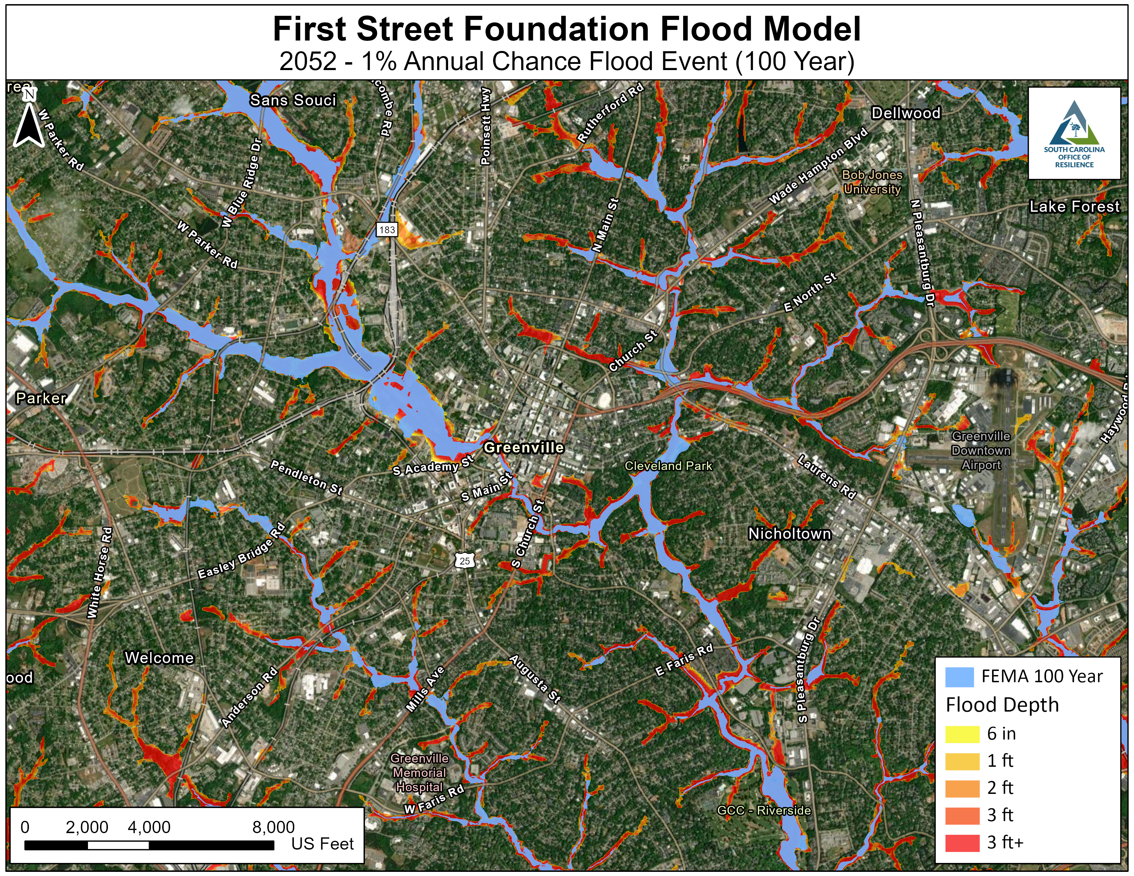

Slide 41
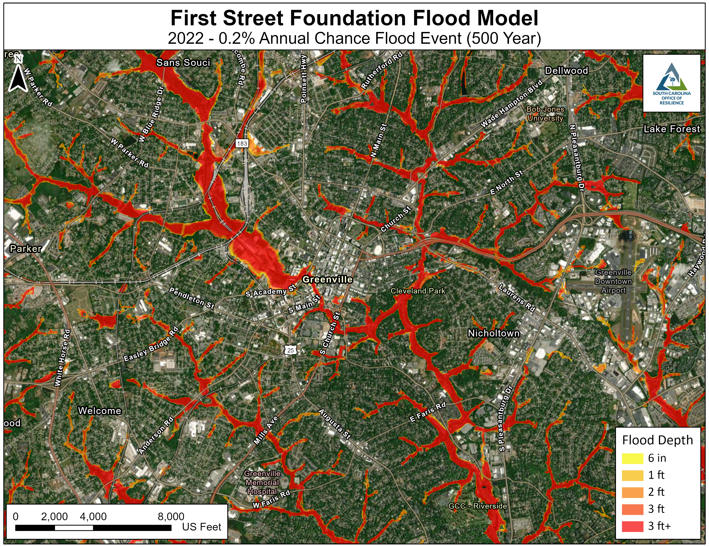

Slide 42


Slide 43
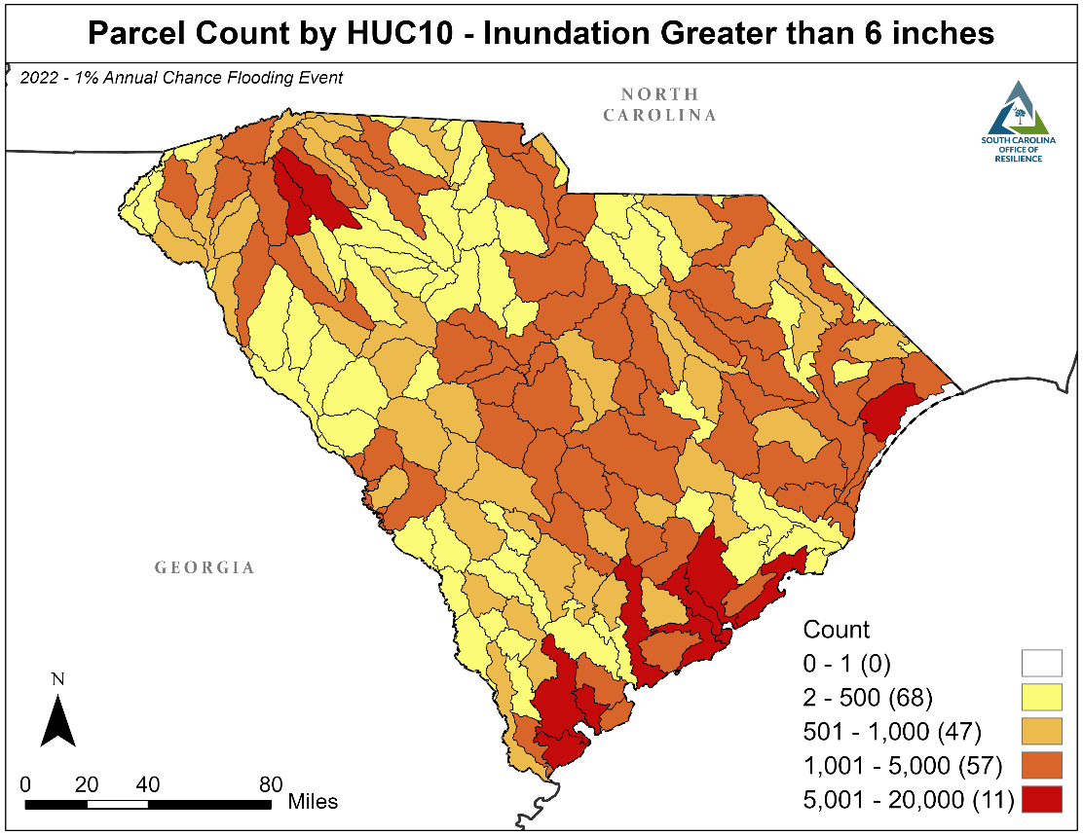
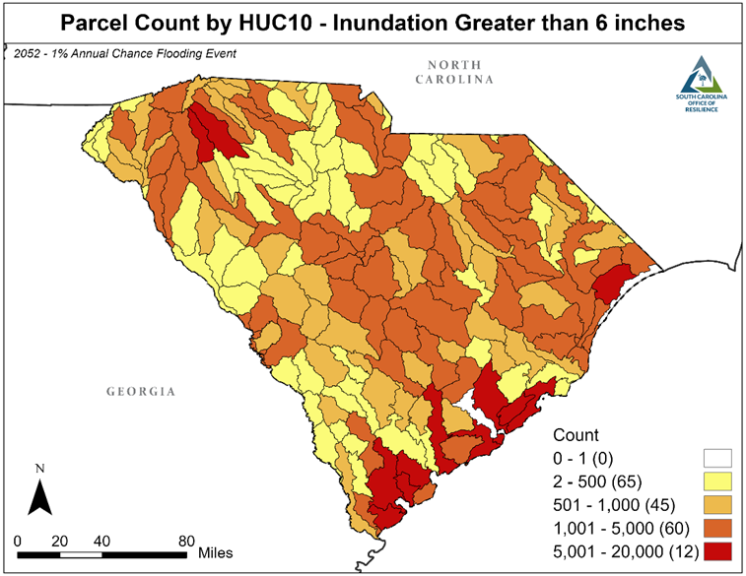

Slide 44
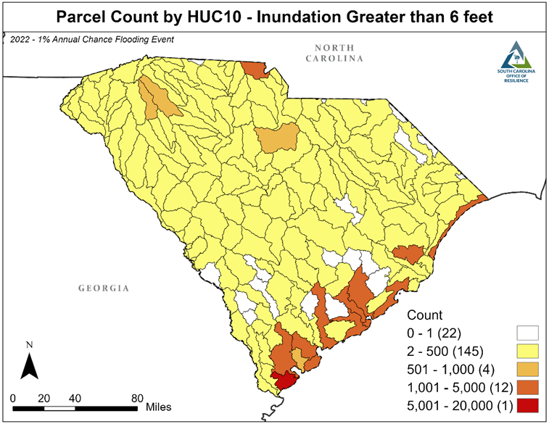


Slide 45
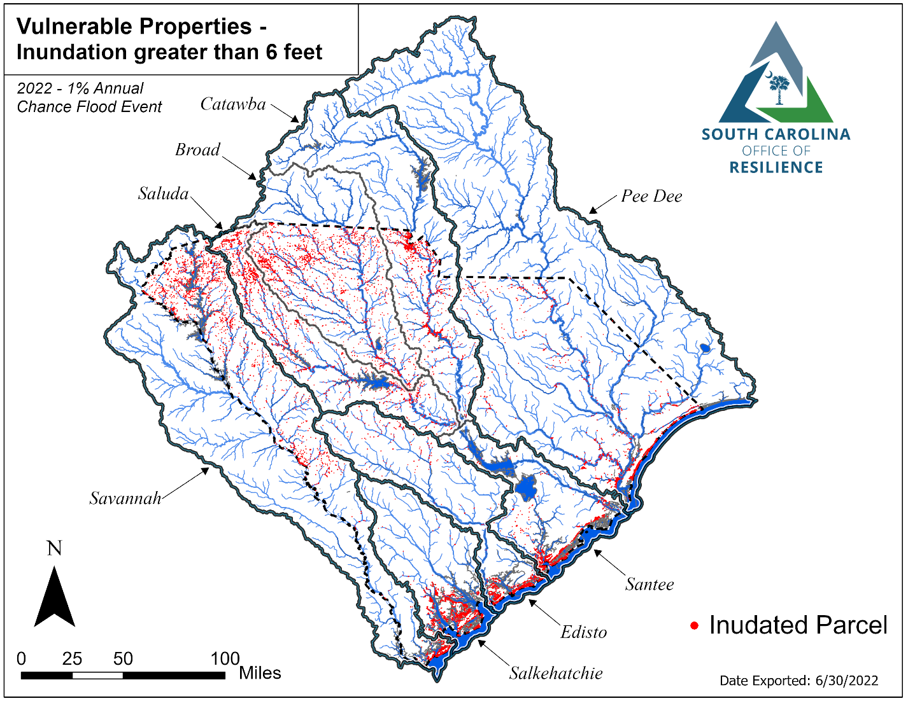

Slide 46

2022 | 2052
43,246 | 63,762

Slide 47
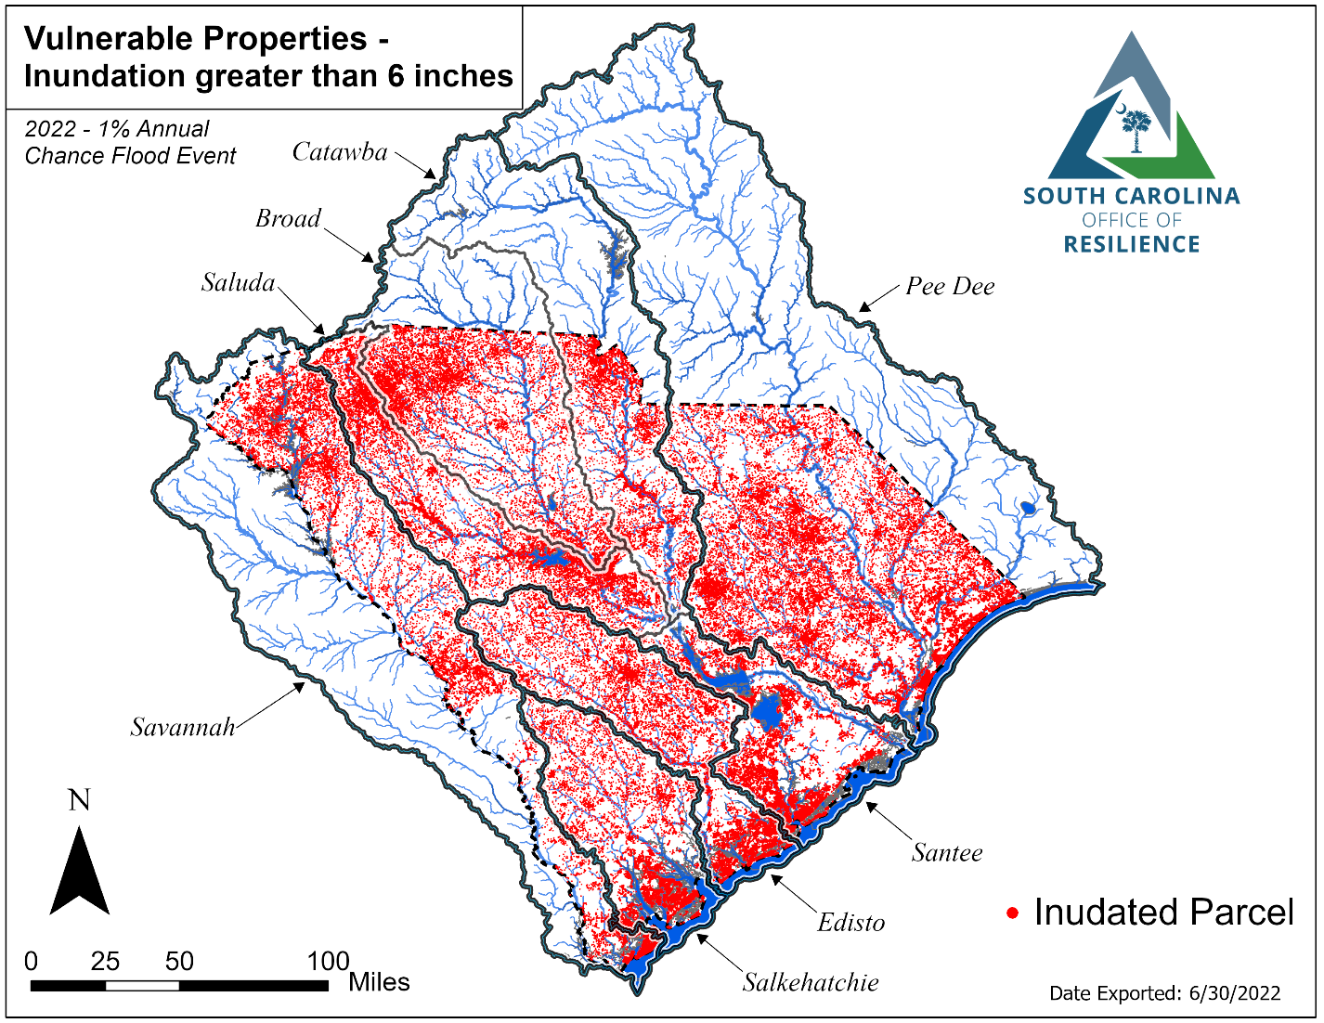

Slide 48

2022 | 2052
306,118 | 340,901

Slide 49
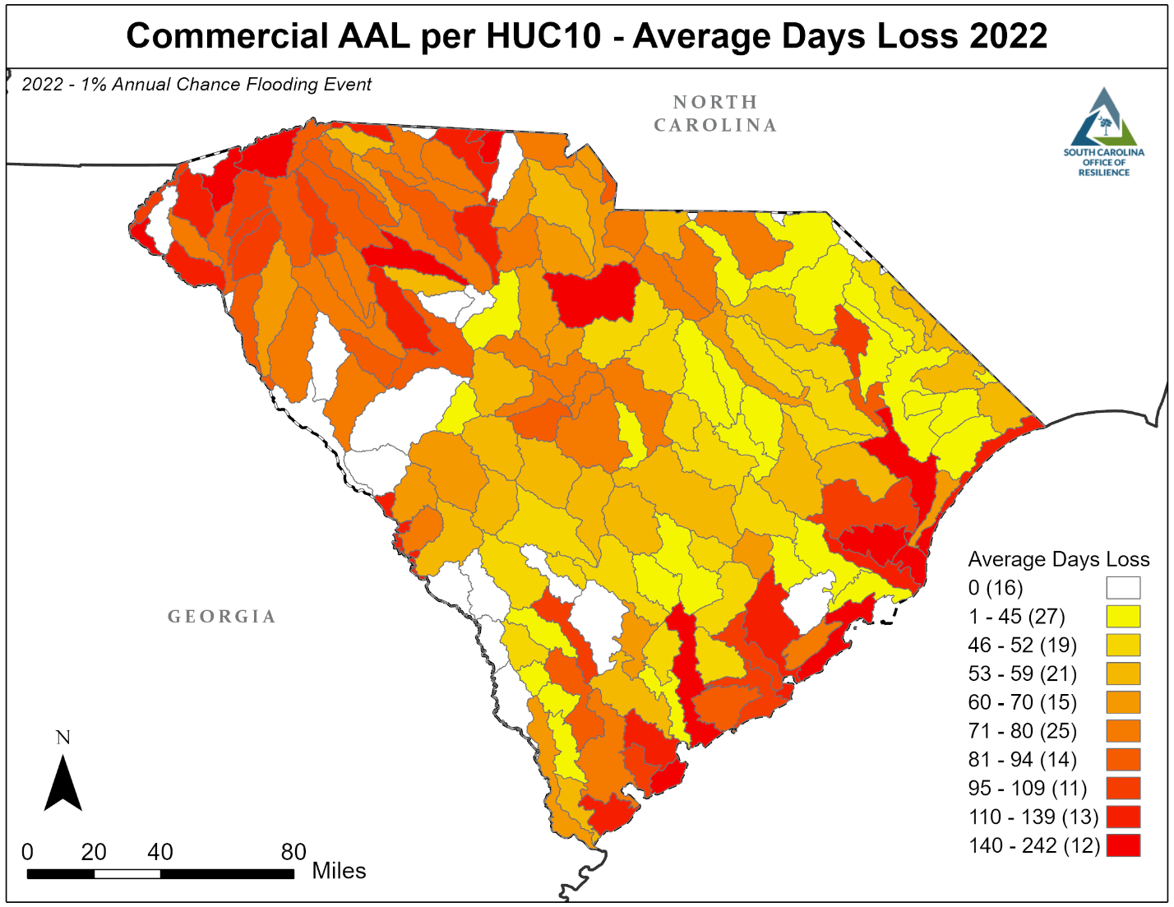
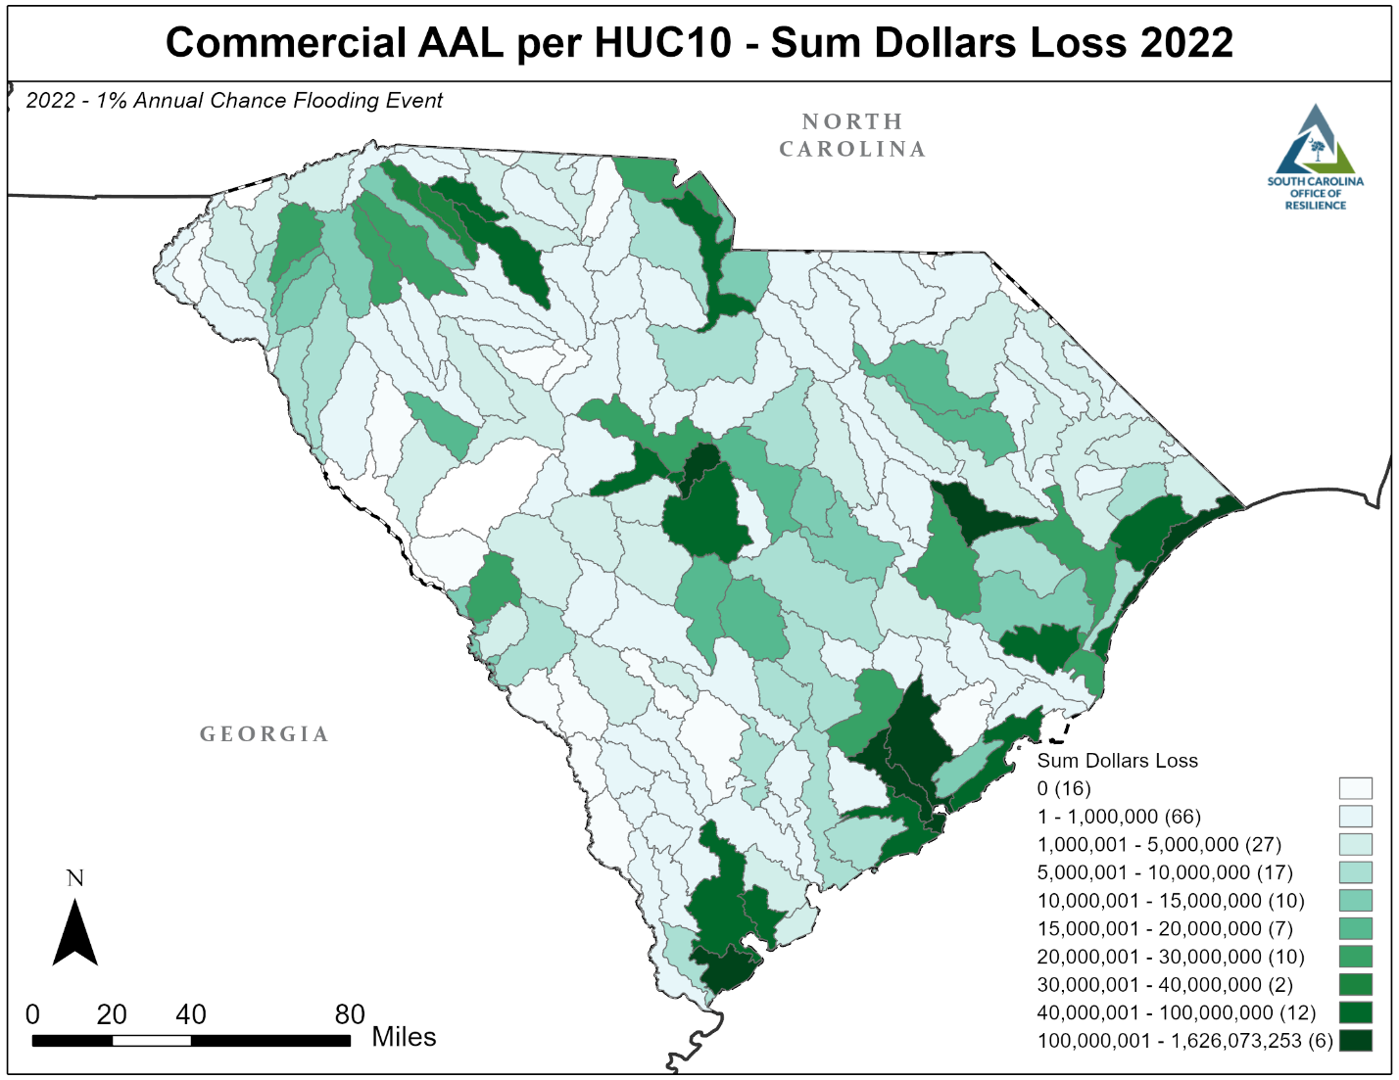

Slide 50
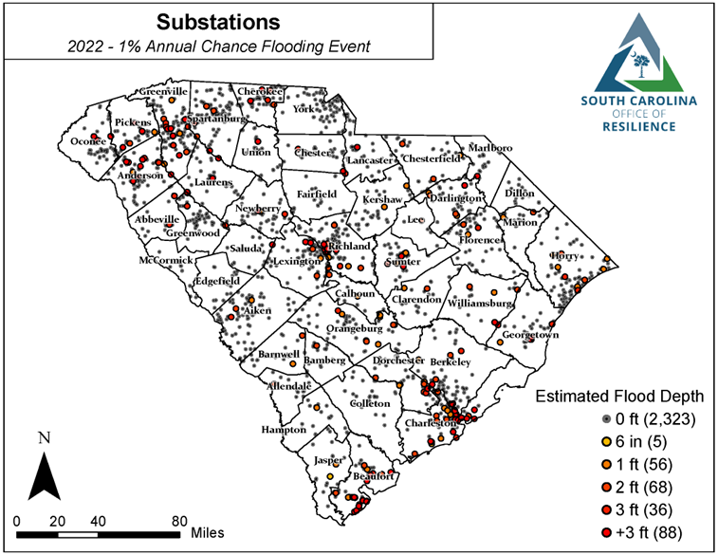


Slide 51
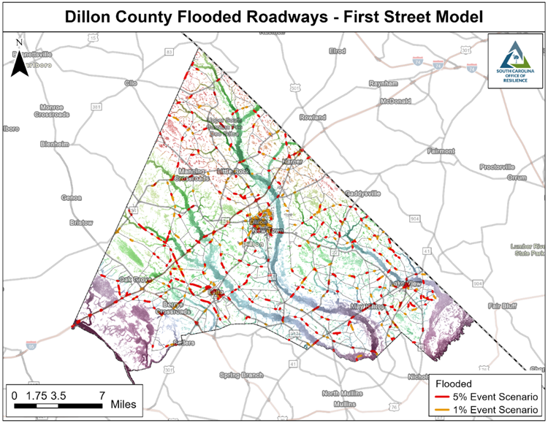

Slide 52
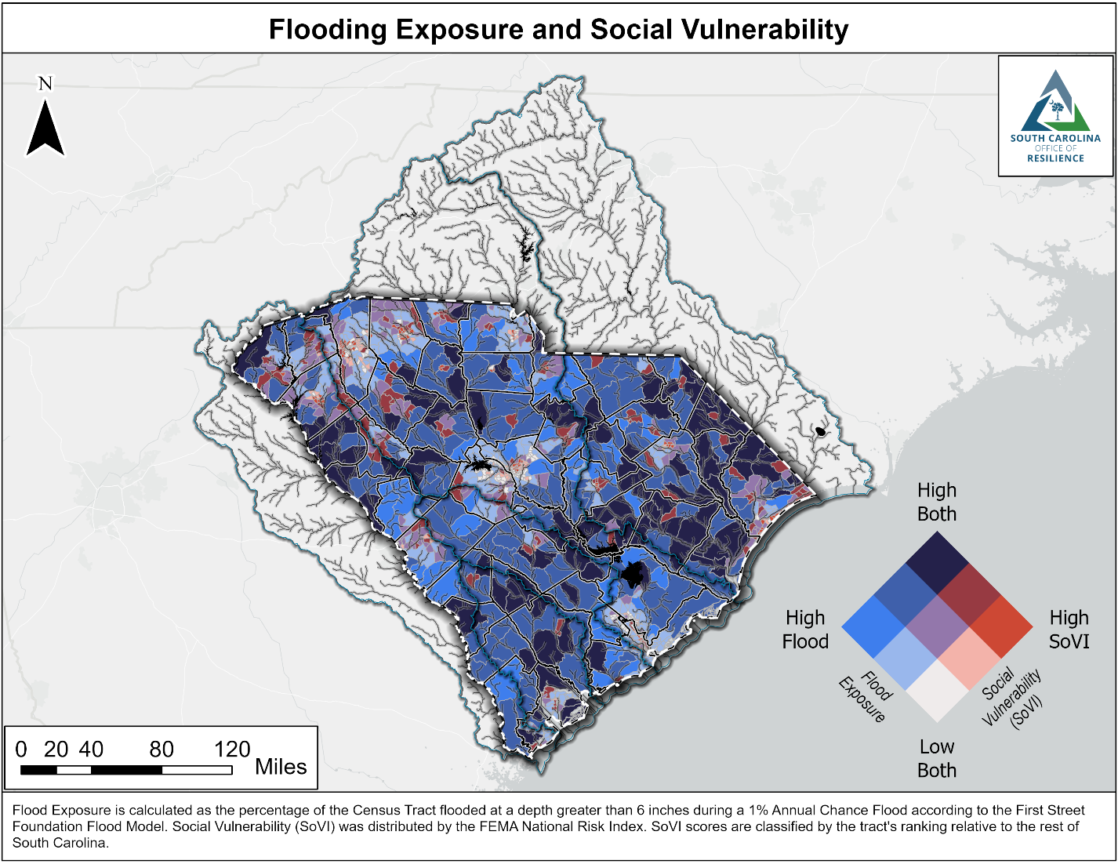

Slide 53

Wildfire
Drought
Heat
Lightning & Strong Wind
Hurricane
Tornado
Winter Weather
Earthquake

Slide 54
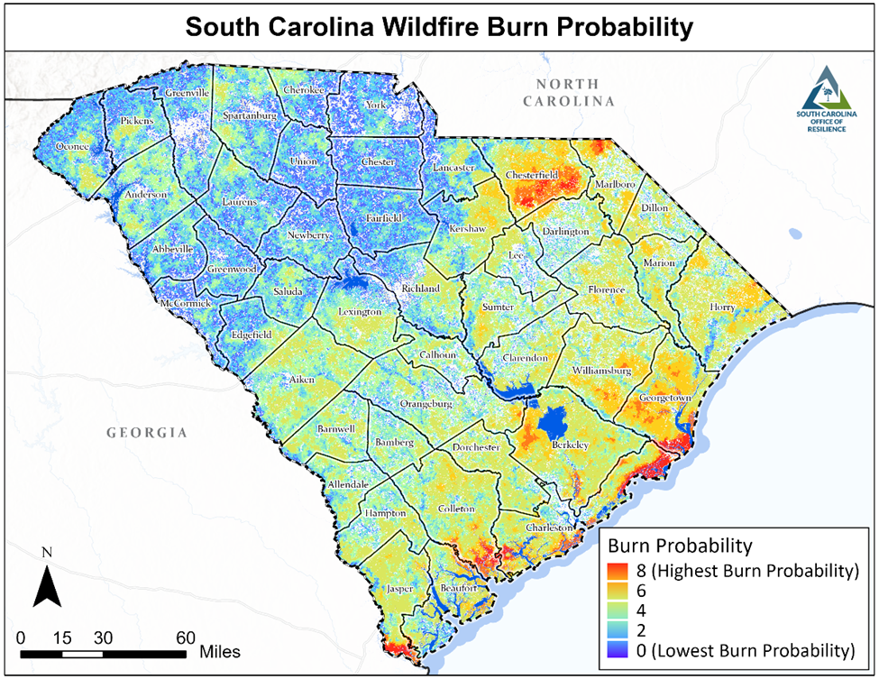
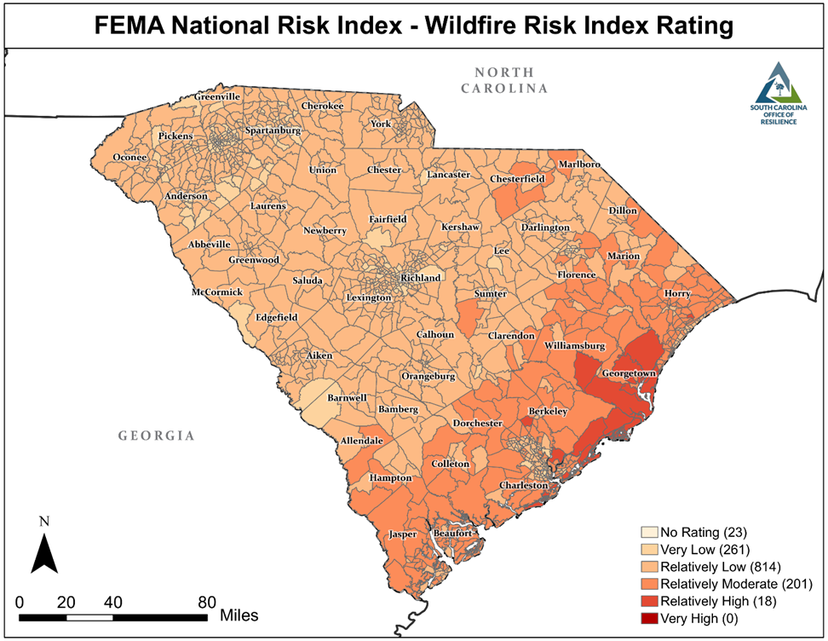
Wildfire

Slide 55
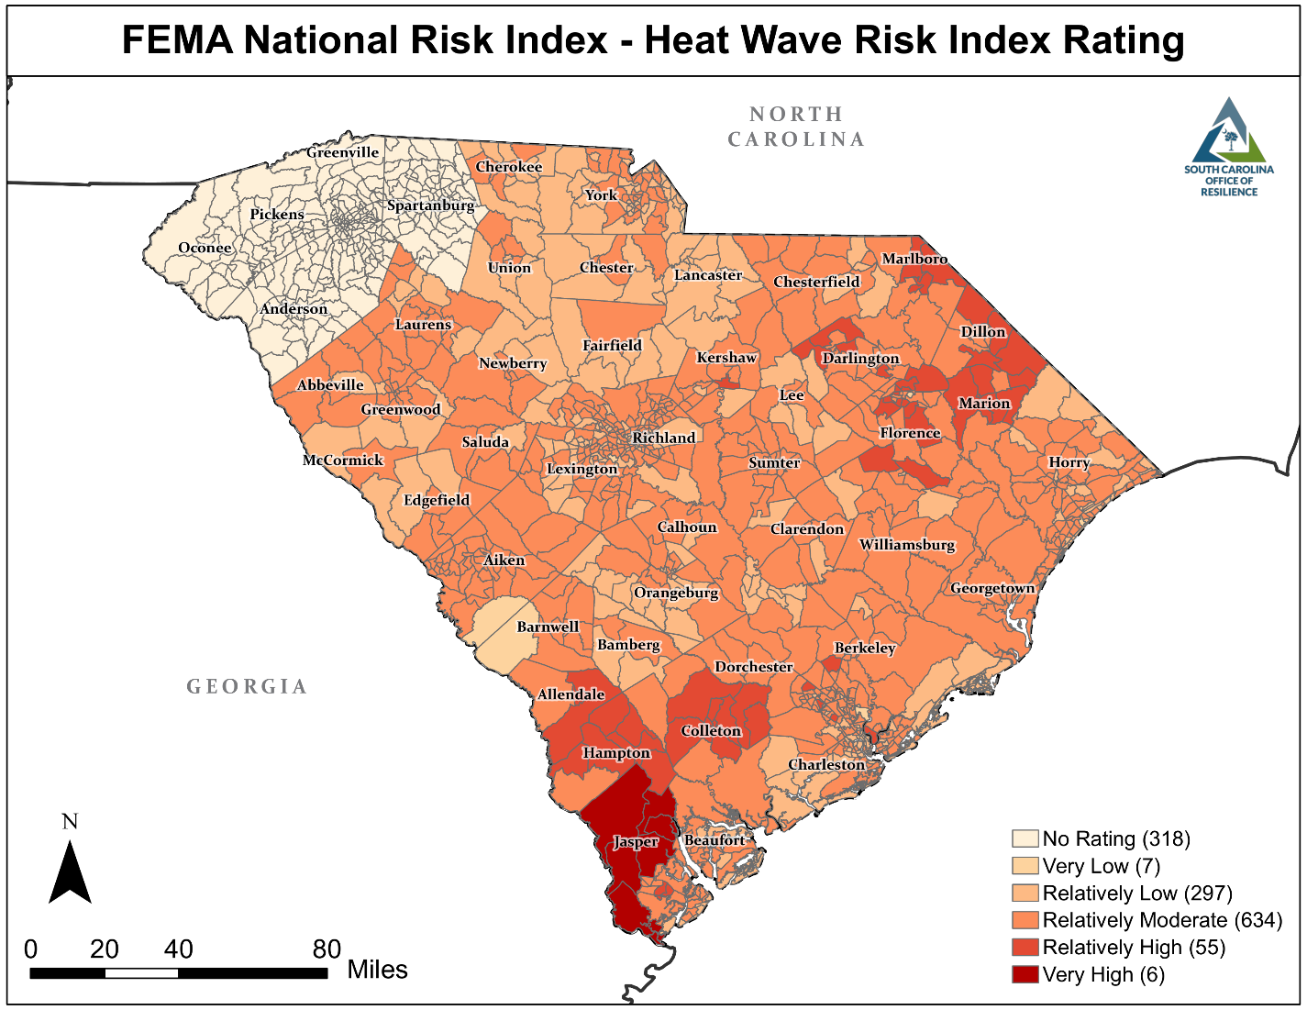
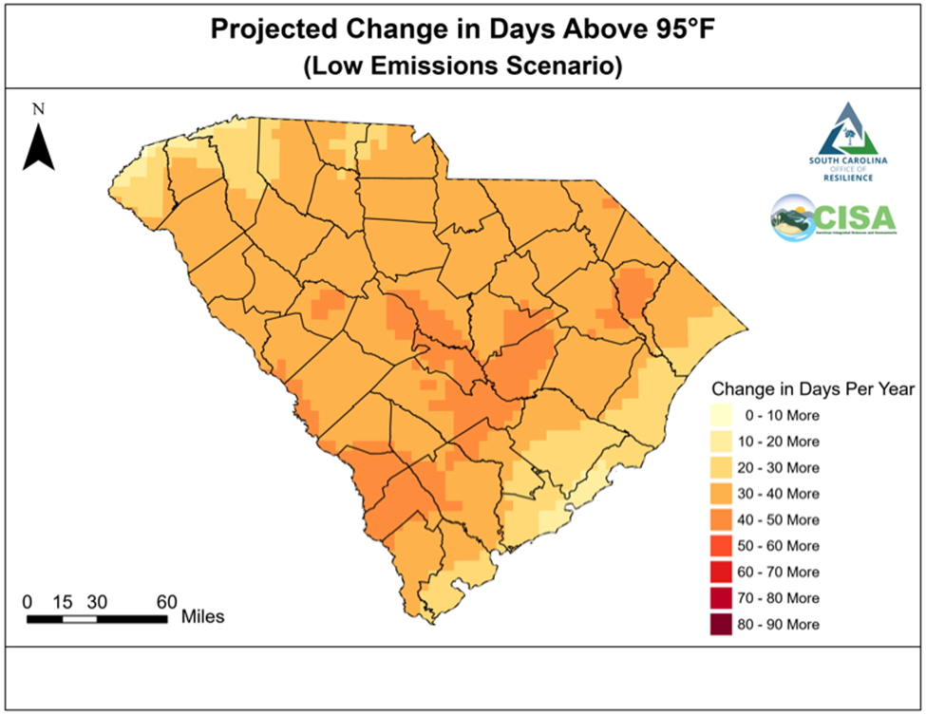
Heat
Notes:
Largely driven by presence of agriculture

Slide 56
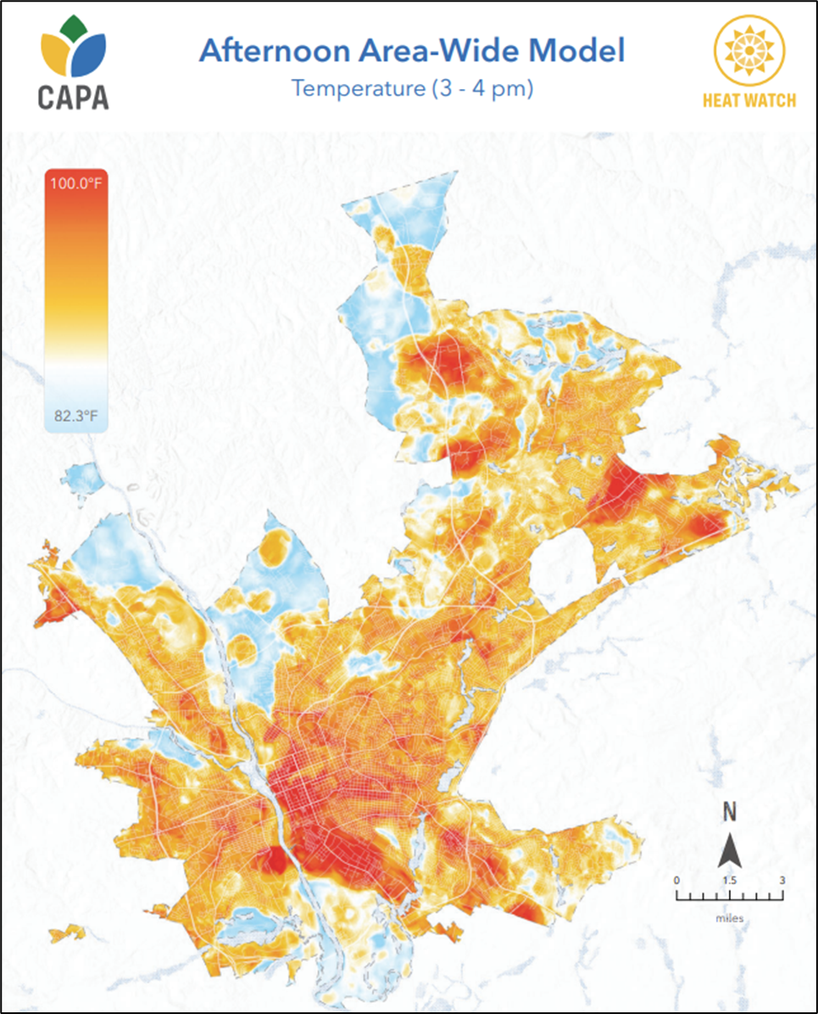


Slide 57


Earthquakes

Slide 58


Slide 59
Current Process Contents
Anticipate
Absorb
Recover
Thrive
Land Use Planning & Regulations
Hazard Mitigation Planning
State Water Planning
Other Related Statewide Planning Efforts
Floodplain Management
Community Rating System
Real Estate Disclosure
Data
Stormwater Management Regulations & Infrastructure Design
Green Infrastructure
Building Codes
Coastal Zone Management
Protection of Wetlands
National Disaster Response & Recovery Framework
State Coordination of Recovery
Complicating Factors
Non-Profit Partners
Community Co-Benefits
Economic Co-Benefits
Ecosystem Co-Benefits

Slide 60

Stormwater Infrastructure Design
Recommended Design Storms for Various Drainage Facilities
 | Design AEP (Annual Exceedance Probability)
Functional classification and structure type | 50% | 10% | 4% | 2% | 1%
 | (2-yr) | (10-yr) | (25-yr) | (50-yr) | (100-yr)
Primary Roads and Interstates
Culverts |  |  |  | X
Bridges |  |  |  | X
Scour at Bridges |  |  |  |  | X
Secondary Roads
Culverts |  |  | X
Bridges |  |  | X
Scour at Bridges |  |  |  |  | X
All Roads
Inlets, storm drain pipes, roadside ditches, and outfalls |  | X *
Sag Inlets for roadways |  |  |  | X
Temporary Erosion and Sediment Control Devices |  | X**
Permanent Stormwater Management | X* | X** |  |  | X ***
* AEP increases for watersheds > 40 acres ** SC State Regulations *** For Emergency Spillway Design only.

Slide 61

Protection of Wetlands
Preliminary Visualization of Isolated Wetlands in South Carolina

Slide 62


Slide 63

Federal Funding

Slide 64
Reserve and Revolving Funds
Reserve Fund
$44M Initial ($200M added in FY2024)
Pre-disaster programs
  Hazard mitigation infrastructure projects
  Buyouts and acquisitions
Post-disaster programs
  Provide nonfederal share for federal disaster assistance programs
  Infrastructure repairs for non-CDBG-DR eligible homeowners and communities
  Local government loans and grants for immediate assistance
  Support Disaster Case Management efforts jump starting the disaster recovery
Revolving Fund
$6M for low interest loan for voluntary home buyouts and floodplain restoration projects

Slide 65


Slide 66
Recommendations Themes
Data Collection & Coordination
Education, Outreach, Disclosure
Maintain Natural Protection through Conservation
Maintain & Strengthen Building Codes
Incorporate Resilience into Housing Recovery
Watershed Based Resilience Planning & Projects
Establish a Voluntary Pre-Disaster Buyout Program
Incorporate Resilience into Existing Planning, Land Use & Other Regulatory Processes
Identify & Maximize All Available Funding Sources for Resilience Activities
Incorporate Resilience into Infrastructure Design, Construction & Maintenance

Slide 67

Improve Data Collection & Coordination

Slide 68


Improve Data Collection & Coordination

Slide 69

Improve Data Collection & Coordination

Slide 70


Increase Education, Outreach, and Disclosure

Slide 71

Coordinate Watershed-Based Resilience Planning and Projects

Slide 72

Community Capacity Building & Planning
Regional (Watershed) Coordination of Efforts
State and Federal Partnerships

Slide 73

South Carolina Resilient Coastal
Communities Collaborative Program
Watershed-based planning process in the Salkehatchie River basin, as a pilot program for future watershed-based resilience planning efforts.
Working with partners at S.C. Sea Grant Consortium and S.C. Beach Advocates.
Will provide technical assistance to 10 underserved communities to complete community risk assessments, grounded in local engagement, leading to a portfolio of resilience projects.
Creation of a comprehensive Salkehatchie Watershed Resilience Plan.
Continued coordination between other proposals/projects.

Slide 74


Incorporate Resilience into Planning, Land Use and Other Regulatory Processes

Slide 75

Maintain and Strengthen Building Codes

Slide 76


Incorporate Resilience into Infrastructure Design

Slide 77

Maintain Natural Flood Protection Through Conservation

Slide 78


Maintain Natural Flood Protection Through Conservation

Slide 79


Incorporate Resilience into Housing Recovery

Slide 80

Develop a Pre-Disaster Voluntary Buyout Program

Slide 81

Identify and Maximize All Available Funding Source for Resilience Activities

Slide 82


https://scor.sc.gov/public-engagement

Slide 83

Questions?
South Carolina
Office of Resilience

