Slide 1
Ethics Cases of the Year: 2023
SC APA Spring Conference – April 28, 2023
APA National Panning Conference – April 2, 2023
Philadelphia, PA
Prepared by the Ethics Committee of the American Institute of Certified Planners

Slide 2
Panelists
Barry C. Nocks, PhD, FAICP - Professor Emeritus & Lecturer, Clemson University
Member, AICP Ethics Committee
Amy Southerland, AICP
City of Charleston
SCAPA Professional Development Officer

Slide 3
Agenda
Refresher on Planning Ethics
Overview of 2022 Case/Inquiry Activity
Ethical Scenarios
Sexual Harassment
Conflict of Interest
(2 scenarios)

Slide 4
Disclaimer
This session has been created to provide general education regarding the AICP Code of Ethics.
Although ethical scenarios and question-and-answer sessions are an important part of illustrating the application of the Code’s provisions, all certified planners should be aware that only the AICP Ethics Committee is authorized to give formal advice on the propriety of a planner’s proposed conduct.
If you have a question regarding a situation in your own professional practice, you are encouraged to seek informal advice from the AICP Ethics Officer (ph: 312-786-6360; email: ethics@planning.org).

Slide 5
AICP Code of Ethics Pledge
This AICP Ethics Code certificate is available for downloading from planning.org/ethics.

Slide 6
A Few Ethical Questions As posed by Michael Schur, creator of “The Good Place” TV series
What are we doing?
Why are we doing it?
Is there something we could do that’s better?
Why is it better?

Slide 7
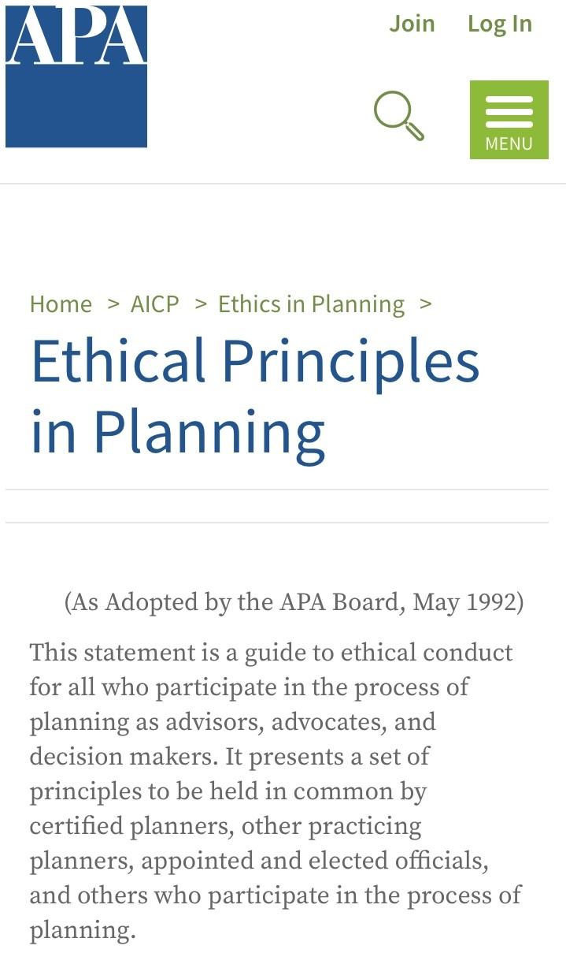
APA’s Ethical Principles in Planning Adopted in 1980 by the American Planning Association; rev. 1992 Guidelines for advisors, advocates, and decision makers in the planning process
1. Serve the public interest
2. Maintain high standards of integrity and proficiency
3. Improve planning competence

Slide 8
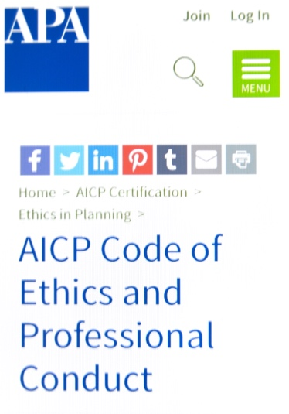
AICP Ethics Code Adopted in 1948 by the American Institute of Planners; rev. 1959, 1970, 1978, 1991, 2005, 2016, 2022
GRAB YOUR PHONE. GO TO: www.planning.or/ethics/ethicscode
A. Aspirational Principles
B. Rules of Conduct
C. Advisory Opinions
D. Complaints of Misconduct
E. Discipline of Members

Slide 9
Aspirational Principles Section A of the AICP Ethics Code
People who participate in the planning process shall:
1. Continuously pursue and faithfully serve the public interest
2. Do so with integrity
3. Work to achieve economic, social, and racial equity
4. Safeguard the public trust
5. Improve planning knowledge and increase public understanding of planning activities

Slide 10
Rules of Conduct Section B of the AICP Ethics Code
The 24 Rules of Conduct—to which certified planners can be held accountable—have been revised (down from 26 Rules) and reorganized under these headings:
1. Quality and Integrity of Practice
2. Conflict of Interest
3. Improper Influence/Abuse of Position
4. Honesty and Fair Dealing
5. Responsibility to Employer
6. Discrimination/Harassment
7. Bringing and Cooperating with an Ethics Charge

Slide 11
Adjudication of Complaints of Misconduct Section D of the AICP Ethics Code
D6a: Only current members of AICP may appeal a determination of the Ethics Officer.
This revision eliminates the ability of non-members to contest ethics rulings through a time-consuming appeal process.
However, non-AICP members can still file an appeal by having an AICP member do so on their behalf.

Slide 12
Ethical Misconduct Cases in 2022
9 Cases Dismissed
No justification to file a charge or planner not AICP (8 cases)
Preliminary charge filed (1 case)
10 Cases Resulted in Disciplinary Actions
Cease and desist letters issued (7 cases) for misuse of the AICP credential
Confidential Letters of Admonition (2 cases) for “wrongful conduct:” 1) for plagiarism and misrepresentations of information in a planning report; and 2) for committing a wrongful act reflecting adversely on the profession
Public Letter of Admonition and Revocation of FAICP credential (1 case) for sexual harassment
Nccaom.org

Slide 13
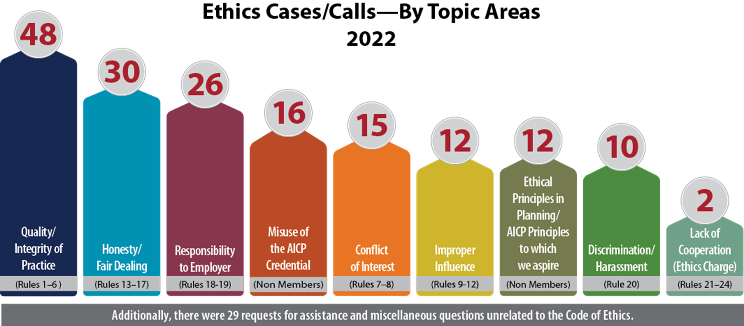
Ethics Topics in 2022

Slide 14
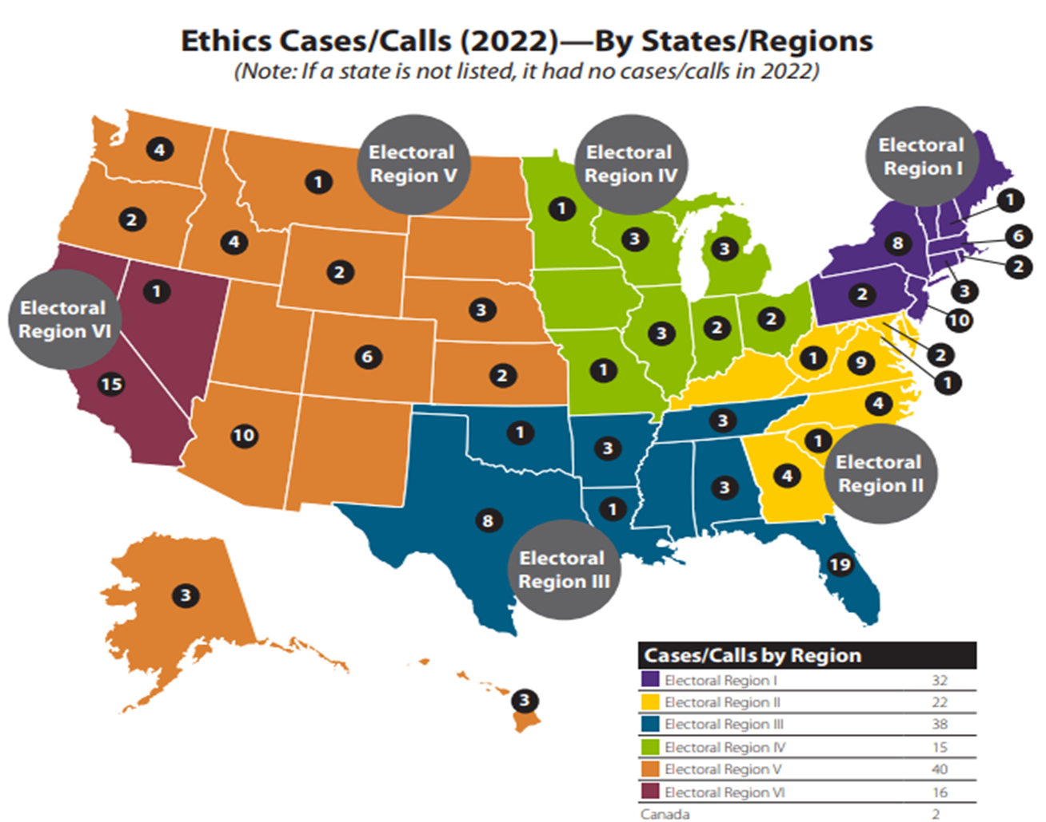
Cases/Inquiries of the Year
The following scenarios were based on misconduct complaints or informal inquiries reviewed by the Ethics Officer and the Ethics Committee in 2022.
Although the scenarios are based on real-life situations, all of the names, details, and locations are fictional.

Slide 15
Scenario 1: Sexual Harassment

Slide 16
Scenario 1 Sexual Harassment
Harry, FAICP - a respected leader in his APA Chapter
chapter events
panel presentations
mentor
One of Harry’s mentees found his actions to be disturbing and complained of sexual harassment.
After repeated requests to stop, the mentee left the chapter because she felt unsafe.
Other women also felt uncomfortable and unsafe.
Notes:
Harry, FAICP, is a respected leader in his APA Chapter. He attends chapter events, participates on panel presentations, and volunteers as a mentor. One of Harry’s mentees found his approach to be disturbing and complained of sexual harassment. After repeated requests to stop, the mentee left the chapter because she felt unsafe. There were other women who also felt uncomfortable and unsafe.

Slide 17
Scenario 1 (contd.)
One of the women filed a complaint with the AICP Ethics Officer.
Asked to remain anonymous
EO investigated
EO talked to the original victim and other women who were also harassed by Harry, and a witness.
All conversations were held in strict confidence.
The Ethics Officer felt that sexual harassment had taken place at APA chapter events.
ThoughtCo
Notes:
One of the women filed a complaint with the AICP Ethics Officer. She asked to remain anonymous. The Ethics Officer carefully investigated the complaint over a period of several months. The Ethics Officer talked to the original victim and other women who were also harassed by Harry, as well as a witness. All conversations were held in strict confidence. The Ethics Officer felt that sexual harassment had taken place at APA chapter events.

Slide 18
Scenario 1 Questions
Q 1.1:
Is Harry guilty of violating the Code of Ethics if the complaints were filed anonymously?
Yes
No
Not Sure

Slide 19
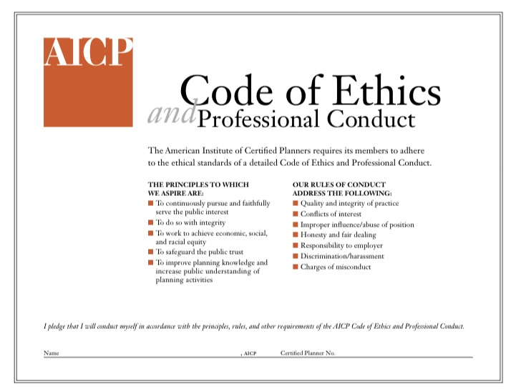
Scenario 1 Ethical Issues
AICP Ethics Code “Principles to Which We Aspire”
A.1.a “Examine our own cultures, practices, values, and professional positions in an effort to reveal and understand our conscious and unconscious biases and privileges as an essential first step so we can better serve a truly inclusive public interest promoting a sense of belonging.
A.2.h “Respect the rights of all persons and groups and do not discriminate against or harass others.”

Slide 20
Scenario 1 Ethical Issues
AICP Ethics Code “Rules of Conduct:
Rule #6 a certified planner “shall not deliberately commit any wrongful act, whether or not specified in the Rules of Conduct that reflects adversely on our professional fitness or the planning profession”
Rule #20 a certified planner “shall not commit or ignore an act of discrimination or harassment.”

Slide 21
Scenario 1 Real-Life Outcome
EO charged Harry with violation of the AICP Code of Ethics Rule #6, wrongful acts.
Not charged under Rule #20, discrimination or harassment, because these incidents took place prior to when this Rule went into effect.
EO issued a “Public Letter of Admonition” and recommended that Harry be suspended indefinitely as a member of AICP (and FAICP).
Harry appealed the decision to the Ethics Committee, which upheld the decision of the Ethics Officer.
Harry’s AICP and FAICP credentials were removed, and he was the subject of a public notification in APA’s Interact online newsletter.

Slide 22
AICP Code of Ethics – Impact of the New Code
Section B. Rules of Conduct (new):
20. We shall not commit or ignore an act of discrimination or harassment.
22. We shall not harass, retaliate, or threaten retaliation against a person who has filed a charge of ethical misconduct against us or another planner, or who is cooperating in the Ethic Officer’s investigation of an ethics charge.
Glossary (new):
Harassment: Severe, unwelcome, and pervasive behavior.
Can take place in the workplace or on social media and includes:
Verbal or written statements
Physical actions
Visual elements—clothing, office décor

Slide 23
APA Action on Sexual Harassment
Do not tolerate harassment of any type.
APA has instituted, for NPC23, a Code of Conduct for all involved in the conference.
It is an AICP Code violation to ignore an act of discrimination or harassment.
Ethics Officer is available to discuss possible complaints, or for advice.
APA is instituting the position of Ombudsperson specifically for harassment complaints at NPC23 and in any APA activity.
APA is instituting an overall process to deal with harassment.
Everyone is committed to confidentiality, protecting victims, and conducting a thorough investigation.
Victims are not to be blamed.

Slide 24
Scenario 2.1: Conflict of Interest

Slide 25
Scenario 2.1 Conflict of Interest
Samuel, an AICP planner, is the planning director for Anytown, a city of 45,000 in a developing area of 500,000.
His wife, Geri, is also an AICP planner who works remotely for Planning Wizards (PW), a planning and development consulting firm.
Anytown has published an RFP/RFQ seeking consultants to take the lead in completing the ten-year rewrite of their comprehensive plan.

Slide 26
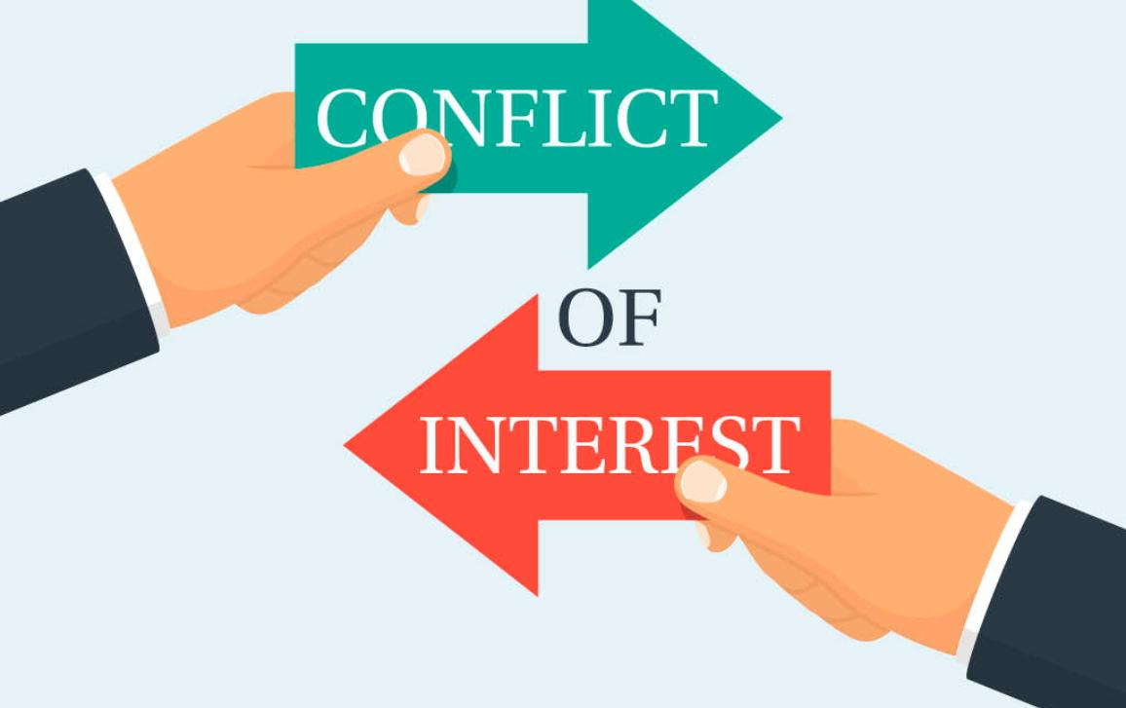
Scenario 2.1 (contd.)
European Union
Planning Wizards asked Geri to develop a response to the RFP.
Eight responses were received to this RFP/RFQ and the town manager directed Samuel to screen them down to three for in person/zoom interviews based on the criteria listed in the RFP/RFQ.
Recognizing that one of the applications was submitted by his wife’s firm (with his wife as lead), how does Samuel proceed?
What ethical issues are involved? How might they be resolved?

Slide 27
Scenario 2.1 Ethical Issues
A. Aspirational Principles:
4.3: Public trust – Don’t let any official action be influenced by personal relationships.
4.5: Public trust – Avoid conflict of interest or even the appearance of a conflict in accepting assignments.
4.6: Public trust – Disclose all personal any pecuniary interests considered broadly and avoid being involved in such decisions.
4.9: Do not commit a wrongful act which reflects adversely on the planning process.
4.10: Do not seek business by stating or implying the ability to influence decisions by improper means.

Slide 28
Scenario 2.1 Ethical Issues (contd.)
B. Rules of Conduct
8. Conflict of interest – do not accept work if there is a possibility for direct personal or financial gain to us, our family etc. without full disclosure prior and during the process.
9. Improper influence/abuse of position – do not engage in private communications if we have authority to make final determination.
13. Honesty and fair dealing – we shall not disclose or use to our advantage any confidential information.

Slide 29
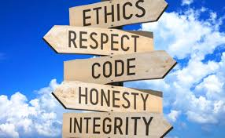
Scenario 2.1 What option(s) are ethical?
A. Geri puts a team together and submits an application to Anytown for the work. The City includes Samuel on the review team.
B. Samuel recuses himself from the review of applications, with Geri’s application in the mix.
C. Geri recuses herself from the team and PW submits a proposal.
D. PW does not submit a proposal.

Slide 30
Scenario 2.1 Real-Life Outcome
The Ethics Officer recommended that PW should contact the Anytown Planning Department and ask them how to resolve the situation
Contacting Samuel and asking him to recuse himself from the proposal review
PW could recommend that Geri not be on the project team, and/or
Both parties provide full written disclosure of conflict.
Elderflower Legal

Slide 31
Scenario 2.2: Conflict of Interest

Slide 32
Scenario 2.2 Conflict of Interest
Dorothy, an AICP planner, is leaving her position as principal planner at Maeville and joining the Planning Magicians (PM) consulting firm.
Signed letter of employment.
Maeville has issued an RFP to update its land management ordinance.
During her interview with the PM consulting firm, they noted that they are aware of the pending RFP pending from Maeville.
Dorothy is aware of the issues that the town has dealt with over the past decade and what approaches would be acceptable to the community.
Notes:
Dorothy, an AICP planner, is leaving her position as principal planner at Maeville and joining the Planning Magicians (PM) consulting firm, heading up their office which will be located at the City of Richards, which is 30 miles from Maeville. She has a signed letter of employment. Maeville has issued an RFP to update its land management ordinance.
During her interview with the PM consulting firm, they noted that they are aware of an RFP pending from the City of Maeville about an update to their land management ordinance. Dorothy is very much aware of the issues that the town has dealt with over the past decade and what approaches would be acceptable to the community.

Slide 33
Scenario 2.2 (contd.)
The PM firm has offered to bring Dorothy on-board and be a senior member of the team for that project and is suggesting that she at least review and comment on PM’s draft response.
She is leaving the town in 30 days and joining the consulting firm thereafter.
RFP responses are due in 30 days.
The City of Maeville does not have a revolving-door policy against working for a jurisdiction that you just left.
Notes:
The PM firm has offered to bring Dorothy on-board and be a senior member of the team for that project and is suggesting that she at least review and comment on PM’s draft response.
She is leaving the town in 30 days and joining the consulting firm thereafter. The RFP responses are due in 30 days. PM wants Dorothy to be a senior member of the team for that project and is suggesting that she at least review and comment on PM’s draft response.
The City of Maeville does not have a revolving-door policy against working for a jurisdiction that you just left.

Slide 34
Scenario 2.2 Ethical Issues
A. Aspirational Principles:
4.c: Public trust – Do not let any official action be influenced by personal relationships.
4.e: Public trust – Avoid conflict of interest or even the appearance of a conflict in accepting assignments.
4.f: Public trust – Disclose all personal any pecuniary interests considered broadly and avoid being involved in such decisions.
4.i: Do not commit a wrongful act which reflects adversely on the planning process.
4.j: Do not seek business by stating or implying the ability to influence decisions by improper means.

Slide 35
Scenario 2.2 Ethical Issues (contd.)
B. Rules of Conduct
8. Conflict of interest – do not accept work if there is a possibility for direct personal or financial gain to us, our family etc. without full disclosure prior and during the process.
9. Improper influence/abuse of position – do not engage in private communications if we have authority to make final determination.
13. Honesty and fair dealing – we shall not disclose or use to our advantage any confidential information.

Slide 36
Scenario 2.2 What option(s) are ethical for Dorothy?
Have no contact with PM about the RFP, and work on whatever projects PM assigns her in 30 days when she leaves the city and joins that firm.
Take a few days of personal leave to help PM craft their response to the RFP after receiving permission from the city administrator.
Answer all questions from interested consulting groups about the RFP, including PM, then work on whatever projects PM assigns her in 30 days when she leaves the city and joins that firm.
Refer all questions about the RFP to another planner, then work on whatever projects PM assigns her in 30 days when she leaves the city and joins that firm.
Work on whatever projects PM assigns her in 30 days except for the Maeville project (assuming they win the contract) when she leaves the city and joins that firm.
Notes:
Dorothy continues to work full-time in Maeville, has no contact with PM about the RFP, and will work on whatever projects PM assigns her in 30 days when she leaves the city and joins that firm.
Dorothy continues to work in Maeville and takes a few days of personal leave to help PM craft their response to the RFP after receiving permission from the city administrator.
Dorothy continues to work full-time in Maeville, answers all questions from interested consulting groups about the RFP, including PM, and will work on whatever projects PM assigns her in 30 days when she leaves the city and joins that firm.
Dorothy continues to work full-time in Maeville and refers all questions about the RFP to another planner and will work on whatever projects PM assigns her in 30 days when she leaves the city and joins that firm.
Dorothy continues to work full-time in Maeville and will work on whatever projects Planning Magicians assigns her in 30 days except for the Maeville project (assuming they win the contract) when she leaves the city and joins that firm.

Slide 37
Scenario 2.2 Real-Life Outcome
The Ethics Officer recommends full disclosure and suggests that Dorothy look closely at Rule 13, discuss matter with her supervisor, and possibly recuse herself from the interview with former employer, and fully divulge potential conflict to other reviewers.

Slide 38
Further Discussion

Slide 39
Final Note
For informal advice regarding ethical conduct, please contact the AICP Ethics Officer at 312-786-6360 or ethics@planning.org. For more information about ethics, please visit planning.org/ethics
AICP Ethics Committee
Robert L. Barber, FAICP Kimberley Mickelson, AICP, JD
Carol Barrett, FAICP Barry Nocks, PhD, FAICP
Michele S. Delisfort, AICP, PP Erin Perdu, AICP, Chair
Staron Faucher, AICP Robin Scholetzky, AICP, LEED AP ND

