Slide 1
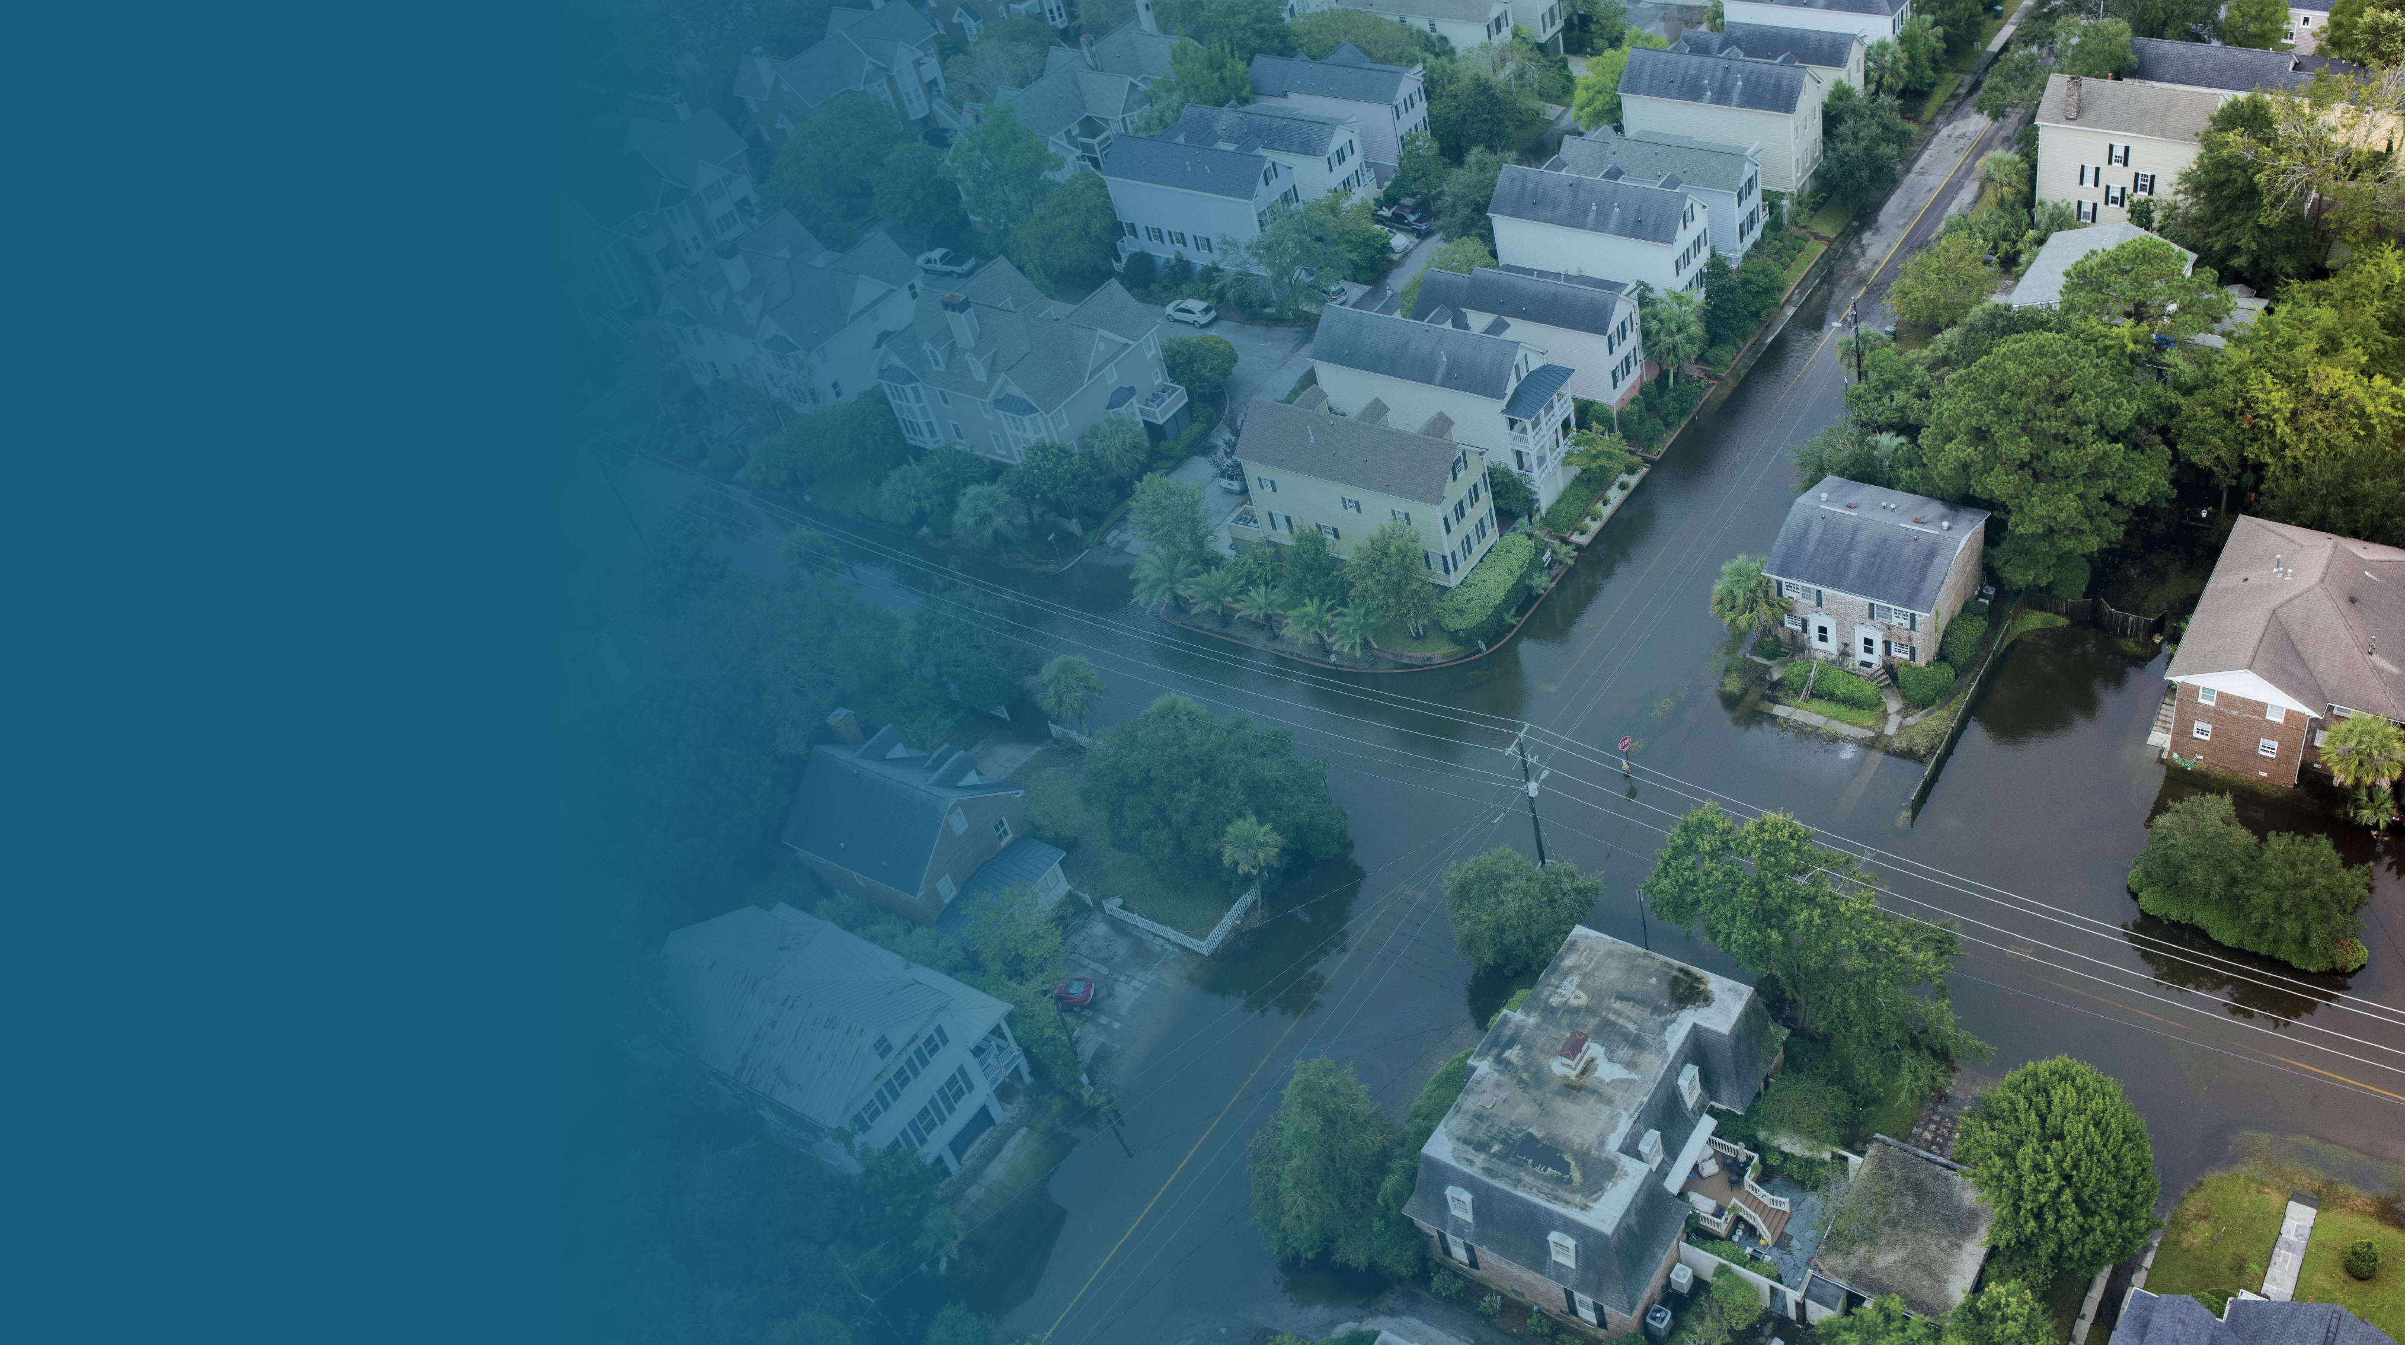


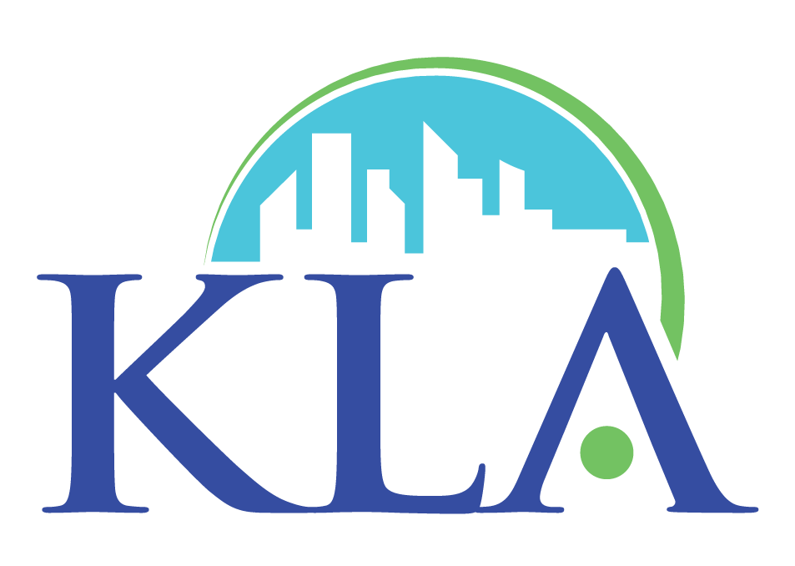

Why Your Community's Buyout Program Needs an Engagement, Outreach, and Green Infrastructure Toolkit
[object File]
South Carolina American Planning Association Conference
Thursday, November 2, 2023
Notes:
Welcome to the community town hall on the South Carolina Office of Resilience Mitigation Buyout Program.

Slide 2
Today's Objectives
Presenters will share how modular and flexible green infrastructure solutions and a strategic communications and outreach approach can help your community to enhance participation in buyout programs and envision the future state of buyout properties.
Participants will practice using these tools through an interactive activity and discussion and reflect upon how similar approaches could apply to their communities.

Slide 3





Meet the Team
Tacy Lambiase
Kim Lundgren Associates, Inc.
Nancy Miramonti
South Carolina Office of Resilience
Kelly Main
Buy-In Community Planning, 501c3
Nupur Roy
One Architecture & Urbanism, Inc.
Oksana Veselkova
One Architecture & Urbanism, Inc.

Slide 4
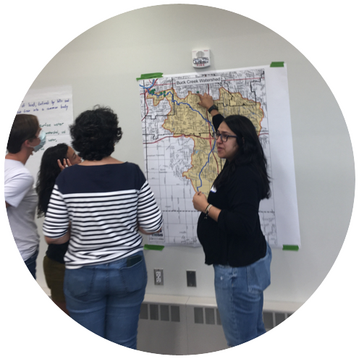
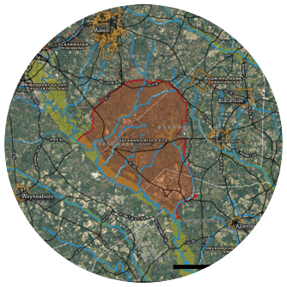
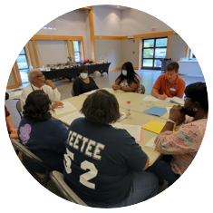

Equitable Resilience Building
New EPA Tools for small and mid-sized communities
Notes:
Voluntary buyout programs offer a range of benefits, such as protecting residents and property from repeated flooding and creating green spaces that the local community can enjoy.
A primary objective for this program is that it relocates homeowners out of harms way, prevents more buildings being built in these flood-prone areas, and reduces the flood risk for the whole neighborhood.

Slide 5

Equity as Key Theme
Resilience: strengthening community’s capacity to prepare for, withstand, respond, and transform in the face of climate change and other hazards.
Equitable resilience does so in ways that:
Are culturally appropriate
Are informed by local knowledge
Use inclusive methods of making decisions
Address social and environmental inequalities
Pay attention to distribution of benefits and costs of resilience actions
Eligible homes that have been repetitively flooded can be purchased with CDBG-Mitigation HUD funds
Any structures on the land will be safely removed
The land will be turned into natural green spaces and maintained by the local government
Notes:
Before we dive into the details of the program, let's take a 100o foot view of what a buyout is.
The first step of a buyout process is identifying homes that have been repeatedly flooded in the past. Eligible homes may be voluntarily sold through the program.
After properties are sold, any structures on the land will be safely removed.
In this program specifically, the land will be turned into natural green space an enhanced with green infrastructure.

Slide 6
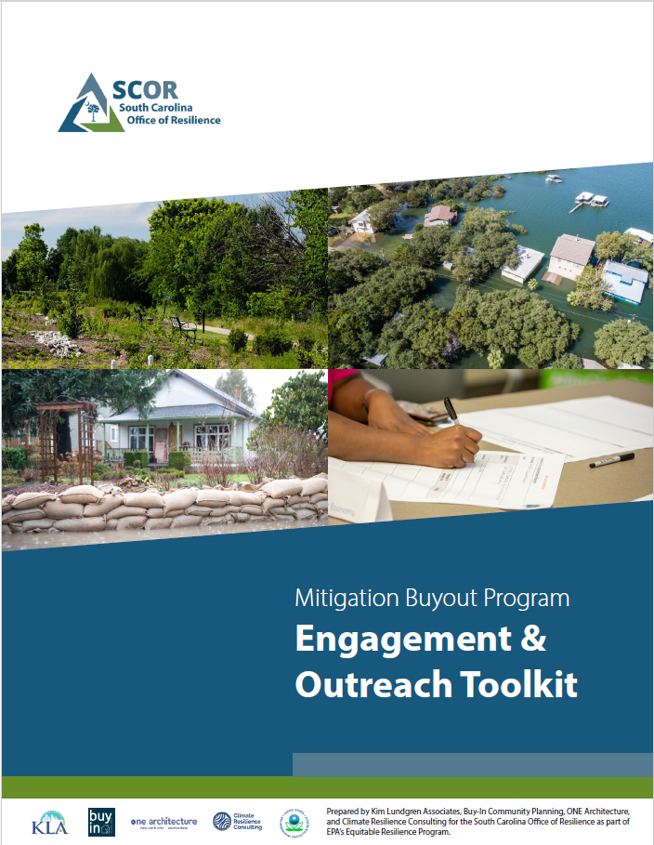
SCOR + EPA's Equitable Resilience Program
SCOR pursued a grant to create an Engagement, Outreach, and Green Infrastructure Toolkit to build effective and meaningful engagement in LMI communities through listening, collaborating, and building trust and strong relationships.
Eligible homes that have been repetitively flooded can be purchased with CDBG-Mitigation HUD funds
The land will be turned into natural green spaces and maintained by the local government
Notes:
Before we dive into the details of the program, let's take a 100o foot view of what a buyout is.
The first step of a buyout process is identifying homes that have been repeatedly flooded in the past. Eligible homes may be voluntarily sold through the program.
After properties are sold, any structures on the land will be safely removed.
In this program specifically, the land will be turned into natural green space an enhanced with green infrastructure.

Slide 7
SCOR Mitigation Buyout Program
Notes:
So let's dive into SCOR's Buyout Program! We'll have time for questions at the end of the presentation.

Slide 8
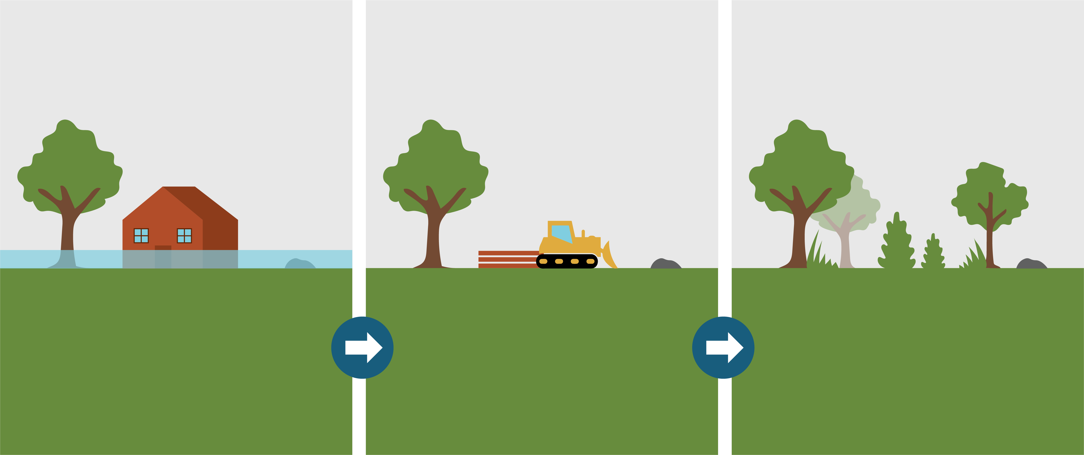
SCOR's Voluntary Mitigation Buyout Program
Eligible homes that have been repetitively flooded can be purchased with CDBG-Mitigation HUD funds
Any structures on the land will be safely removed
The land will be turned into natural green spaces and maintained by the local government
Notes:
Before we dive into the details of the program, let's take a 100o foot view of what a buyout is.
The first step of a buyout process is identifying homes that have been repeatedly flooded in the past. Eligible homes may be voluntarily sold through the program.
After properties are sold, any structures on the land will be safely removed.
In this program specifically, the land will be turned into natural green space an enhanced with green infrastructure.

Slide 9
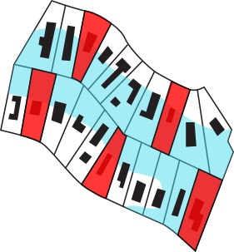
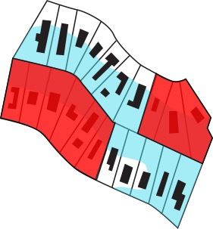
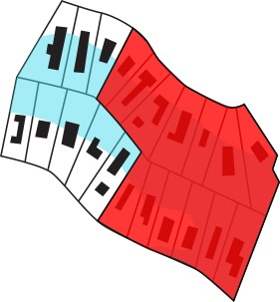

Avoiding the Checkerboard Effect
Notes:
Maximizing the flood-reducing benefits of these transformed properties work best when the properties are contiguous, or bordering one another.
If neighboring properties are sold through the buyout program, the green infrastructure solutions can be larger and more flexible.

Slide 10



What are the benefits?
Relocates homeowners to a safer area to help reduce or eliminate risk to health and safety and loss of property
Eliminates financial hardship of maintaining and fixing flood-damaged homes
Reduces flood risk for entire neighborhood
Notes:
Voluntary buyout programs offer a range of benefits, such as protecting residents and property from repeated flooding and creating green spaces that the local community can enjoy.
A primary objective for this program is that it relocates homeowners out of harms way, prevents more buildings being built in these flood-prone areas, and reduces the flood risk for the whole neighborhood.

Slide 11
Community Engagement and Outreach
Before, During, and After Buyouts

Slide 12
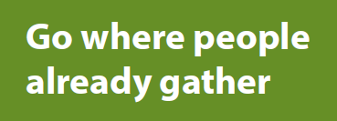

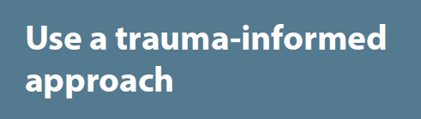

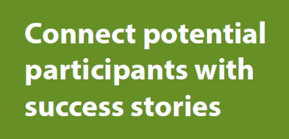
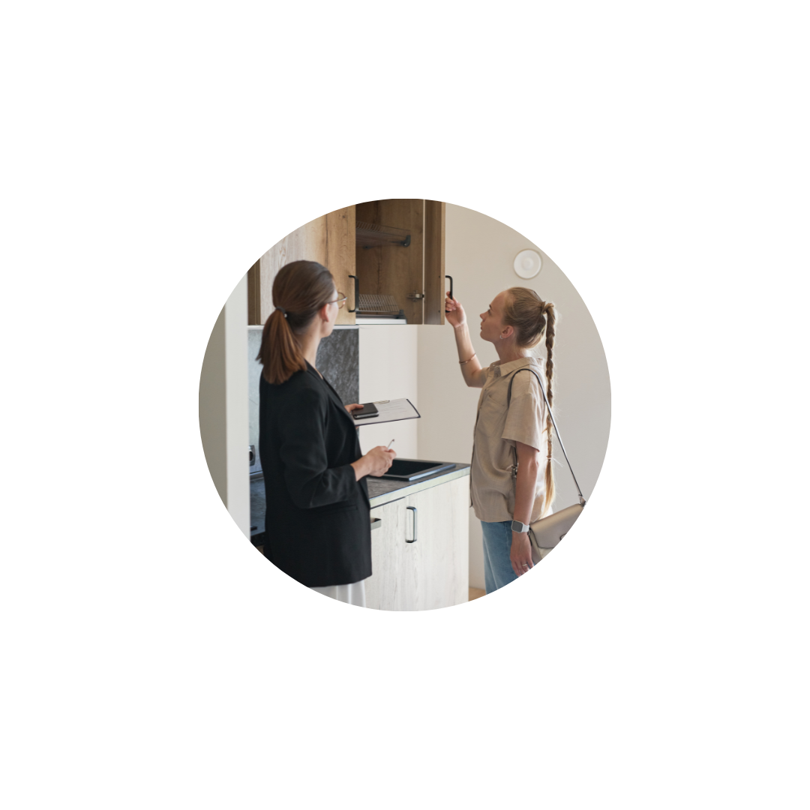
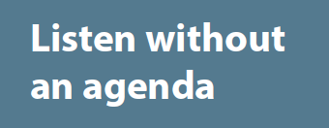
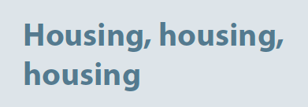
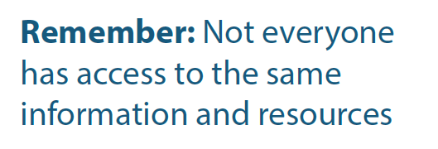
Seek out trusted community leaders and CBOs

Slide 13
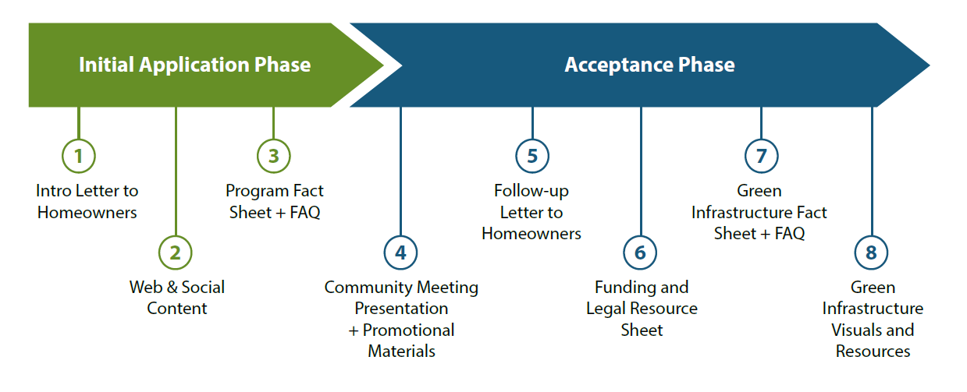
Engagement Resources for the Whole Process
Notes:
Maximizing the flood-reducing benefits of these transformed properties work best when the properties are contiguous, or bordering one another.
If neighboring properties are sold through the buyout program, the green infrastructure solutions can be larger and more flexible.

Slide 14
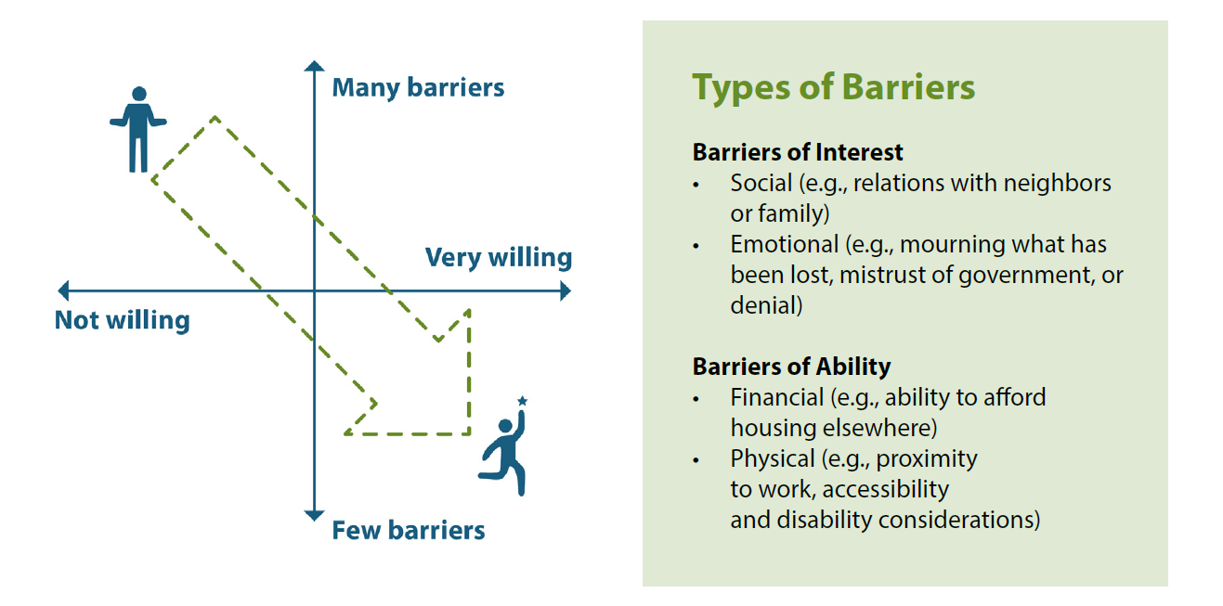
Who is Willing AND Able to Participate?

Slide 15

Identifying and Leveraging Personas
The Willing Homeowner
Reluctant:
Uninterested
Reluctant:
Unable
Absentee
Owner
Landlord
Buyout
Program Manager
Notes:
Maximizing the flood-reducing benefits of these transformed properties work best when the properties are contiguous, or bordering one another.
If neighboring properties are sold through the buyout program, the green infrastructure solutions can be larger and more flexible.

Slide 16
Green Infrastructure Opportunities
For Buyouts

Slide 17
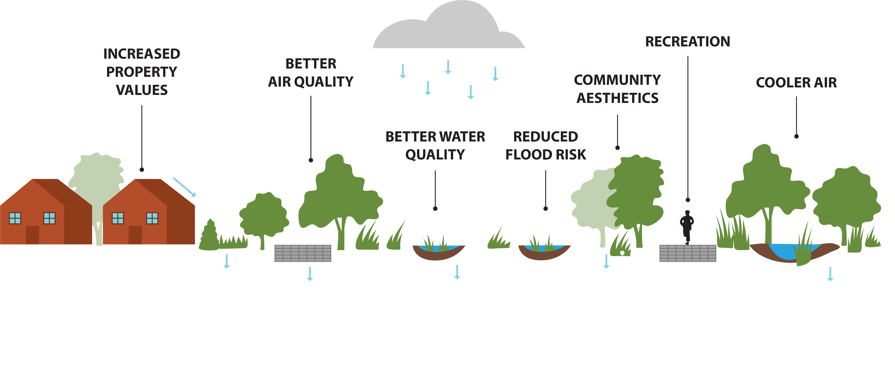
What is Green Infrastructure?
What is Green Infrastructure?
Green Infrastructure
Natural solutions that infiltrate, store, or absorb stormwater to reduce runoff
Notes:
Green infrastructure refers to natural solutions that infiltrate, store, or absorb stormwater to reduce runoff.
There are other benefits as well!
This kind of natural infrastructure cleans our air and water, keeps the surrounding area cooler, increases surrounding property values, and lowers flooding impacts for the whole neighborhood.

Slide 18
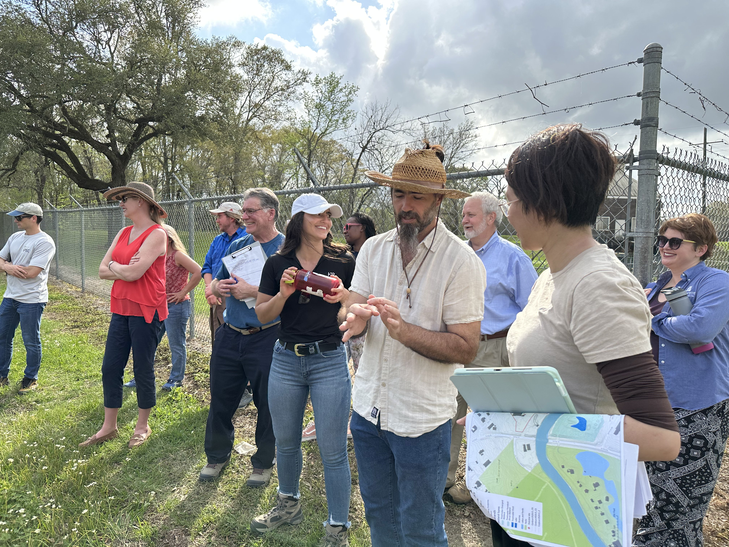
Community Visioning Tool
Nature-based solutions are the tool and language to frame out the desired future with the various stakeholders
Based upon familiar approaches and solutions to inform shared vision of the future
Community resources to inform this process are not necessarily financial - communication, administrative, workforce, knowledge, data, case-based experience
Connecting benefits and co- benefits of Green Infrastructure strategies to stakeholder groups with personas classification
Notes:
The end result of properties that go through this Buyout is that they structures will be safely removed and the will be returned to natural open space.
This open space will be enhanced with flood-reducing natural infrastructure and other features for recreation and public use.
The properties will be owned and maintained by [UGLG] like other public land and it will be accessible to all and protected from future development.
The open space may be enhanced with green infrastructure – which are natural solutions (e.g. rain gardens) that infiltrate, store, or absorb stormwater and reduce flooding.

Slide 19
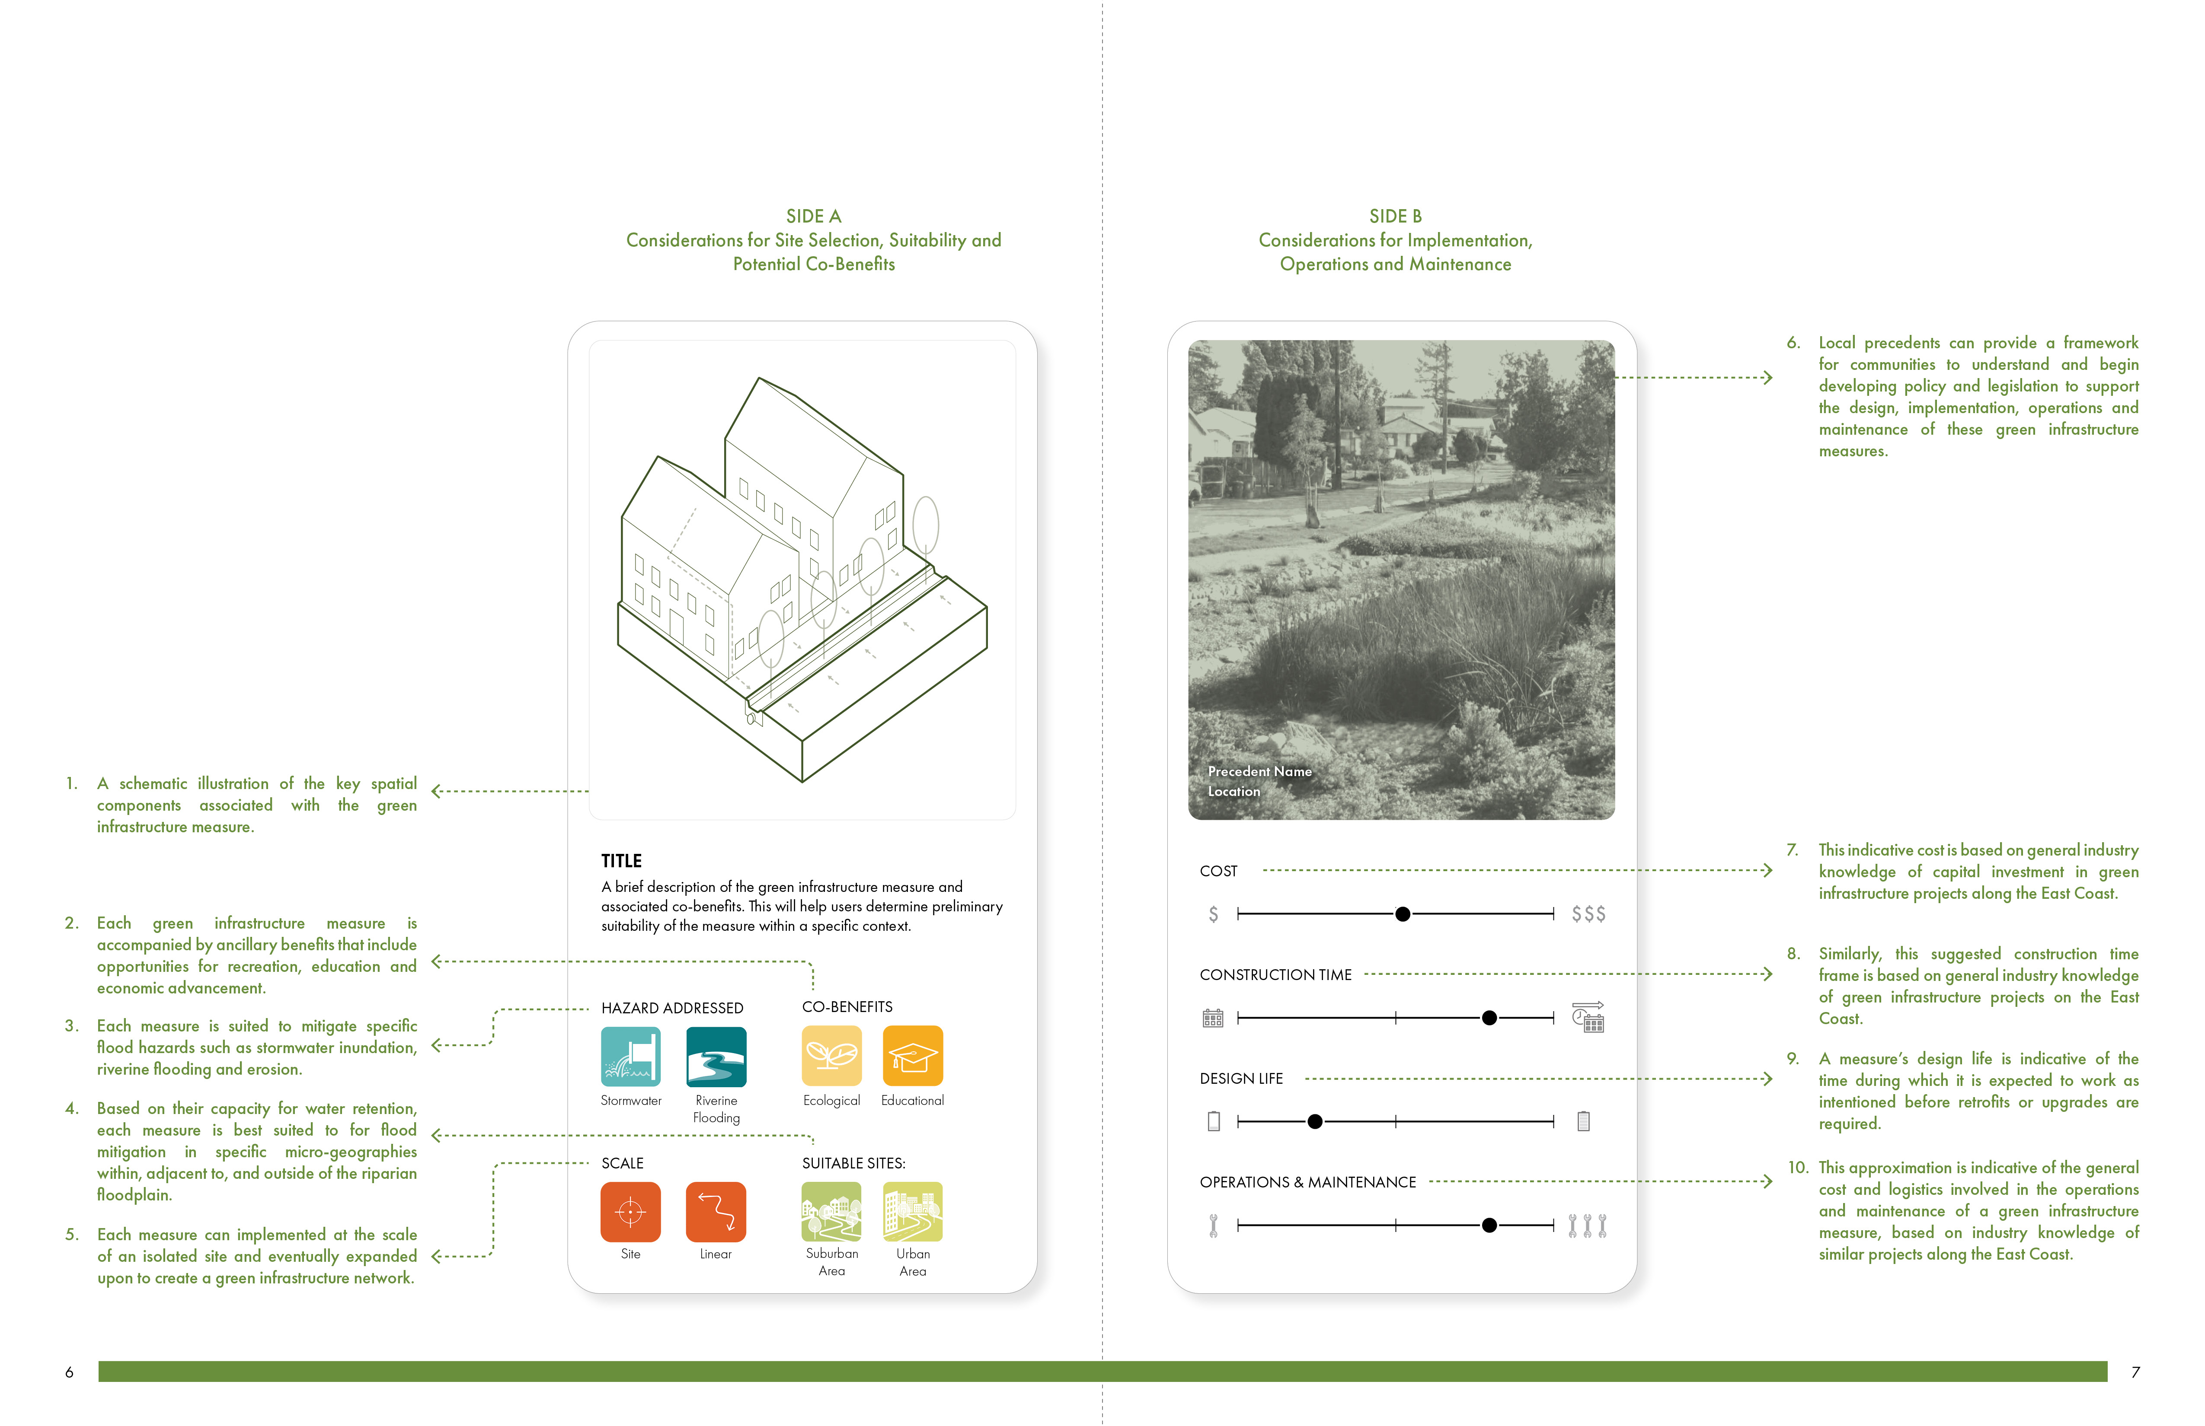
The Green Infrastructure Toolkit

Slide 20
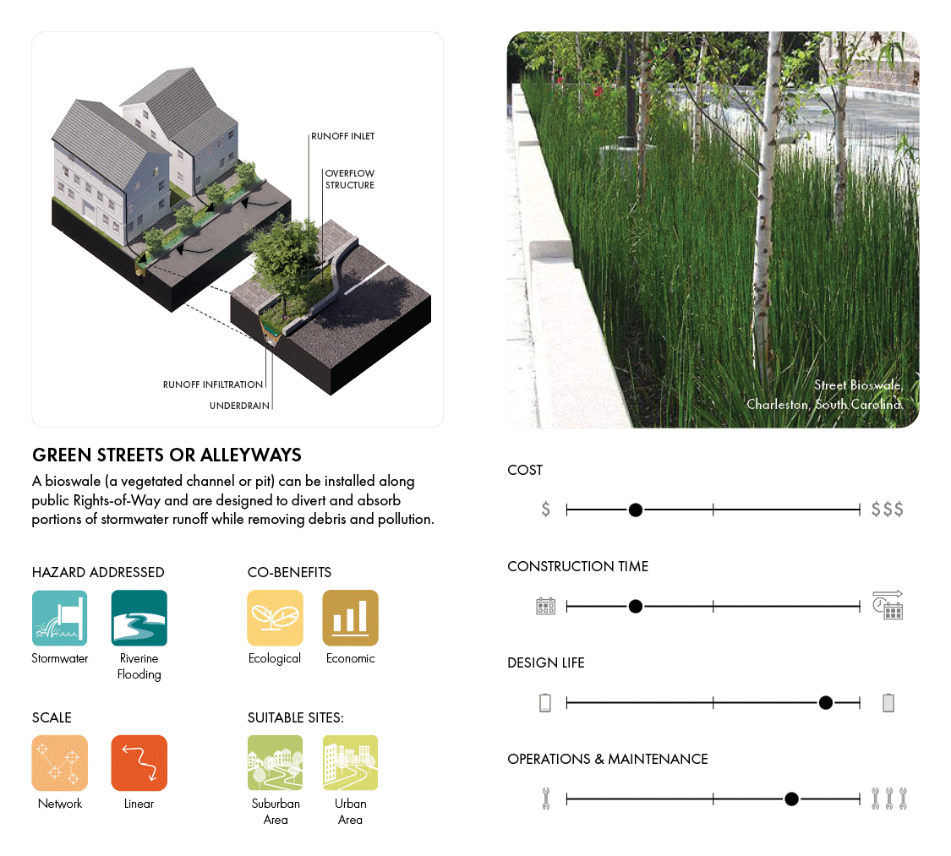
The Green Infrastructure Toolkit

Slide 21
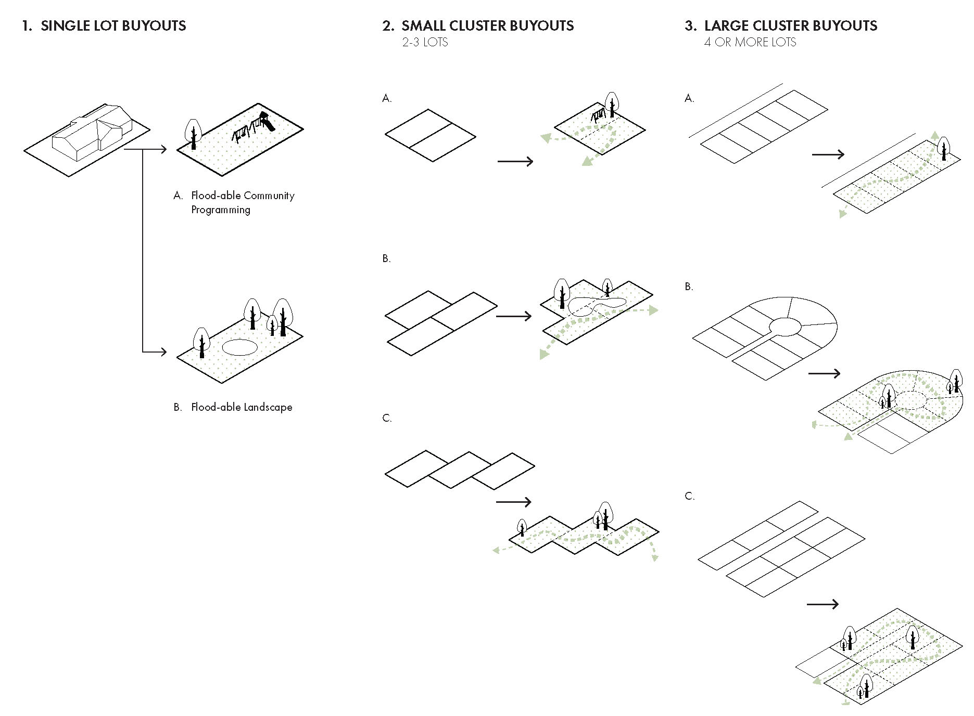
Process and Vision
Green infrastructure features based on community input needs and co-benefits envisioned/ desired
Combination of measures creates a project package that multiplies the effects
Owned and maintained by local government
Public space accessible for all the community
Notes:
The end result of properties that go through this Buyout is that they structures will be safely removed and the will be returned to natural open space.
This open space will be enhanced with flood-reducing natural infrastructure and other features for recreation and public use.
The properties will be owned and maintained by [UGLG] like other public land and it will be accessible to all and protected from future development.
The open space may be enhanced with green infrastructure – which are natural solutions (e.g. rain gardens) that infiltrate, store, or absorb stormwater and reduce flooding.

Slide 22
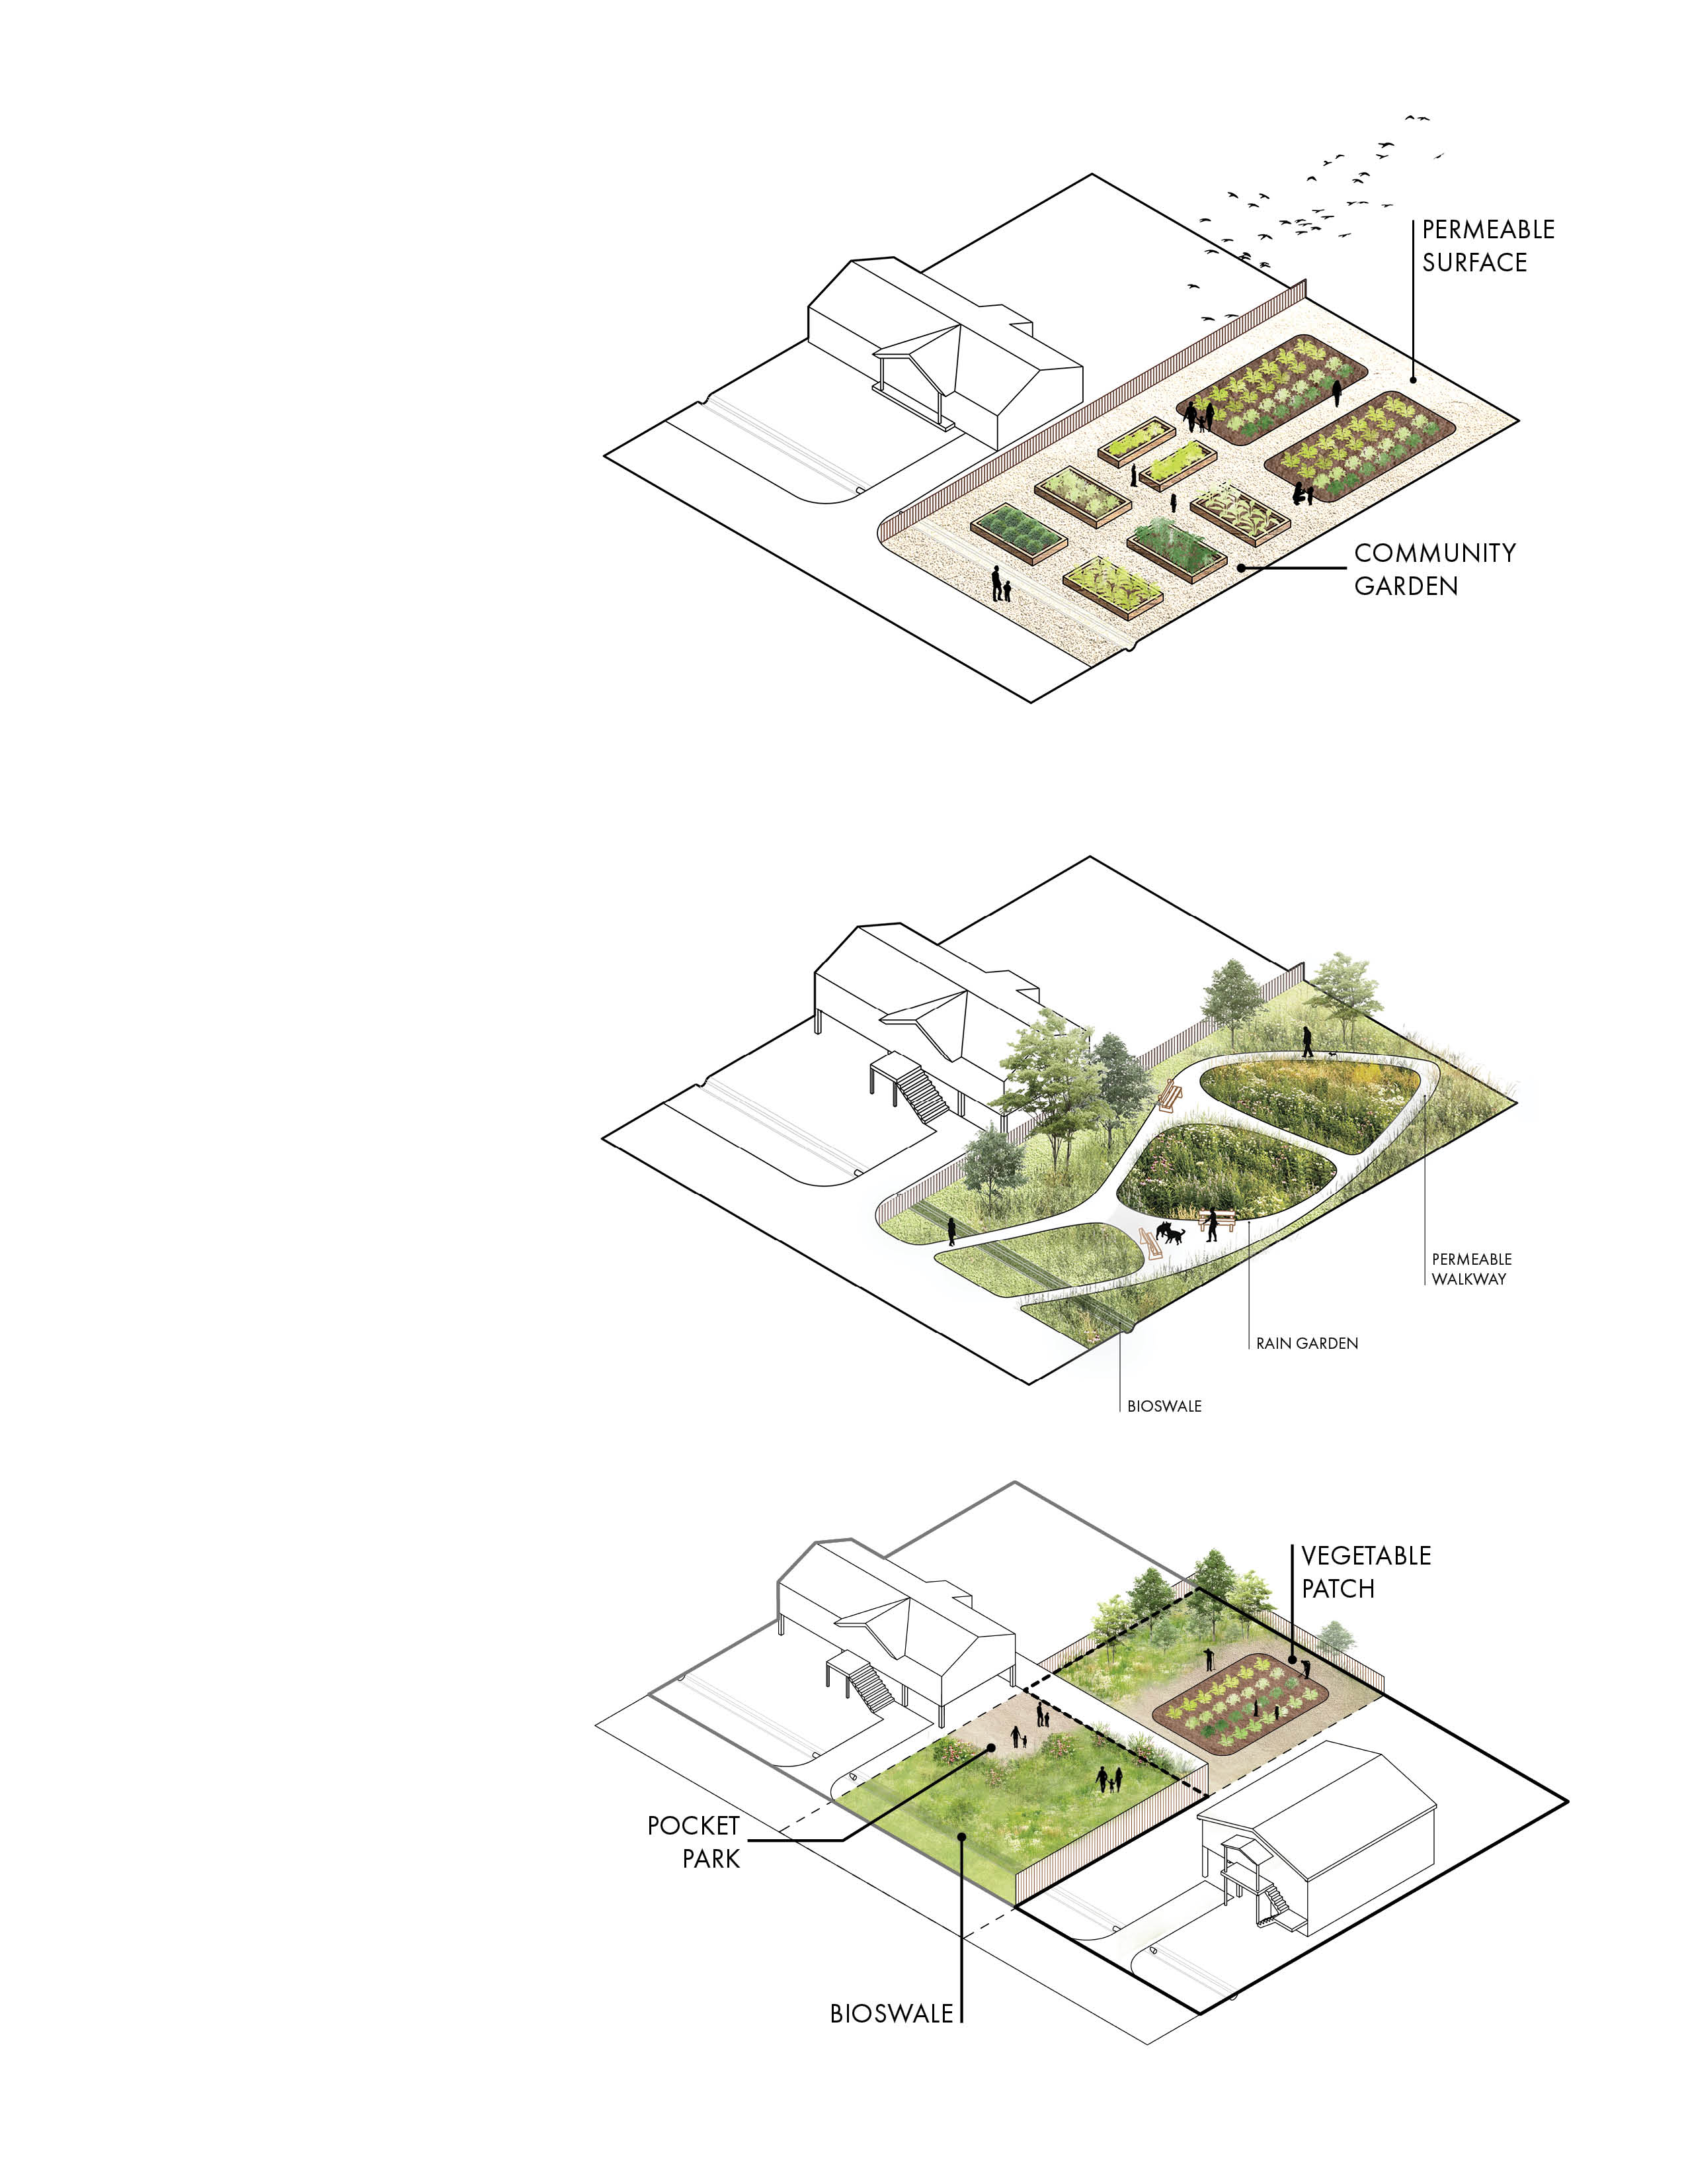
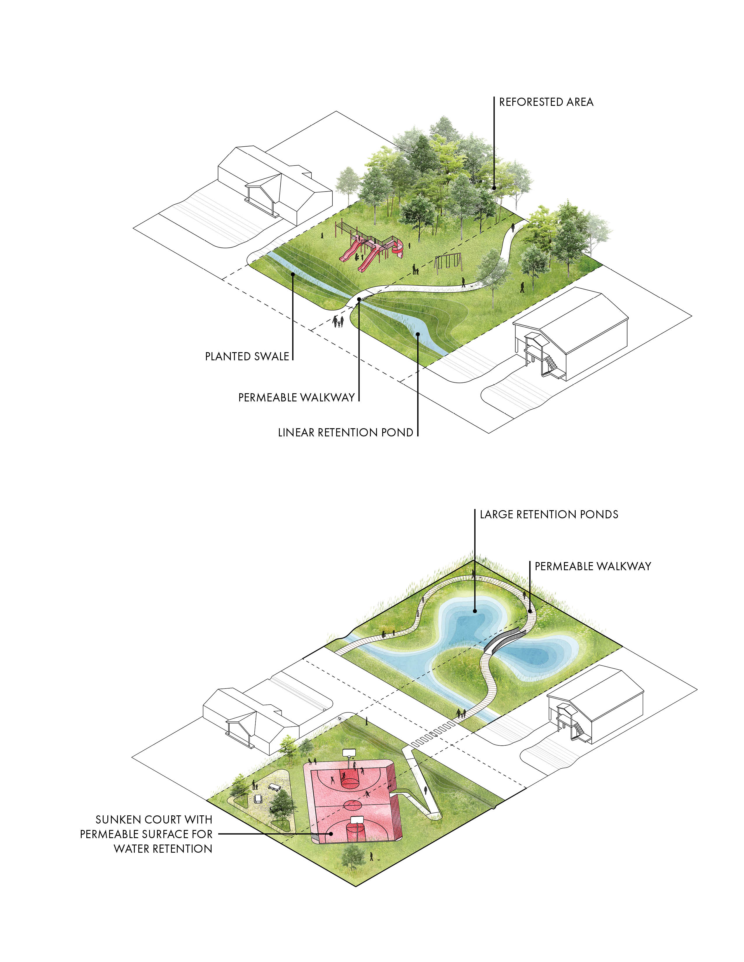
Types of Green Infrastructure
Single Lot Buyout Properties
Multiple Buyout Properties
Notes:
For single-lot properties, the Buyout Program could transform the land into small community spaces such as a dog park, recreation area, or community garden.
The Buyout Program prioritizes grouping several properties together to maximize the flood-reducing benefits of green infrastructure. Opportunities for several-lot buyouts include creating parks, paths, ponds and wetlands, among other features.

Slide 23
How would this process play out?
GROUP ACTIVITY

Slide 24
Choose a Persona
The Willing Homeowner
Reluctant:
Uninterested
Reluctant:
Unable
Absentee
Owner
Landlord
Buyout
Program Manager

Slide 25
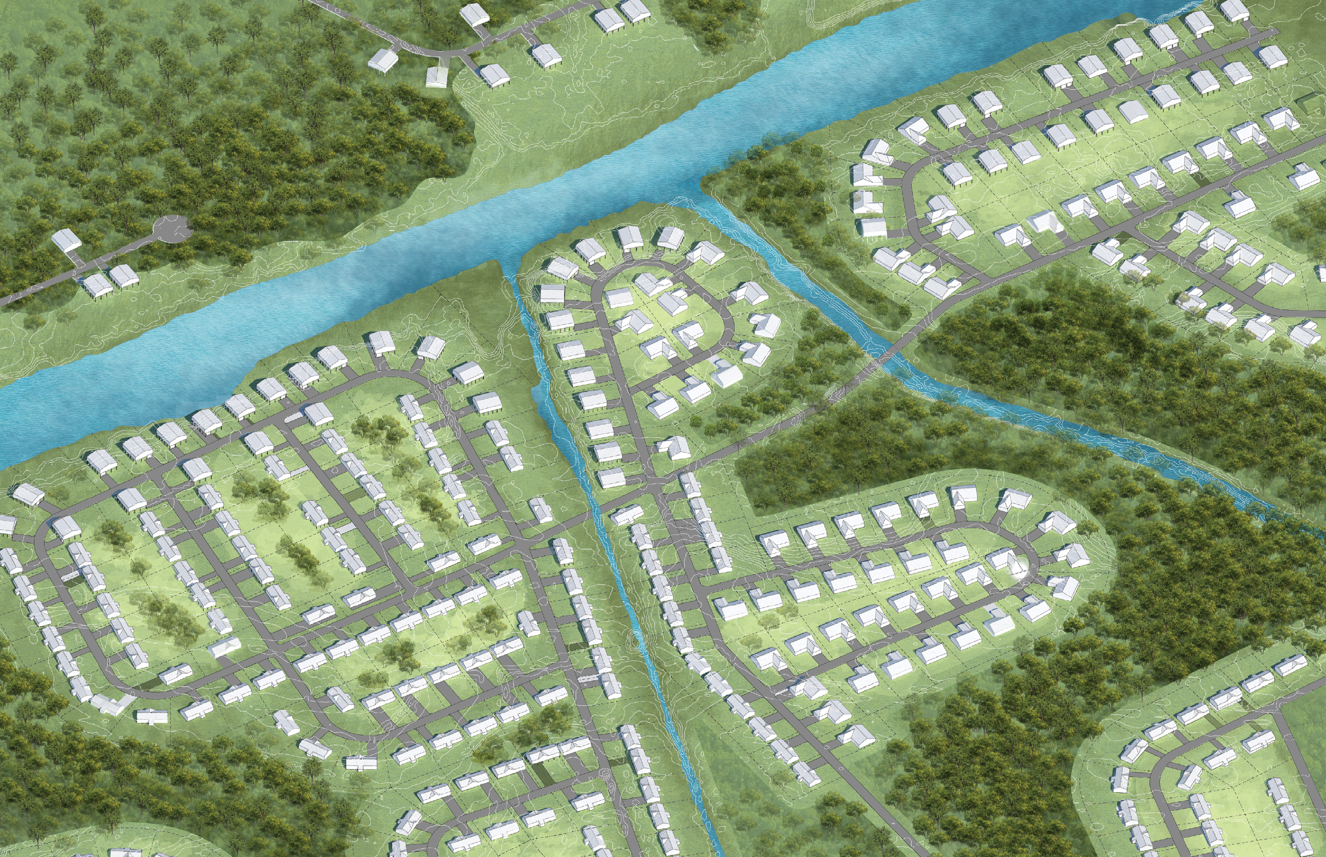
This fictional neighborhood represents an area prone to flooding.

Slide 26
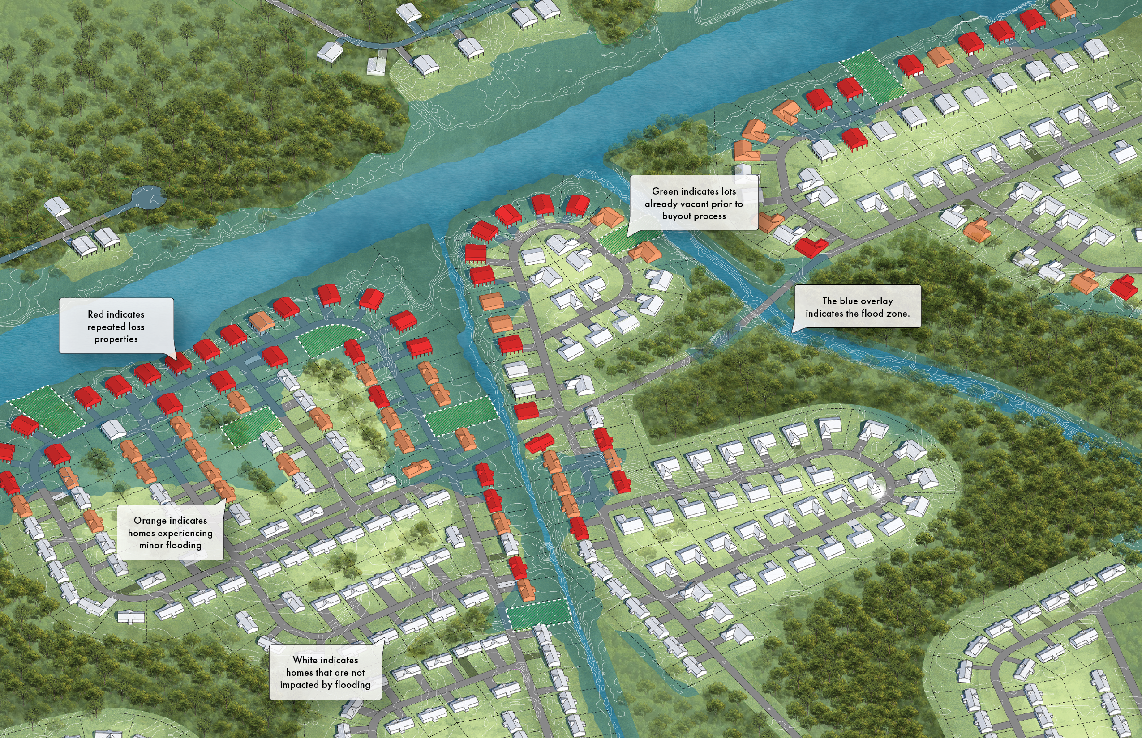
Lots eligible for buyouts have been identified.

Slide 27


What challenges or opportunities will different residents experience?

Slide 28
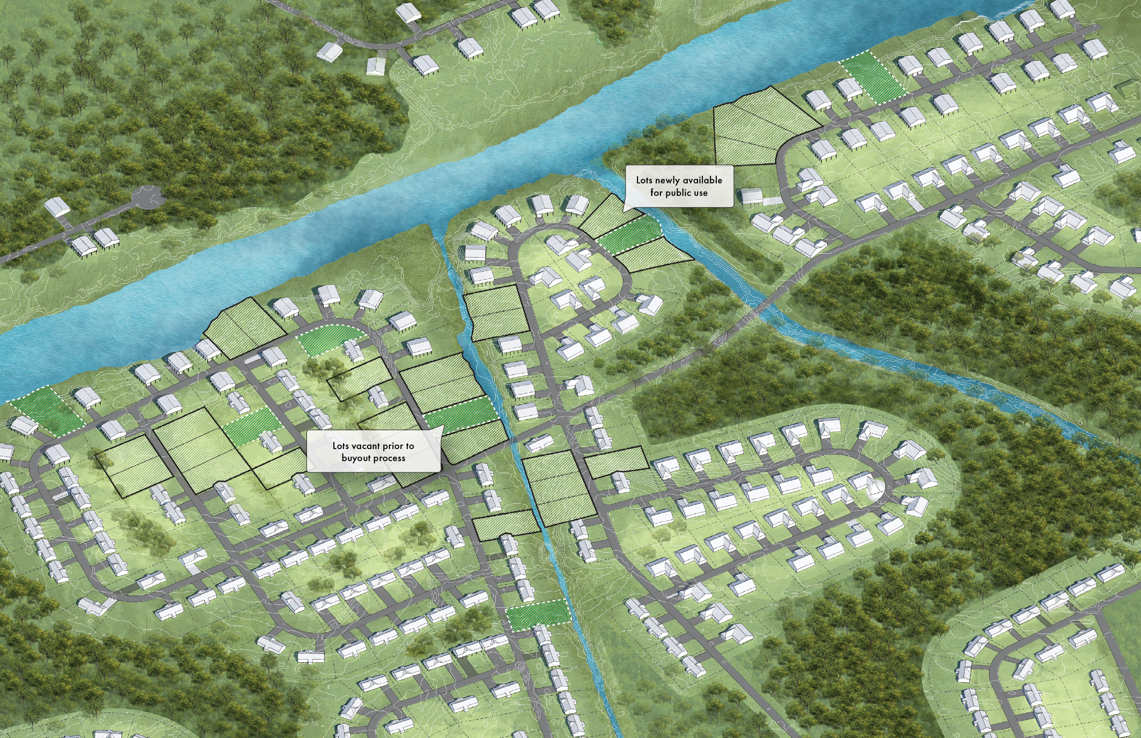
Once properties are purchased, all structures are removed from lots.
Notes:
Talk

Slide 29
What opportunities for green infrastructure now exist?
Notes:
Talk

Slide 30
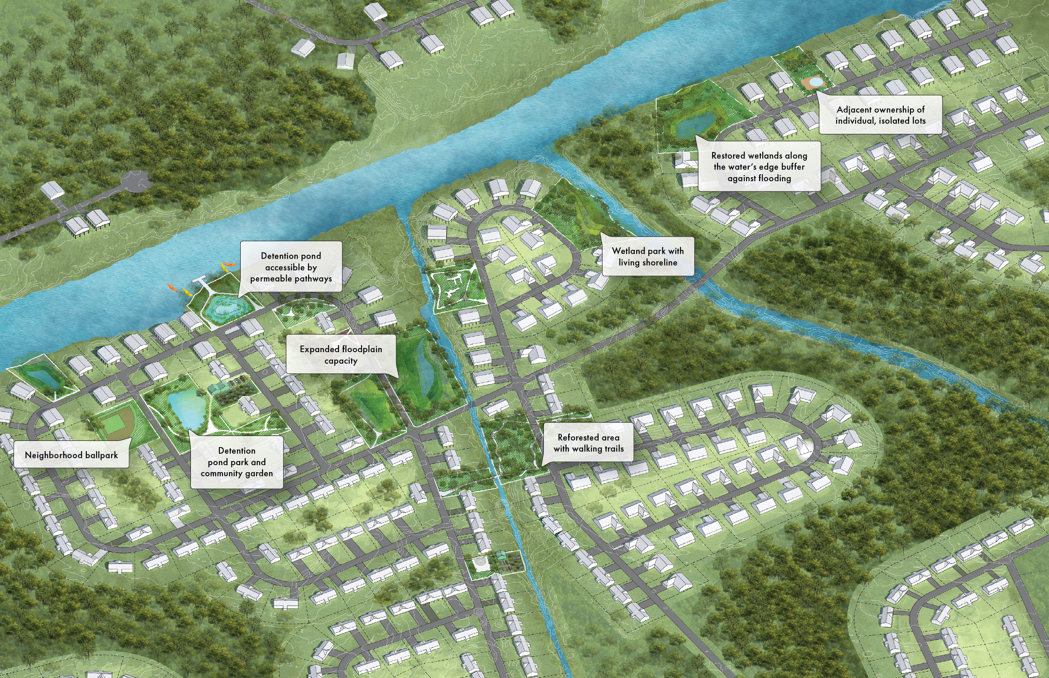
What co-benefits can the community expect?

Slide 31
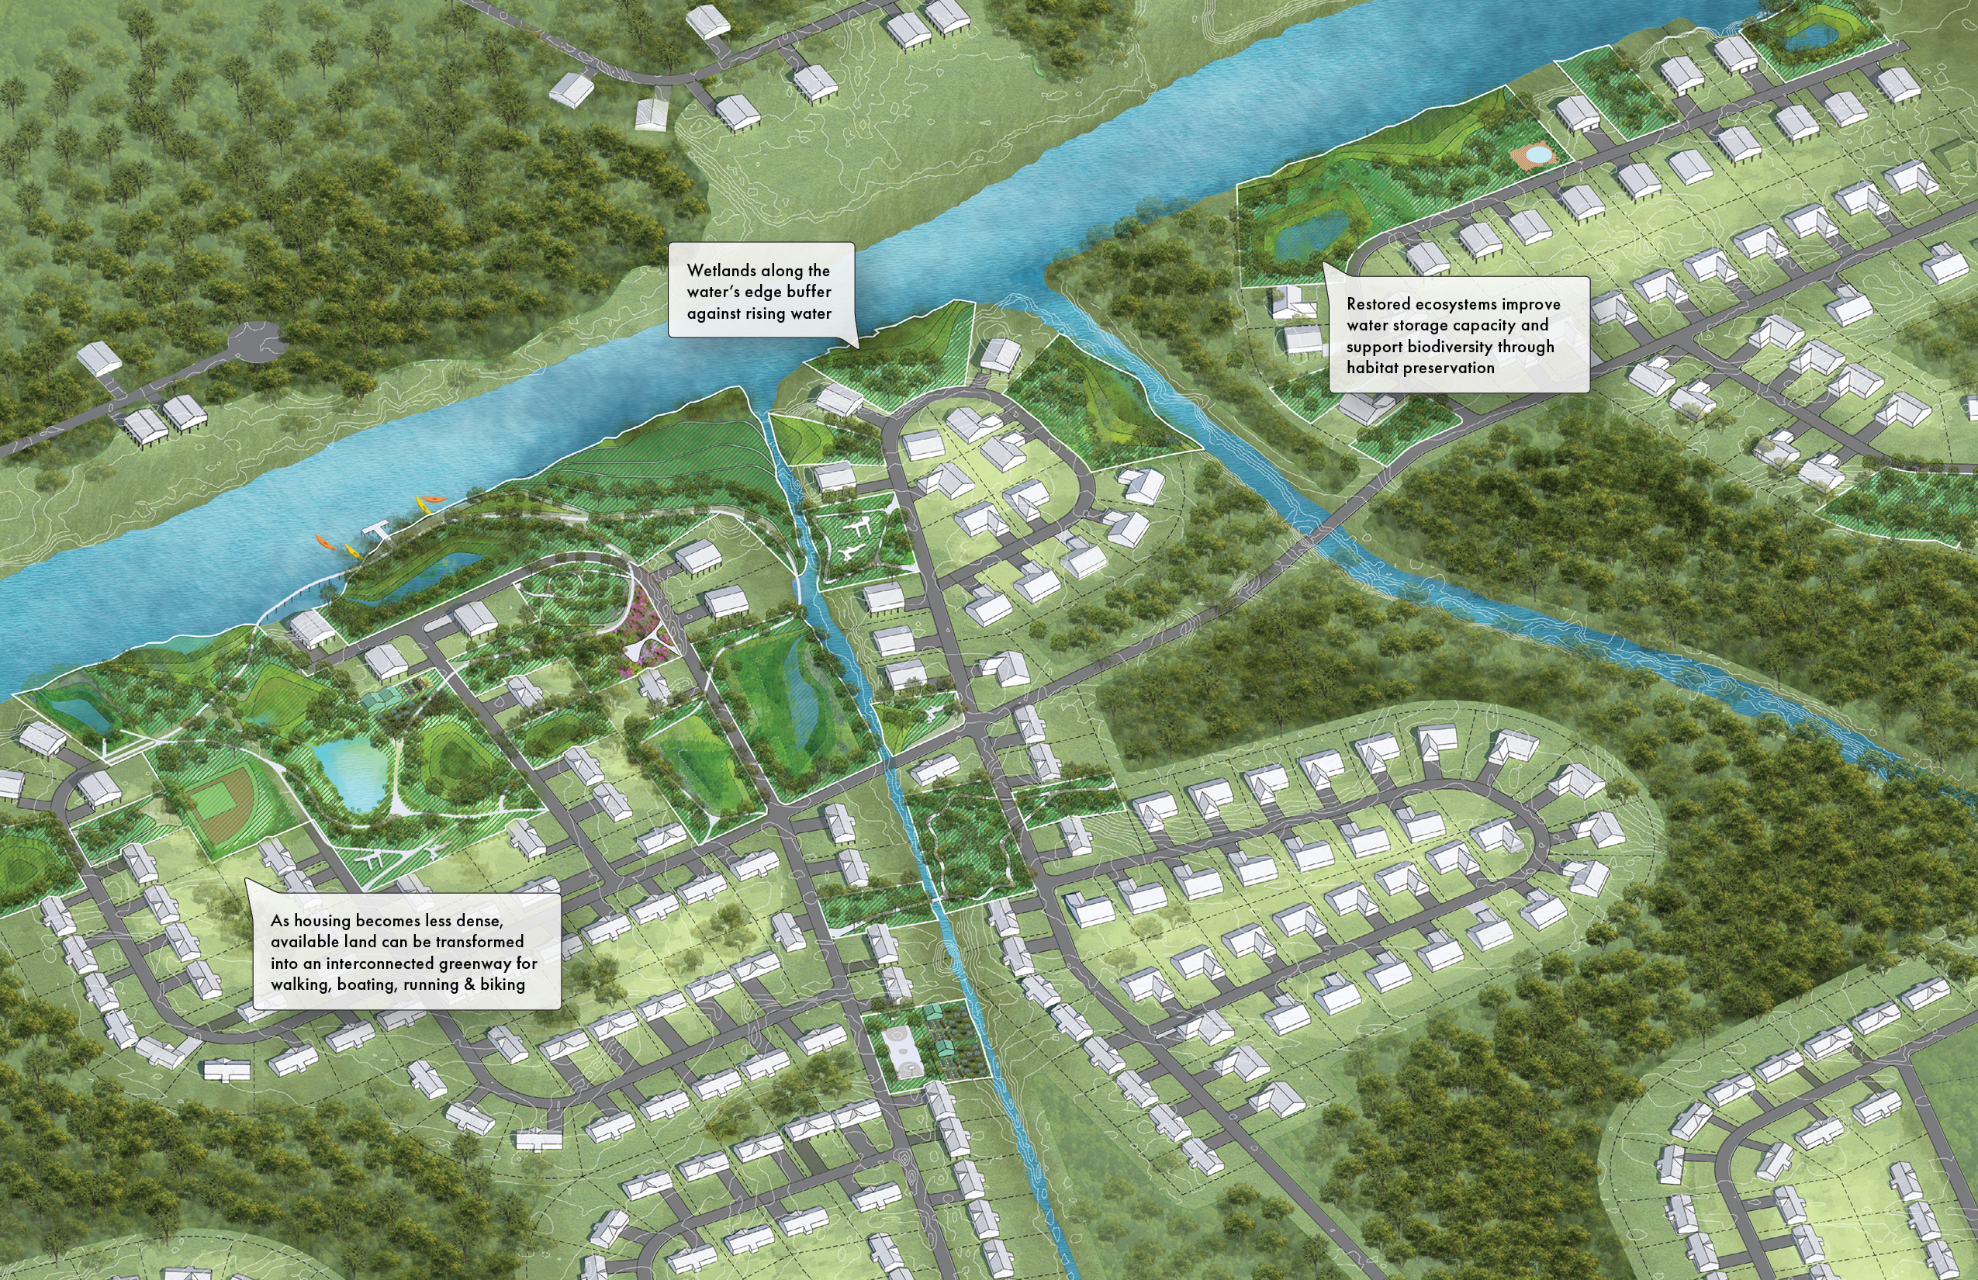
How can buyout properties continue to benefit the community in the long term?

Slide 32

Reflections and Questions

