Slide 1


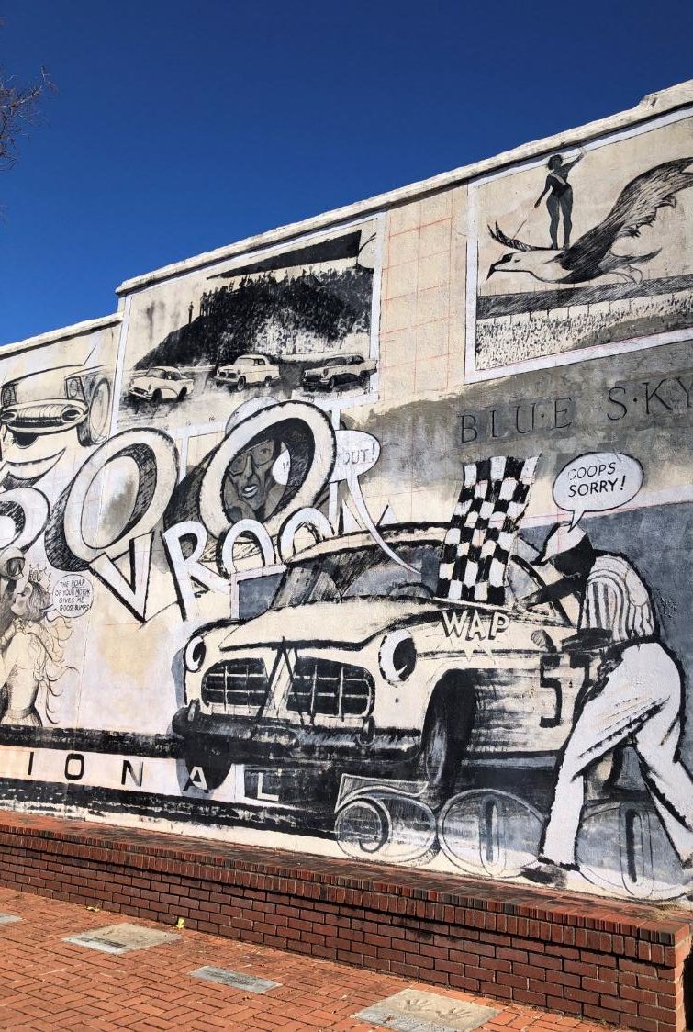
Bill Eubanks, PLA, FASLA, LEED AP
beubanks@urbanedgestudio.net
843-224-8804
Joseph O’Callaghan, PLA, International ASLA
jocallaghan@surculusdesign.com

Slide 2
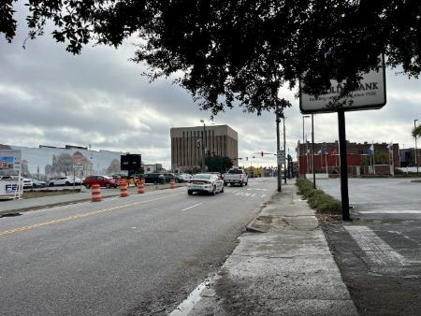
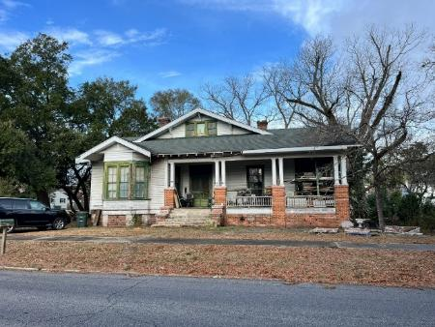
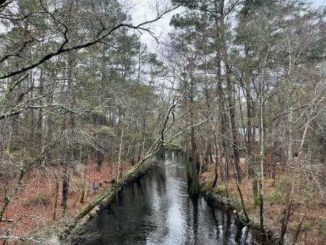
WHAT WE WILL COVER:
DARLINGTON, SC
PUBLIC ENGAGEMENT
DESIGN CHARRETTE
MASTER PLANNING
ZONING ORDINANCE
ZONING MAPS
QUESTIONS | DISCUSSION

Slide 3
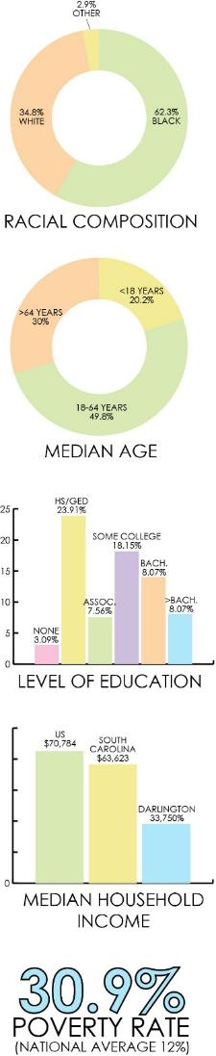
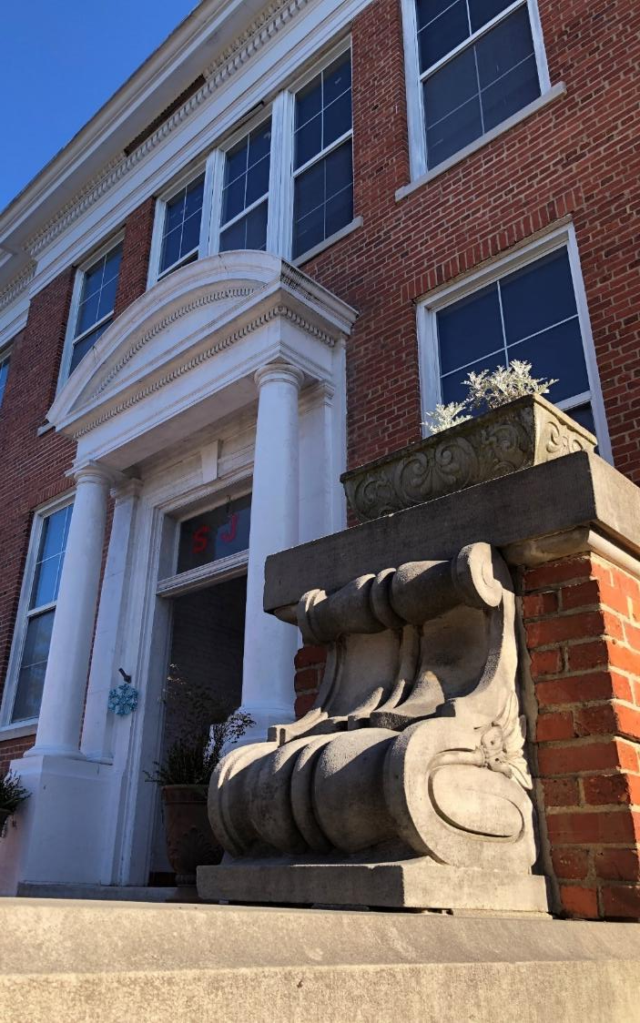
The Renaissance of Darlington is not a small undertaking.
Since 1980, the population of Darlington has been in a continuous decline.
The population in 2020 was 6,133 and in 2024 it is 5,971.
The racial composition of Darlington is about 62.3% Black or African American, 34.8% White, with the balance (about 2.9%) being mixed or other races.
About 30% of the population is 65 or older and about 20.2% are under the age of 18.
About 79.2% of the population completed high school while only about 17.1% completed college.
The median household income is only about $33,750 and about 30.9% of the population live below the poverty line.
There are empty storefronts. There are neighborhoods in decline. There is significant crime. There are hard feelings and a lack of trust in the community.
Yet the City has “good bones” and is filled with wonderful people who care about their community.

Slide 4
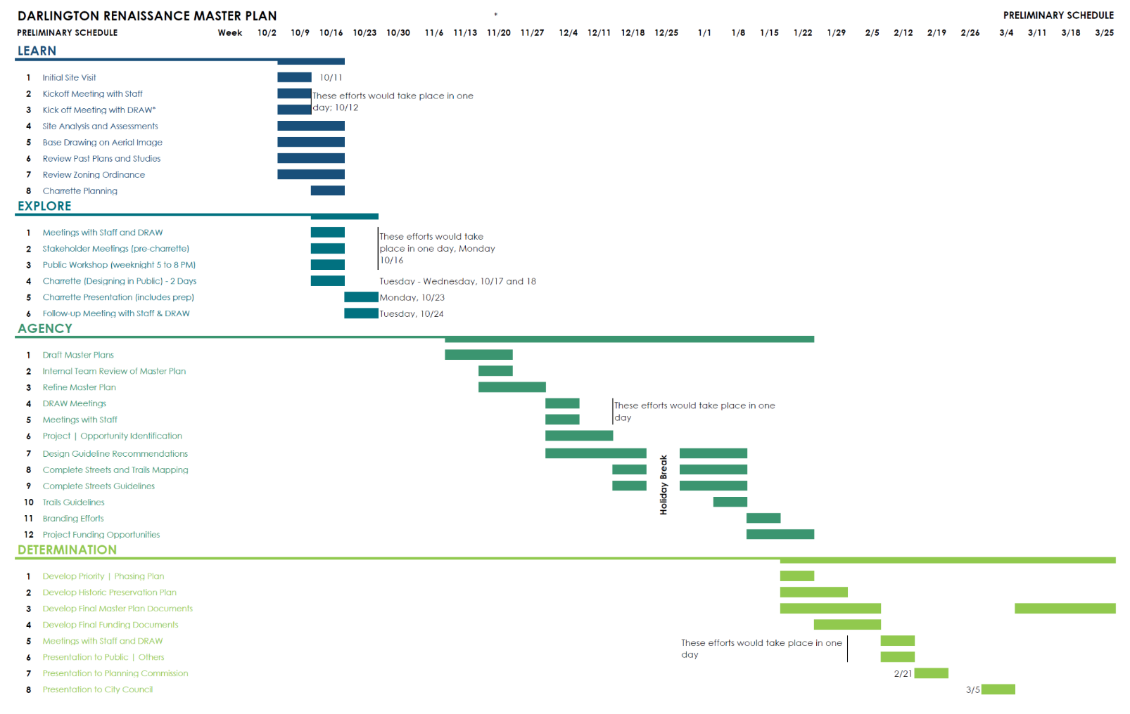

Slide 5
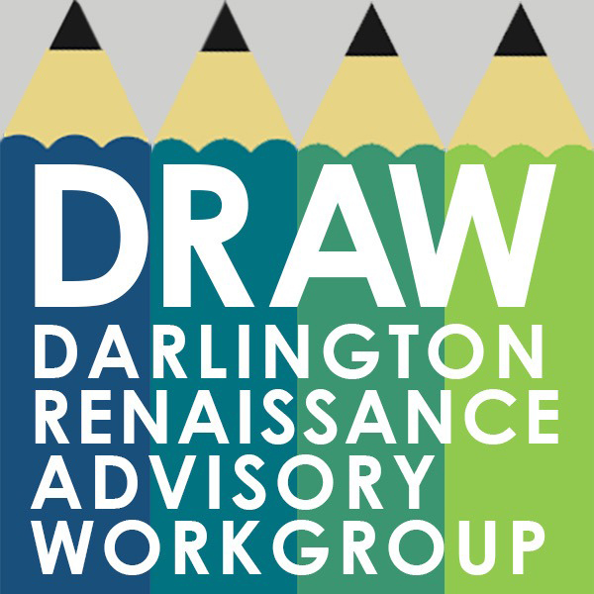
Darlington Renaissance Advisory Workgroup
James Cooper
Angie Godbold
Lou Kirchen
Jannie Lathan
Howard Nettles
Kye Owens
Patsy Sawyer
T.C. Sawyer
Julie Scott
Justin Wallace
Ronnie Ward
Rujon Williams

Slide 6
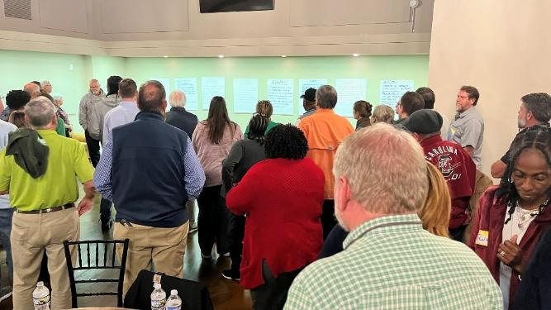
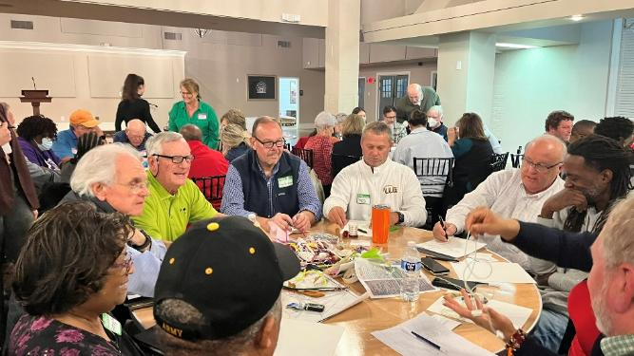
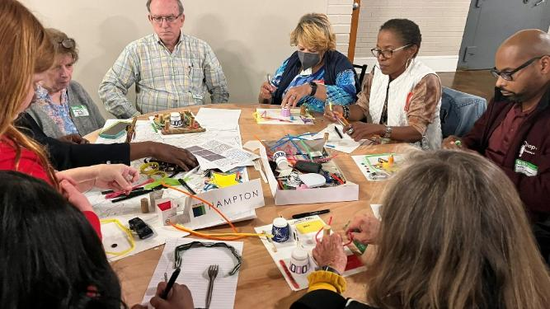
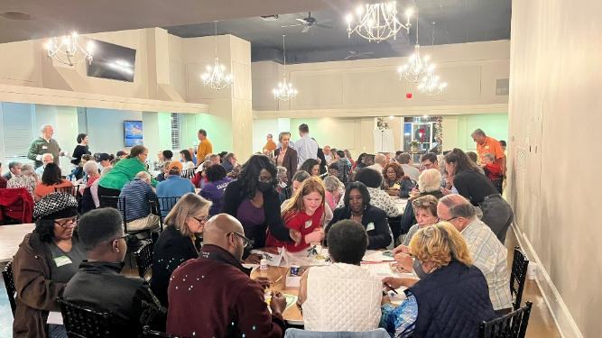
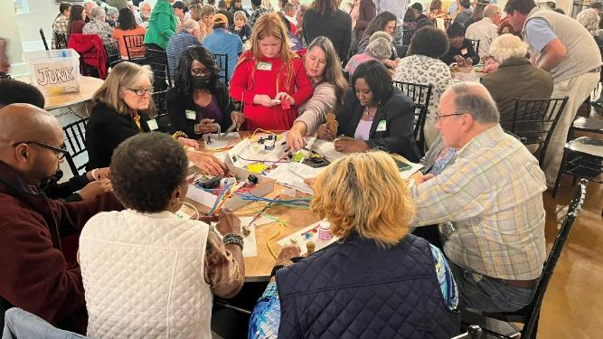
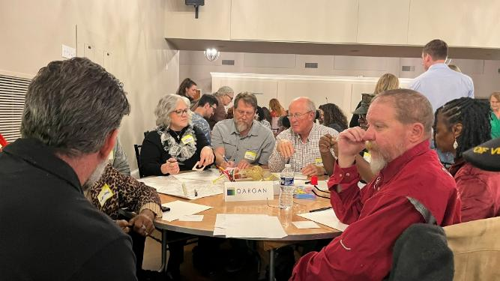
THE PUBLIC
WORKSHOP

Slide 7
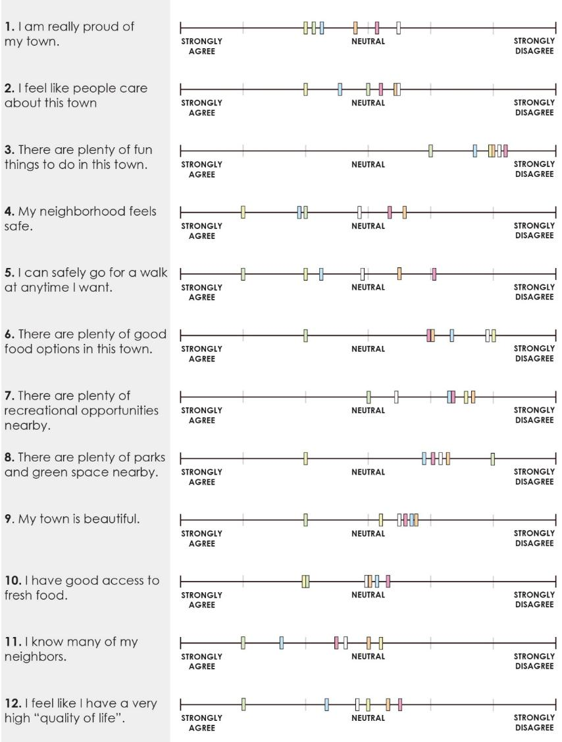
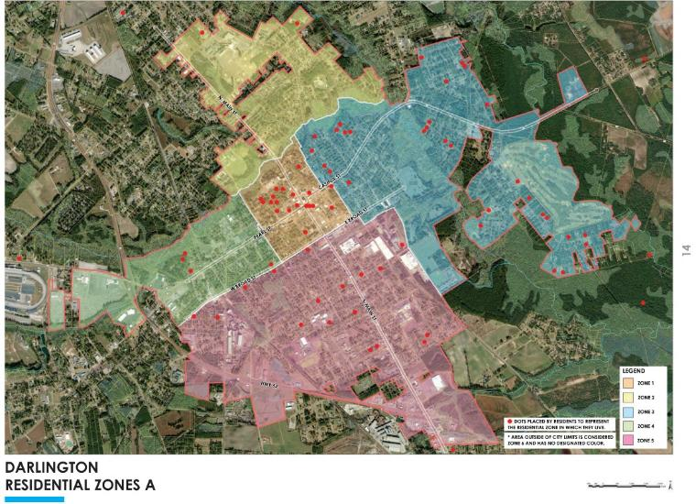
THE PUBLIC
WORKSHOP

Slide 8
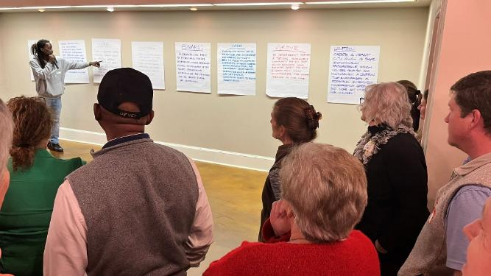
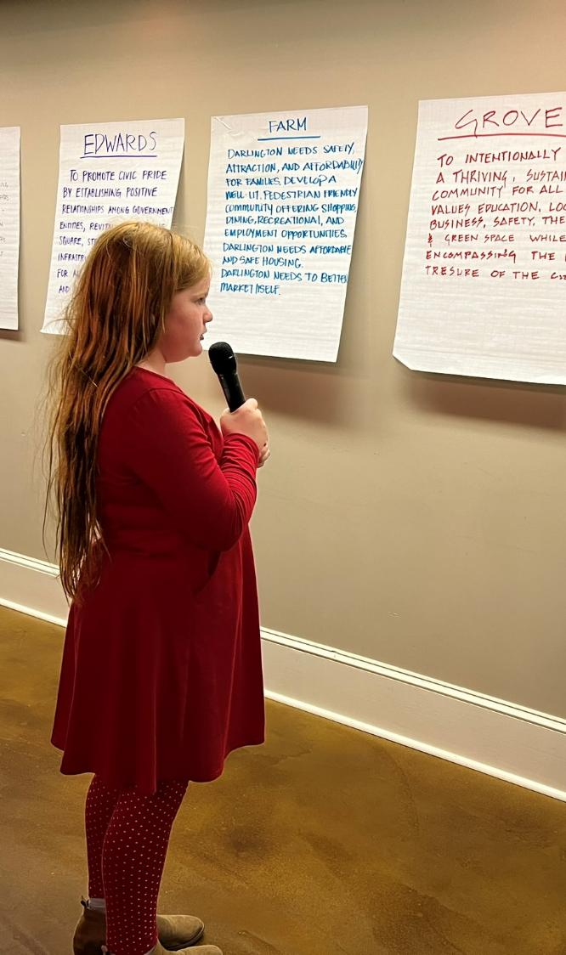
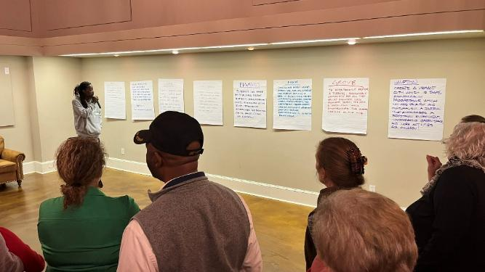
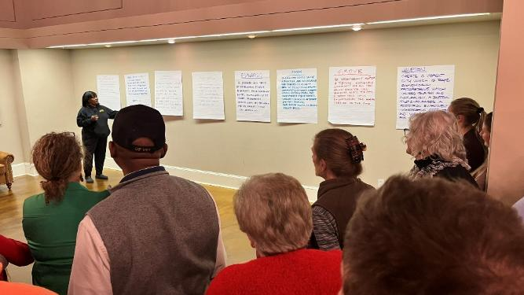
THE PUBLIC
WORKSHOP

Slide 9
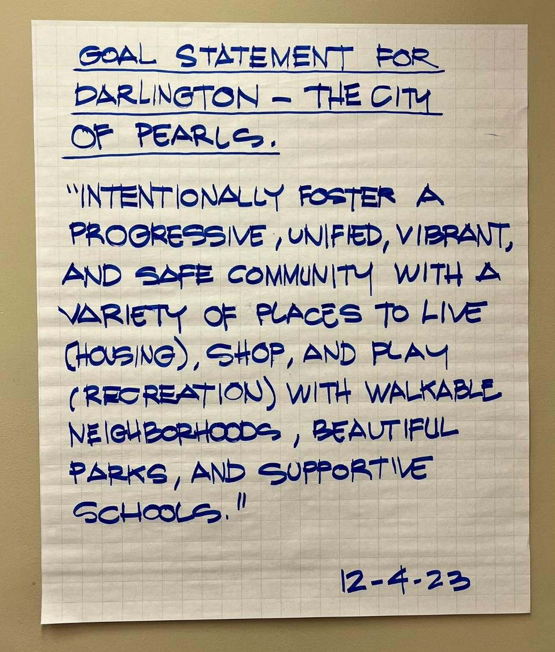
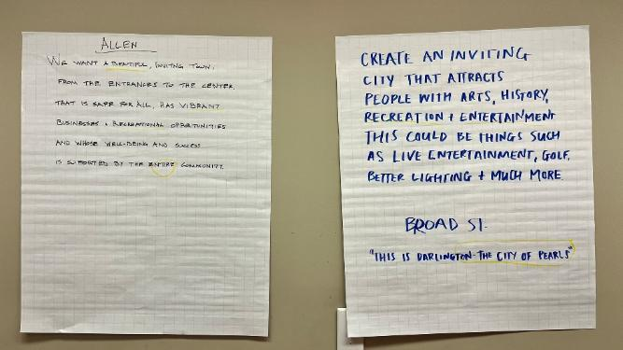
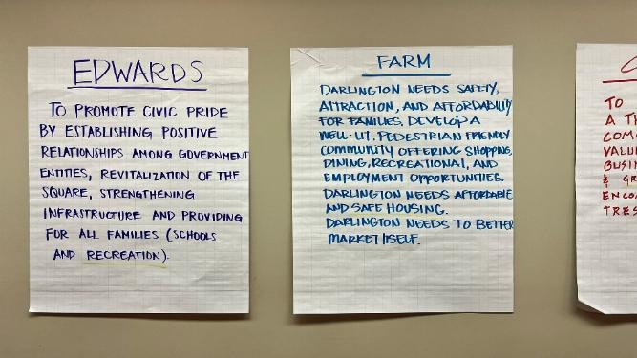
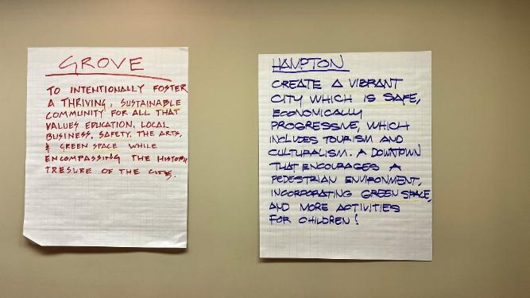

Slide 10
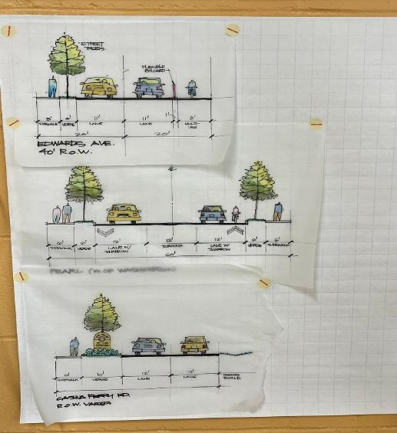
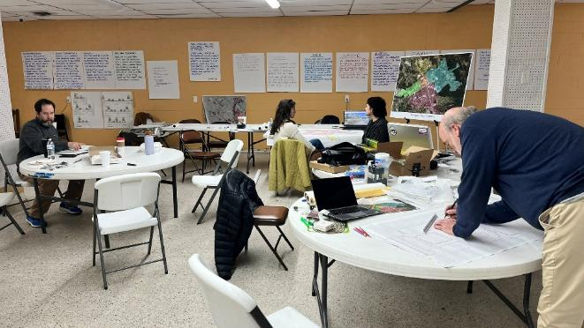
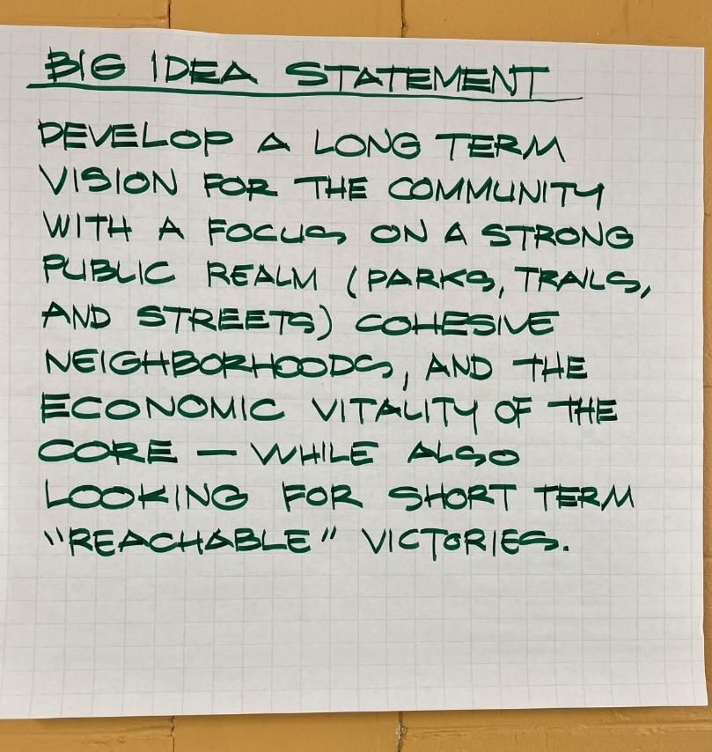
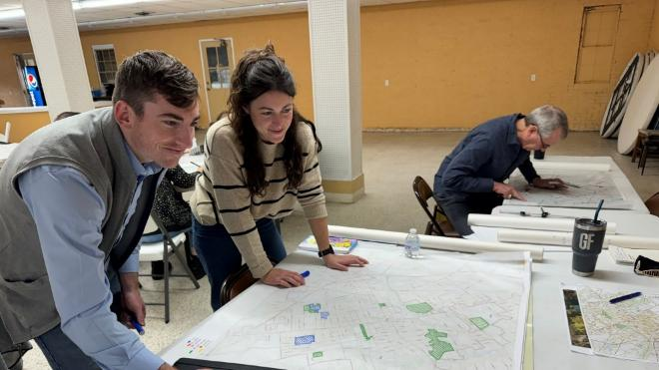
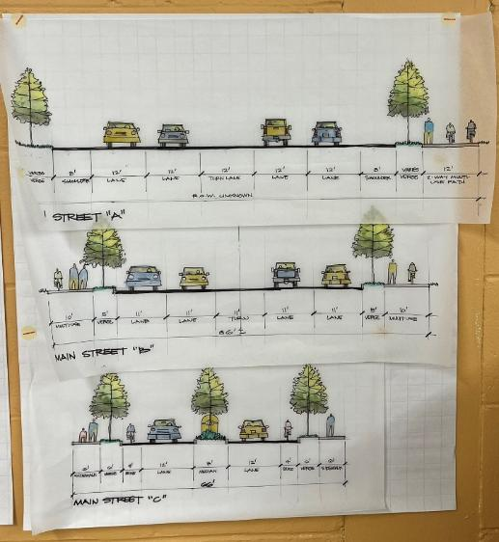
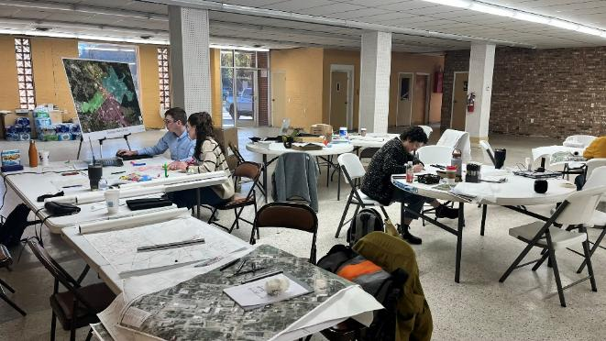
THE DESIGN CHARRETTE

Slide 11
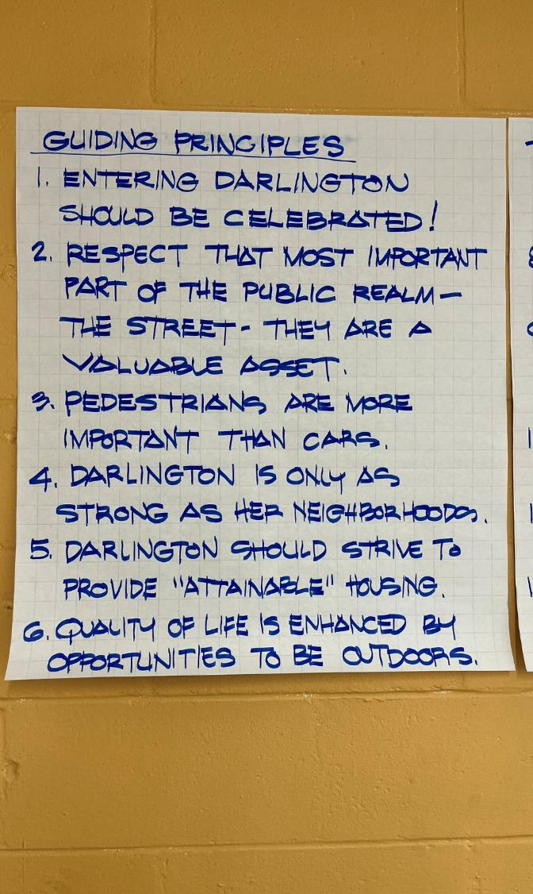
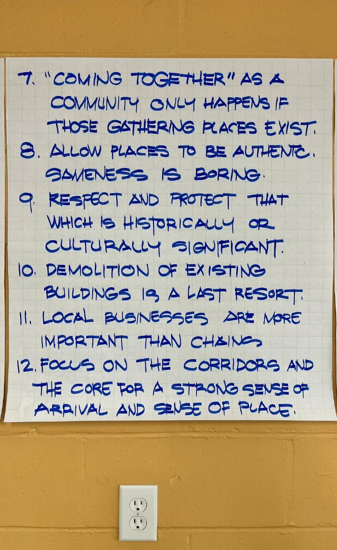
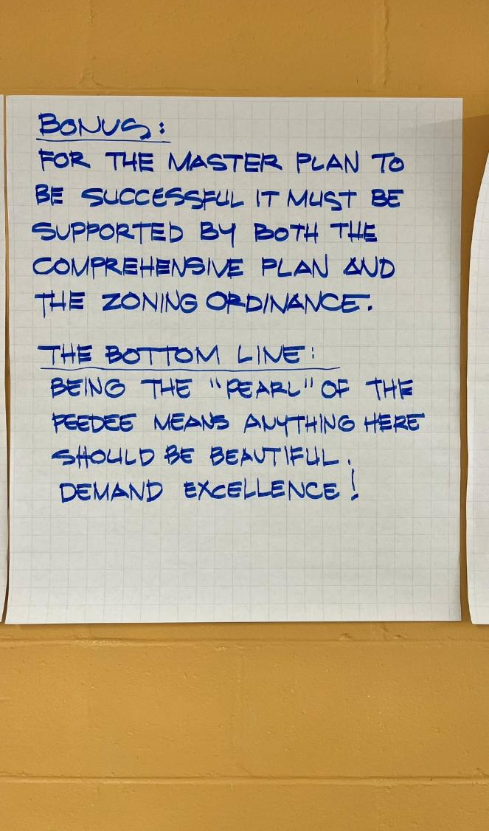

Slide 12
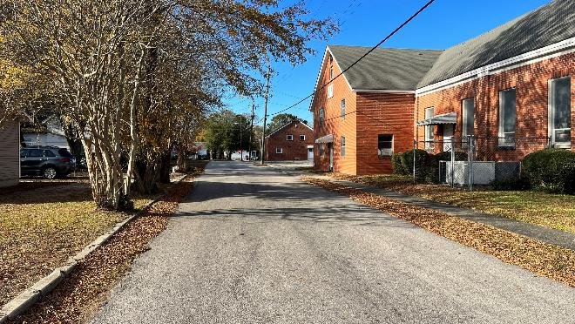
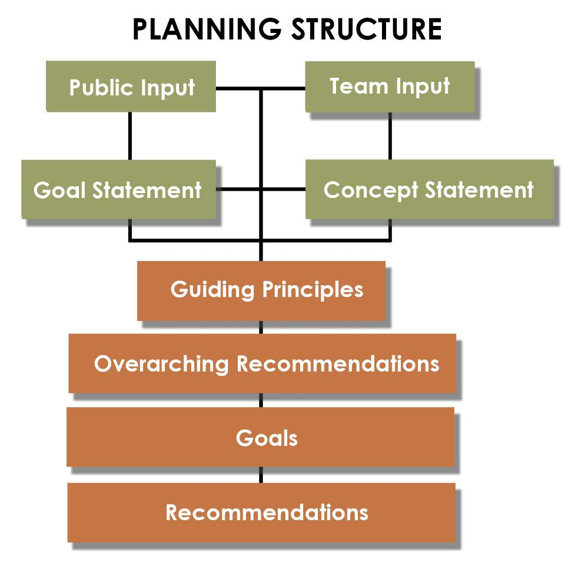
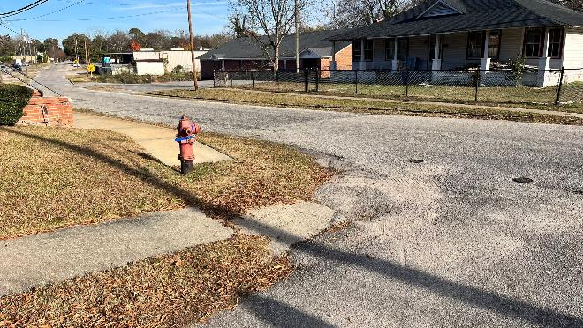
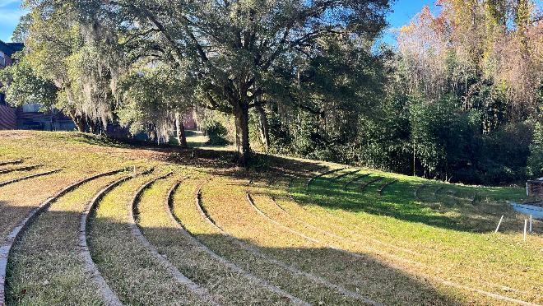

Slide 13
GUIDING PRINCIPLES
1. Entering Darlington Should Be Celebrated!
2. Respect That Most Important Part of the Public Realm – The Street.
3. Pedestrians Are More Important Than Cars.
4. Darlington Is Only As Strong As Her Neighborhoods.
5. Darlington Should Strive to Provide “Attainable” Housing.
6. Quality of Life Is Enhanced by Opportunities to Be Outdoors.
7. “Coming Together” As A Community Only Happens If Those Gathering Place Exist.
8. Allow Places To Be Authentic. Sameness Is Boring.
9. Respect and Protect That Which Is Historically or Culturally Significant.
10. Preservation is essential. Demolition of Existing Buildings Is a Last Resort.
11. Local Businesses Are More Important Than Chains.
12. Focus On the Corridors and The Core for a Strong Sense of Arrival and Sense of Place.

Slide 14
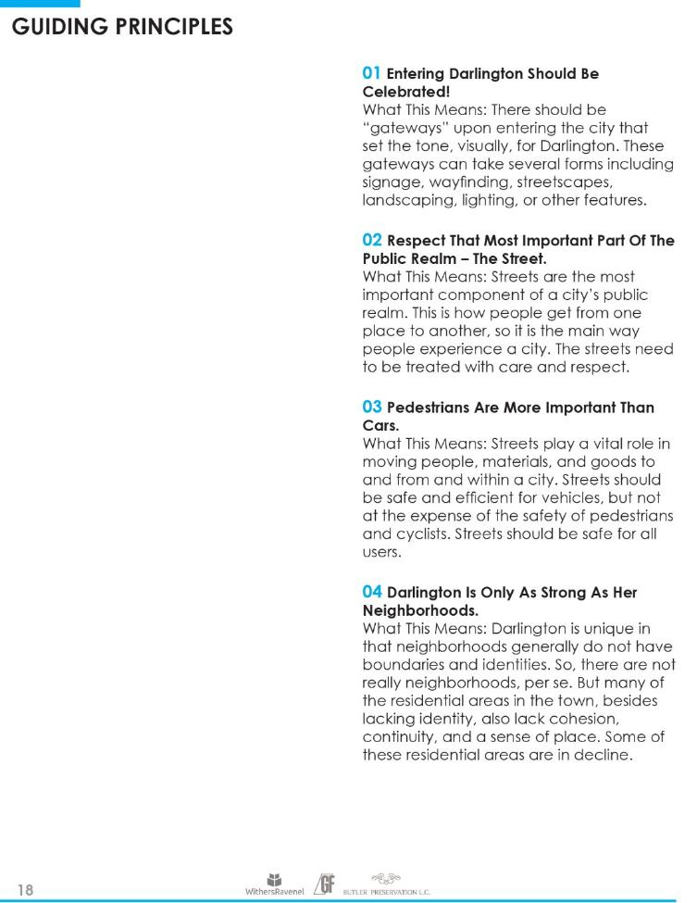
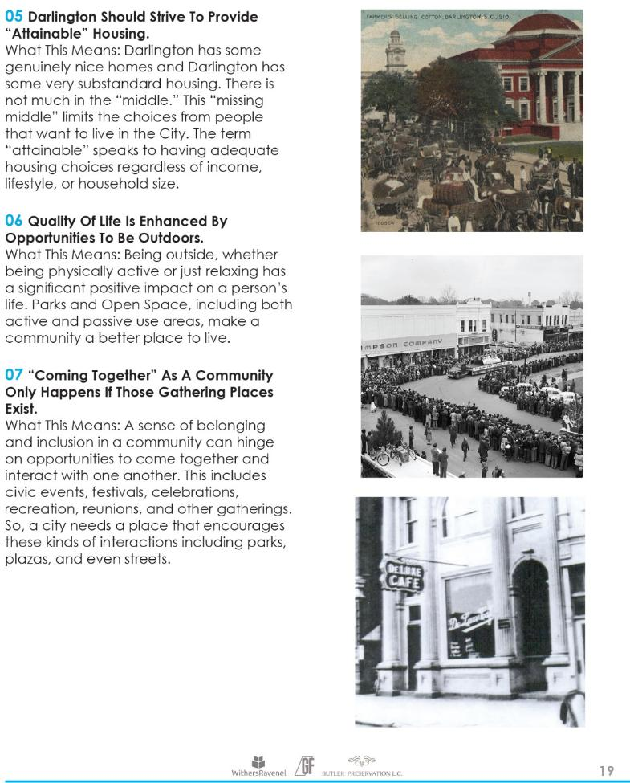

Slide 15
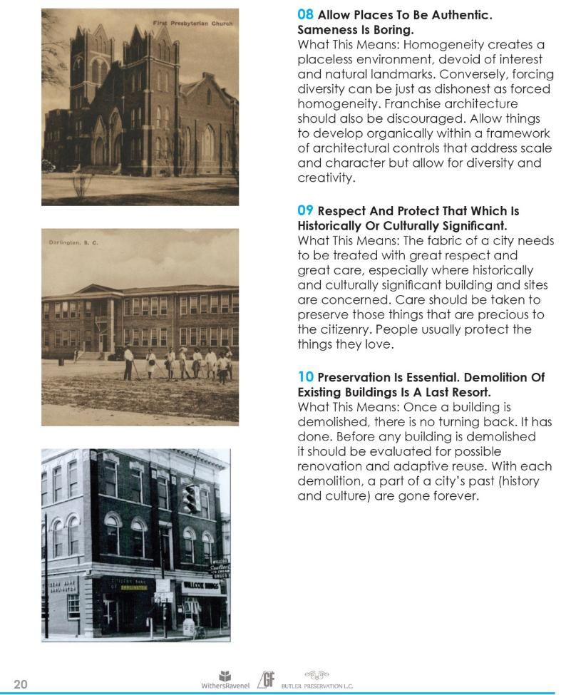
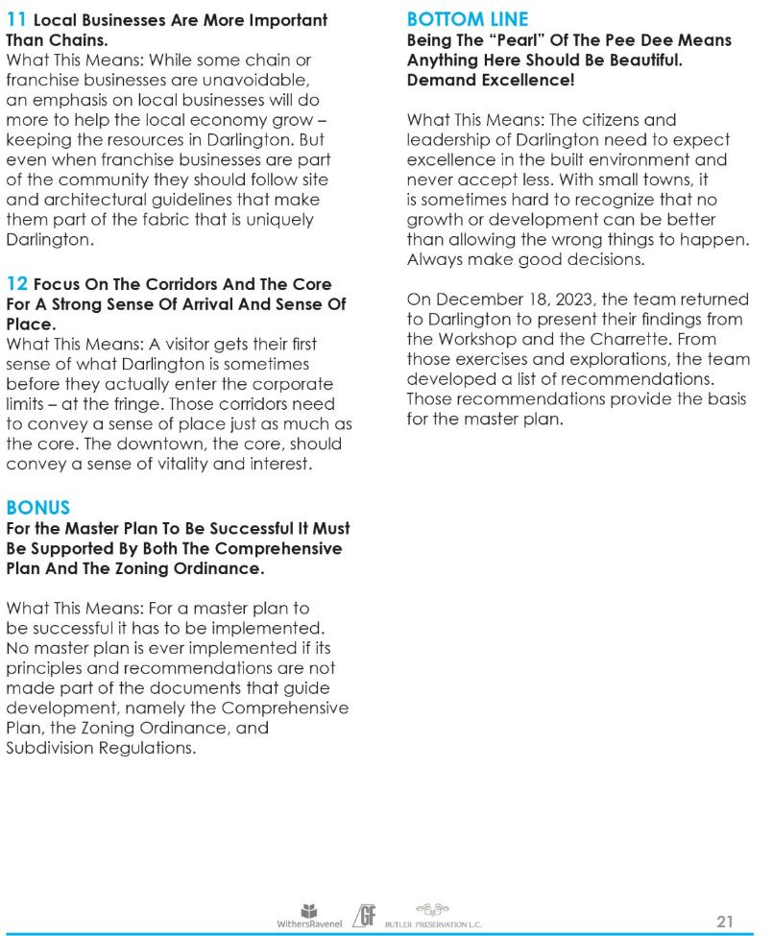

Slide 16
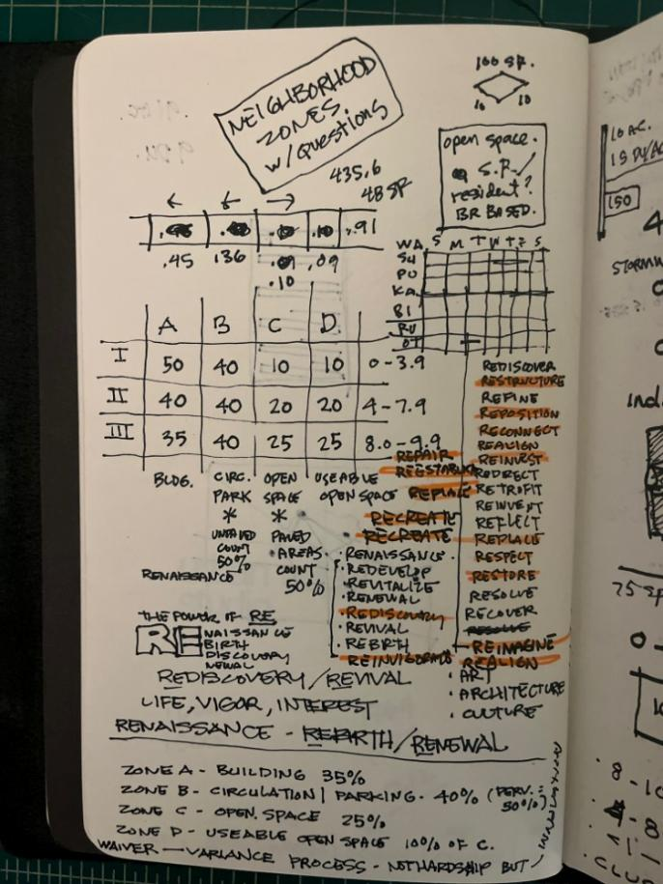
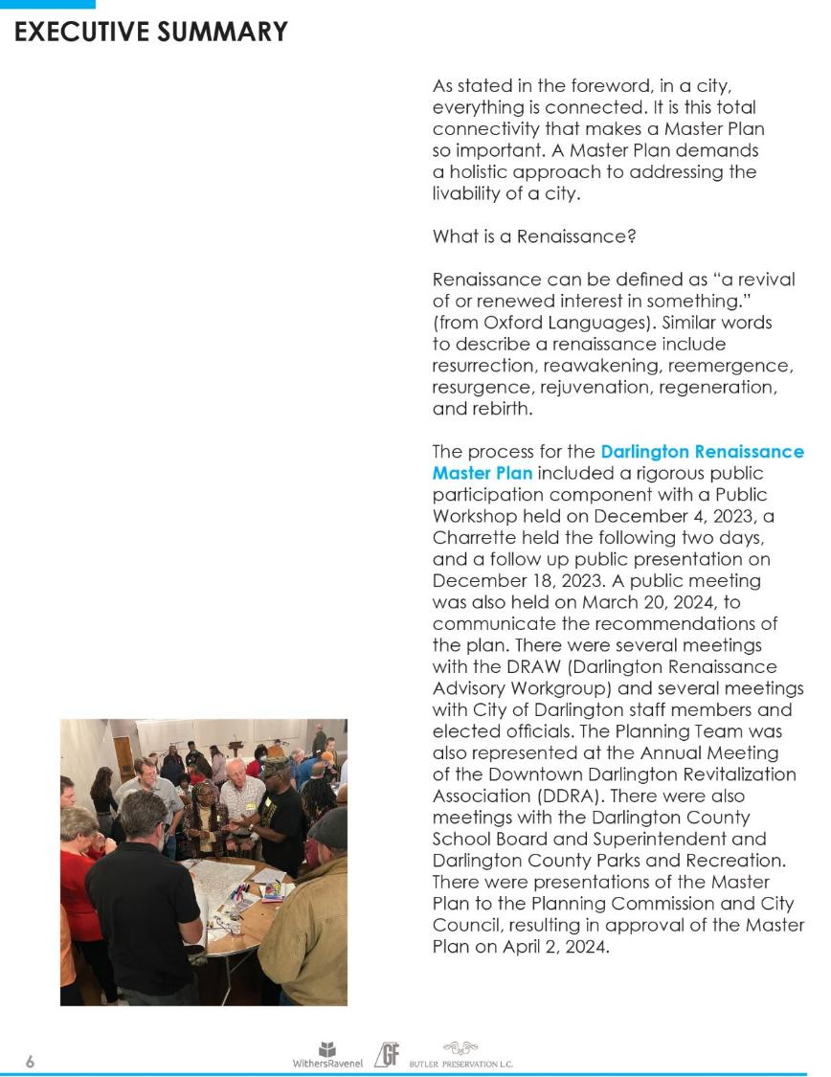

Slide 17
OVERARCHING RECOMMENDATIONS
Reimagine and Restore | Enhance Identity & Sense of Place
Respect and Reestablish | Enhance the Core as Center of the City
Refine and Redirect | Develop Design Guidelines to Protect Community Character
Reconnect and Realign | Make Darlington more Pedestrian & Bicycle Friendly
Recreate and Re-Create | Enhance & Create Community Gathering Spaces
Retrofit and Revitalize | Protect Historic Structures & Neighborhoods
Reinvigorate and Replace | Strengthen & Revitalize Neighborhoods
Reposition and Restructure | Address Growth & Redevelopment Opportunities
Rediscover and Redefine | Develop a Campaign to Promote a New Community Brand
Repair and Reinvest | Address Infrastructure Needs

Slide 18
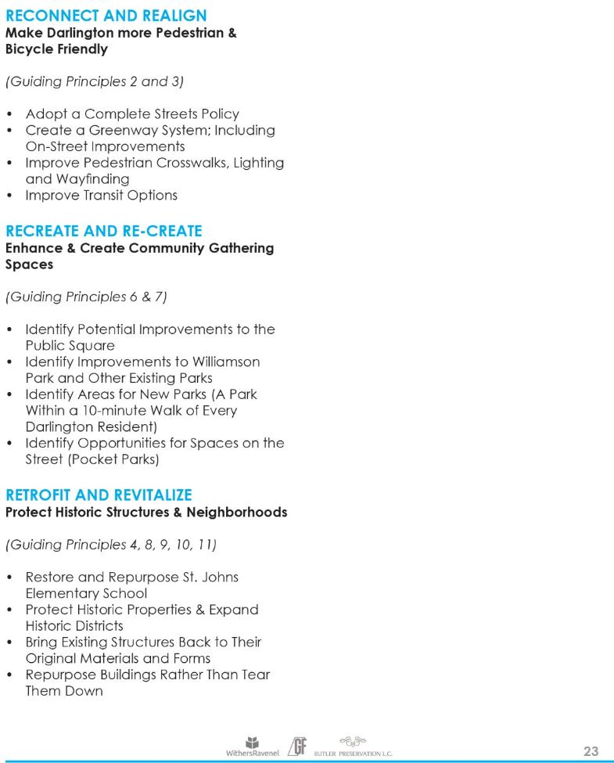
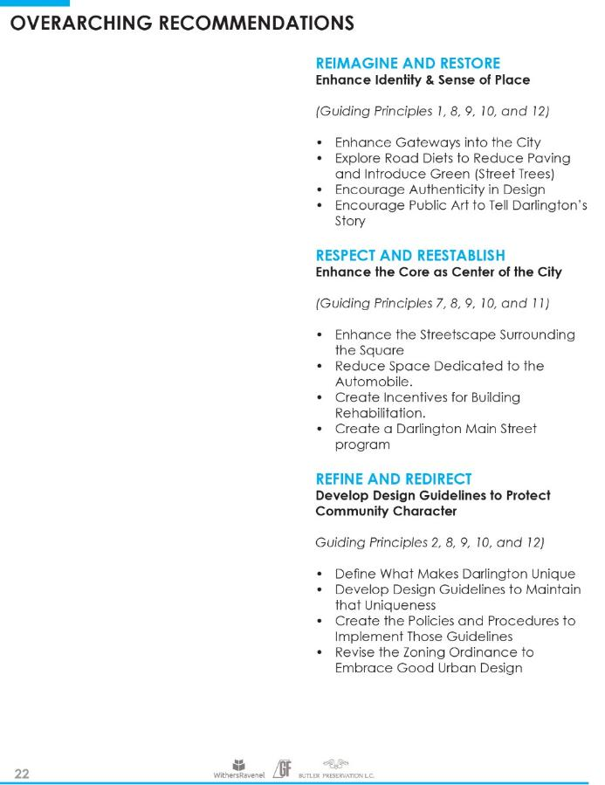

Slide 19
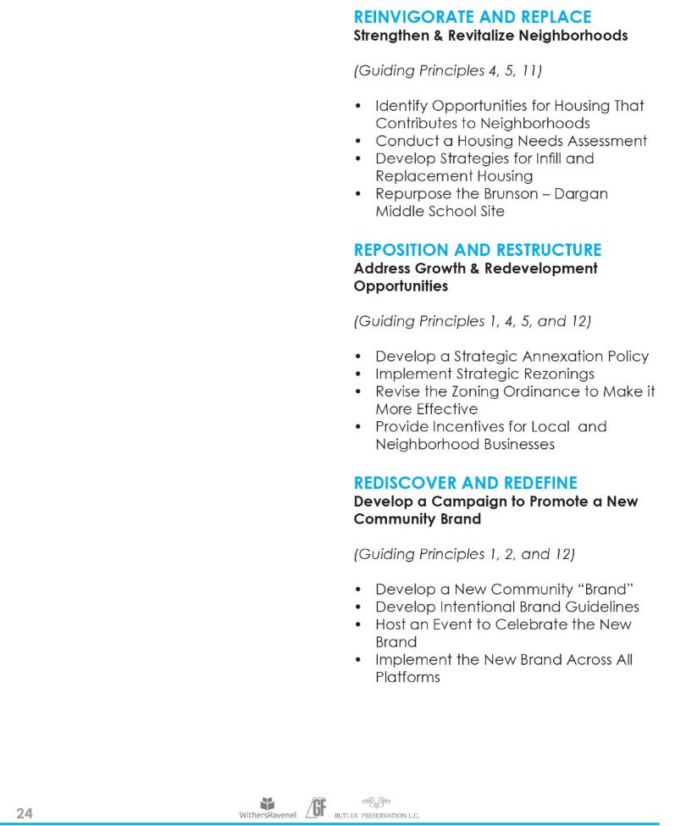
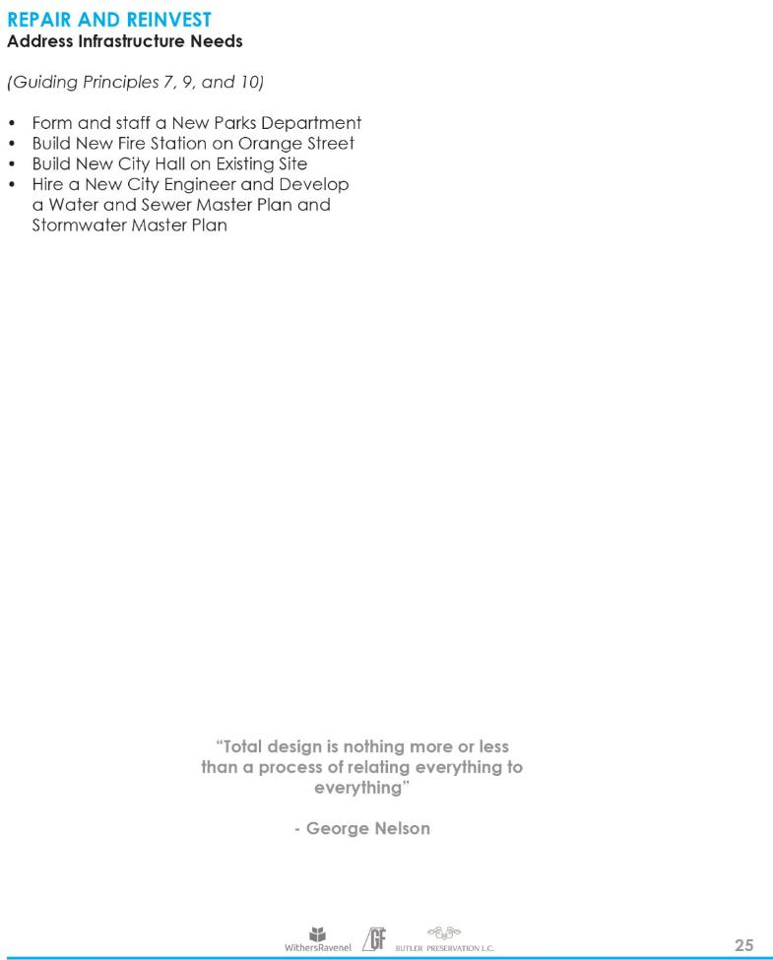

Slide 20
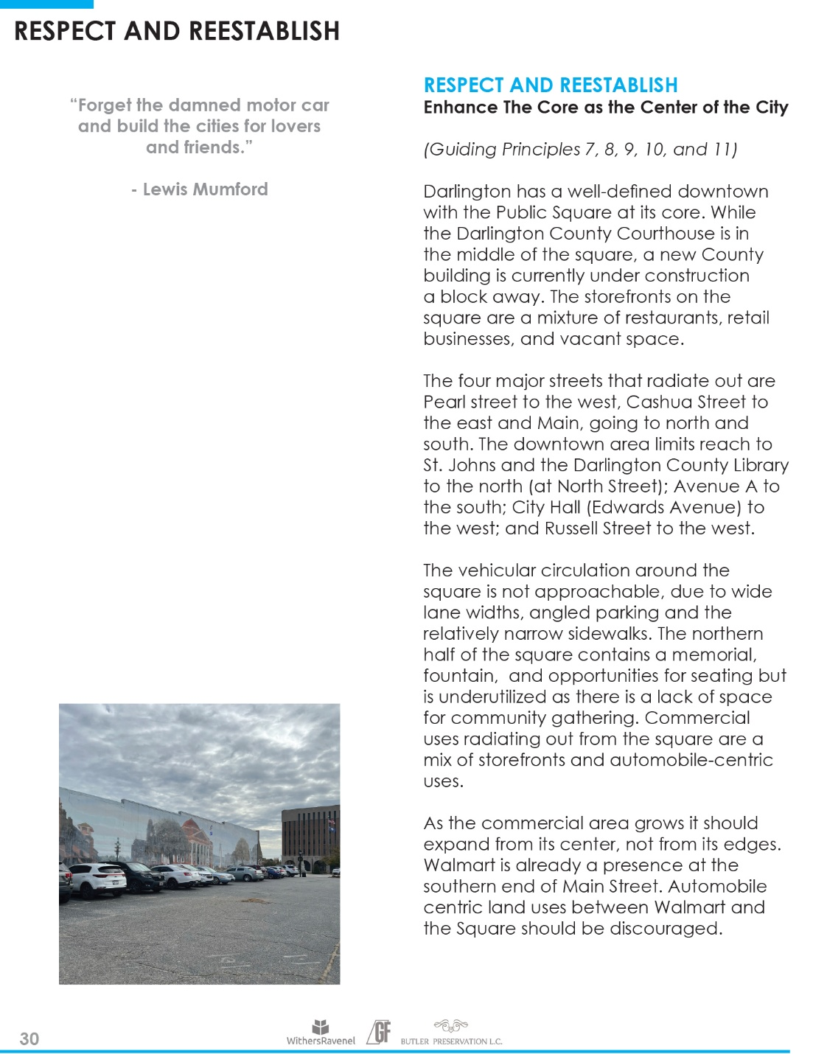
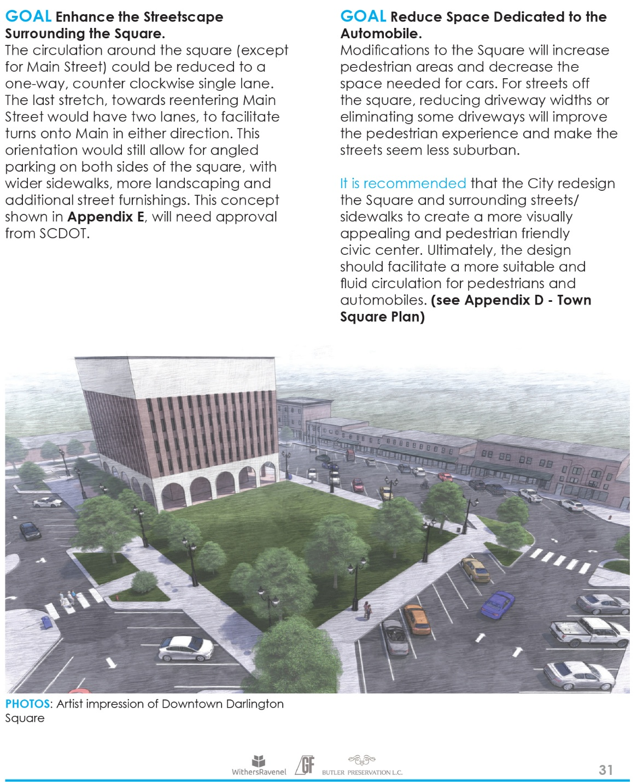

Slide 21
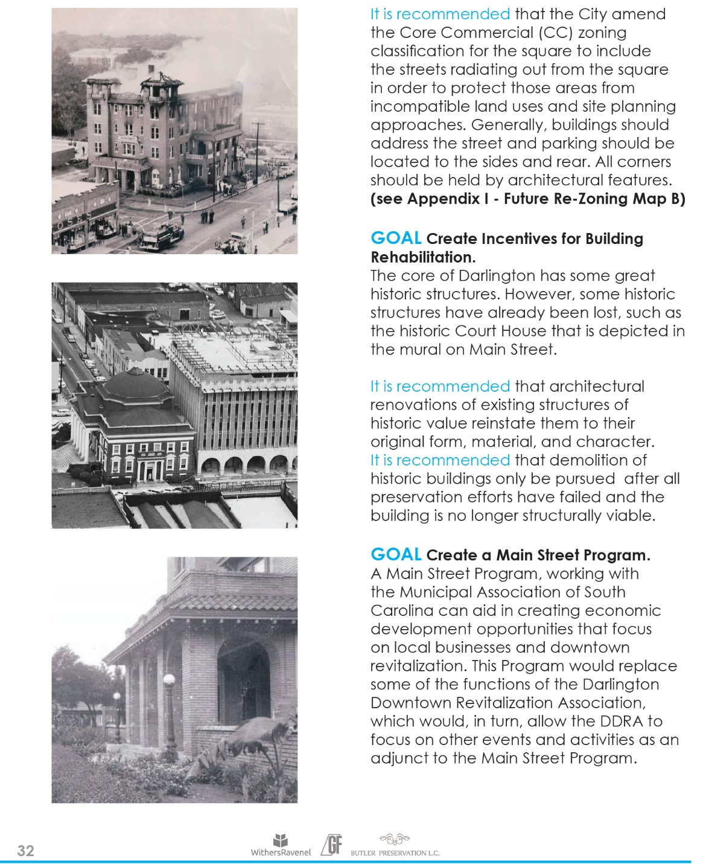


Slide 22

“TOP FIVE” PRIORITIES AS EXPRESSED BY PLANNING COMMISSION
MAJOR REVISIONS TO THE ZONING ORDINANCE
HIRE A CITY ENGINEER
ESTABLISH A MAIN STREET PROGRAM AND HIRE A MANAGER
ESTABLISH A PARKS DEPARTMENT AND HIRE A DIRECTOR
IMPLEMENT A STRATEGY FOR ANNEXATION

Slide 23
MAJOR REVISIONS TO THE ZONING ORDINANCE
It is recommended that the City make broad revisions to the ordinance addressing lot sizes, setbacks, densities, impervious areas, district names, parking, the land use chart, etc.
R-10 could become LD (Low Density Residential District); R-8 could become MD (Medium Density Residential District); and R-6 could become HD (High Density Residential District).
Front setbacks should be measured from the Right of Way, not the street center line.
It is recommended that a new residential district (TR – Traditional Residential District) be created.
It is recommended that the RG District be eliminated.
It is recommended that a new district be created for multi-family land uses (MF – Multi-Family Residential District).
It is recommended that the Zoning Ordinance be amended to allow Accessory Dwelling Units on residential parcels.
1

Slide 24

HIRE A CITY ENGINEER
Develop a Water and Sewer Master Plan
Develop a Stormwater Master Plan
2

Slide 25
ESTABLISH A MAIN STREET PROGRAM AND HIRE A MAIN STREET MANAGER
Create and staff a new Main Street Program, under the Office of Economic Development and Planning, and house them both, along with Historic Tourism, in the historic Darlington Carnegie Library at 127 Main Street.
Identify Potential Improvements to the Public Square
Develop Design Guidelines to Protect Community Character
Provide Incentives for Local and Neighborhood Businesses
Bring Existing Structures Back to Their Original Materials and Forms
Repurpose Buildings Rather Than Tear Them Down
Expand the Core Commercial (CC) District
Develop a Campaign to Promote a New Community Brand
Establish a program that encourages public art in all forms.
3

Slide 26




Slide 27


Slide 28



“Forget the damned motor car and build the cities for lovers and friends.”
Lewis Mumford

Slide 29
ESTABLISH A PARKS DEPARTMENT AND HIRE A DIRECTOR
It is recommended that the City and County complete a Parks and Recreation System Master Plan to determine community recreation needs and that the City form a new Parks Department. It is also recommended that the City form and staff a new Parks Department.
Identify Improvements to Williamson Park and Other Existing Parks
A Park Within a 10-minute Walk of Every Darlington Resident
Identify Opportunities for Spaces on the Street (Pocket Parks)
Adopt a Complete Streets Policy
Create a Greenway System; Including On-Street Improvements
4

Slide 30


Slide 31




Slide 32


Slide 33


Slide 34

IMPLEMENT A STRATEGY FOR ANNEXATION
5

Slide 35
THE TEAM’S “OTHER FIVE” PRIORITIES
Housing Assessment | The City should have a comprehensive Housing Study done to determine the level of need for housing in the community.
Historic Preservation | Place adaptive use targets to the National Register for tax credit opportunities. Create two new historic districts, Mayo North and Mill Village, and expand existing districts. Create local historic districts as an alternative, or in addition to, National Register Districts.
Property Acquisition | The City should develop a strategy and a budget to proactively acquire property for parks, recreation areas, infill housing, and other uses that serve the community.
New Fire Station | The existing Fire Station, which is part of City Hall is not adequate for the needs of Darlington’s only fire station. It is recommended that the City construct a new Fire Station on vacant land on the north side of Orange Street, between Lucas and Buchanan Streets, or another suitable location.
New City Hall | The existing city hall currently houses all city offices, the fire station, and the police station. The existing court chambers do not provide a suitable setting for City Council meetings. The facility is outdated and in need of extensive maintenance, repair, or replacement.

Slide 36

Housing Assessment | Explore programs for first time home buyers (with reduced down payments and interest rates, etc.) and explore providing affordable housing in scattered site opportunities, instead of multi-family housing “projects” which often carry a stigma for the residents.
1

Slide 37

Historic Preservation |
2

Slide 38

Property Acquisition |
3

Slide 39

New Fire Station | New City Hall |
4/5

Slide 40

OTHER SPECIAL PROJECTS
Brunson-Dargan | This former Middle School is vacant and has been demolished. This presents a great opportunity for reuse of the site for attainable housing. This housing should be a mix of market rate and workforce (affordable) with ample shared open space. This new development should address the existing street network, not turn its back on it, and be a model for new residential development in the City.

Slide 41


Slide 42
OTHER SPECIAL PROJECTS
St. John’s |Possible adaptive reuse of the buildings could be residential (apartments), boutique hotel, event venue, offices (including civic uses), adult education, and recreation.
All buildings, except for the cafeteria, should be preserved and restored. The cafeteria (Building C) has no historic or cultural significance and could be demolished.
The Gymnasium could be used by the County and City for recreation leagues and adult fitness.
The Dargan Memorial Amphitheater should be restored and improved and used for civic events such as concerts, public meetings, etc. with the City renewing the pledge to dedicate the amphitheater to “the happiness of youth.”.
The J.C. Daniel Auditorium has extensive damage, but possible uses should be explored for adaptive reuse of the building, or perhaps only the shell of the building. So, it could serve as a partially enclosed outdoor event venue. An extensive structural analysis of this building should be done.
The Administrative Building (Central Baptist Church) could be used as office space, particularly for legal office across the street from the new County Courthouse.
The residual grounds of the school should (once parking requirements are met) could become a passive City Park, restoring it to its historic use as The Academy Green.

Slide 43


Slide 44


REVISED ZONING ORDINANCE

Slide 45




Slide 46





Slide 47



Slide 48



Slide 49



Slide 50



Slide 51



Slide 52



Slide 53


Slide 54


Slide 55


Slide 56

QUESTIONS + DISCUSSION
www.cityofdarlington.com/darlington-renaissance-master-plan/

