Slide 1
South Carolina Office of Resilience
Building Resilience through Planning, Conservation, and Partnerships

Slide 2
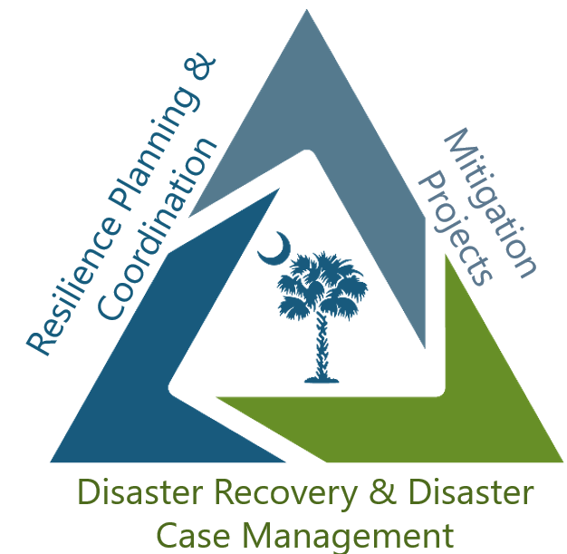
Mission
SCOR lessens the impact of disasters on the communities and citizens of South Carolina by planning and coordinating statewide resilience, long-term recovery and hazard mitigation.

Slide 3







History
1989
2015
2016
2018
2018
2020
2021
2023
2024
Hurricane
Hugo
SC Disaster Recovery Office created following Historic Floods of 2015, which resulted from Hurricane Joaquin
Hurricane Matthew
Hurricane Florence
Floodwater Commission established
Disaster Relief and Resilience Act was signed, creating the Office of Resilience
Officially began operation at the start of FY 2022
Published South Carolina’s first Statewide Resilience Plan
Hurricane
Helene

Slide 4
The ability of communities, economies, and ecosystems to anticipate, absorb, recover, and thrive when presented with environmental change and natural hazards.
What is Resilience?

Slide 5
Resilience Planning and Implementation

Slide 6
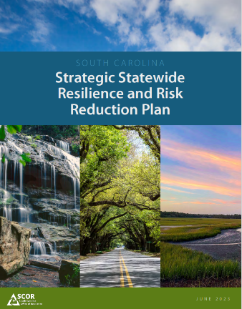
Statewide Resilience Plan
The South Carolina Office of Resilience released the Strategic Statewide Resilience and Risk Reduction Plan (Resilience Plan) in June 2023. The Plan identifies major flood risks around the state and potential losses that could occur as a result of extreme weather events. The Plan guides state investment in flood mitigation and provides strategies for local governments to implement resilience into their communities in order to mitigate potential flood risks.
Planning Principles
Use high-quality data to assess risk and vulnerability, and make that data accessible
Coordinate at the federal, state, regional and local level
Recognize beneficial function of natural systems
Plan and develop solutions based on watershed boundaries, not just jurisdictional
Recognize Co-benefits beyond flood mitigation to communities, economies, and ecosystems

Slide 7
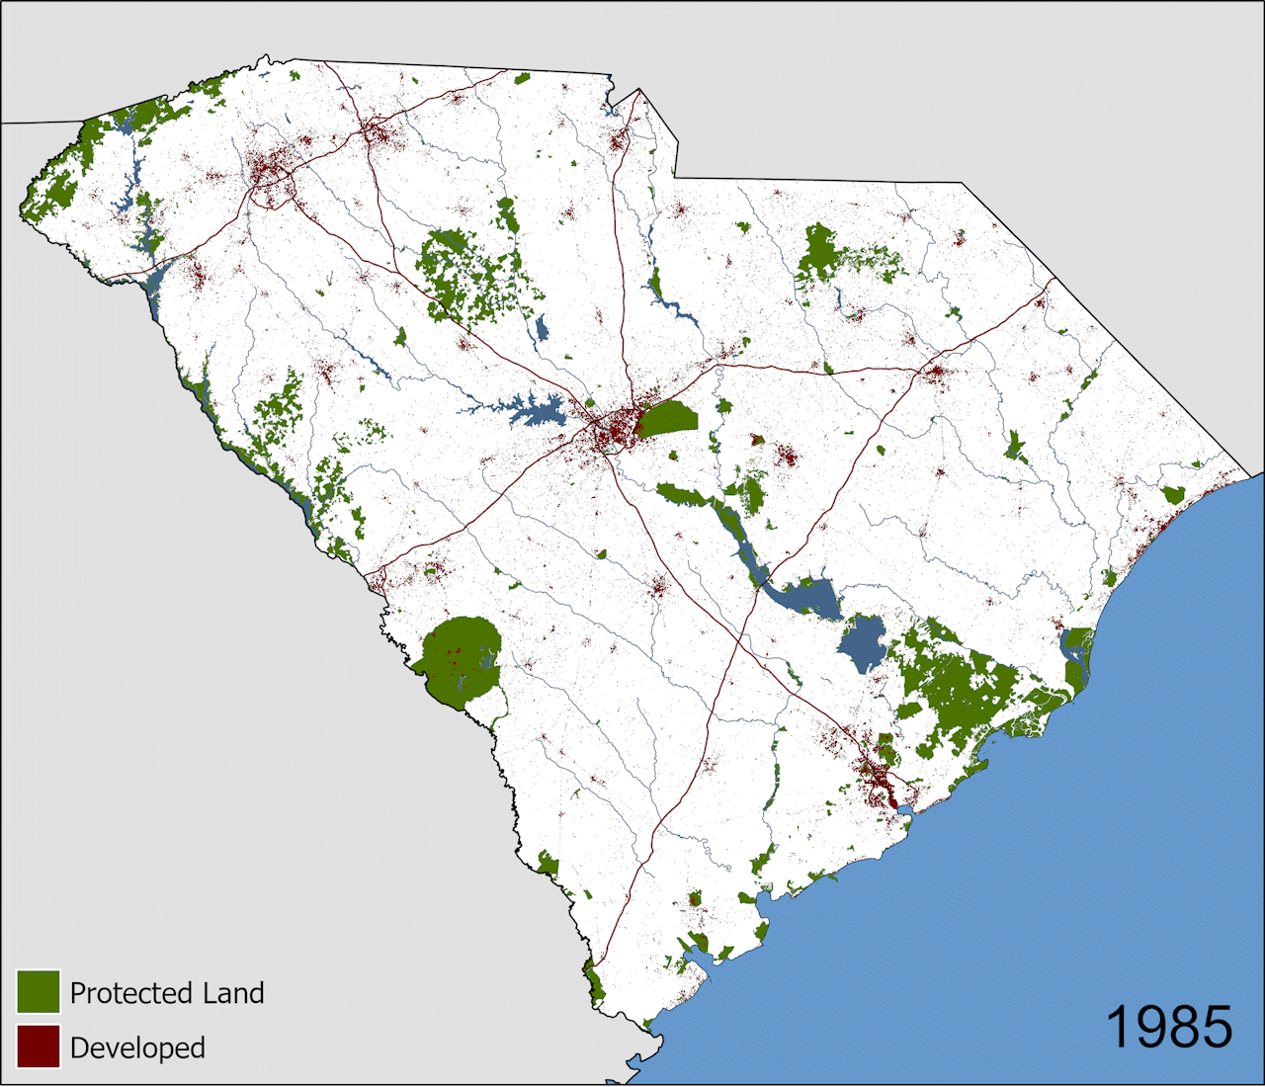
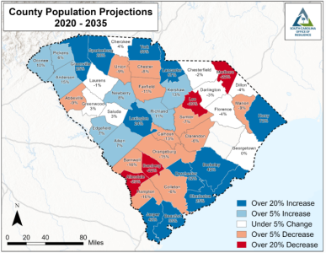
Planning Conditions

Slide 8
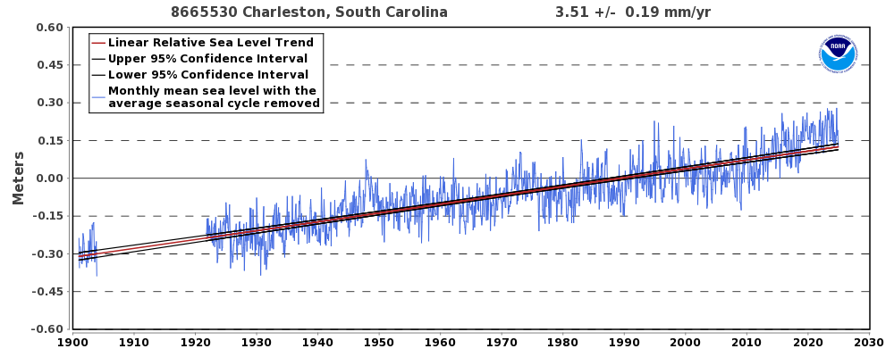
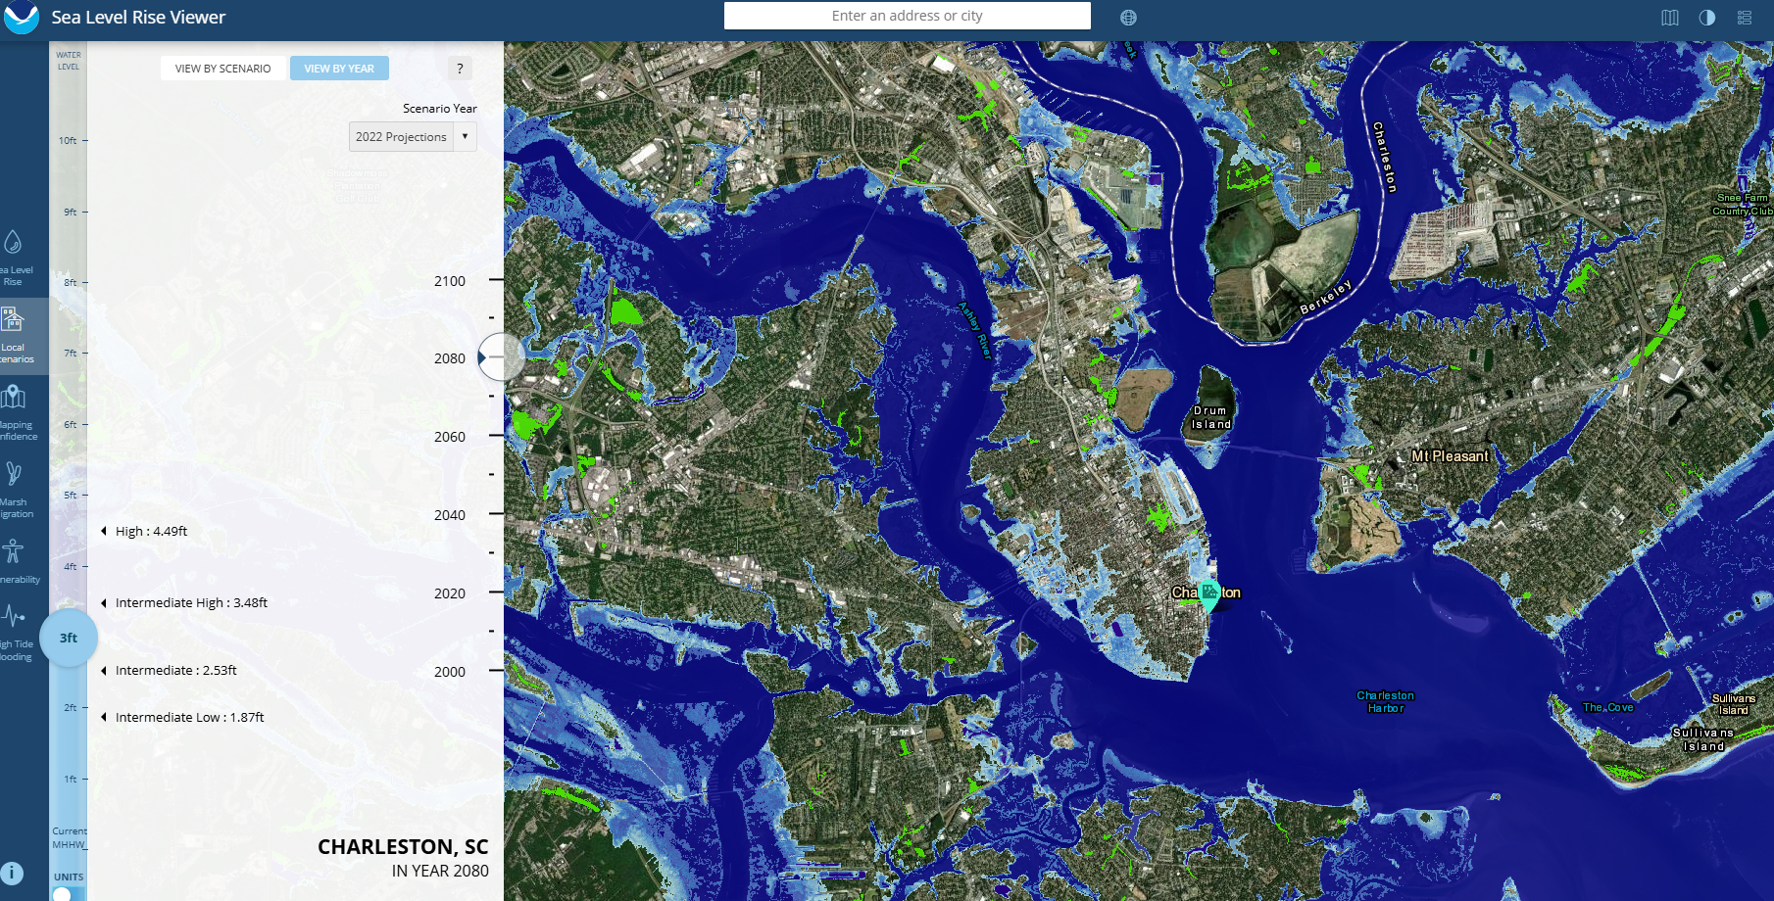

Planning Conditions
Strategic Environmental Research and Development Program

Slide 9
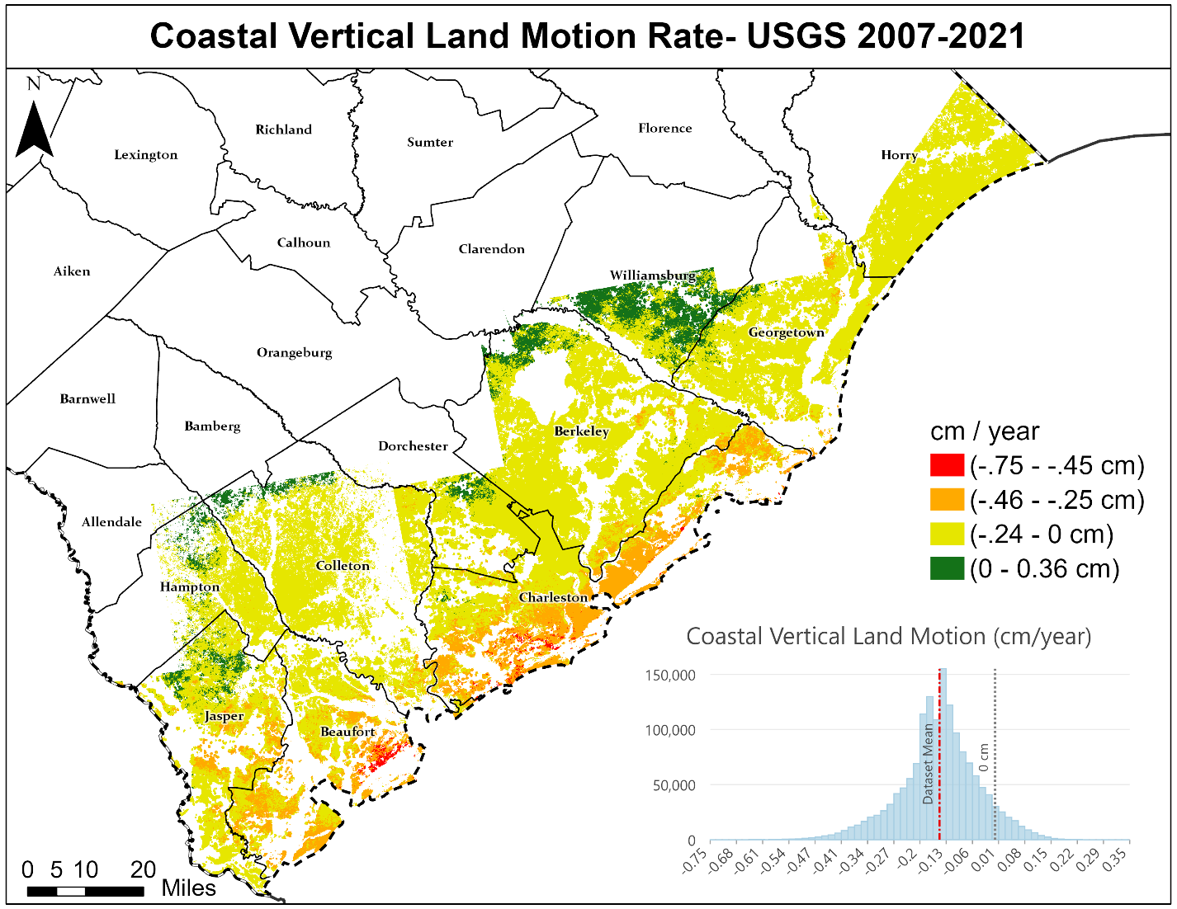

Slide 10
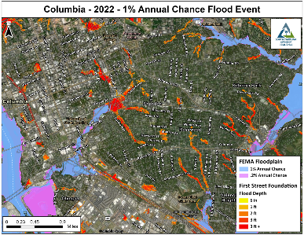
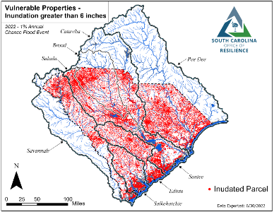
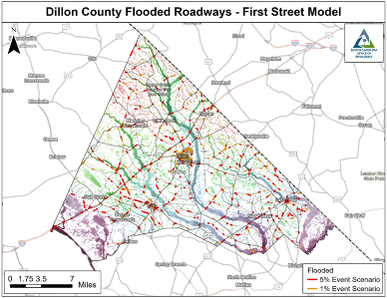
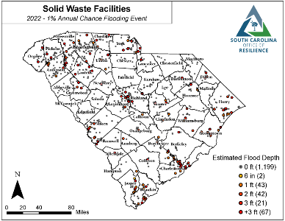
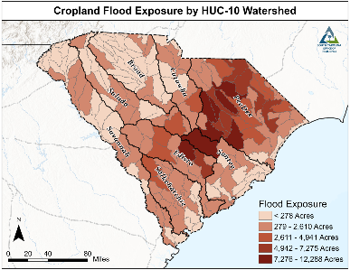
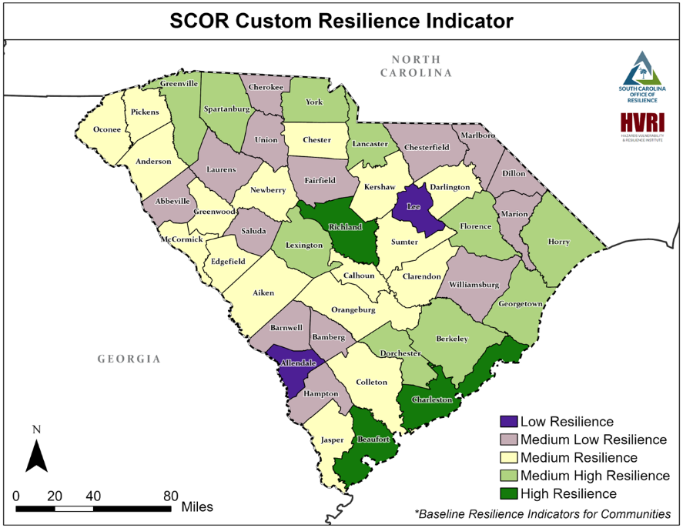
Risk and Vulnerability Assessment

Slide 11
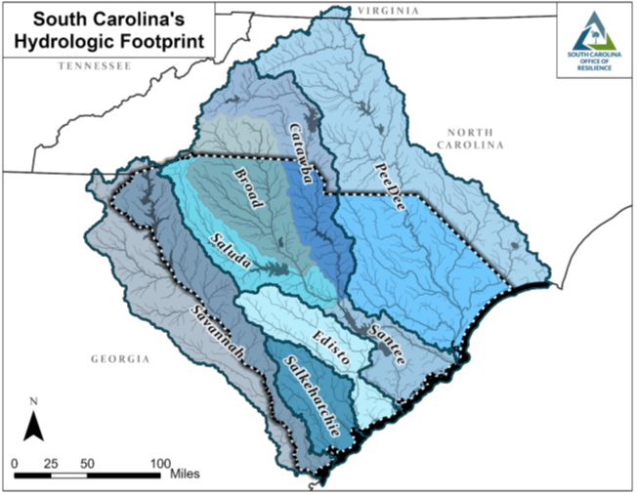
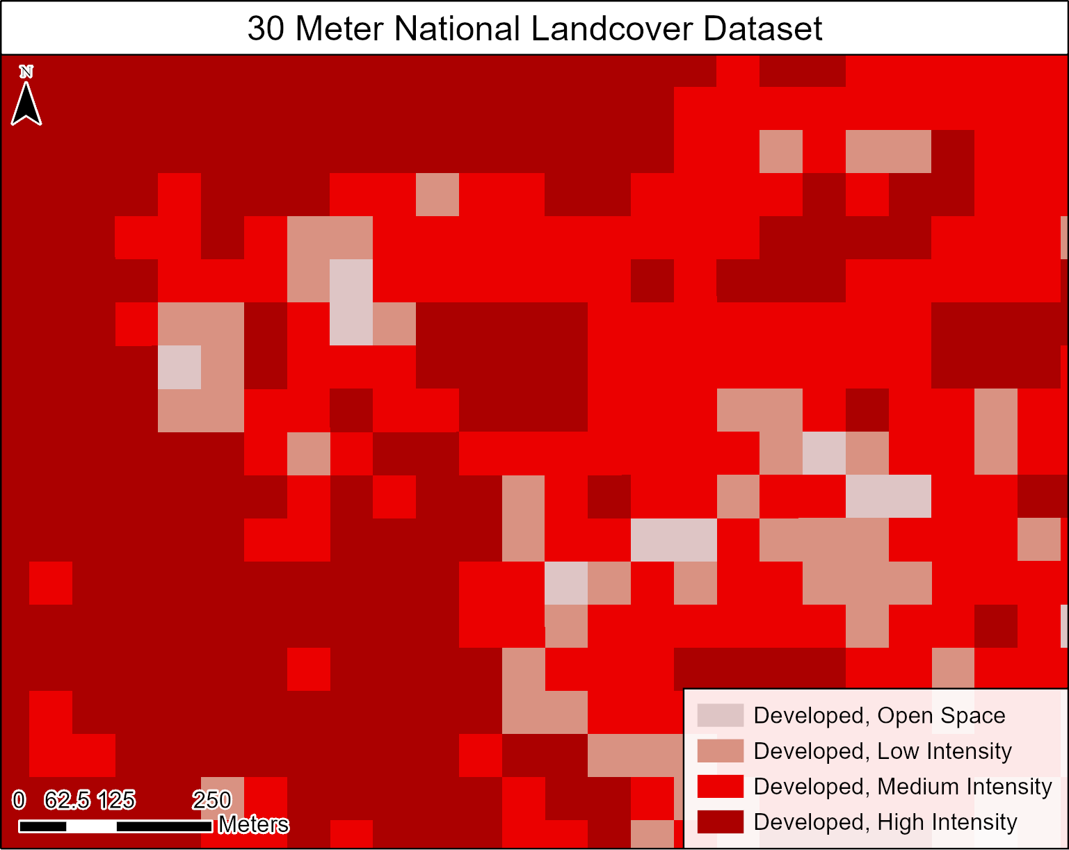
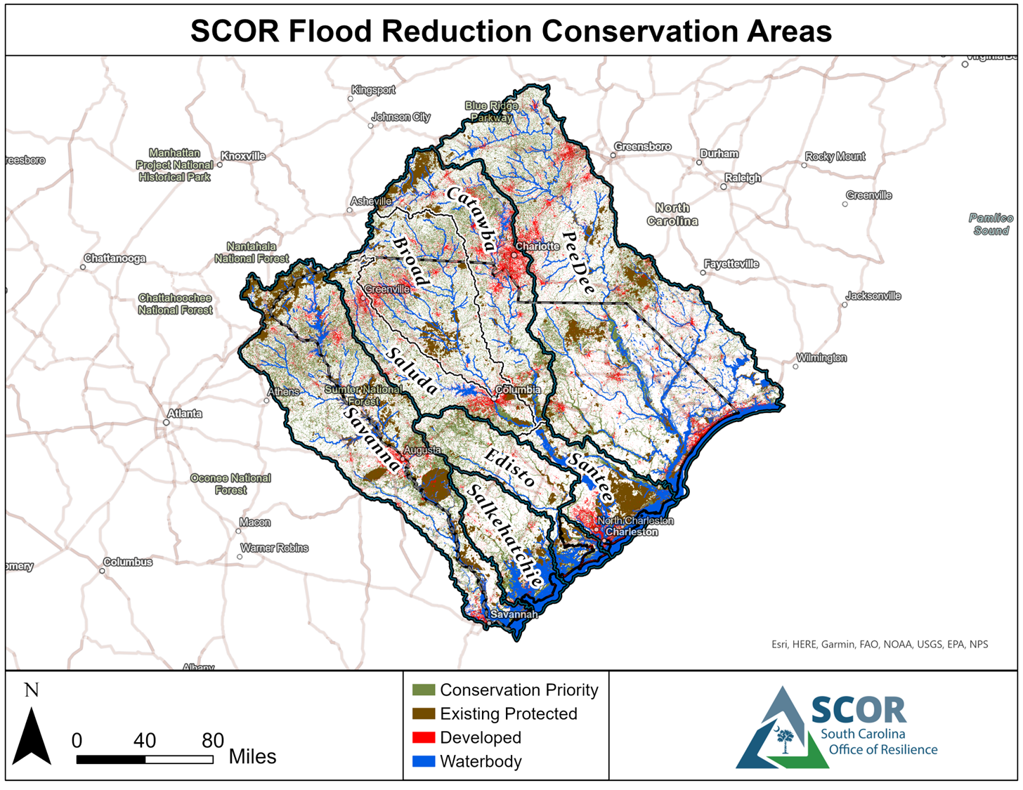
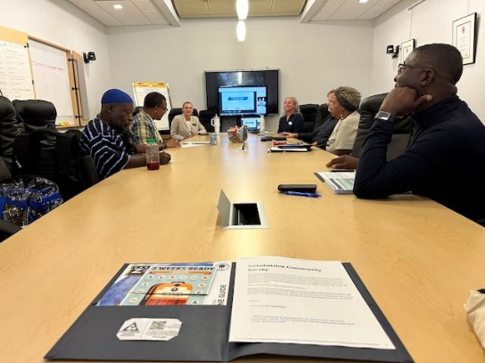
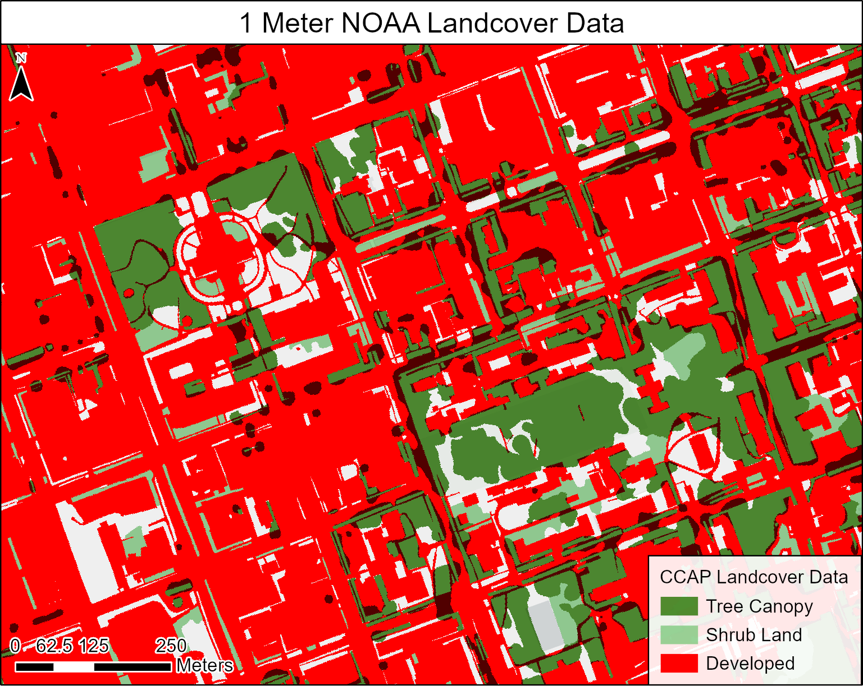
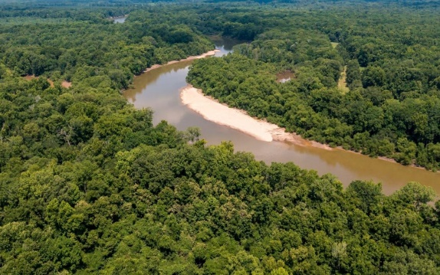
Resilience Plan Implementation
54 Individual Recommendations
Watershed –Based Planning and Coordination
Data collection and Coordination
Grants
Coordinated Land Conservation
2 NFWF-National Coastal Resilience Fund projects ($1.1M)
EPA -Solar for All ($124M)
EPA - CPRG Planning ($3M)
EPA - CPRG – Regional Conservation Coalition ($421M, $89M to SC)
Photo Credit- Use permitted by the Gullah/Geechee Sea Island Coalition

Slide 12
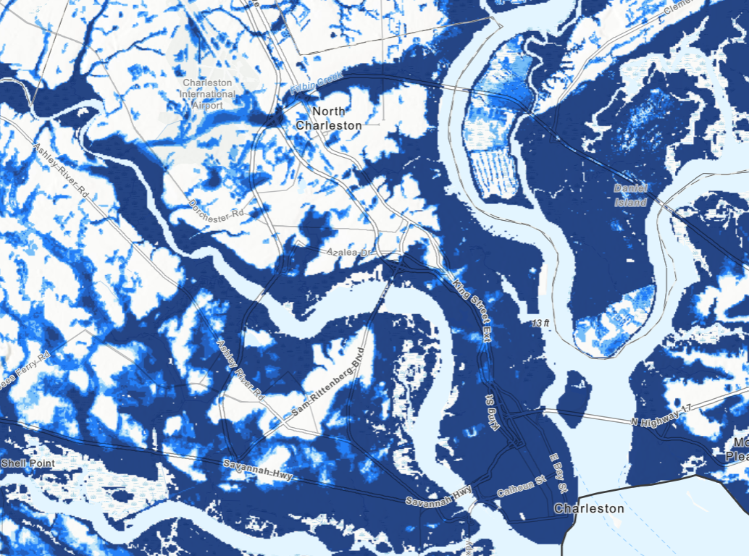
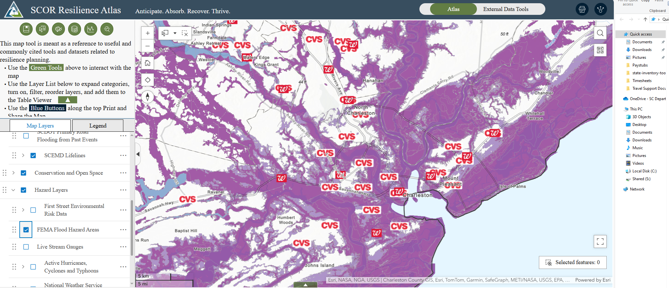
Data Collection and Coordination
Resilience planning resources you can access now
First Street Flood Model data
SCOR's Resilience Atlas

Slide 13
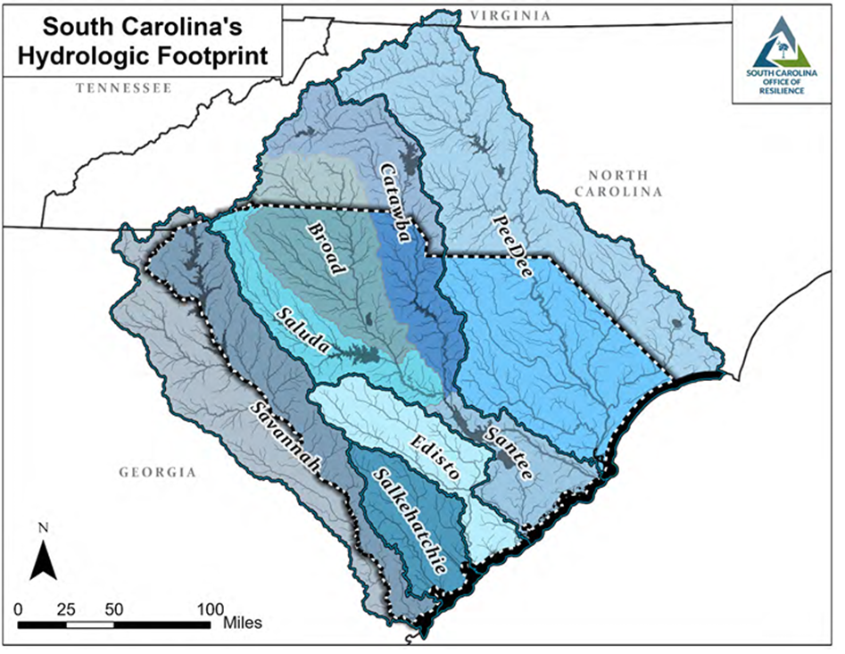
Watershed-based Resilience Coordination
A watershed is an area of land where all the water drains to a common point, such as a stream, river, lake, or ocean
Community Engagement, Risk Assessment, & Planning
Engage with communities to identify risks and vulnerabilities related to flooding
Identify and prioritize local solutions
Watershed Coordination
Coordinate with jurisdictions within watershed to implement solutions that minimize negative upstream and downstream impacts
Develop basin-specific resilience plans for each basin by December 2026
Connection to Resources
Link communities with local, regional, state, federal, and private/non-profit funding, technical assistance, and resources to enable implementation and further resilience efforts
Water doesn't follow political boundaries

Slide 14
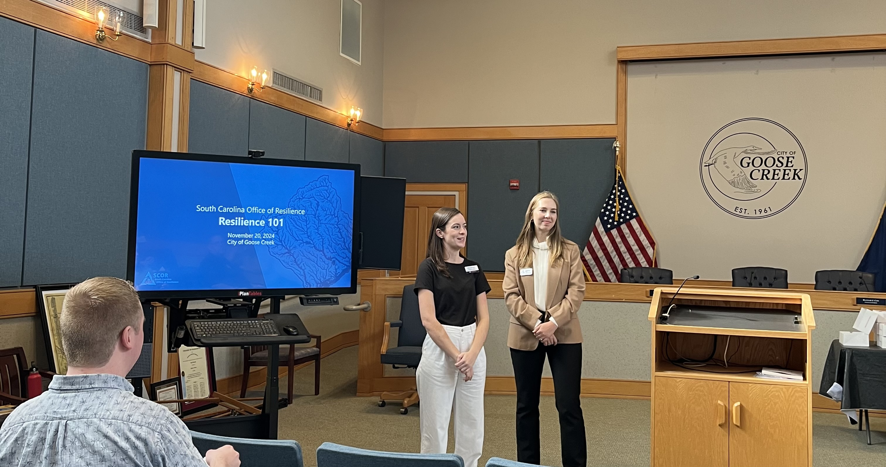
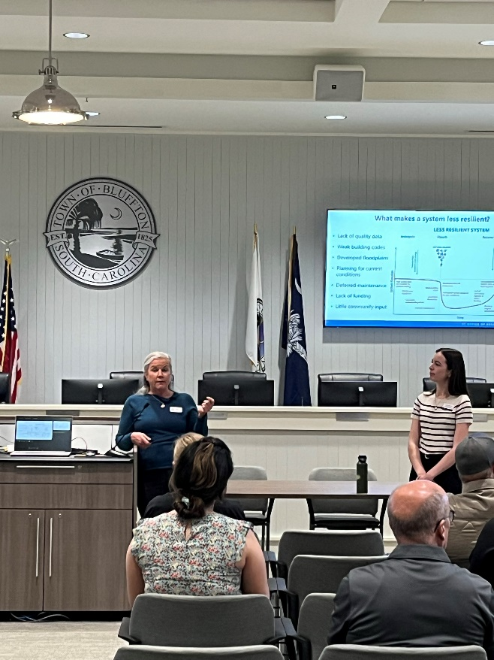
Watershed Coordination Team
South Carolina
Office of Resilience
Let us know what your community needs
Technical Assistance
Data Needs
Trainings
  Resilience 101
  Resilience Atlas
Plan Review
Catherine Min,
Santee River Basin
Catherine.min@scor.sc.gov
(839) 250-0290
Karen Hardison, Salkehatchie River Basin
'Resilience 101' training for your jurisdiction
karen.hardison@scor.sc.gov
(839) 250-0090

Slide 15
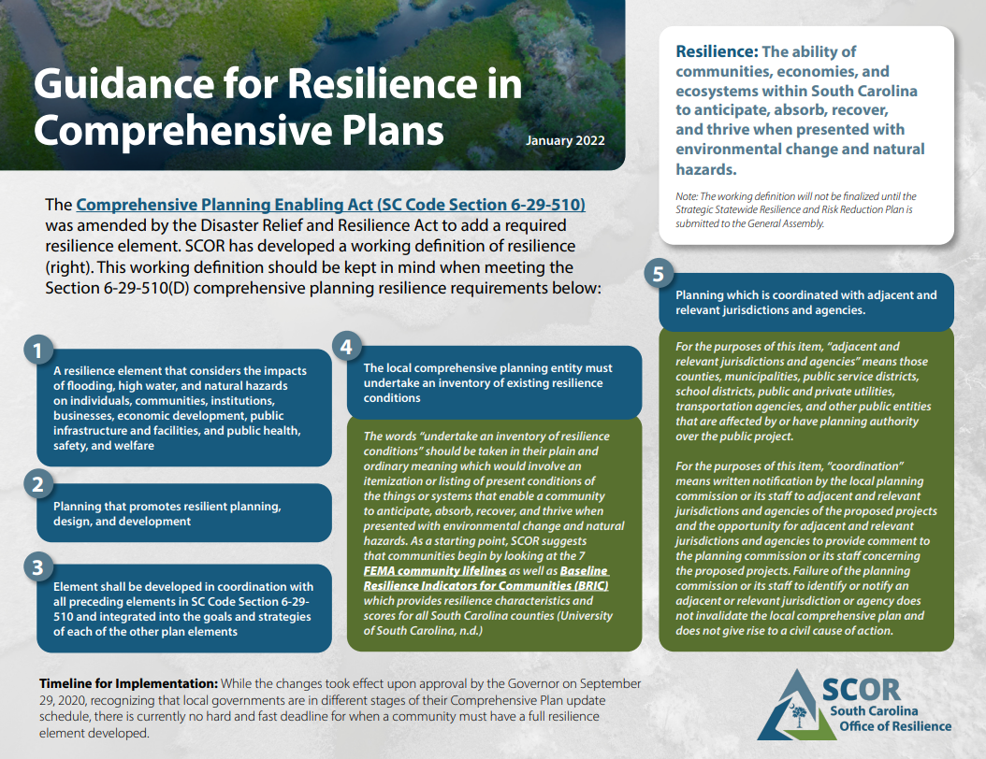

Slide 16
Land Conservation
Priority Areas for Flood Mitigation
  Wetlands
    Act to slow water and reduce flooding
    Filter and improve water quality
  Flood Hazard Areas
    Areas Expected to Flood during a “100yr” event
    Allow natural function of flood plain protection
  Marsh Migration Areas
    Allows marsh areas to move inland as sea levels rise
    Marsh offer storm protection, water quality, and fisheries benefits
  Infiltration Areas
    Reduces flood waters
    Protects water supplies
    Improves drought conditions

Slide 17
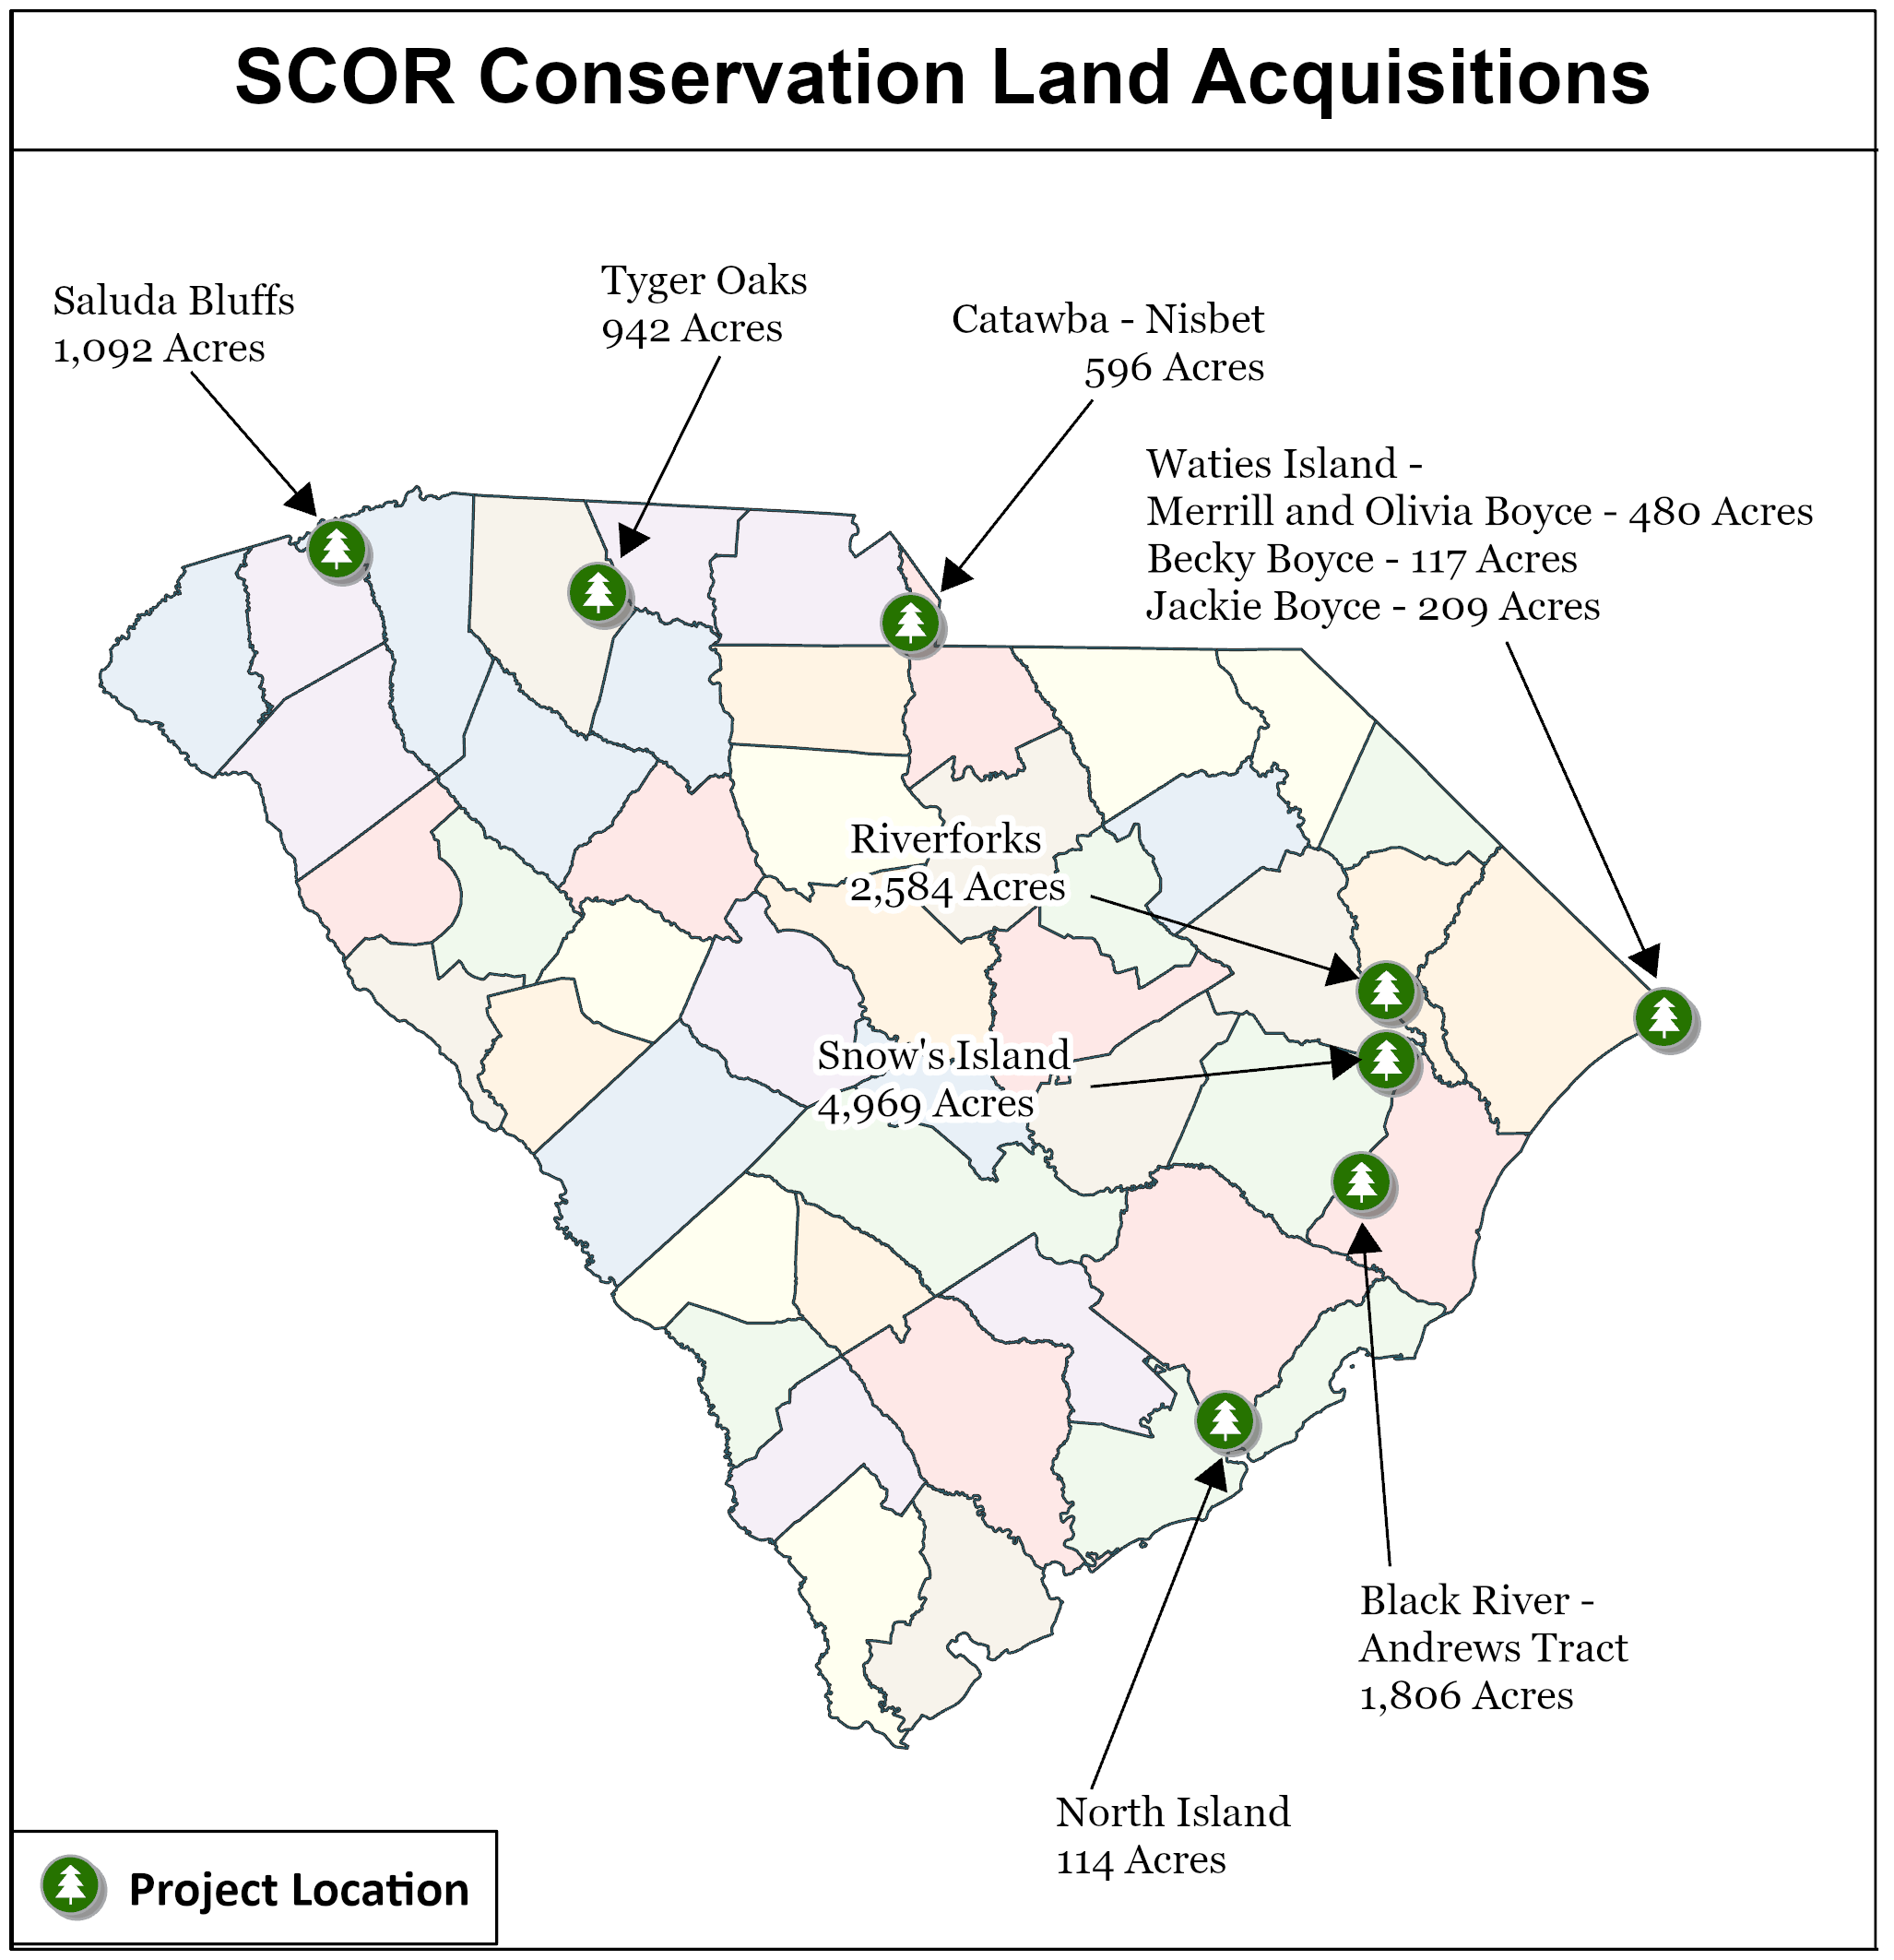
Land Conservation
76,986 Acres Approved for Protection
Type | Project | Location | Acres | SCOR Funding | Potential Reimbursement
Land Acquisition | Waties Island Merrill and Olivia Boyce Tracts | Horry Co. | 480 | $14,950,000 | $6,000,000 *($4M in grants awarded & in process)
Support/Study | Coastal Carolina BCA and Report (Waties) | CCU |  | $56,820
Land Acquisition | Black River - Andrews Tract | Georgetown Co. | 1,806 | $700,000
Land Acquisition | Tyger Oaks | Spartanburg Co. | 942 | $20,000,000
Land Acquisition | Catawba-Nisbet | Lancaster Co. | 596 | $1,900,000
Land Acquisition | North Island | Berkeley Co. | 114 | $1,000,000
Land Acquisition | Saluda Bluffs | Pickens Co. | 1,092 | $2,000,000
Land Acquisition | Waites Island – Becky Boyce Tracts | Horry Co. | 117 | $8,000,000 | $1,000,000
Land Acquisition | Snows Island Tracts | Florence Co. | 4,969 | $14,400,000 | $10,000,000
Land Acquisition | Riverforks, adjacent to and N. of Snows Island | Florence Co. | 2,584 | $5,000,000
Land Acquisition | Waties Island - Jackie Boyce | Horry Co. | 209 | $8,000,000
Conservation Easement | Pee Dee Basin RMS Initiative (62,220 acres) Foresty Legacy Grant Match | Georgetown Co. Williamsburg Co. Marion Co. | 61,340 | $17,777,000
Land Acquisition (Revolving Loan Fund) | TNC Chelsea Planation (loan to assist in funding $32M acquisition of 2,727 acres.) – SCOR funds to go towards 887 acre portion. | Jasper Co. | 2,737 | $5,000,000 loan
SUBTOTAL |  |  | 76,986 | $98,783,820 | $17,000,000
*The above properties have been approved for acquisition by the Joint Bond Review Committee.

Slide 18
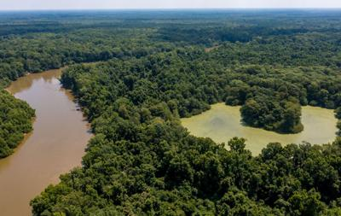
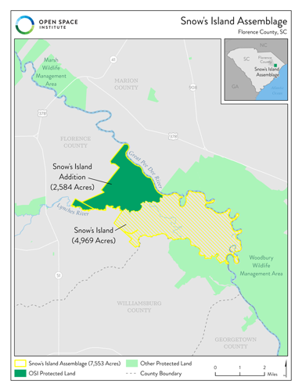
Snow’s Island Assemblage
Project Details
Partners: Florence County ($), the South Carolina Department of Natural Resources (long-term management), and Office of Resilience ($), the South Carolina Conservation Bank ($), Open Space Institute (land trust partner to hold property), Darla Moore Foundation ($), and Knobloch Family Foundation ($)
SCOR Contribution: $19,400 (Island + Addition)
Future: SCDNR Heritage Preserve and Wildlife Management Area
Property Details
Acreage: 7,600
Location: confluence of the scenic Lynches and Great Pee Dee Rivers, the newly protected land includes both the expansive 5,000-acre Snow’s Island and an adjacent 2,600-acre timber tract
Resilience Stats: 60 miles of river frontage, extensive floodplain, bottomland hardwoods, upland pines

Slide 19
South Carolina Solar for All Program
$124,440,000
Goal: Expand access to solar for low-income communities and provide affordable, resilient, clean energy
Funded through the EPA Greenhouse Gas Reduction Fund (GGRF)
Period of Performance: 5 years (May 2024-April 2029)
Includes a one-year planning period to refine the program design
Includes $440,000 in technical assistance from EPA and Department of Energy
Website: https://scor.sc.gov/solarforall

Slide 20
South Carolina Solar For All Program
Focus Areas
1) Community Solar Initiative: Implement community-based solar projects to diversify energy generation and expand subscription programs
2) Solar Innovation Fund: Establish grant program to support creative solutions such as solar and storage infrastructure at multi-family affordable housing facilities and community-serving facilities; community resilience hubs; new technologies (e.g., solar canopies, agrovoltaics)
3) Workforce Training and Development: Invest in high-quality jobs and effective solar workforce training programs statewide
4) Coordination with Energy Efficiency Programs: Partner with home energy efficiency and weatherization programs to coordinate activities

Slide 21
Mitigation

Slide 22
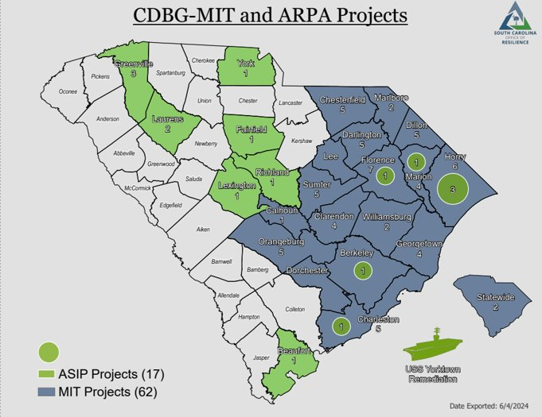
Mitigation Department
Funding Sources & Programs:
CDBG-MIT
Stormwater Infrastructure 27 projects
Voluntary Buyouts 6 projects
Plans & Studies 22 projects
Federal Funds Match 8 projects
ARPA
Stormwater Infrastructure 17 projects
USS Yorktown Remediation
South Carolina Disaster Relief and Resilience Reserve Fund (DRRF)
Stormwater Infrastructure 2 projects

Slide 23
Mitigation Voluntary Buyouts
SCOR Mitigation Department Buyout Programs by County
County | Approved Buyout Parcels | Program Notes
Chesterfield (Town of Cheraw) | 11 | Located on a Superfund site All parcels have been acquired in the Huckleberry Park Neighborhood Start of Demolition September 2024
Darlington | 40 | Parcels are in the city limits of Darlington and in Hartsville Identified through a Darlington County Watershed Study
Dillon | 6 | The parcels lie along the Little Pee Dee
Horry | 61 | The parcels are in the Socastee Area Acquired 54 parcels Phase I demolition completed
Marion (Town of Nichols) | 23 | Parcels within 1.5 mile radius of Town Hall, refereed to as the “Mullins Street area”
Marlboro (City of Bennettsville) | 51 | The parcels lie throughout the Shady Rest and Richardson Park neighborhoods. Offers to Purchase began in July 2024

Slide 24
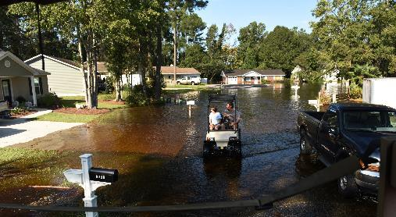
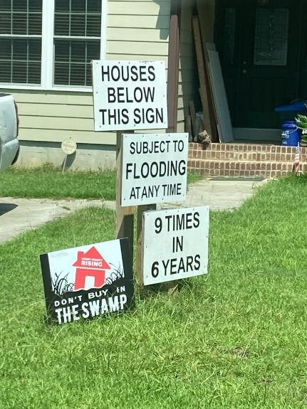
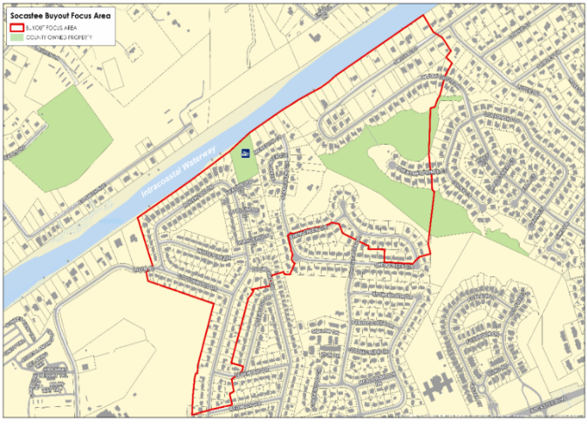
Horry County Buyout
Phase 1 Complete - 33 houses demolished.
Phase II demolition of up to 25 parcels is anticipated to begin by late 2024/early 2025.

Slide 25
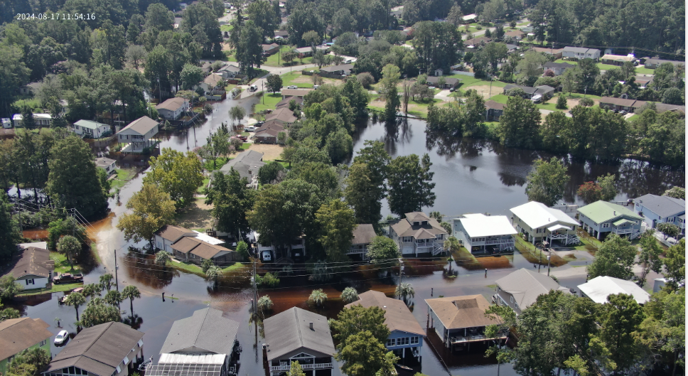
Horry County Rosewood Neighborhood Post Tropical Storm Debby
Demolished Disaster Recovery parcels
Demolished Phase I Mitigation parcels
Phase II Mitigation parcels scheduled for demolition
Photo courtesy of Horry County

Slide 26
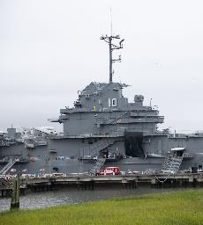
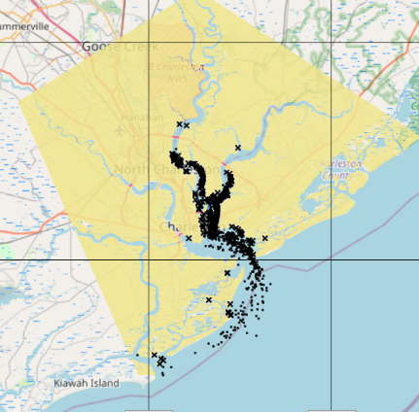
American Rescue Plan Act (ARPA)
USS Yorktown Remediation
Oil spill trajectory for 2,100 gallons of heavy fuel oil released from the USS Yorktown run for 2 days
SCOR tasked with studying the cost of removing or remediating all legacy contaminants
1,750,000 gallons of contaminated water and fuel on the ship
Phase I: Complete​ | Phase II: In Progress
Estimated $10,710,016​ Environmental Assessment​ Immediate hull repair and tank cleanup, necessary of environmental remediation​ Phase 2 Bid Package​ | Estimated $18M​ Cleanup of hazardous materials (fuels, PCBs, etc.)​ Cleanup engineering oversight​ Additional hull repair related to environmental remediation​ Remediation contingency​
Impact & Need for Remediation:
Natural Resources, National Historic Landmark, Port Economic Impact

Slide 27
Disaster Recovery &
Disaster Case Management

Slide 28
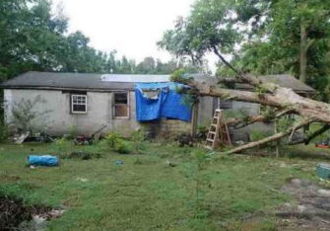
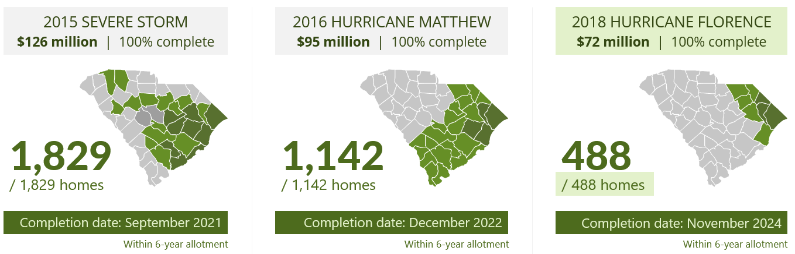
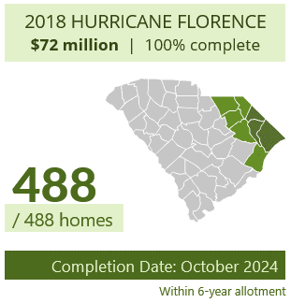
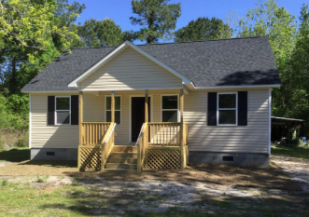
SCOR’s Background in Disaster Recovery
SCOR has used three HUD Community Development Block Grant- Disaster Recovery (CDBG-DR) grants to repair, replace, or rebuild 3,459 homes damaged by hurricanes and flooding.
*Note: Richland & Lexington counties received CDBG-DR grants for the 2015 Severe Storm and therefore were not served by our programs.

Slide 29
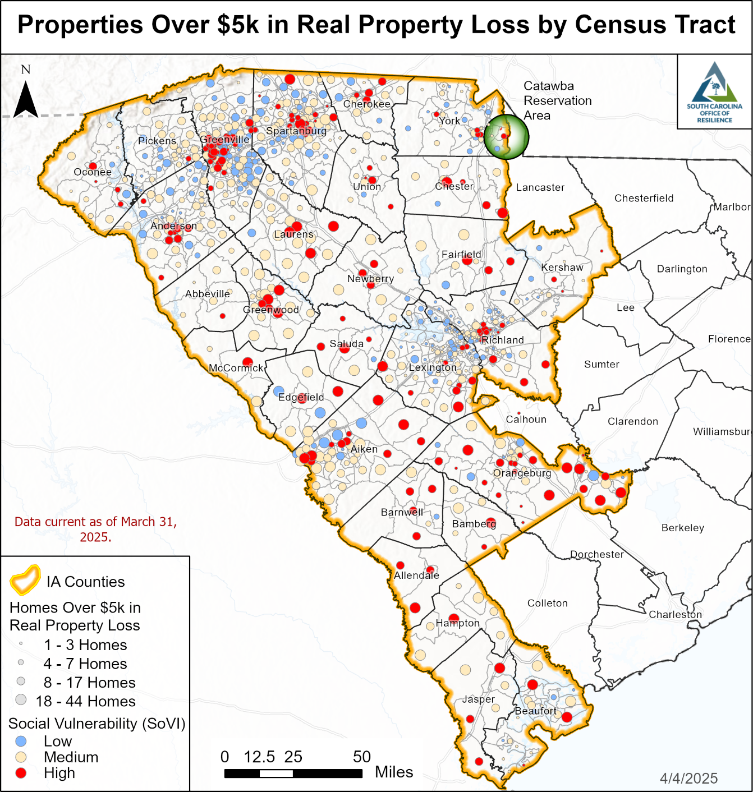
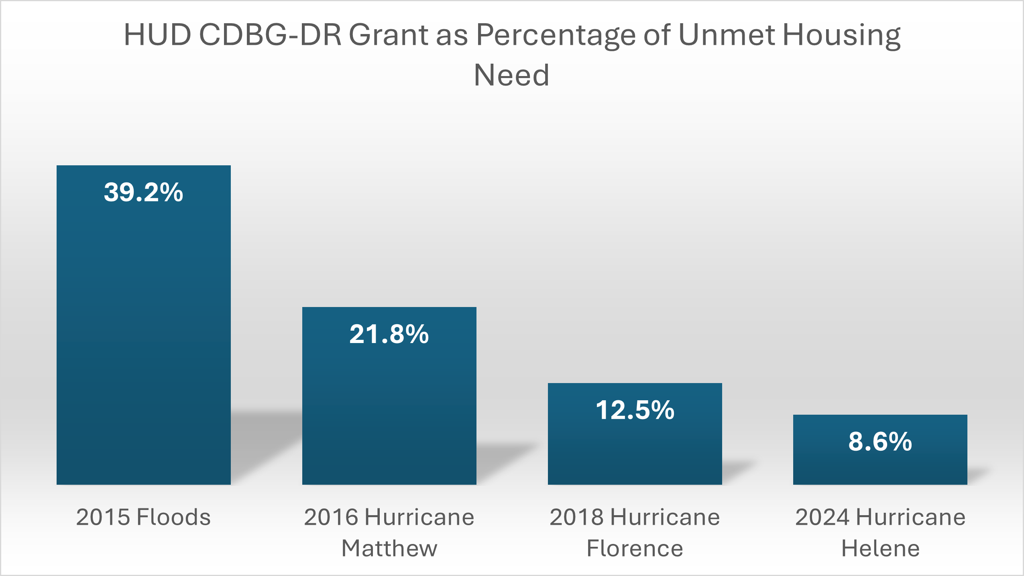
2024 Hurricane Helene Disaster Impact
28x counties and the Catawba Indian Nation were declared for FEMA Individual Assistance (IA)
452,000 citizens have applied to FEMA for Individual Assistance
29

Slide 30
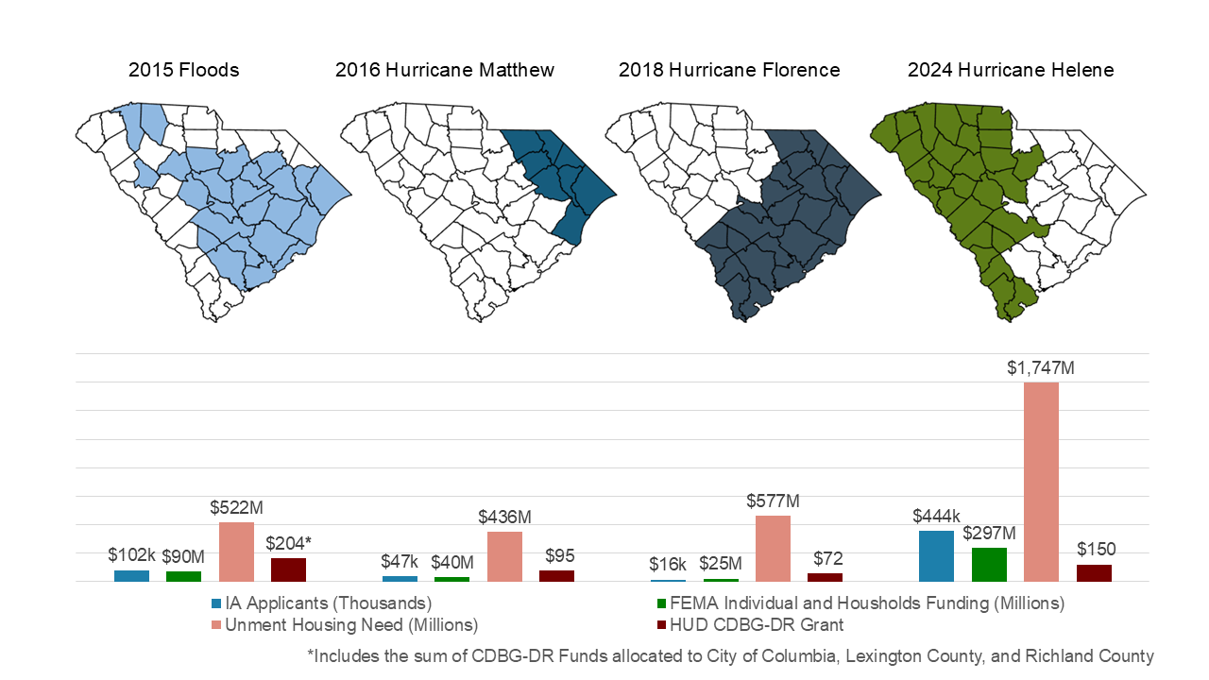

Slide 31
SCOR Hurricane Helene Recovery Efforts
Disaster Case Management ($22M FEMA DCMP Grant)
Intake Numbers – 4,053 total; 950+ applicants w/housing needs; 2,000+ referrals to other resources
4x Regional Field Offices
CDBG-DR ($150M Allocation)
Unmet Needs Assessment
Developing Action Plan (Updated Guidance From HUD)
Identifying State Most Impacted and Distressed (MID Counties)
Rapid Rebuild
Procurement
House Plans
Coordination and Cooperation
Coordination with Voluntary Organizations Active in Disaster (VOADs), non-profits (Central Carolina Community Foundation OneSC Fund) and others (Google)
Agency Coordination: SCEMD, SC Housing, etc.

Slide 32
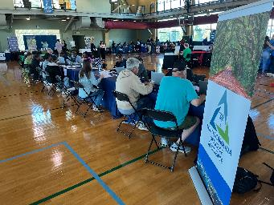
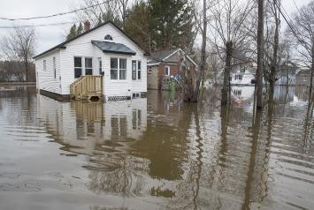
Disaster Case Management
Uses FEMA Disaster Case Management Program (DCMP) grant funds and HUD CDBG-DR grant funds to serve citizen disaster survivors; meeting their disaster related unmet needs
  Served 2,600 citizens in the 2016 $4.5M FEMA DCMP grant
  Served 850+ citizens in the 2018 $3.8M FEMA DCMP grant
Connected survivors of other recent events to recovery resources
  Hurricane Ian
  Tropical Storm Debby
  Disaster Recovery Reserve Corps (DRRC)
    Jumpstart the disaster recovery process by hiring and training a pool of highly qualified reservists who can be activated to assist survivors following a federally declared disaster.
    70+ reservists hired to date, ongoing trainings
    Activated reservists become part of SCOR’s Disaster Case Management Team
Notes:
*DRRC members paid when activated

Slide 33
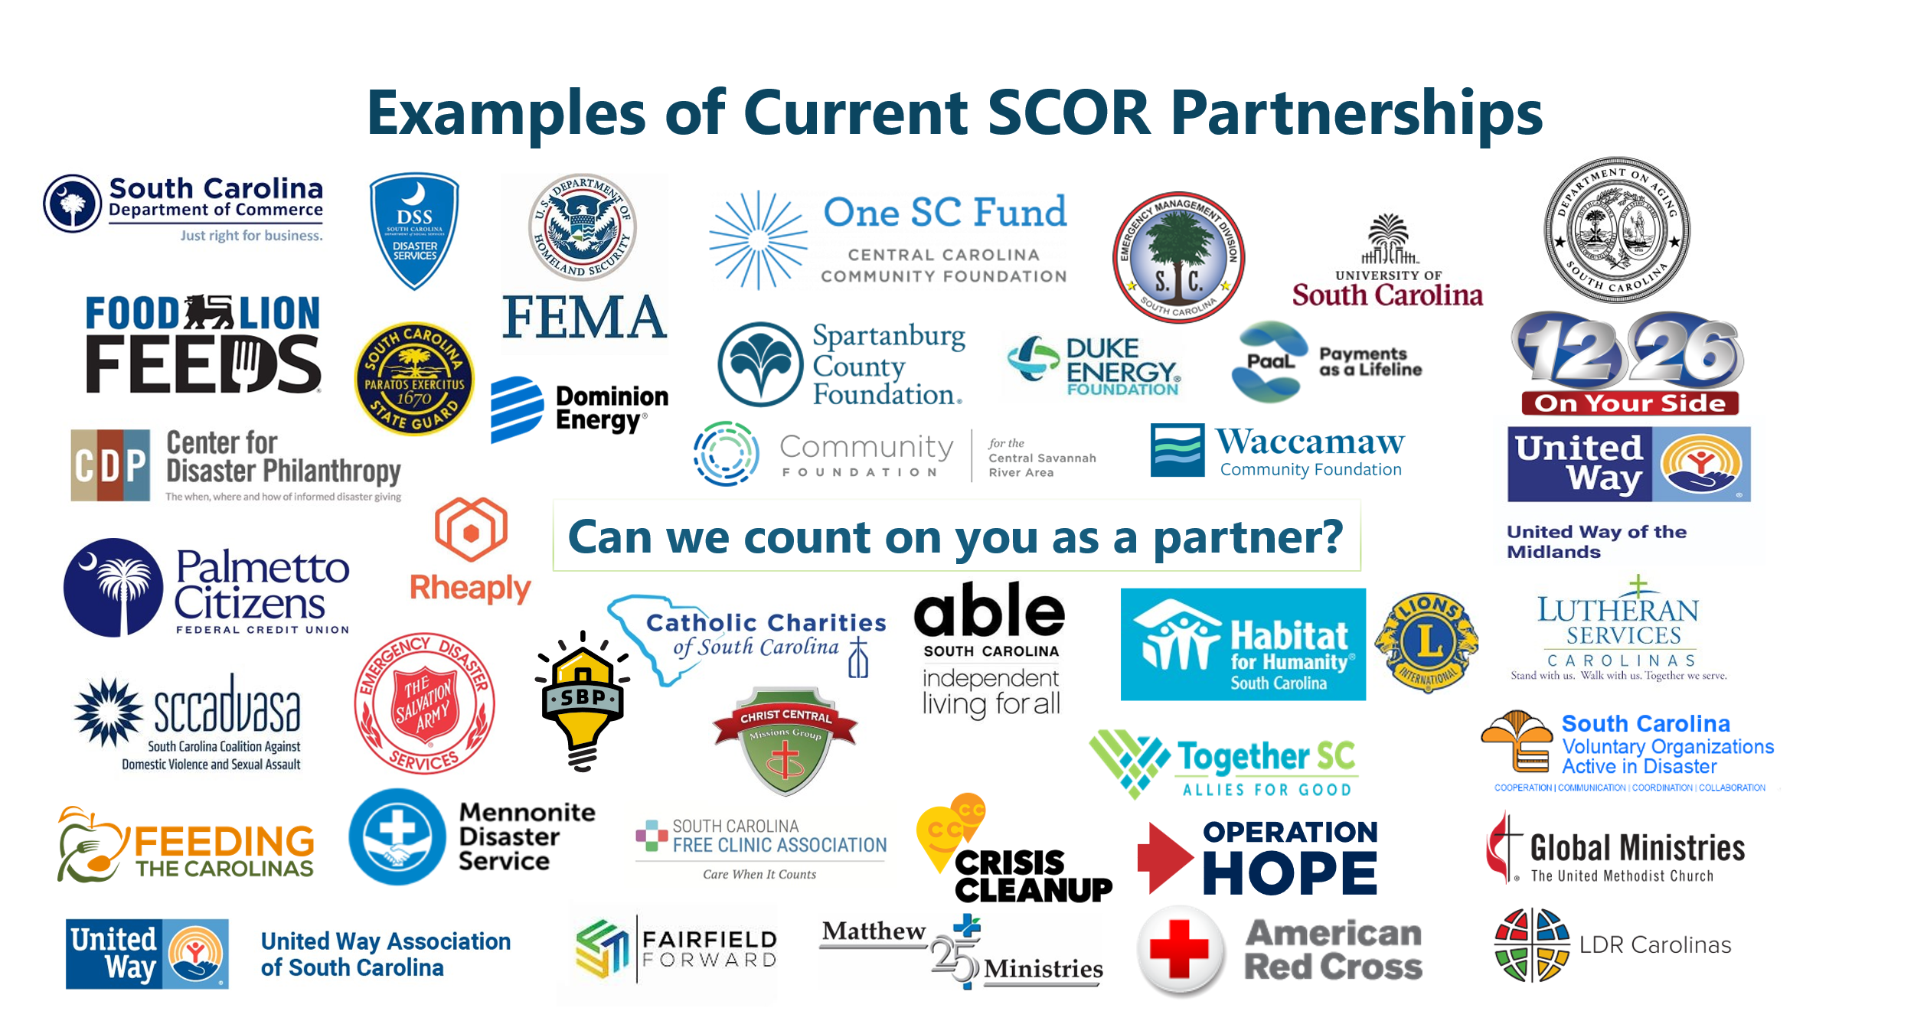

Slide 34
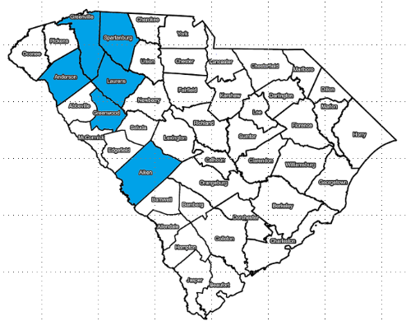
2024 Hurricane Helene Allocation from HUD
$150,354,000- total grant allocation
  70% ($105,247,800) must benefit low to moderate income citizens
  80% ($120,283,200) must benefit HUD Most Impacted and Distressed (MID) areas
HUD designated 6x counties as MIDs
  Aiken, Anderson, Greenville, Greenwood, Laurens, and Spartanburg
$130,743,000- allocated for disaster recovery
  Options: Housing, Infrastructure, Economic Revitalization, Mitigation, Public Assistance
$19,611,000- allocated for mitigation
Max of 5% ($7,517,700) can be spent on Admin costs
34

Slide 35
Questions?
35

