Slide 1
Notes:
Start with a safety moment?

Slide 2
Agenda
Introductions
The Project – Simple Simpsonville
The SynTerra Difference & Our Team
Key Factors for Success
Implementation Schedule
Questions & Discussion
Notes:
KATHERINE:
Feel free to stop us at any point and we are happy to answer questions…we would love to make this conversational

Slide 3
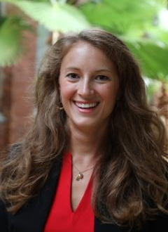
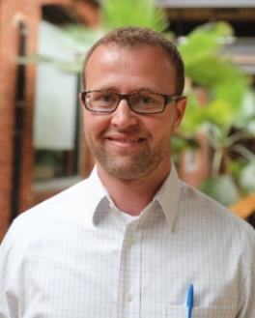
Presentation Team
Katherine Amidon, AICP Environmental Planner
MCRP City and Regional Planning – Clemson University
BS Organic Chemistry – Bates College
Over 9 years professional experience including environmental science, planning, stakeholder facilitation, research and analysis, land use and water quality, and public outreach
Project Manager, Environmental Planning, Stakeholder & Community Engagement
Brian Green, PE, LEED AP
Senior Civil Engineer
MS Civil Engineering in Hydrology and Applied Fluid Mechanics – Clemson University
BS Civil Engineering – Clemson University
Over 14 years of experience in civil and environmental engineering working on infrastructure planning, permitting, stormwater design, preliminary engineering reports, sidewalk design, funding assistance, and more
Civil Engineering Lead, Permitting
Notes:
We will all introduce ourselves..
Katherine hit on being the project manager.
I am a career-dedicated certified planner with a strong background in science. I will bring the planning lens to the core engineering and science that we do and will help support the vision for Simpsonville to simply be the place to want to be!

Slide 4
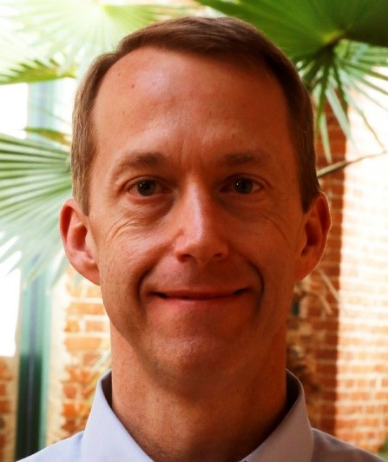
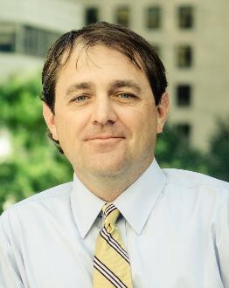
Presentation Team
Josh Fowler, PE
Director of Client Relations – Management Team
MBA – Clemson University
Bachelor of Civil Engineering (co-op) – Georgia Institute of Technology
Over 23 years professional experience in engineering, utility, and sales and marketing fields including municipal consulting
Engineering Oversight
Kevin C. Ammons, RLA
Managing Principal
Bachelor of Environmental Design in Landscape Architecture – Clemson University
BS in Ceramic Engineering – Clemson University
Over 20 years professional experience including master planning, landscape architecture, civil engineering, public engagement, stakeholder facilitation, and project leadership
Streetscape Design and Implementation, Landscape Architecture, Placemaking
Notes:
We will all introduce ourselves
Josh, please touch on dedicating staff, reactivity to project needs, etc.

Slide 5
Additional Consultants
Columbia based,
SCDOT relationships, public space experience
Greenville based
Planning, design, municipal, & park, experience
Notes:
KATHERINE So who is not in the room
We have also partnered with
Ridgeway Traffic Consulting.
Mike Ridgeway
Don Burdette
If there are other partners that are needed to make this project a success we will work with you to chose that Partner especially if the city already has a preferred firm for example surveying or if additional branding work is needed we would call up Tripp Muldrow

Slide 6
Your Vision
Notes:
KATHERINE
We understand that Simpsonville wants a downtown City Park that has a unique identity to Simpsonville that honors the current branding
What I love about the branding is the simple roots and dedication to family that couple with the desire to maintain history while attracting new residents and visitors with intentional programing, home grown businesses, and exciting destinations that create a unique vibrancy to downtown. This public space, the surrounding corridors, and connectivity within this project scope should be inviting to residents, and visitors alike.

Slide 7
Achieving YOUR VISION
A successful Downtown Revitalization project will help the City of Simpsonville achieve the guiding principles of its Downtown Master Plan:
“…simply historic, simply connected, and simply home.”
SynTerra has selected a team of professionals with the skills and expertise to meet Simpsonville’s unique goals.
With SynTerra, Simpsonville gets a local firm that is built on project management success.
Notes:
KATHERINE
To achieve your vision and achieve the guiding principals from your Downtown Master Plan: simply historic, simply connected, and simple home, we believe you need a team that can complete every task and solve every challenge that may arise during this revitalization project
This project is about implementing your vision.
We are the team for this project.
We also are part of the constantly changing environment that is our world here in the upstate. And within the scope of this project are ever changing requirements, regulations, and trends.
We’ve proven time and time again that we can adjust and deliver even when we’ve been tested with new projects. We have not failed. We rise to these challenges and determine a solution every time from project start to project completion.
SynTerra’s partner, ColeJenest & Stone, brings 30 years of successful streetscape design experience and were intentionally chosen for their extensive public space and placemaking experience.
They have created award wining parks. Partnering with ColeJenest & Stone was important to us because of the scale and prominence of this project. The streetscape and urban design needs to be right for Simpsonville.
In summary, you have a big idea and together we want to deliver on that idea.

Slide 8
Project Understanding
Downtown Master Plan Implementation
Sustainable streetscape and Urban Design
Stakeholder Engagement
Challenges and Adaptability
Stay true to Simpsonville brand
Notes:
KATHERINE
Downtown Master Plan Implementation
We understand this Project is important to the successful implementation of the Downtown Master Plan. Time, effort, and funding went into creating those and we will work with those plans, while also working with you to determine where we need to pivot from those plans and recognizing that some of that has already happened.
Sustainable streetscape and urban design
The design needs to make local sense and we know it is important to you to continue downtown activated spaces and ped safety. The design components need to both tie into existing character and be timeless by containing local plant species that will thrive in their locations.
Adding a trail section and improving lighting are also important.
Stakeholder Engagement
This includes you in the room as well as other city personnel, the mayor and council, and may include Greenville County personnel, ACOG, GPATS, SCDOT, SCDHEC, and of course the public
We have relationships with all these stakeholders and will involve them throughout at key project stages.
Challenges and Adaptability
We recognize that this is an evolving project and coincides with your public facilities project. Changes in scope may arise and our team will be flexible and adjust based on project needs. Our experience with a variety of projects and in multiple cities allows us the capability to efficiently adjust to project challenges. We will provide project ideas that are directed at enables this public space to be a functional asset to the community.
Simpsonville Brand
“Our credo is simple: celebrate our past, embrace change that is sure to come, and curate the right balance for our hometown.”

Slide 9
The SynTerra Difference
Notes:
JOSH

Slide 10
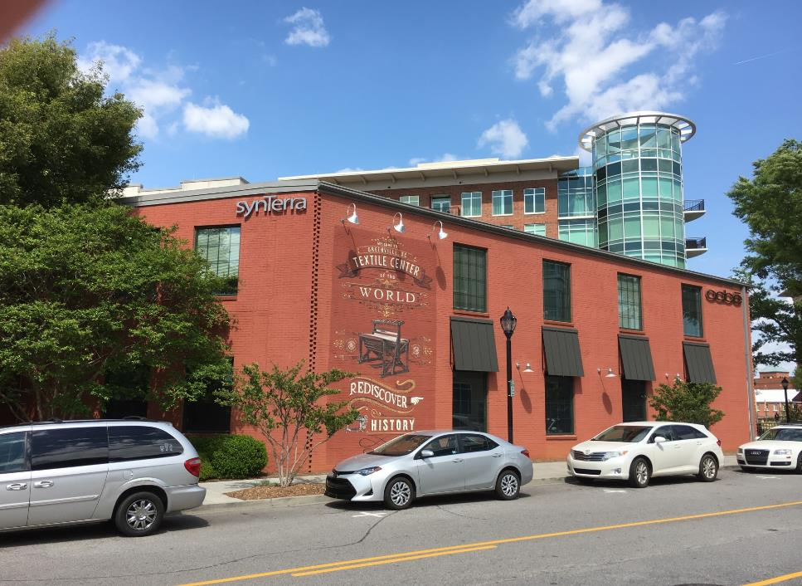
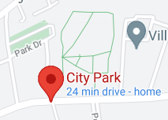
Downtown Greenville HQ:
Our headquarters office is conveniently located under 15 miles from City Park.
Notes:
JOSH
The majority of our team allocated to this project, is less than a 30 minute drive away from this site, making coordination both efficient and accessible. SynTerra has identified key individuals from our other offices that bring specific experience that compliments this project. We are constantly working collaboratively between offices, we do it every day, it comes natural. We also encourage it because innovative ideas and creativity can blossom when we work collaboratively. In addition, communication between SynTerra, CJS, Mike Ridgeway, and Burdette will continue to be prompt, allowing the urban design to work hand in hand with the engineering, traffic and electrical project components.
We built our project team this way because we believe that bringing the needed expertise to the table upfront allows a comprehensive and more holistic project to be delivered.
Collectively we will be responsive to project needs

Slide 11
Invested in the Upstate
Long history of delivering successful engineering solutions and working alongside municipalities and government agencies both locally and across the Southeast
Local participation in regional groups
We want to be a long-term partner as Simpsonville grows. We live, work, and play here too.
Notes:
JOSH
FoRR, Energy and Environmental Compliance Committee with the Greenville Chamber, SC Adopt a Stream, and many more

Slide 12
Invested in the Upstate We give back to our community
United Way of Greenville County
American Red Cross Greenville Chapter
Greenville Humane Society
Upstate Forever
Greenville Chamber Member
Upstate Alliance & TATT investors
Blue Ridge Chapter Michael J. Fox Foundation
Public Education Partners of Greenville County
Just a few of the organizations we support!
Notes:
JOSH

Slide 13
SynTerra’s Goal
Our Goal is to meet our clients’ objectives in a cost-effective way while achieving compliance with laws, rules, and regulations.
Notes:
JOSH We not only have experience and have built relationships with regulators in South Carolina, which allows us to propel projects forward efficiently.
But we also have regulators as our clients because of our expertise.
They look to us for solutions to their problems.
They will be a stakeholder and partner to this project.

Slide 14
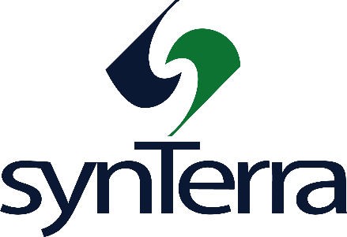
Team Approach
Notes:
KATHERINE
SynTerra and ColeJenest & Stone, Ridgeway Traffic Consulting, and Burdette Engineering are collaborating together to provide Simpsonville with one comprehensive solution. We bring the best of our diverse experience to thoughtfully work through any project tasks and challenges.
Our collaborative project methodology will enable us to align with the City and work across a broad team of complimenting expertise to deliver this project. We bring local experience and the regulatory agency relationship that will help allow this project to progress in a smooth manner, while also bringing outside experience with cities across the southeast and beyond.
We also all appreciate the importance of planning ahead. We want to make sure that we understand the previous work that has been completed, the flexibility with those plans and studies, and really take the time to understand both short term and long term goals for this prominent project.
We know we need to plan for the farmers market and flow and parking that relates to that activity. We will want to kickstart this project with a robust discussion of what else you want to happen here. We want to keep in mind what already works on this parcel and what you all would like to happen on this parcel. In your plan I saw pictures of kids in hallow costumes, concerts, frisbee golf, sporting events. Lets work together to make all these possible!

Slide 15
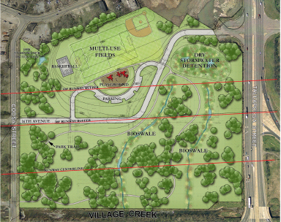
Team Experience
Vast project experience, designing public spaces with engineering in mind
Notes:
KATHERINE

Slide 16
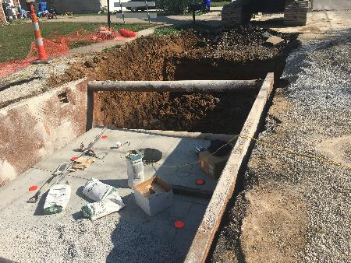
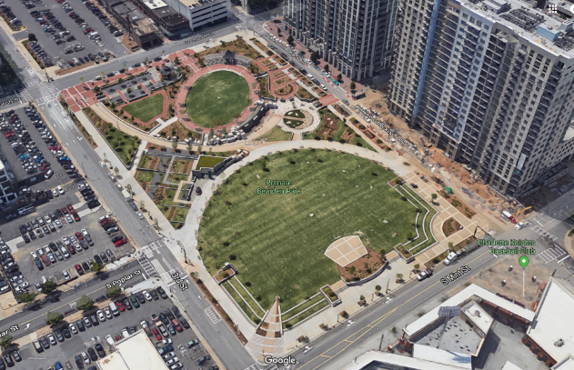
Team Experience (cont.)
Permitting
Drainage design
Utility coordination and relocation
Regulatory coordination
Preliminary and final designs
Construction management
Notes:
KATHERINE

Slide 17
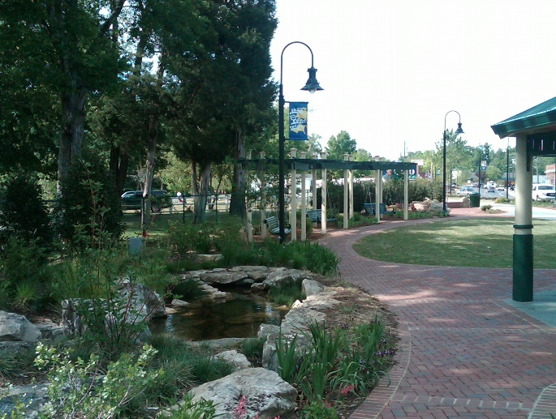
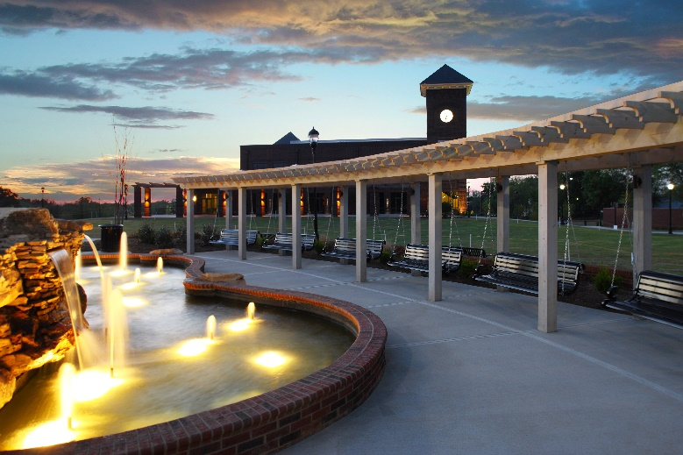
Team Experience (cont.)
Electrical planning and design
Power distribution
LEED design
Traffic studies
Signal timing
Parking studies
Signal design
Notes:
KATHERINE

Slide 18
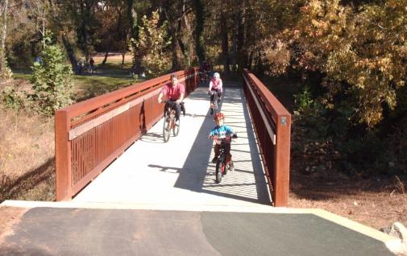
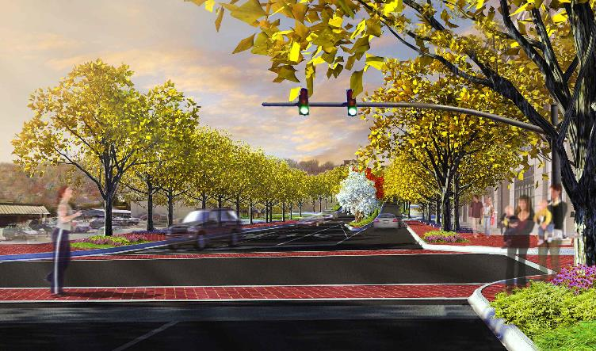
Team Experience (cont.)
Streetscape
Wayfinding
Recreational stormwater projects
GSI/LID features
Nature trails
Educational kiosks
Public safety features
Placemaking
Notes:
KATHERINE
Our team has worked on every component of this project and will be ready to address project needs

Slide 19
Key Success factors
Notes:
BRIAN
Let’s get into some specifics

Slide 20
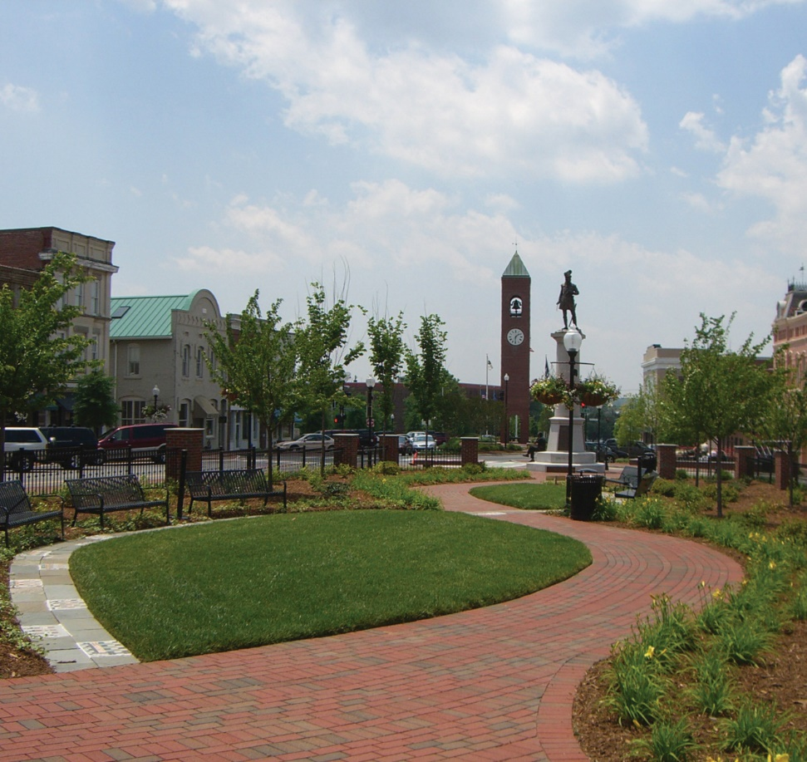
Key Success Factors
Public Space
Creating a space both loved and used by the community and visitors alike
Destination to explore
Keeping the public engaged, excited and informed
Data and Graphics Management
GIS management
Notes:
BRIAN Start by mentioning that you live and recreate here, you also drive the roads that surround this project. Make a plug that this means something to you personally and with your family.
A key to this project’s success is that you end up with a public space that is both loved and consistently utilized.
It needs to be a destination that locals and visitors want to explore. It needs to connect to existing and potential future pedestrian access points. It needs to be a functional space supporting uses that Simpsonville values: for example you want space that people can just throw a blanket down for a picnic and you want space for more formal events.
We know the charrette process was included in the Downtown Master Plan process. That being said, we feel it is important to keep the public engaged and excited about the project. One affordable way to do this is through graphics and interactive websites. Our ROBUST design team is fully equipped to help with this effort providing assistance from a press releases to an interactive StoryMap that can be updated throughout the project.
We are also experienced and capable of both in person and virtual public engagement
More details about GIS
SynTerra’s online GIS offerings include password-protected synchronized 2D/3D data visualizations, query-driven statistical analysis with full chart/graph support, 2D/3D measurement capabilities, 2D sketching tools, Apple/Android/Windows mobile device support, mobile data editing, custom print layouts, and more. What is a StoryMap: We also offer Story Map development and support, integrating the power of GIS in an interactive PowerPoint-like format that are great for presentations and reports.

Slide 21
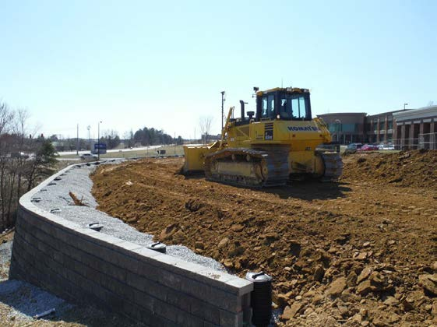
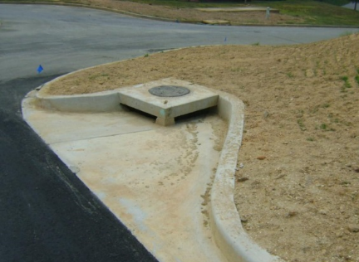
Key Success Factors
Engineering
Sidewalk, Curb, & Gutter
Grading and Drainage
GSI/LID
Utilities
Limitations
Triple Bottom Line
Notes:
BRIAN
We recognize that there are many components of this project will drive it’s success.
This is an engineering project at its core. The success of this park space and the streetscaping relies on really good survey, as builts, utility analysis and the ability to work around existing limitations to this project.
We bring the multifaceted engineering required for project success, including geotechnical analysis, civil site design, permitting, erosion control, stormwater.
Again we will be responsible with the City’s funding for this Project and will make suggestions to improve the City Park Project from start to finish and we will focus on this Project being a long-term and sustainable initiative for the City of Simpsonville

Slide 22
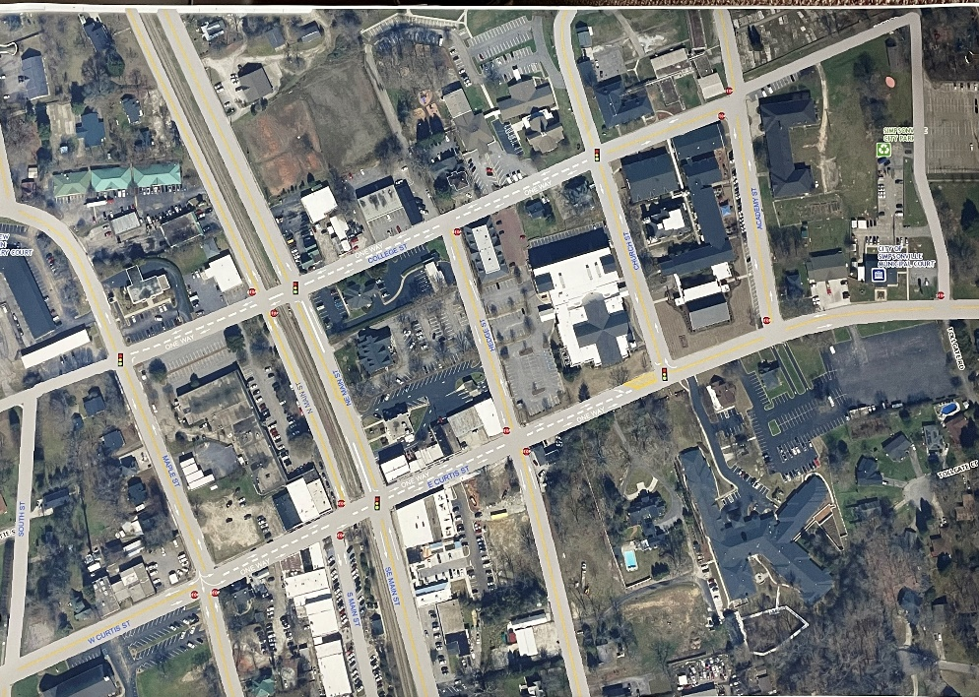
Key Success Factors
Realigning Traffic Patterns
SCDOT as a key partner
Safety
Funding
Notes:
BRIAN
ADD
Other Grants: Our firms also have vast experience with many grants including, RIA, CDBG, South Carolina Revolving Loan Funds, C funds, Department of Commerce funds
Private Investment: We think the prominence of this park could garner private investment to offset some of the costs not only from traditional businesses but even think about partnering with local schools. Furman or even the SC Governor’s School for the Arts and Humanities funding assistance.

Slide 23
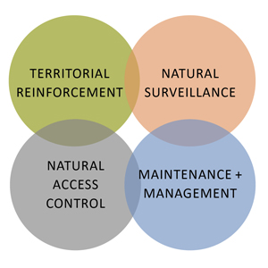
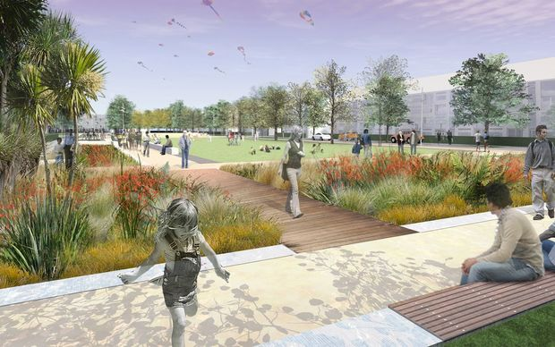
Key Success Factors
Design
Model for green projects in the Upstate and Beyond
Sustainable and Timeless
Species Selection
Wayfinding
Connectivity
Limitations
CPTED Design Principles
Notes:
KEVIN
General Design points feel free to elaborate on all of these
CPTED is defined as a multi-disciplinary approach for reducing crime through urban and environmental design and the management and use of built environments. In planning this space we will keep these principles in mind at the forefront. Katherine is a CPTED professional

Slide 24
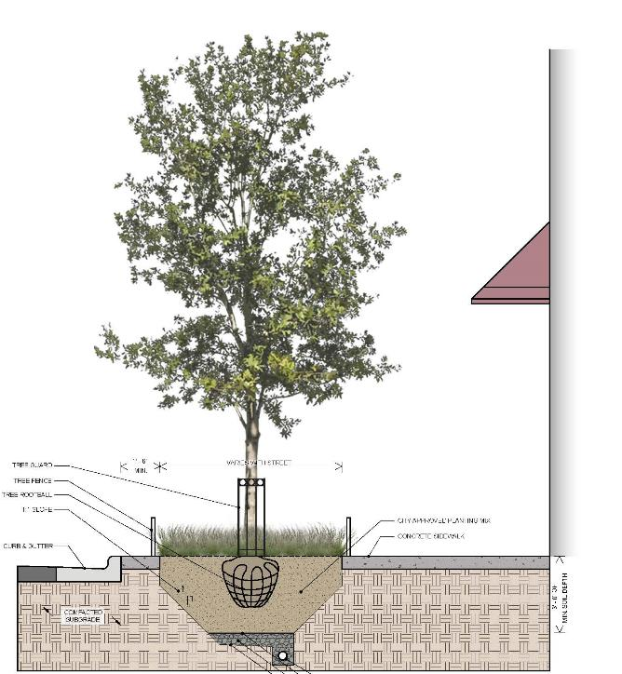
Key Success Factors
Assessment
Inventory existing conditions
Evaluate local ordinances and standards
Establish Goals
Technical Considerations
Utility Conflicts
Notes:
KEVIN
Inventory & Mapping of Existing Conditions
Evaluation of Downtown Master Plan
Evaluate Existing local and County tree ordinance and standards
Establish Community/Simpsonville Goals
Establish project goals for GSI (Green Stormwater Infrastructure) and LID (Low Impact Development) principles
Subsurface Drainage & Routing of needed drainage
Develop minimums for soil volume and standard for implementation (open planter, suspended slab and/or modular suspended pavement system)
Irrigation Standards
Overhead Utility conflicts
Subsurface Utility conflicts affecting the root ball depths or limiting soil volume
Finding good tree stock (inventory supply/caliper size/healthy root and branching structure)
Utility conflicts affecting the root ball depths or limiting soil volume
Routing the subsurface drainage

Slide 25
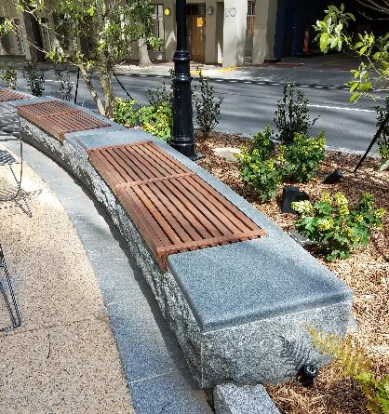
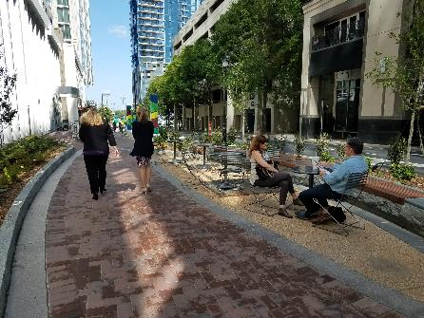
Key Success Factors
Design Considerations
Biodiversity
Careful tree selection
ANSI Standards
Placemaking
Pedestrian Zones
Paving and Furnishings
Notes:
KEVIN
Biodiversity – Careful tree selection
Climate-appropriate plants
Respectful biodiverse palette
Weather patterns
Shade canopy
Cost effective maintenance plan
Identifiable spaces
ANSI Standards
Soil specifications
Paving Standards
Pedestrian Zones
Placemaking Opportunities
Streetscape Furnishing Standards

Slide 26
We are your Team
Downtown Master Plan Implementation
Sustainable streetscape and Urban Design
Stakeholder Engagement
Challenges and Adaptability
Stay true to Simpsonville brand
Notes:
KATHERINE Bring it home
Our team brings a multifaceted and experienced approach to engineering, landscape architecture, urban design, traffic, and electrical.
We are invested in this community!!

Slide 27
Questions & Discussion
We want to deliver YOUR VISION
Notes:
KATHERINE

Slide 28
POCKET SLIDES – NEED TO UPDATE
Photo Credit:

Slide 29
Story Map Example
https://maps.synterracorp.com/cityofclinton/opportunityzoneretail/index.html
Photo Credit:

Slide 30
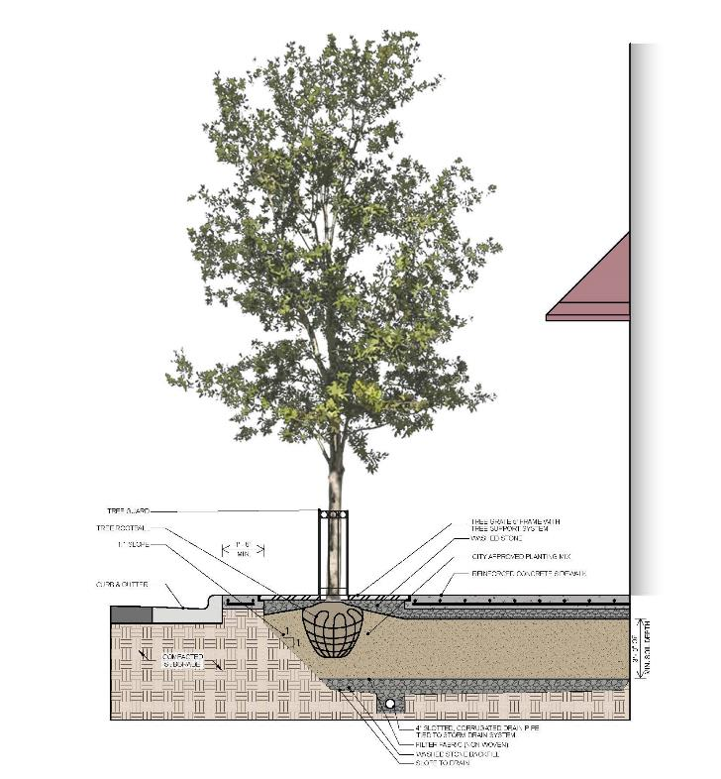
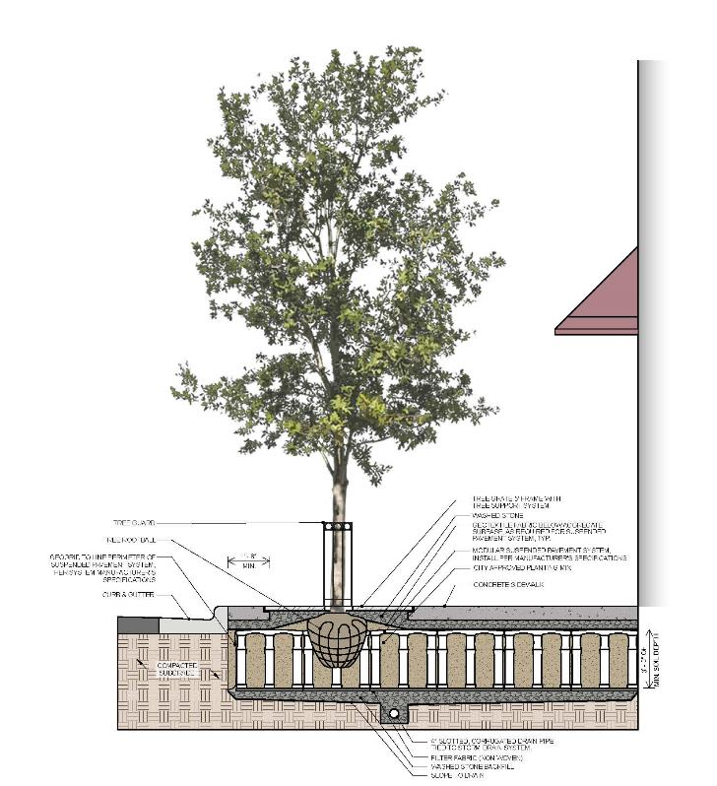

Slide 31
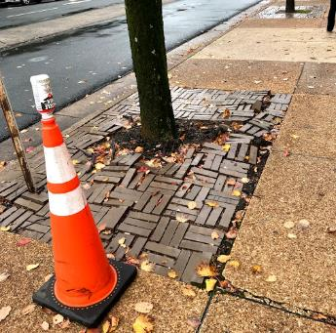
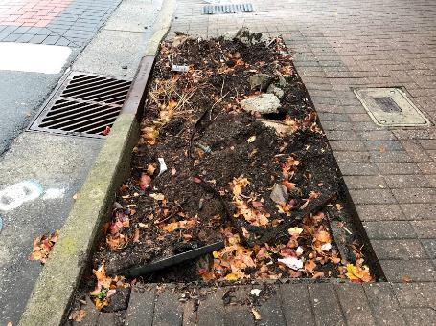
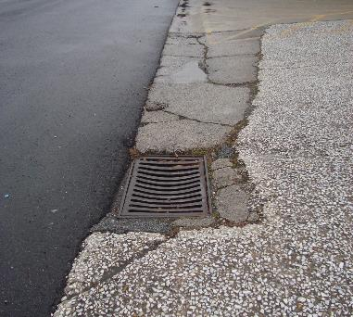
Key Success Factors
Inventory and Analysis
Inventory & mapping of existing conditions
Evaluation of Poinsett Highway + Center Street Corridor Study
Evaluate Existing local and County tree ordinance and standards
Establish Community/TR Goals
Use Downtown Master Plan & Corridor study to define cross sections
Assess existing and right-of-way needs

Slide 32
Key Success Factors
Technical Considerations
Develop minimums for soil volume and standard for implementation (open planter, suspended slab and/or modular suspended pavement system)
Establish soil specifications
Maintenance plan
Subsurface drainage & routing of needed drainage
Routing the subsurface drainage
Inventory & mapping of existing conditions
Establish project goals for GSI (Green Stormwater Infrastructure) and LID (Low Impact Development) principles
Evaluate existing local and County tree ordinance and standards
Develop minimums for soil volume and standard for implementation (open planter, suspended slab and/or modular suspended pavement system)

Slide 33
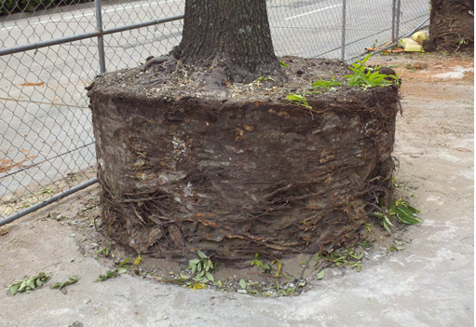
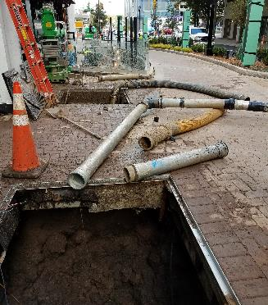
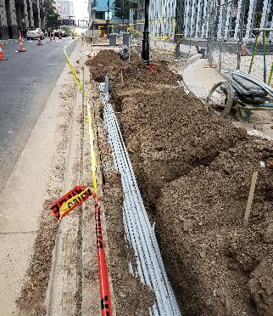
Key Success Factors
Technical Considerations
Irrigation Standards
Overhead Utility conflicts
Subsurface Utility conflicts affecting the root ball depths or limiting soil volume
Finding good tree stock (inventory supply/caliper size/healthy root and branching structure)
Utility conflicts affecting the root ball depths or limiting soil volume

Slide 34
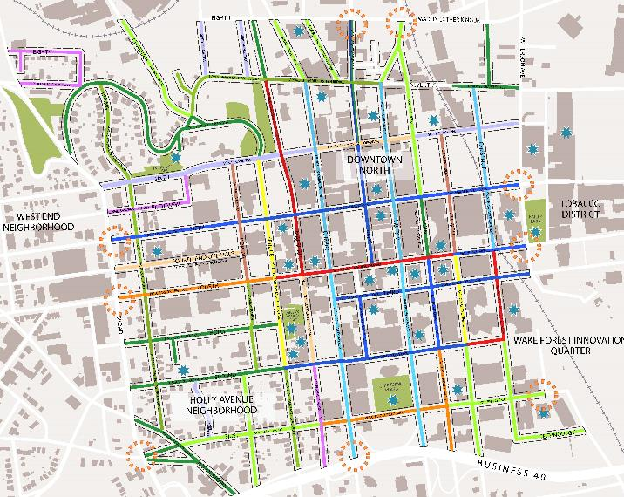
Urban Tree Considerations
Biodiversity – Careful tree selection
Climate-appropriate plants
Respectful biodiverse palette
Weather patterns
Shade canopy
Cost effective maintenance plan
Identifiable spaces
ANSI Standards
Soil specifications

Slide 35
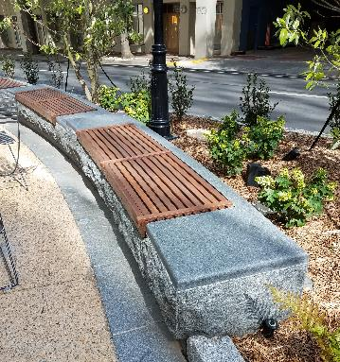
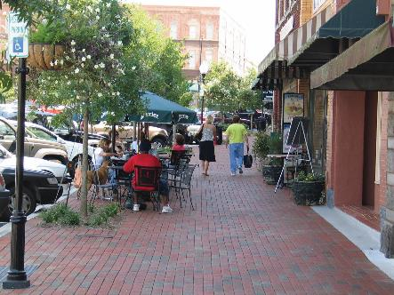
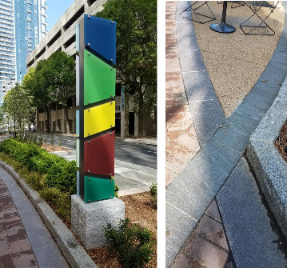
Design Considerations
Paving and hardscape standards
Pedestrian and amenity zones
Placemaking opportunities – retail and civic spaces
Streetscape furnishing and material standards
Lighting, benches, planters, tree grates, signage, landscape guards, etc.

Slide 36
Case Study 01: Brevard Streetscape
BEFORE: Street View
PROPOSED: Perspective Rendering
Auto-dependent streetscape
Narrow sidewalks
Sparse street tree
Existing trees lack adequate growth area & optimum growing conditions
Maintained existing Right of Way
Tree lined boulevard with planted median
Cohesive planting
Protected Pedestrian Zone

Slide 37
Case Study 01: Brevard Streetscape
Reduced existing travel lane widths to accommodate planting and hardscape areas
Improved the pedestrian experience with wider sidewalks and bump-outs
Addition of on-street parking
BEFORE
AFTER

Slide 38
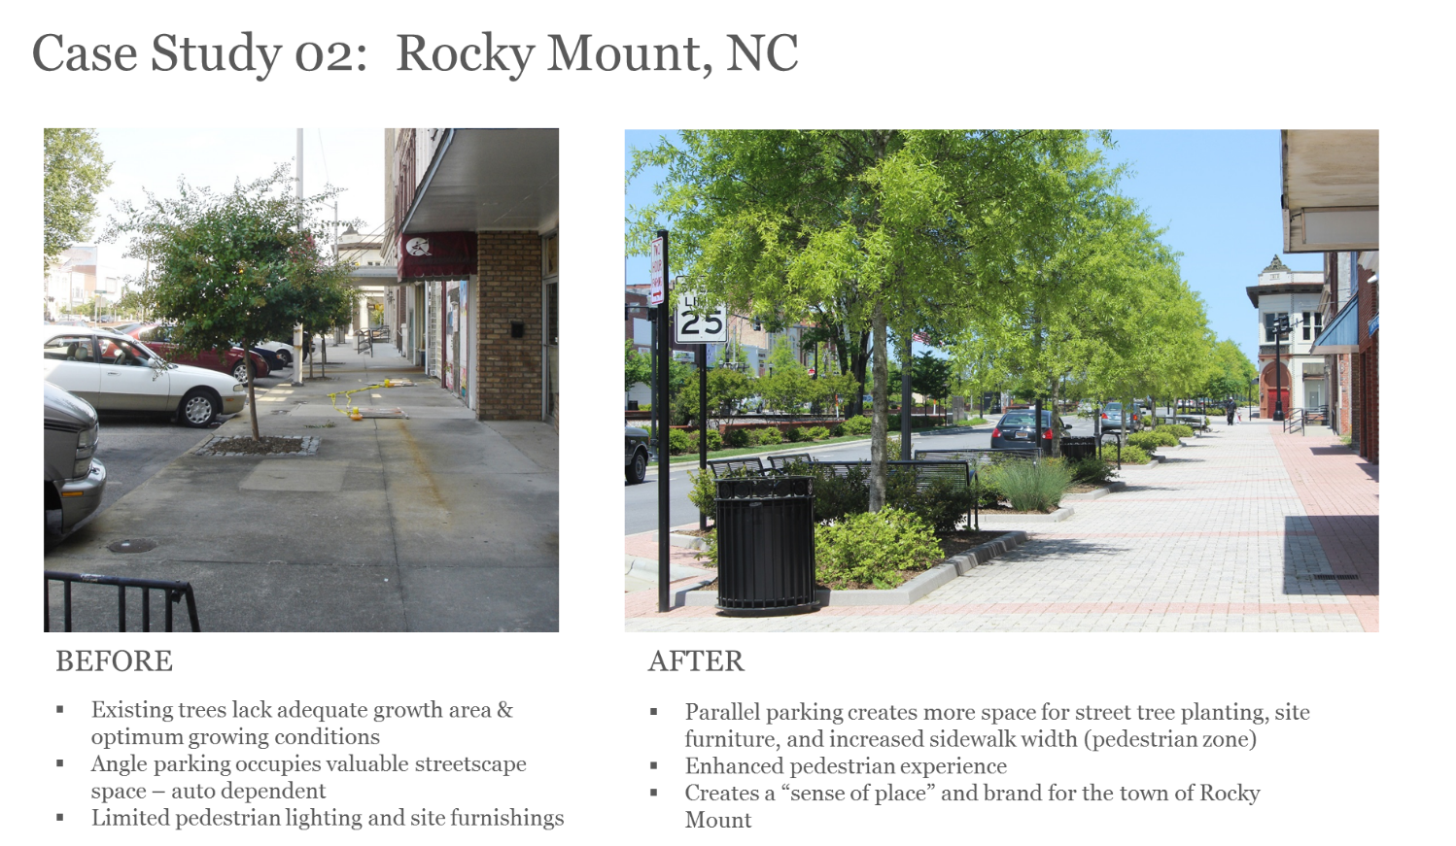

Slide 39
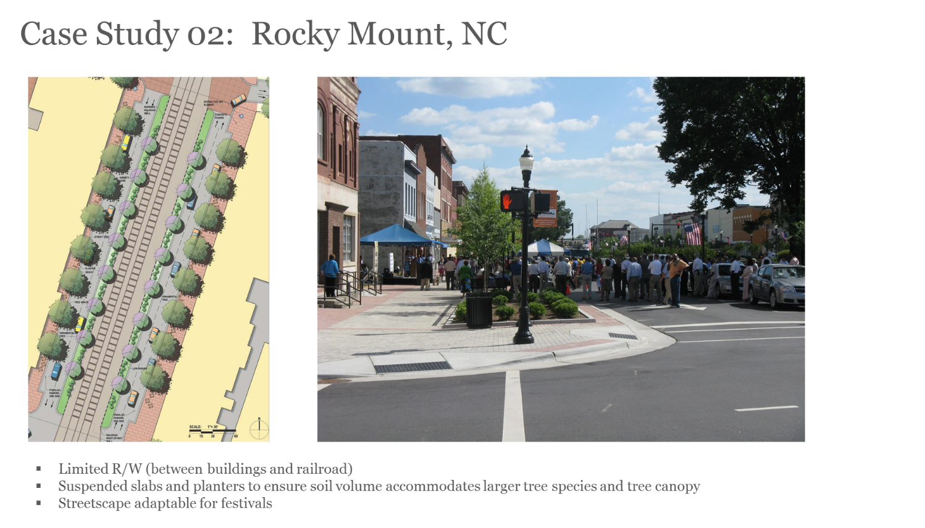

Slide 40
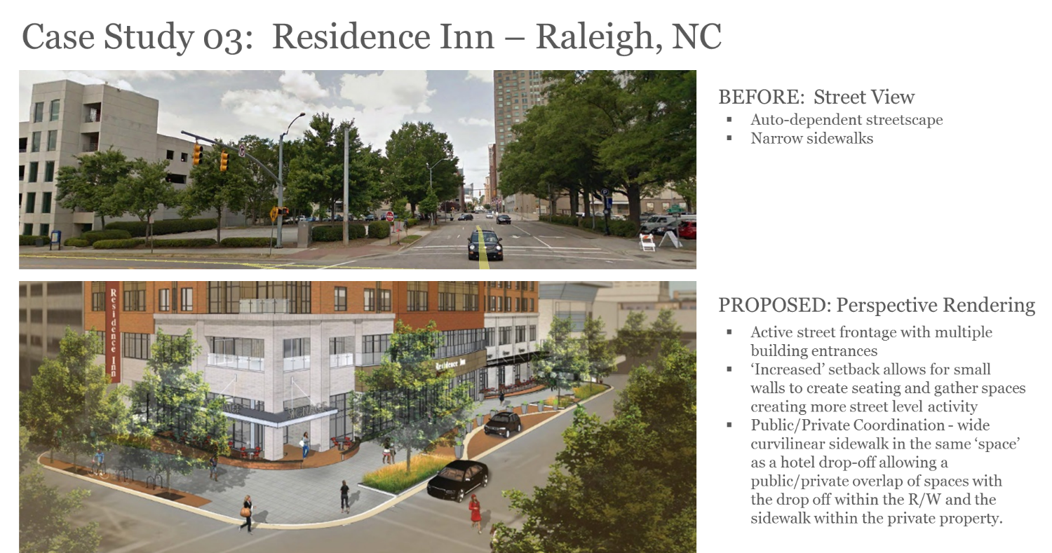

Slide 41
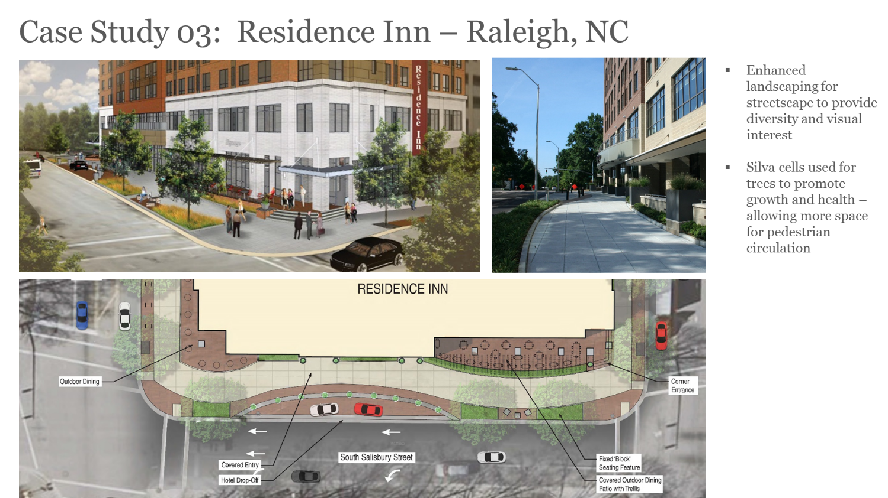

Slide 42
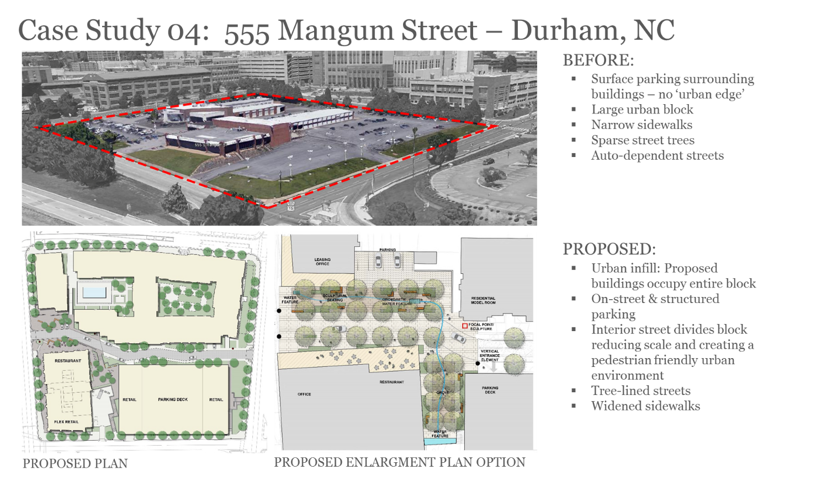

Slide 43
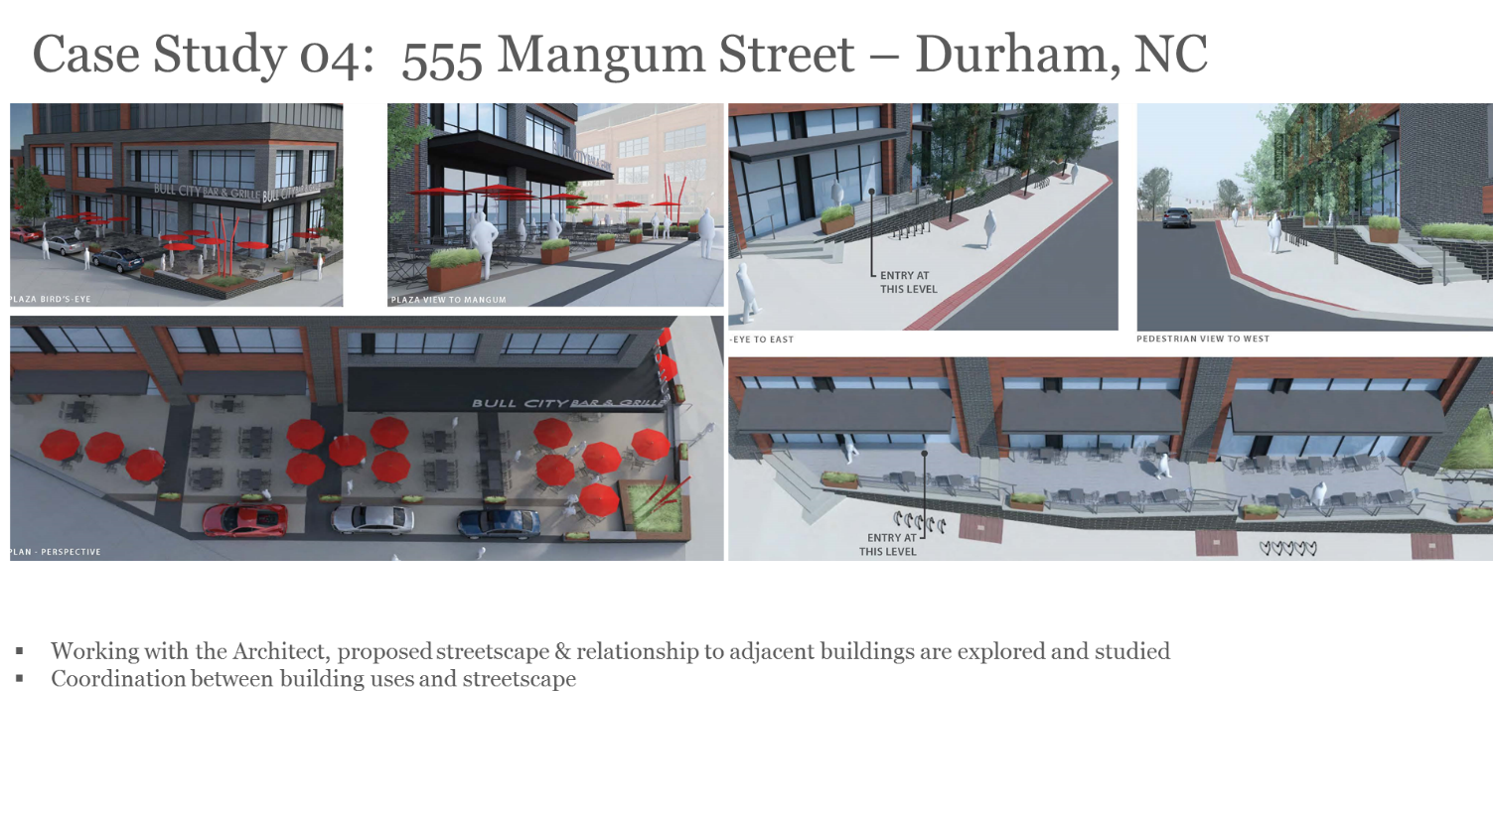

Slide 44
