Slide 1
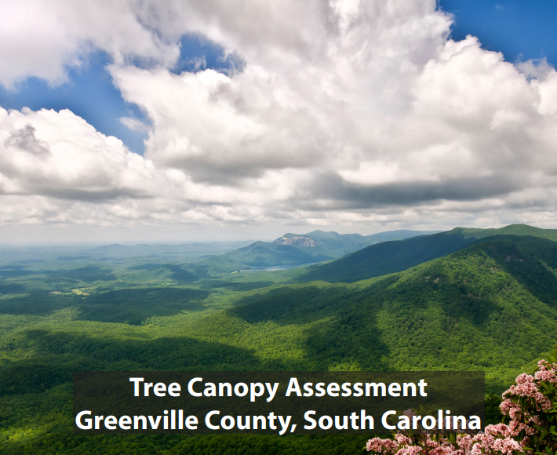

Riparian Buffers & Growth Management
Greenville County, SC
Rashida Jeffers-Campbell, AICP - Greenville County Planning Director
Meagan Staton, AICP – Greenville County Subdivision Administrator
Notes:
"Before we dive into today’s topic, raise your hand, if you have ever seen a product or a plan that seemed so ambitious that you thought, they lyin - there’s no way this is going to work
"Well, that's how I felt when it came to aligning Greenville County's development with our comprehensive plan's policies. But in January of this year, we made a big leap forward. The County adopted an ordinance that establishes countywide riparian buffer requirements and design standards for major subdivisions served by septic which advertently established minimum infrastructure requirements for major subdivisions.
With the adoption of this ordinance, we’ve taken a crucial step toward not only protecting water quality and but also sustainable growth.

Slide 2
THE CONTEXT & OUR CHALLENGE
1
Agenda
  OUR CASE & INITIAL DRAFT
  2
  PROCESS & STAKEHOLDER CONCERNS
  3
  FINAL DRAFT & ADMINISTRATION
  4
  OUTCOMES & TAKE AWAYS
  5

Slide 3

The Context:
2/3 of County Unzoned
Rapid Scattered Growth
No Capital Improvement Program
Misalignment of Policies & Regulations
Increased Litigation
MS4 Permit Compliance
Public Health & Safety Concerns
Notes:
As it relates to growth management, the concerns are:
Land consumption rates due to the continuance low density development beyond urbanized areas where public sewer, adequate transportation facilities, and other services are largely unavailable.
Loss of community open,
Diminished quality of life
And makes the prospect of expanding infrastructure to these areas inefficient and costly.

Slide 4

Our
Challenge
Make a strong case
Get an audience with County Council
Engage Stakeholders
Build Consensus

Slide 5
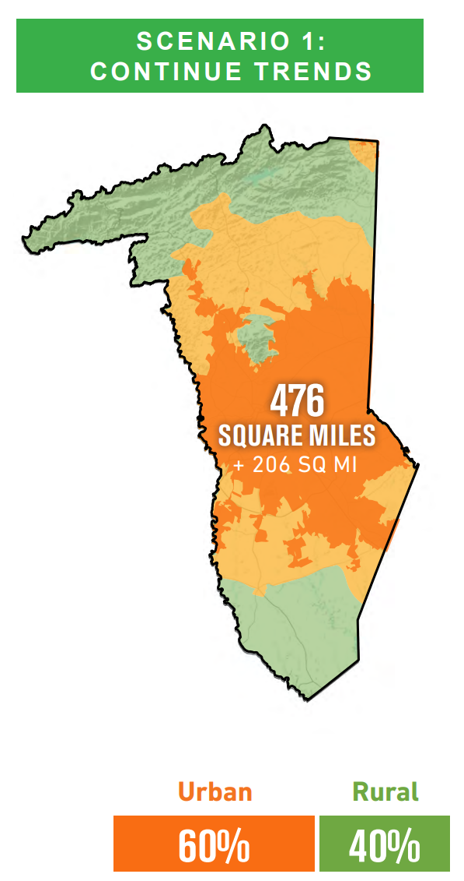
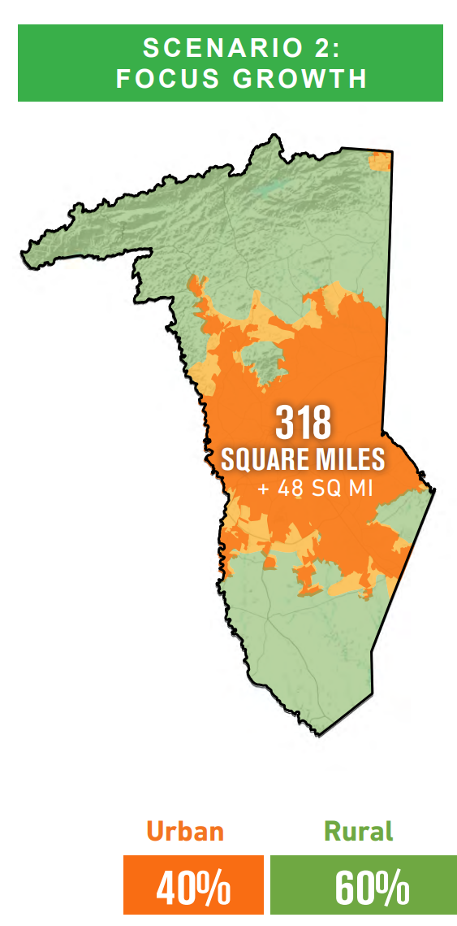
Comprehensive Land Use Policy (2040 Horizon): Rationale
Focused Growth & Increase Density in Urbanized Areas
High Cost of Expanding Critical Infrastructure & Service
Affordable Housing
Loss of Open Space & Rural Land
Traffic

Slide 6
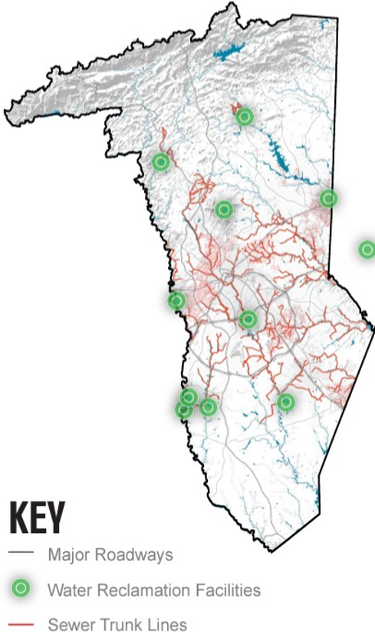
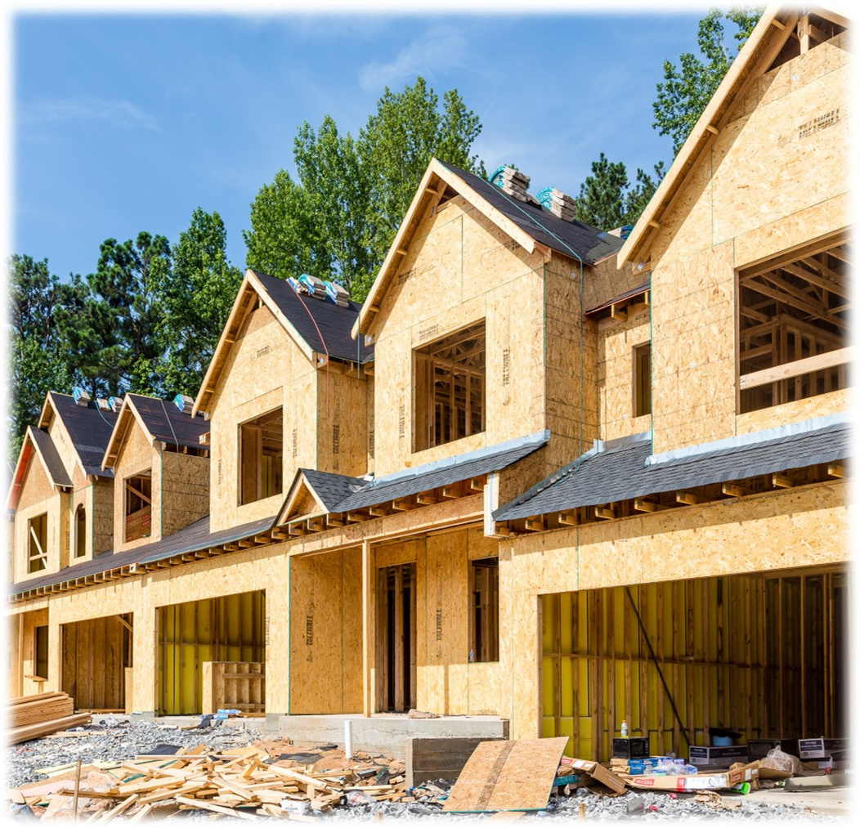

Our Case
Growth Management
Land Consumption
Transportation Network
Critical Infrastructure
Community Opens Space
Quality of Life
Environmental Protection
Water Quality
Habitat Cores and Corridors
Public Health & Safety
Notes:
we made a case for the ordinance based on the growth management and water quality issues identified in the comprehensive plan.

Slide 7

A Strong Case: Water Quality
65% of watersheds impaired
Local studies confirm contamination due to septic tank density
County’s 2021 NPDES Permit (new TMDL compliance requirement)
TMDL - point and nonpoint source pollution (such as septic systems)
NPDES Permits only regulate point source pollution
The burden is on the County to regulate septic developments
Notes:
Rationale & Need for the Ordinance:
Limit the use of septic systems
Limit high density developments in areas where infrastructure can’t be easily expanded.
Align the LDR with the County’s MS4 Permit compliance requirements
Provide a regulatory tool to implement the policies of the comprehensive plan.

Slide 8
Initial Draft
Subdivisions with 10 or more lots
  Unzoned areas - 1.5 acre min.lot size requirement applies
  Zoned areas -SCDEC min. lot size requirements
Riparian Buffer Requirements
  Min. 50’ buffer along all waters of the U.S. -all development s
  Min. 100' buffer for major subdivision served by septic in the unzoned area.
Notes:
Rationale & Need for the Ordinance:
Limit the use of septic systems
Limit high density developments in areas where infrastructure can’t be easily expanded.
Align the LDR with the County’s MS4 Permit compliance requirements
Provide a regulatory tool to implement the policies of the comprehensive plan.

Slide 9


Stakeholder Concerns:
  Lost economic activity due to buffer ordinance
  Limited land within the Urbanized Areas
  100' buffer too restrictive on private property
  Increased housing costs and urban sprawl
  Minimum infrastructure requirements - devalues private property in unzoned areas
  Area zoning is difficult to accomplish

Slide 10
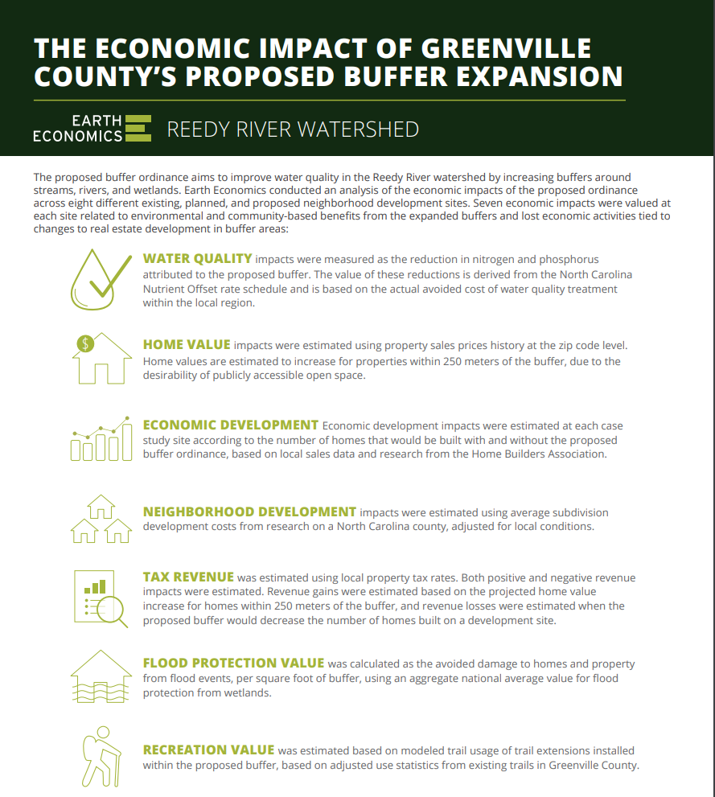

The Reedy River Water Quality group is a local consortium with the goal of reducing nutrient levels in the watershed and avoiding a state-mandated clean-up plan.

Slide 11
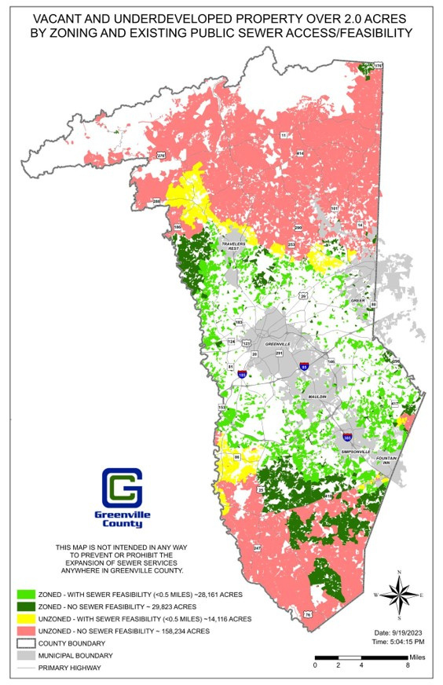
Land Availability:
  Zoned areas with feasible sewer access – 28,161 acres
  Unzoned areas with feasible sewer access – 14, 116 acres
Notes:
Based on land consumption rates in 2022, the available land served by public sewer would accommodate the next 15 years.

Slide 12
Final Draft
Subdivisions with 10 or more lots
  Unzoned areas - 1.5 acre min.lot size requirement applies
  Zoned areas -SCDEC min. lot size requirements
Riparian Buffer Requirements - All Developments
  Min. 50’ buffer along all waters of the state
  Min. 100' buffer along all waters of the state within watersheds draining 50 or more acres.
Notes:
Rationale & Need for the Ordinance:
Limit the use of septic systems
Limit high density developments in areas where infrastructure can’t be easily expanded.
Align the LDR with the County’s MS4 Permit compliance requirements
Provide a regulatory tool to implement the policies of the comprehensive plan.

Slide 13

Timeline
Five(5) P&D Committee Presentations &
Draft Ordinance Approved
1st & 2nd Reading
HBA, GGAR, and
Upstate Forever Meeting
Two (2) Stakeholder Workshops & multiple canceled public hearings and readings
Public Hearing & Adoption
May -August 2023
September 2023
October - November 2023
October - November 2023

Slide 14
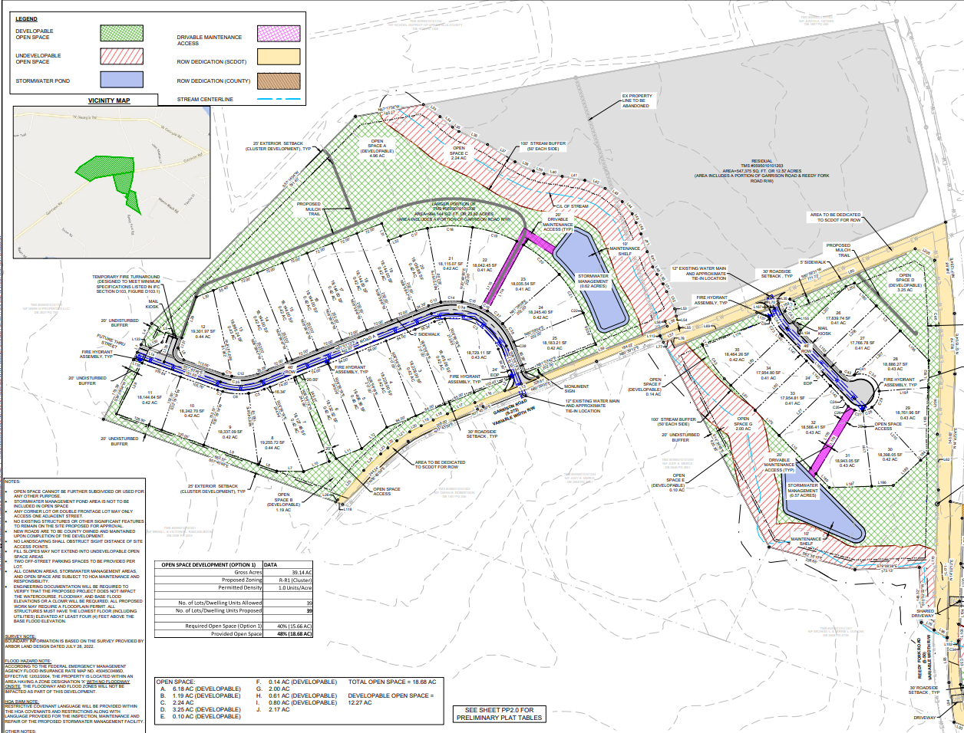
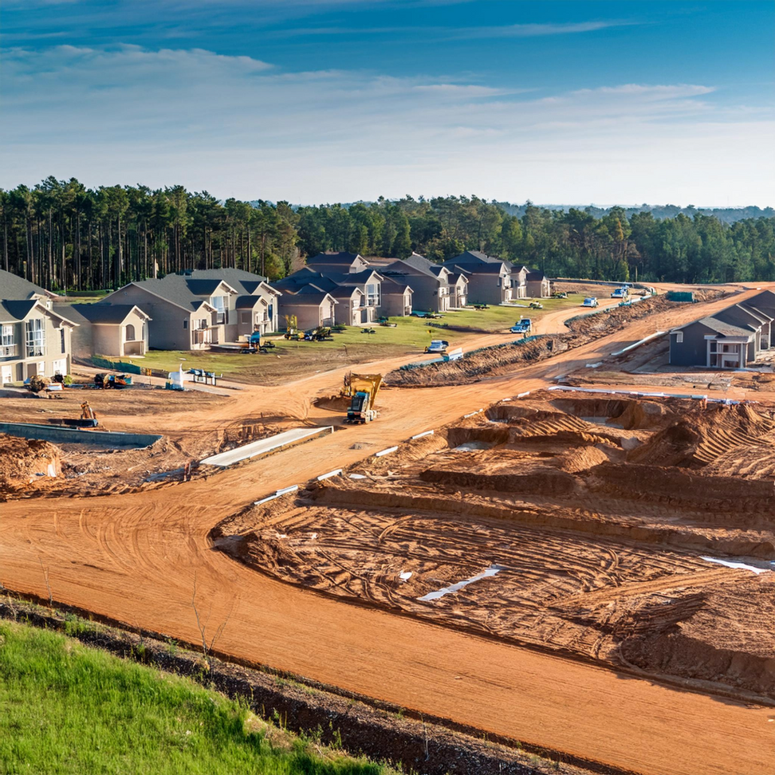
Ordinance Administration
Preliminary Plan Phase
  Submittal Requirements
  Coordination with Land Development (Stream Classification)
Grading Permit Phase
  Delineation of all jurisdictional waters or streams classified as waters of the state.
  No disturbance in the buffer area
Notes:
Rationale & Need for the Ordinance:
Limit the use of septic systems
Limit high density developments in areas where infrastructure can’t be easily expanded.
Align the LDR with the County’s MS4 Permit compliance requirements
Provide a regulatory tool to implement the policies of the comprehensive plan.

Slide 15
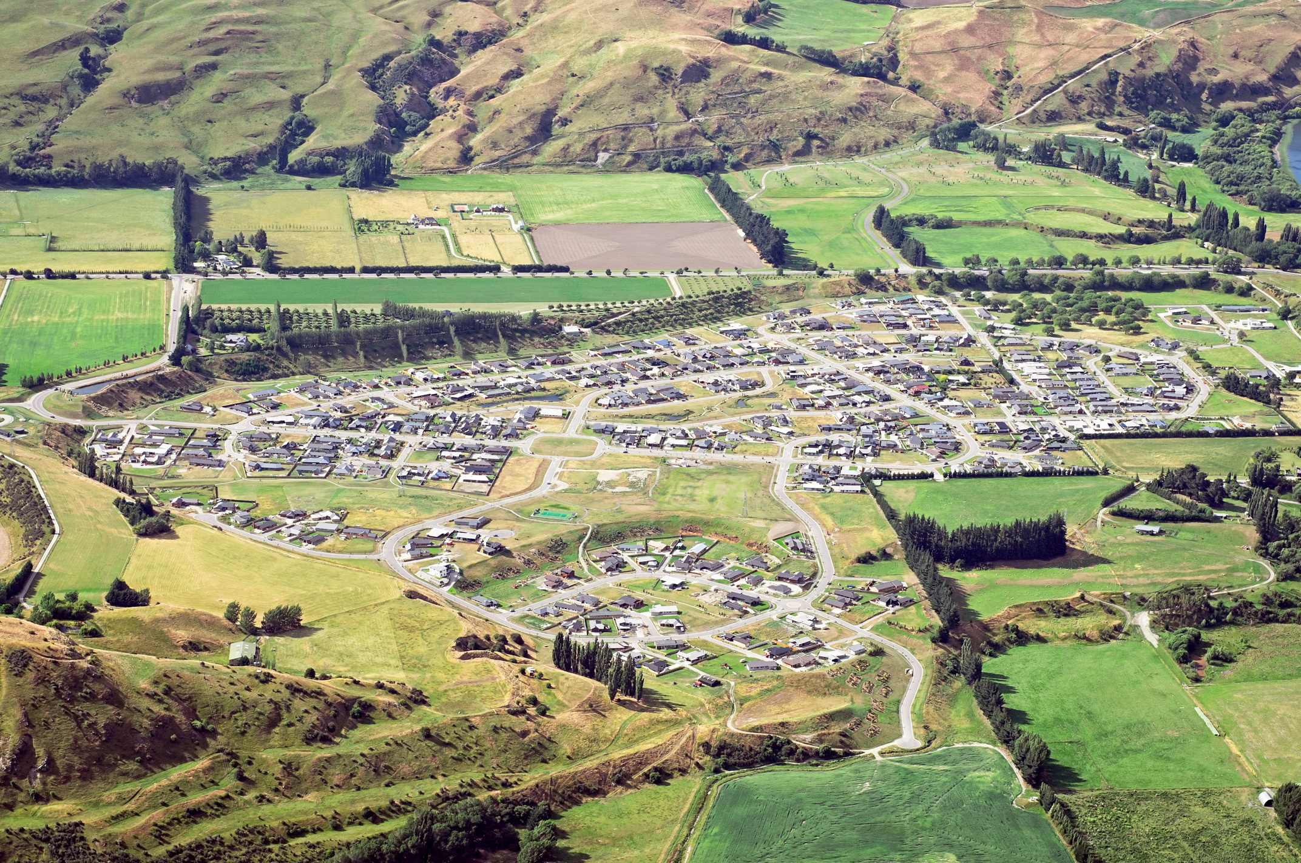
Council Resolution
Assess the impact of major subdivisions served by septic systems in the Unzoned areas of Greenville County.
Report Requirements:
  Annual count of approved major subdivisions served by septic systems within the unzoned and zoned areas
  Approved major subdivision served by public sewer systems within the unzoned and zoned areas
  Approved total lots and acres encompassed by approved subdivisions served by septic systems in unzoned and zoned areas.
  Total lots and acres encompassed by approved subdivisions served by public sewer in the unzoned and zoned areas.

Slide 16

Outcomes & Trends
ORDINANCE EFFECTIVENESS
No Increase in Large-Lot Subdivisions:
The absence of new applications for large-lot subdivisions in unzoned areas without public sewer is a direct reflection of the ordinance’s effectiveness in curbing urban sprawl in these areas.
SEPTIC SYSTEM STANDARDS:
By updating design standards for septic systems, the ordinance ensures that developments relying on these systems are more environmentally sustainable and aligned with long-term water quality and growth management goals.
RIPARIAN BUFFER PROTECTION:
The introduction of riparian buffer requirements has begun to safeguard water quality, reducing the potential negative impact of septic systems on local waterways.

Slide 17



Short range planners have a critical role to play in implementing the comprehensive plan
Take Aways
Balancing act of planning and political will
Best practice and compliance are foundational

Slide 18
QUESTIONS
Rashida Jeffers-Campbell, AICP - Greenville County Planning Director
Meagan Staton, AICP – Greenville County Subdivision Administrator
Notes:
"Before we dive into today’s topic, raise your hand, if you have ever seen a product or a plan that seemed so ambitious that you thought, they lyin - there’s no way this is going to work
"Well, that's how I felt when it came to aligning Greenville County's development with our comprehensive plan's policies. But in January of this year, we made a big leap forward. The County adopted an ordinance that establishes countywide riparian buffer requirements and design standards for major subdivisions served by septic which advertently established minimum infrastructure requirements for major subdivisions.
With the adoption of this ordinance, we’ve taken a crucial step toward not only protecting water quality and but also sustainable growth.

