Slide 1

Land Use Law: The Role of County & City Attorneys
SCAPA Fall Conference 2024
Bob Coler
John Harris
Todd Okolichany, AICP
Source: Chapman Cultural Center

Slide 2
South Carolina Local Government Comprehensive Planning Enabling Act of 1994
Title 6, Chapter 9 of the SC Code of Laws
Article 1 - Creation of Local Planning Commission
Article 3 - Local Planning - The Comprehensive Planning Process
Article 5 - Local Planning - Zoning
Article 7 - Local Planning - Land Development Regulation
Article 9 - Educational Requirements for Planning or Zoning Officials and Employees
Article 11 - Vested Rights

Slide 3
Article 1 - Creation of Local Planning Commission
Section 6-29-320
The city council of each municipality may create a municipal planning commission. The county council of each county may create a county planning commission. The governing body of a consolidated government may create a planning commission. Any combination of municipal councils and a county council or any combination of municipal councils may create a joint planning commission.

Slide 4
Article 1 - Creation of Local Planning Commission
Section 6-29-330
A) A municipality may exercise the powers granted under the provisions of this chapter in the total area within its corporate limits. A county may exercise the powers granted under the provisions of this chapter in the total unincorporated area or specific parts of the unincorporated area. Unincorporated areas of the county or counties adjacent to incorporated municipalities may be added to and included in the area under municipal jurisdiction for the purposes of this chapter provided that the municipality and county councils involved adopt ordinances establishing the boundaries of the additional areas, the limitations of the authority to be exercised by the municipality, and representation on the boards and commissions provided under this chapter. The agreement must be formally approved and executed by the municipal council and the county councils involved.
(B) The governing body of a municipality may designate by ordinance the county planning commission as the official planning commission of the municipality. In the event of the designation, and acceptance by the county, the county planning commission may exercise the powers and duties as provided in this chapter for municipal planning commissions as are specified in the agreement reached by the governing authorities. The agreement must specify the procedures for the exercise of powers granted in the chapter and shall address the issue of equitable representation of the municipality and the county on the boards and commissions authorized by this chapter. This agreement must be formally stated in appropriate ordinances by the governing authorities involved.

Slide 5
Article 1 - Creation of Local Planning Commission
Section 6-29-340
A) It is the function and duty of the local planning commission, when created by an ordinance passed by the municipal council or the county council, or both, to undertake a continuing planning program for the physical, social, and economic growth, development, and redevelopment of the area within its jurisdiction. The plans and programs must be designed to promote public health, safety, morals, convenience, prosperity, or the general welfare as well as the efficiency and economy of its area of jurisdiction. Specific planning elements must be based upon careful and comprehensive surveys and studies of existing conditions and probable future development and include recommended means of implementation. The local planning commission may make, publish, and distribute maps, plans, and reports and recommendations relating to the plans and programs and the development of its area of jurisdiction to public officials and agencies, public utility companies, civic, educational, professional, and other organizations and citizens. All public officials shall, upon request, furnish to the planning commission, within a reasonable time, such available information as it may require for its work. The planning commission, its members and employees, in the performance of its functions, may enter upon any land with consent of the property owner or after ten days' written notification to the owner of record, make examinations and surveys, and place and maintain necessary monuments and marks on them, provided, however, that the planning commission shall be liable for any injury or damage to property resulting therefrom. In general, the planning commission has the powers as may be necessary to enable it to perform its functions and promote the planning of its political jurisdiction.

Slide 6
Section 6-29-340 Continued
(B) In the discharge of its responsibilities, the local planning commission has the power and duty to:​
(1) prepare and revise periodically plans and programs for the development and redevelopment of its area as provided in this chapter; and​
(2) prepare and recommend for adoption to the appropriate governing authority or authorities as a means for implementing the plans and programs in its area:​
(a) zoning ordinances to include zoning district maps and appropriate revisions thereof, as provided in this chapter;​
(b) regulations for the subdivision or development of land and appropriate revisions thereof, and to oversee the administration of the regulations that may be adopted as provided in this chapter;​
(c) an official map and appropriate revision on it showing the exact location of existing or proposed public street, highway, and utility rights-of-way, and public building sites, together with regulations to control the erection of buildings or other structures or changes in land use within the rights-of-way, building sites, or open spaces within its political jurisdiction or a specified portion of it, as set forth in this chapter;​
(d) a landscaping ordinance setting forth required planting, tree preservation, and other aesthetic considerations for land and structures;​
(e) a capital improvements program setting forth projects required to implement plans which have been prepared and adopted, including an annual listing of priority projects for consideration by the governmental bodies responsible for implementation prior to preparation of their capital budget; and​
(f) policies or procedures to facilitate implementation of planning elements.​

Slide 7
Article 1 - Creation of Local Planning Commission
Section 6-29-350
(A) A local planning commission serving not more than two political jurisdictions may not have less than five nor more than twelve members. A local planning commission serving three or more political jurisdictions shall have a membership not greater than four times the number of jurisdictions it serves. In the case of a joint city-county planning commission the membership must be proportional to the population inside and outside the corporate limits of municipalities.
(B) No member of a planning commission may hold an elected public office in the municipality or county from which appointed. Members of the commission first to serve must be appointed for staggered terms as described in the agreement of organization and shall serve until their successors are appointed and qualified. The compensation of the members, if any, must be determined by the governing authority or authorities creating the commission. A vacancy in the membership of a planning commission must be filled for the unexpired term in the same manner as the original appointment. The governing authority or authorities creating the commission may remove any member of the commission for cause.
(C) In the appointment of planning commission members the appointing authority shall consider their professional expertise, knowledge of the community, and concern for the future welfare of the total community and its citizens. Members shall represent a broad cross section of the interests and concerns within the jurisdiction.

Slide 8
Article 1 - Creation of Local Planning Commission
Section 6-29-370
The governing authority may provide for the reference of any matters or class of matters to the local planning commission, with the provision that final action on it may not be taken until the planning commission has submitted a report on it or has had a reasonable period of time, as determined by the governing authority to submit a report.

Slide 9
Article 3 – Local Planning – The Comprehensive Planning Process
Section 6-29-510
(A) The local planning commission shall develop and maintain a planning process which will result in the systematic preparation and continual re-evaluation and updating of those elements considered critical, necessary, and desirable to guide the development and redevelopment of its area of jurisdiction.
(B) Surveys and studies on which planning elements are based must include consideration of potential conflicts with adjacent jurisdictions and regional plans or issues.
(C) The basic planning process for all planning elements must include, but not be limited to:
(1) inventory of existing conditions;
(2) a statement of needs and goals; and
(3) implementation strategies with time frames.

Slide 10
Section 6-29-510 Continued
(D) A local comprehensive plan must include, but not be limited to, the following planning elements:
(1) a population element which considers historic trends and projections, household numbers and sizes, educational levels, and income characteristics;
(2) an economic development element which considers labor force and labor force characteristics, employment by place of work and residence, and analysis of the economic base;
(3) a natural resources element which considers coastal resources, slope characteristics, prime agricultural and forest land, plant and animal habitats, parks and recreation areas, scenic views and sites, wetlands, and soil types. Where a separate board exists pursuant to this chapter, this element is the responsibility of the existing board;
(4) a cultural resources element which considers historic buildings and structures, commercial districts, residential districts, unique, natural, or scenic resources, archaeological, and other cultural resources. Where a separate board exists pursuant to this chapter, this element is the responsibility of the existing board;
(5) a community facilities element which considers water supply, treatment, and distribution; sewage system and wastewater treatment; solid waste collection and disposal, fire protection, emergency medical services, and general government facilities; education facilities; and libraries and other cultural facilities;

Slide 11
Section 6-29-510 Continued
(6) a housing element which considers location, types, age, and condition of housing, owner and renter occupancy, and affordability of housing. This element includes an analysis to ascertain nonessential housing regulatory requirements, as defined in this chapter, that add to the cost of developing affordable housing but are not necessary to protect the public health, safety, or welfare and an analysis of market-based incentives that may be made available to encourage development of affordable housing, which incentives may include density bonuses, design flexibility, and streamlined permitting processes. The planning commission must solicit input for this analysis from homebuilders, developers, contractors, and housing finance experts when developing this element;
(7) a land use element which considers existing and future land use by categories, including residential, commercial, industrial, agricultural, forestry, mining, public and quasi-public, recreation, parks, open space, and vacant or undeveloped;
(8) a transportation element that considers transportation facilities, including major road improvements, new road construction, transit projects, pedestrian and bicycle projects, and other elements of a transportation network. This element must be developed in coordination with the land use element, to ensure transportation efficiency for existing and planned development;

Slide 12
Section 6-29-510 Continued
(9) a priority investment element that analyzes the likely federal, state, and local funds available for public infrastructure and facilities during the next ten years, and recommends the projects for expenditure of those funds during the next ten years for needed public infrastructure and facilities such as water, sewer, roads, and schools. The recommendation of those projects for public expenditure must be done through coordination with adjacent and relevant jurisdictions and agencies. For the purposes of this item, "adjacent and relevant jurisdictions and agencies" means those counties, municipalities, public service districts, school districts, public and private utilities, transportation agencies, and other public entities that are affected by or have planning authority over the public project. For the purposes of this item, "coordination" means written notification by the local planning commission or its staff to adjacent and relevant jurisdictions and agencies of the proposed projects and the opportunity for adjacent and relevant jurisdictions and agencies to provide comment to the planning commission or its staff concerning the proposed projects. Failure of the planning commission or its staff to identify or notify an adjacent or relevant jurisdiction or agency does not invalidate the local comprehensive plan and does not give rise to a civil cause of action;
(10) a resiliency element that considers the impacts of flooding, high water, and natural hazards on individuals, communities, institutions, businesses, economic development, public infrastructure and facilities, and public health, safety and welfare. This element includes an inventory of existing resiliency conditions, promotes resilient planning, design and development, and is coordinated with adjacent and relevant jurisdictions and agencies. For the purposes of this item, "adjacent and relevant jurisdictions and agencies" means those counties, municipalities, public service districts, school districts, public and private utilities, transportation agencies, and other public entities that are affected by or have planning authority over the public project. For the purposes of this item, "coordination" means written notification by the local planning commission or its staff to adjacent and relevant jurisdictions and agencies of the proposed projects and the opportunity for adjacent and relevant jurisdictions and agencies to provide comment to the planning commission or its staff concerning the proposed projects. Failure of the planning commission or its staff to identify or notify an adjacent or relevant jurisdiction or agency does not invalidate the local comprehensive plan and does not give rise to a civil cause of action. This element shall be developed in coordination with all preceding elements and integrated into the goals and strategies of each of the other plan elements.

Slide 13
Section 6-29-510 Continued
(E) All planning elements must be an expression of the planning commission recommendations to the appropriate governing bodies with regard to the wise and efficient use of public funds, the future growth, development, and redevelopment of its area of jurisdiction, and consideration of the fiscal impact on property owners. The planning elements whether done as a package or in separate increments together comprise the comprehensive plan for the jurisdiction at any one point in time. The local planning commission shall review the comprehensive plan or elements of it as often as necessary, but not less than once every five years, to determine whether changes in the amount, kind, or direction of development of the area or other reasons make it desirable to make additions or amendments to the plan. The comprehensive plan, including all elements of it, must be updated at least every ten years.

Slide 14
Article 5 – Local Planning - Zoning
Section 6-29-710
(A) Zoning ordinances must be for the general purposes of guiding development in accordance with existing and future needs and promoting the public health, safety, morals, convenience, order, appearance, prosperity, and general welfare. To these ends, zoning ordinances must be made with reasonable consideration of the following purposes, where applicable:
(1) to provide for adequate light, air, and open space;
(2) to prevent the overcrowding of land, to avoid undue concentration of population, and to lessen congestion in the streets;
(3) to facilitate the creation of a convenient, attractive, and harmonious community;
(4) to protect and preserve scenic, historic, or ecologically sensitive areas;
(5) to regulate the density and distribution of populations and the uses of buildings, structures and land for trade, industry, residence, recreation, agriculture, forestry, conservation, airports and approaches thereto, water supply, sanitation, protection against floods, public activities, and other purposes;
(6) to facilitate the adequate provision or availability of transportation, police and fire protection, water, sewage, schools, parks, and other recreational facilities, affordable housing, disaster evacuation, and other public services and requirements. "Other public requirements" which the local governing body intends to address by a particular ordinance or action must be specified in the preamble or some other part of the ordinance or action;
(7) to secure safety from fire, flood, and other dangers; and
(8) to further the public welfare in any other regard specified by a local governing body.

Slide 15
Article 5 – Local Planning - Zoning
Section 6-29-780
(A) As a part of the administrative mechanism designed to enforce the zoning ordinance, the zoning ordinance may provide for the creation of a board to be known as the board of zoning appeals. Local governing bodies with a joint planning commission and adopting a common zoning ordinance may create a board to be known as the joint board of appeals. All of these boards are referred to as the board.
(B) The board consists of not less than three nor more than nine members, a majority of which constitutes a quorum, appointed by the governing authority or authorities of the area served. The members shall serve for overlapping terms of not less than three nor more than five years or after that time until their successors are appointed. A vacancy in the membership must be filled for the unexpired term in the same manner as the initial appointment. The governing authority or authorities creating the board of zoning appeals may remove any member of the board for cause. The appointing authorities shall determine the amount of compensation, if any, to be paid to the members of a board of zoning appeals. None of the members shall hold any other public office or position in the municipality or county.

Slide 16
Article 5 – Local Planning - Zoning
Section 6-29-790
The board shall elect one of its members chairman, who shall serve for one year or until he is re-elected or his successor is elected and qualified. The board shall appoint a secretary who may be an officer of the governing authority or of the zoning board. The board shall adopt rules of procedure in accordance with the provisions of an ordinance adopted pursuant to this chapter. Meetings of the board must be held at the call of the chairman and at such other times as the board may determine. Public notice of all meetings of the board of appeals shall be provided by publication in a newspaper of general circulation in the municipality or county. In cases involving variances or special exceptions conspicuous notice shall be posted on or adjacent to the property affected, with at least one such notice being visible from each public thoroughfare that abuts the property. The chairman or, in his or her absence, the acting chairman, may administer oaths and compel the attendance of witnesses by subpoena. The board shall keep minutes of its proceedings, showing the vote of each member upon each question, or if absent or failing to vote, indicating that fact, and shall keep records of its examinations and other official actions, all of which must be immediately filed in the office of the board and must be a public record.

Slide 17
Article 5 – Local Planning - Zoning
Section 6-29-800
(A) The board of appeals has the following powers:
(1) to hear and decide appeals where it is alleged there is error in an order, requirement, decision, or determination made by an administrative official in the enforcement of the zoning ordinance;
(2) to hear and decide appeals for variance from the requirements of the zoning ordinance when strict application of the provisions of the ordinance would result in unnecessary hardship. A variance may be granted in an individual case of unnecessary hardship if the board makes and explains in writing the following findings:
(a) there are extraordinary and exceptional conditions pertaining to the particular piece of property;
(b) these conditions do not generally apply to other property in the vicinity;
(c) because of these conditions, the application of the ordinance to the particular piece of property would effectively prohibit or unreasonably restrict the utilization of the property; and
(d) the authorization of a variance will not be of substantial detriment to adjacent property or to the public good, and the character of the district will not be harmed by the granting of the variance.

Slide 18
Section 6-29-800
(i) The board may not grant a variance, the effect of which would be to allow the establishment of a use not otherwise permitted in a zoning district, to extend physically a nonconforming use of land or to change the zoning district boundaries shown on the official zoning map. The fact that property may be utilized more profitably, if a variance is granted, may not be considered grounds for a variance. Other requirements may be prescribed by the zoning ordinance.
A local governing body by ordinance may permit or preclude the granting of a variance for a use of land, a building, or a structure that is prohibited in a given district, and if it does permit a variance, the governing body may require the affirmative vote of two-thirds of the local adjustment board members present and voting. Notwithstanding any other provision of this section, the local governing body may overrule the decision of the local board of adjustment concerning a use variance.
(ii) In granting a variance, the board may attach to it such conditions regarding the location, character, or other features of the proposed building, structure, or use as the board may consider advisable to protect established property values in the surrounding area or to promote the public health, safety, or general welfare;

Slide 19
Section 6-29-800
(3) to permit uses by special exception subject to the terms and conditions for the uses set forth for such uses in the zoning ordinance; and
(4) to remand a matter to an administrative official, upon motion by a party or the board's own motion, if the board determines the record is insufficient for review. A party's motion for remand may be denied if the board determines that the record is sufficient for review. The board must set a rehearing on the remanded matter without further public notice for a time certain within sixty days unless otherwise agreed to by the parties. The board must maintain a list of persons who express an interest in being informed when the remanded matter is set for rehearing, and notice of the rehearing must be mailed to these persons prior to the rehearing.
(B) Appeals to the board may be taken by any person aggrieved or by any officer, department, board, or bureau of the municipality or county. The appeal must be taken within a reasonable time, as provided by the zoning ordinance or rules of the board, or both, by filing with the officer from whom the appeal is taken and with the board of appeals notice of appeal specifying the grounds for the appeal. If no time limit is provided, the appeal must be taken within thirty days from the date the appealing party has received actual notice of the action from which the appeal is taken. The officer from whom the appeal is taken immediately must transmit to the board all the papers constituting the record upon which the action appealed from was taken.

Slide 20
Section 6-29-800
(C) An appeal stays all legal proceedings in furtherance of the action appealed from, unless the officer from whom the appeal is taken certifies to the board, after the notice of appeal has been filed with him, that by reason of facts stated in the certificate a stay would, in his opinion, cause imminent peril to life and property. In that case, proceedings may not be stayed other than by a restraining order which may be granted by the board or by a court of record on application, on notice to the officer from whom the appeal is taken, and on due cause shown.
(D) The board must fix a reasonable time for the hearing of the appeal or other matter referred to the board, and give at least fifteen days' public notice of the hearing in a newspaper of general circulation in the community, as well as due notice to the parties in interest, and decide the appeal or matter within a reasonable time. At the hearing, any party may appear in person or by agent or by attorney.
(E) In exercising the above power, the board of appeals may, in conformity with the provisions of this chapter, reverse or affirm, wholly or in part, or may modify the order, requirements, decision, or determination, and to that end, has all the powers of the officer from whom the appeal is taken and may issue or direct the issuance of a permit. The board, in the execution of the duties specified in this chapter, may subpoena witnesses and in case of contempt may certify this fact to the circuit court having jurisdiction.
(F) All final decisions and orders of the board must be in writing and be permanently filed in the office of the board as a public record. All findings of fact and conclusions of law must be separately stated in final decisions or orders of the board which must be delivered to parties of interest by certified mail.

Slide 21
Article 5 – Local Planning - Zoning
Section 6-29-810
In case of contempt by a party, witness, or other person before the board of appeals, the board may certify this fact to the circuit court of the county in which the contempt occurs and the judge of the court, in open court or in chambers, after hearing, may impose a penalty as authorized by law.

Slide 22
Article 5 – Local Planning - Zoning
Section 6-29-820
(A) A person who may have a substantial interest in any decision of the board of appeals or an officer or agent of the appropriate governing authority may appeal from a decision of the board to the circuit court in and for the county, by filing with the clerk of the court a petition in writing setting forth plainly, fully, and distinctly why the decision is contrary to law. The appeal must be filed within thirty days after the decision of the board is mailed.
(B) A property owner whose land is the subject of a decision of the board of appeals may appeal either:
(1) as provided in subsection (A); or
(2) by filing a notice of appeal with the circuit court accompanied by a request for pre-litigation mediation in accordance with Section 6-29-825.
Any notice of appeal and request for pre-litigation mediation must be filed within thirty days after the decision of the board is postmarked.
(C) Any filing of an appeal from a particular board of appeals decision pursuant to the provisions of this chapter must be given a single docket number, and the appellant must be assessed only one filing fee pursuant to Section 8-21-310(C)(1).

Slide 23
Article 5 – Local Planning - Zoning
Section 6-29-825
(A) If a property owner files a notice of appeal with a request for pre-litigation mediation, the request for mediation must be granted, and the mediation must be conducted in accordance with South Carolina Circuit Court Alternative Dispute Resolution Rules and this section. A person who is not the owner of the property may petition to intervene as a party, and this motion must be granted if the person has a substantial interest in the decision of the board of appeals.
(B) The property owner or his representative, any other person claiming an ownership interest in the property or his representative, and any other person who has been granted leave to intervene pursuant to subsection (A) or his representative must be notified and have the opportunity to attend the mediation. The governmental entity must be represented by at least one person for purposes of mediation.
(C) Within five working days of a successful mediation, the mediator must provide the parties with a signed copy of the written mediation agreement.

Slide 24
Section 6-29-825 Continued
(D) Before the terms of a mediation settlement may take effect, the mediation settlement must be approved by:
(1) the local legislative governing body in public session; and
(2) the circuit court as provided in subsection (G).
(E) Any land use or other change agreed to in mediation which affects existing law is effective only as to the real property which is the subject of the mediation, and a settlement agreement sets no precedent as to other parcels of real property.
(F) If mediation is not successful or if the mediated settlement is not approved by the local legislative governing body, a property owner may appeal by filing a petition in writing setting forth plainly, fully, and distinctly why the decision is contrary to law. The petition must be filed with the circuit court within thirty days of:
(1) the report of an impasse as provided in the South Carolina Circuit Court Alternative Dispute Resolution Rules; or
(2) the failure to approve the settlement by the local governing body.

Slide 25
Section 6-29-825 Continued
(G) The circuit court judge must approve the settlement if the settlement has a rational basis in accordance with the standards of this chapter. If the mediated settlement is not approved by the court, the judge must schedule a hearing for the parties to present evidence and must issue a written opinion containing findings of law and fact. A party may appeal from the decision:
(1) in the same manner as provided by law for appeals from other judgments of the circuit court; or
(2) by filing an appeal pursuant to subsection (F).

Slide 26
Article 5 – Local Planning - Zoning
Section 6-29-870
(A) A local government which enacts a zoning ordinance which makes specific provision for the preservation and protection of historic and architecturally valuable districts and neighborhoods or significant or natural scenic areas, or protects or provides, or both, for the unique, special, or desired character of a defined district, corridor, or development area or any combination of it, by means of restriction and conditions governing the right to erect, demolish, remove in whole or in part, or alter the exterior appearance of all buildings or structures within the areas, may provide for appointment of a board of architectural review or similar body.
(B) The board shall consist of not more than ten members to be appointed by the governing body of the municipality or the governing body of the county which may restrict the membership on the board to those professionally qualified persons as it may desire. The governing authority or authorities creating the board may remove any member of the board which it has appointed.
(C) The appointing authorities shall determine the amount of compensation, if any, to be paid to the members of a board of architectural review. None of the members may hold any other public office or position in the municipality or county.

Slide 27
Section 6-29-870 Continued
(D) The board shall elect one of its members chairman, who shall serve for one year or until he is re-elected or his successor is elected and qualified. The board shall appoint a secretary who may be an officer of the governing authority or of the board of architectural review. The board shall adopt rules of procedure in accordance with the provisions of any ordinance adopted pursuant to this chapter. Meetings of the board must be held at the call of the chairman and at such other times as the board may determine. The chairman or, in his or her absence, the acting chairman, may administer oaths and compel the attendance of witnesses by subpoena. The board shall keep minutes of its proceedings, showing the vote of each member upon each question, or if absent or failing to vote, indicating that fact, and shall keep records of its examinations and other official actions, all of which immediately must be filed in the office of the board and must be a public record.

Slide 28
Article 5 – Local Planning - Zoning
Section 6-29-900
(A) A person who may have a substantial interest in any decision of the board of architectural review or any officer, or agent of the appropriate governing authority may appeal from any decision of the board to the circuit court in and for the county by filing with the clerk of court a petition in writing setting forth plainly, fully, and distinctly why the decision is contrary to law. The appeal must be filed within thirty days after the affected party receives actual notice of the decision of the board of architectural review.
(B) A property owner whose land is the subject of a decision of the board of architectural review may appeal either:
(1) as provided in subsection (A); or
(2) by filing a notice of appeal with the circuit court accompanied by a request for pre-litigation mediation in accordance with Section 6-29-915.
A notice of appeal and request for pre-litigation mediation must be filed within thirty days after the decision of the board is postmarked.
(C) Any filing of an appeal from a particular board of architectural review decision pursuant to the provisions of this chapter must be given a single docket number, and the appellant must be assessed only one filing fee pursuant to Section 8-21-310(C)(1).

Slide 29
Article 5 – Local Planning - Zoning
Section 6-29-910
In case of contempt by a party, witness, or other person before the board of architectural review, the board may certify the fact to the circuit court of the county in which the contempt occurs and the judge of the court, in open court or in chambers, after hearing, may impose a penalty as authorized by law.

Slide 30
Article 5 – Local Planning - Zoning
Section 6-29-915
(A) If a property owner files a notice of appeal with a request for pre-litigation mediation, the request for mediation must be granted and the mediation must be conducted in accordance with South Carolina Circuit Court Alternative Dispute Resolution Rules and this section. A person who is not the owner of the property may petition to intervene as a party, and this motion must be granted if the person has a substantial interest in the decision of the board of architectural review.
(B) The property owner or his representative, any other person claiming an ownership interest in the property or his representative, and any other person who has been granted leave to intervene pursuant to subsection (A) or his representative must be notified and have the opportunity to attend the mediation. The governmental entity must be represented by at least one person for purposes of mediation.
(C) Within five working days of a successful mediation, the mediator must provide the parties with a signed copy of the written mediation agreement.

Slide 31
Section 6-29-915 Continued
(D) Before the terms of a mediation settlement may take effect, the mediation settlement must be approved by:
(1) the local legislative governing body in public session; and
(2) the circuit court as provided in subsection (G).
(E) Any land use or other change agreed to in mediation which affects existing law is effective only as to the real property which is the subject of the mediation, and a settlement agreement sets no precedent as to other parcels of real property.
(F) If mediation is not successful or if the mediated settlement is not approved by the local legislative governing body, a property owner may appeal by filing a petition in writing setting forth plainly, fully, and distinctly why the decision is contrary to law. The petition must be filed with the circuit court within thirty days of:
(1) the report of an impasse as provided in the South Carolina Circuit Court Alternative Dispute Resolution Rules; or
(2) the failure to approve the settlement by the local governing body.
(G) The circuit court judge must approve the settlement if the settlement has a rational basis in accordance with the standards of this chapter. If the mediated settlement is not approved by the court, the judge must schedule a hearing for the parties to present evidence and must issue a written opinion containing findings of law and fact. A party may appeal from the decision:
(1) in the same manner as provided by law for appeals from other judgments of the circuit court; or
(2) by filing an appeal pursuant to subsection (F).

Slide 32
Article 7 – Local Planning – Land Development Regulation
Section 6-29-1145
(A) In an application for a permit, the local planning agency must inquire in the application or by written instructions to an applicant whether the tract or parcel of land is restricted by any recorded covenant that is contrary to, conflicts with, or prohibits the permitted activity.
(B) If a local planning agency has actual notice of a restrictive covenant on a tract or parcel of land that is contrary to, conflicts with, or prohibits the permitted activity:
(1) in the application for the permit;
(2) from materials or information submitted by the person or persons requesting the permit; or
(3) from any other source including, but not limited to, other property holders, the local planning agency must not issue the permit unless the local planning agency receives confirmation from the applicant that the restrictive covenant has been released for the tract or parcel of land by action of the appropriate authority or property holders or by court order.

Slide 33
Section 6-29-1145
(C) As used in this section:
(1) "actual notice" is not constructive notice of documents filed in local offices concerning the property, and does not require the local planning agency to conduct searches in any records offices for filed restrictive covenants;
(2) "permit" does not mean an authorization to build or place a structure on a tract or parcel of land; and
(3) "restrictive covenant" does not mean a restriction concerning a type of structure that may be built or placed on a tract or parcel of land.

Slide 34
Article 7 – Local Planning – Land Development Regulation
Section 6-29-1200
(A) A local planning commission created under the provisions of this chapter shall, by proper certificate, approve and authorize the name of a street or road laid out within the territory over which the commission has jurisdiction. It is unlawful for a person in laying out a new street or road to name the street or road on a plat, by a marking or in a deed or instrument without first getting the approval of the planning commission. Any person violating this provision is guilty of a misdemeanor and, upon conviction, must be punished in the discretion of the court.
(B) A commission may, after reasonable notice through a newspaper having general circulation in which the commission is created and exists, change the name of a street or road within the boundary of its territorial jurisdiction:
(1) when there is duplication of names or other conditions which tend to confuse the traveling public or the delivery of mail, orders, or messages;
(2) when it is found that a change may simplify marking or giving of directions to persons seeking to locate addresses; or
(3) upon any other good and just reason that may appear to the commission.
(C) On the name being changed, after reasonable opportunity for a public hearing, the planning commission shall issue its certificate designating the change, which must be recorded in the office of the register of deeds or clerk of court, and the name changed and certified is the legal name of the street or road.

Slide 35
Article 11 – Vested Rights
Section 6-29-1370
(A) The local governing body is responsible for:
(1) sponsoring and providing approved education programs; or
(2) funding approved education programs provided by a sponsor other than the local governing body for the appointed officials and professional employees in the jurisdiction.
(B) The clerk must keep in the official public records originals of:
(1) all filed forms and documentation that certify compliance with educational requirements for three years after the calendar year in which each form is filed; and
(2) all filed forms and documentation that certify an exemption for the tenure of the appointed official or professional employee.

Slide 36
Article 11 – Vested Rights
Section 6-29-1530
(A)(1) A vested right is established for two years upon the approval of a site specific development plan.
(2) On or before July 1, 2005, in the local land development ordinances or regulations adopted pursuant to this chapter, a local governing body must provide for:
(a) the establishment of a two-year vested right in an approved site specific development plan; and
(b) a process by which the landowner of real property with a vested right may apply at the end of the vesting period to the local governing body for an annual extension of the vested right. The local governing body must approve applications for at least five annual extensions of the vested right unless an amendment to the land development ordinances or regulations has been adopted that prohibits approval.
(B) A local governing body may provide in its local land development ordinances or regulations adopted pursuant to this chapter for the establishment of a two-year vested right in a conditionally approved site specific development plan.
(C) A local governing body may provide in its local land development ordinances or regulations adopted pursuant to this chapter for the establishment of a vested right in an approved or conditionally approved phased development plan not to exceed five years.

Slide 37
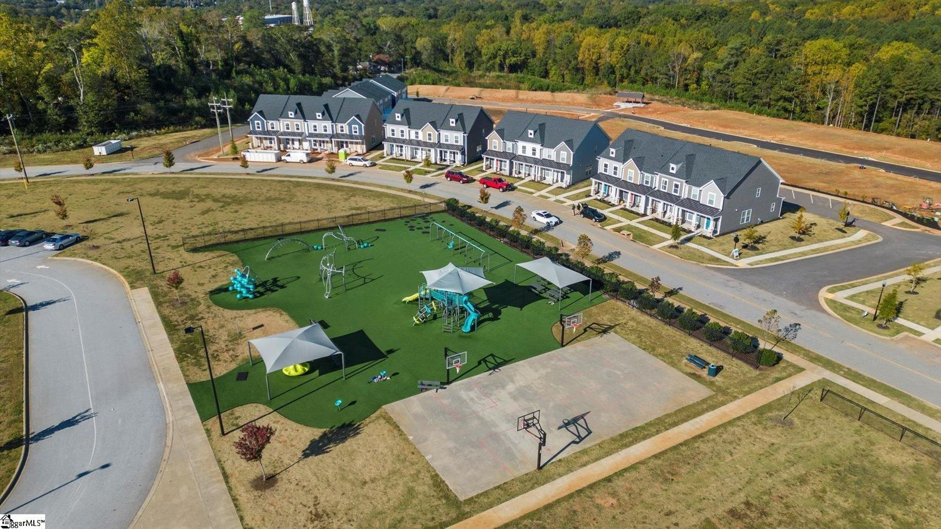
Development Tools

Slide 38
Development Tools
Planners are often first point of contact for a business
Taxing scheme of a state is an important factor when a company is deciding where to locate or expand its business
Businesses are often unaware of available tax incentives that may reduce its tax burden

Slide 39
SPECIAL SOURCE REVENUE CREDITS (SSRC)
South Carolina Code of Laws §4-1-175
SSRCs designed to be a reimbursement mechanism
Reduces property taxes, allowing the business to retain tax savings to reimburse it for certain investment/project costs
Qualifying costs: infrastructure serving county or municipality and the real estate used in the business

Slide 40
SPECIAL SOURCE REVENUE CREDITS (SSRC)
Amount of SSRC is discretionary and negotiated with the county government
SSRC can be a fixed amount (i.e.. $500,000 for cost of land) or
SSRC can be calculated as a percentage of the annual property tax bill over a period of time (i.e.. 15% for 20 years)

Slide 41

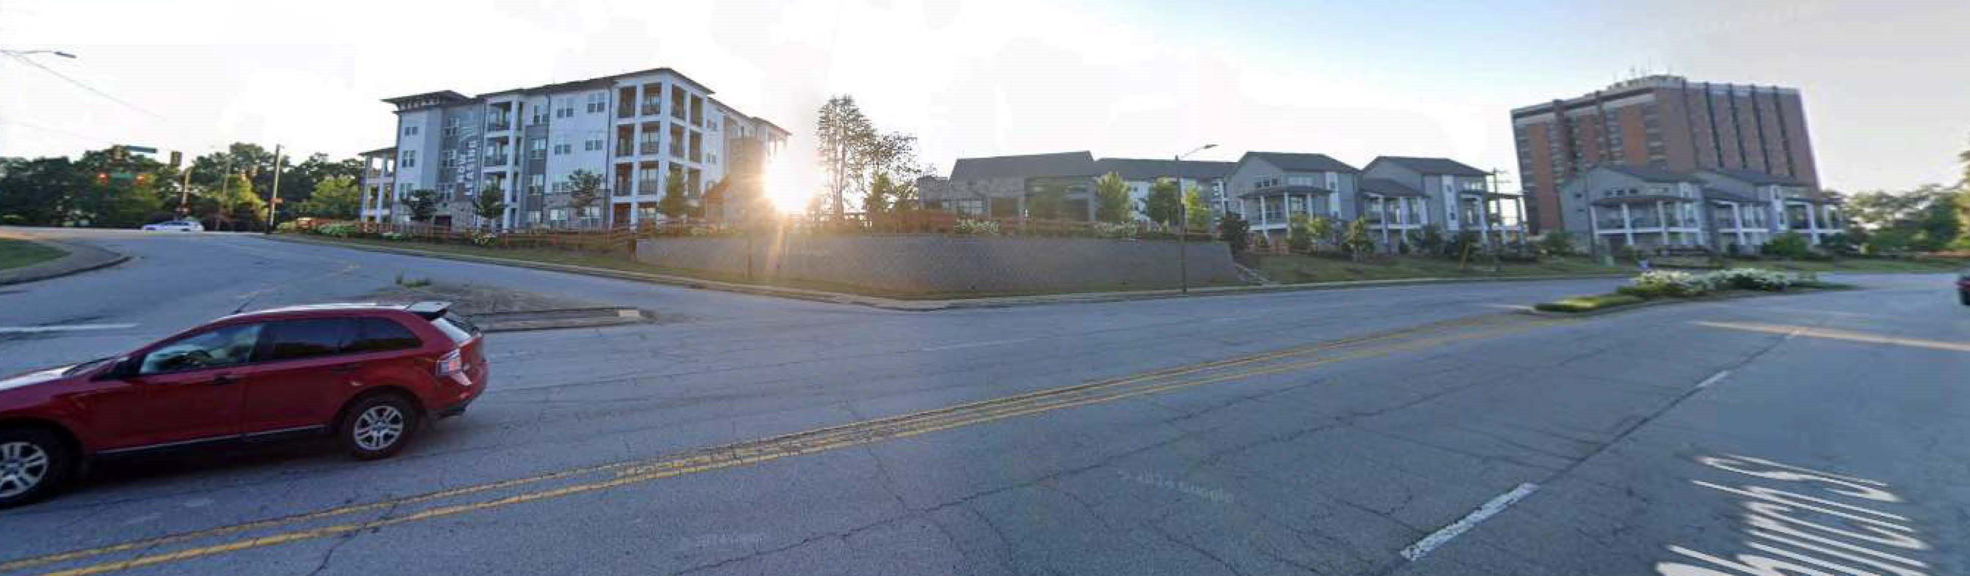
SPECIAL SOURCE REVENUE CREDITS
(Bon Haven c.1884 built by Cleveland family)
BEFORE
AFTER

Slide 42
BAILEY BILL
South Carolina Code of Laws Section §§ 4-9-195 & 5-21-140
Named after former Rep. James Bailey from Charleston
Purpose:
  Encourage rehabilitation of historic structures
  Promote community development and redevelopment
  Encourage sound community planning

Slide 43
BAILEY BILL
Fixes the property tax assessment based on the fair market value of the property before rehabilitation
Assessment fixed for a period of not more than 20 years
Must adopt a Bailey Bill ordinance to use this tool

Slide 44
BAILEY BILL
What structures qualify?
  Listed on National Register of Historic Places
  Designated as historic by governing body & 50 years old; OR
  50 years old & located in historic district designed by governing body

Slide 45
BAILEY BILL
Preliminary Certification
  Locality resolved property is eligible
    (meaning it qualifies as historical)
  Proposed rehabilitation work receives approval from reviewing authority

Slide 46
BAILEY BILL
Minimum Expenditures:
  Determined by locality
    Spartanburg County = 25% of Fair Market Value
Fair Market Value (Greatest of):
  Appraisal - within 6 months of Preliminary Certification
  Taxable Value
  Sales Price – within 6 months of Preliminary Certification

Slide 47
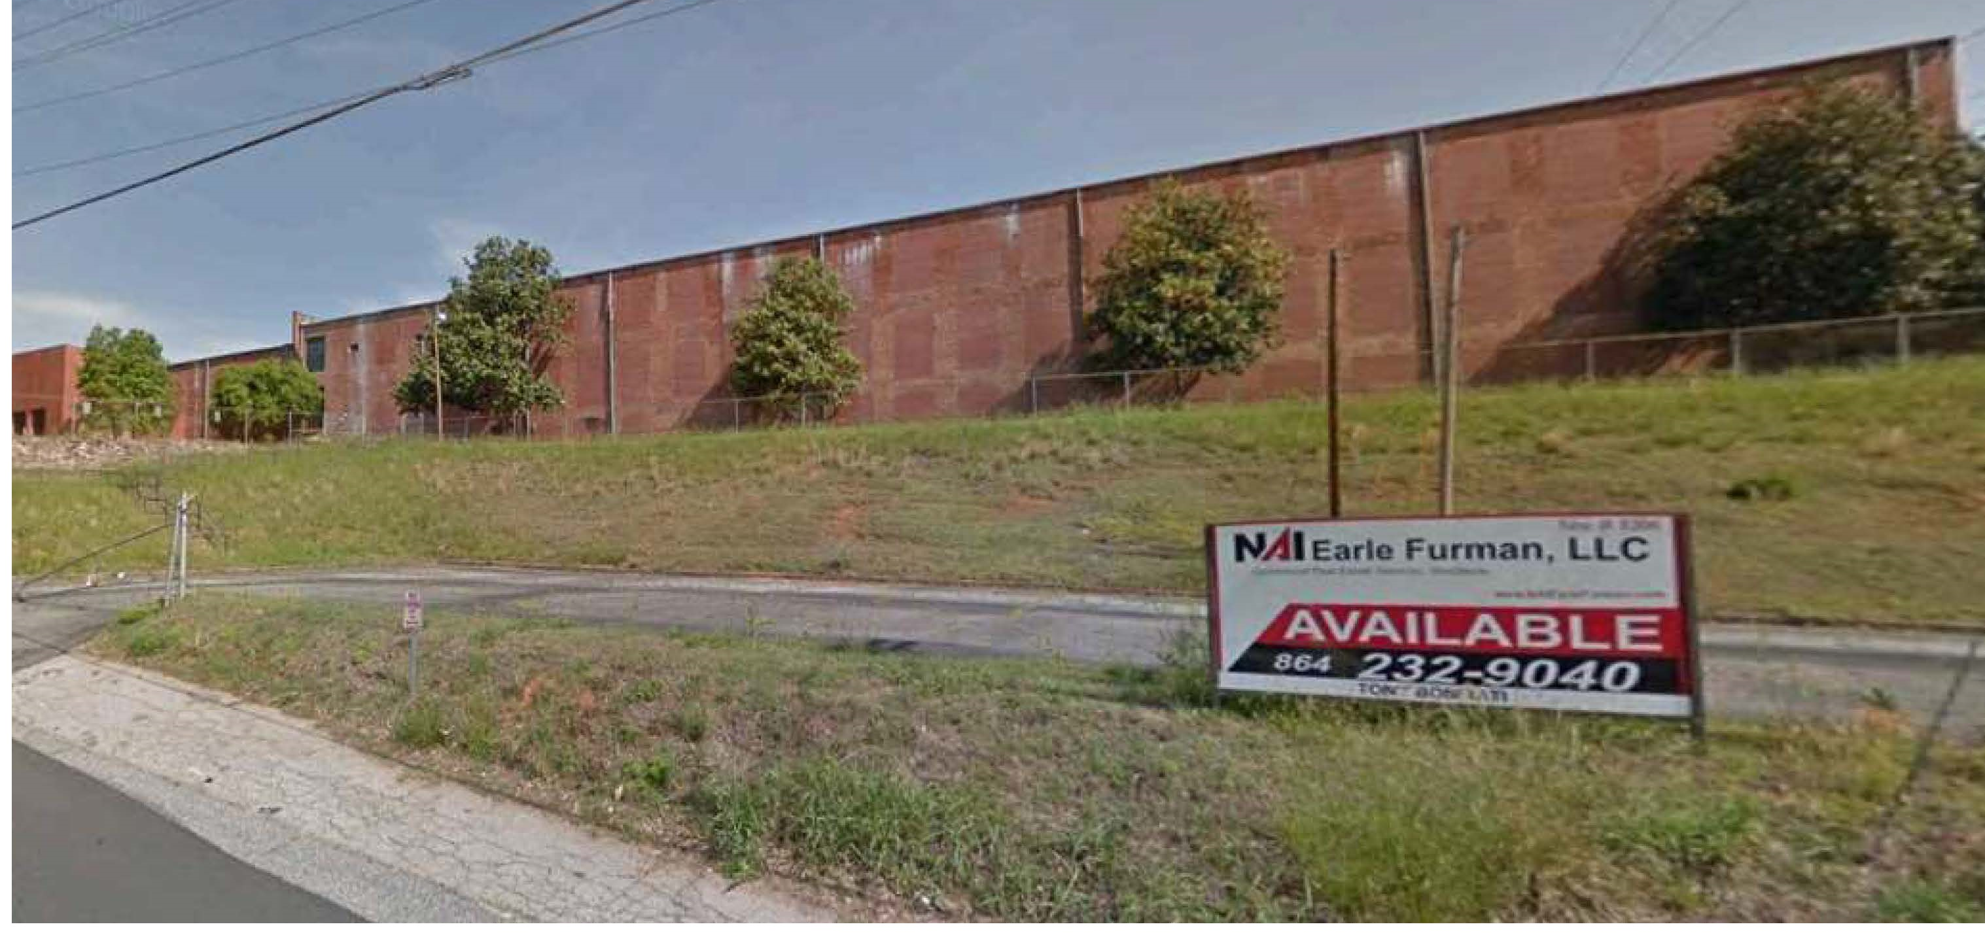

BAILEY BILL
(Apalache Mill c. 1837)
BEFORE
AFTER

Slide 48
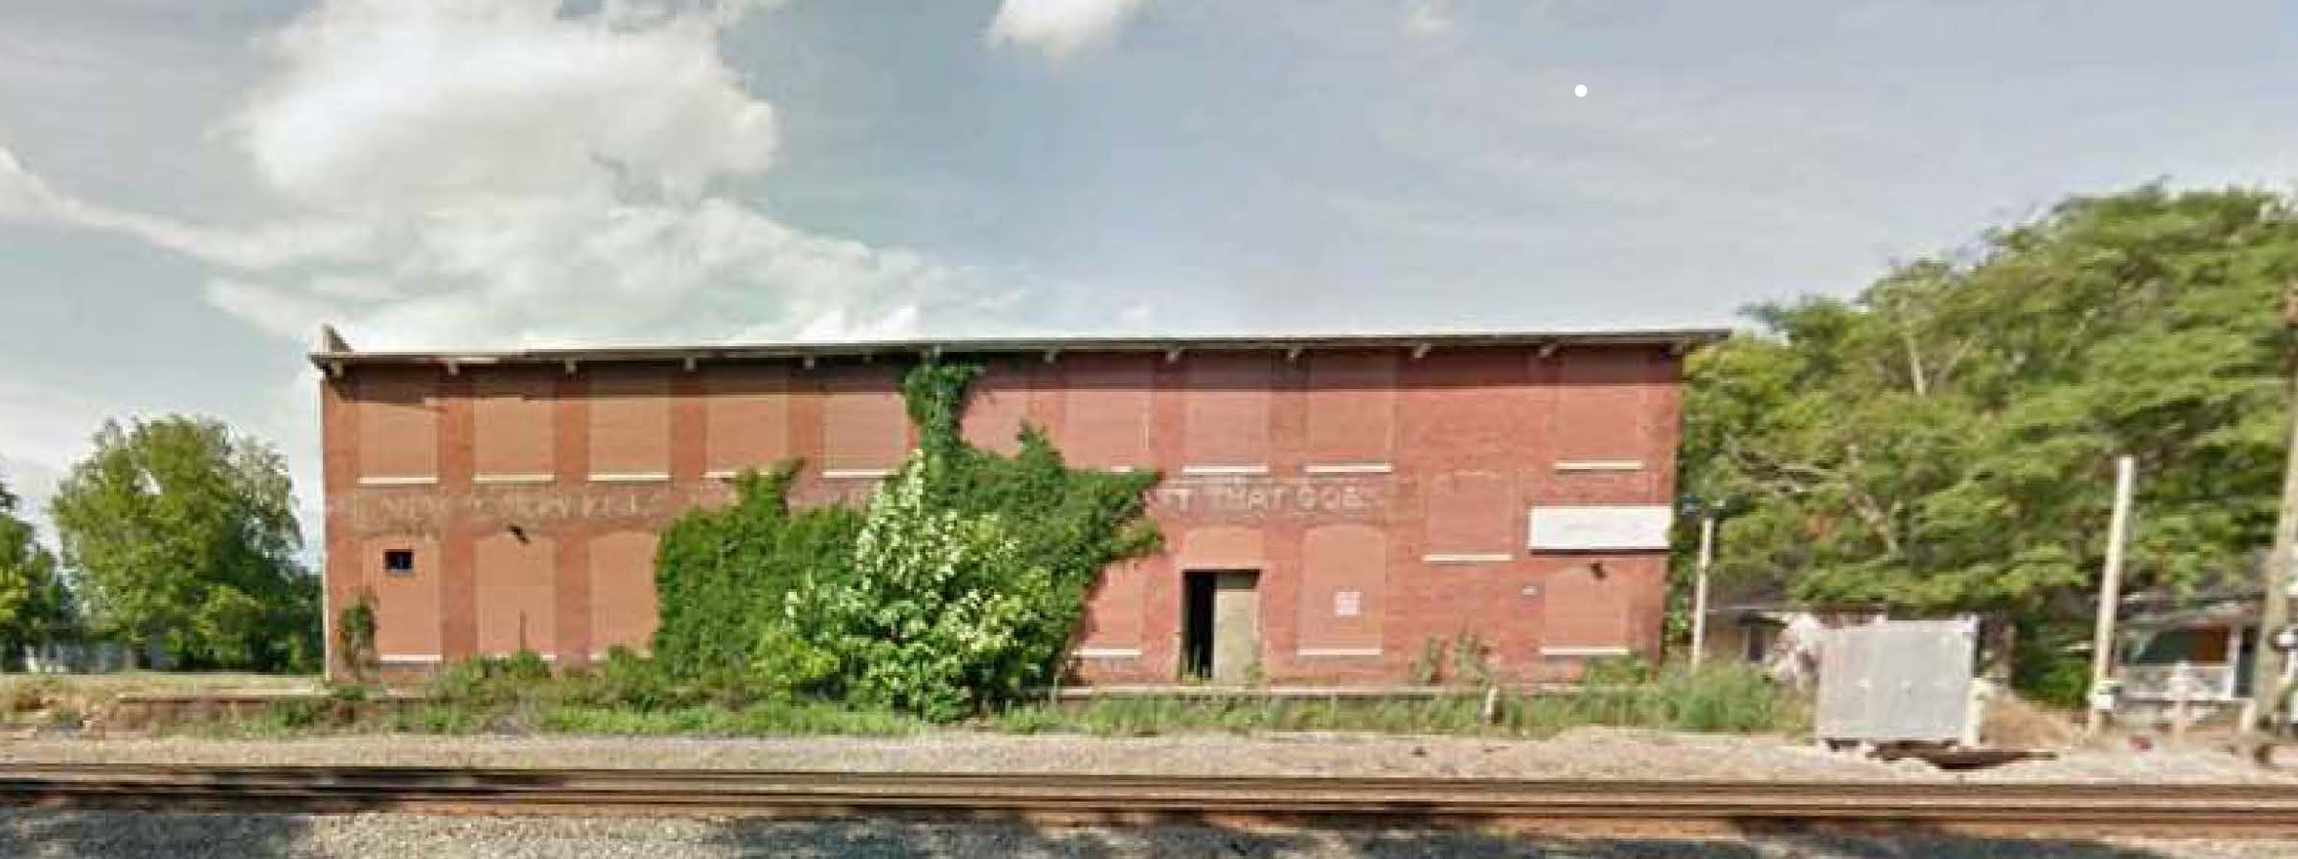
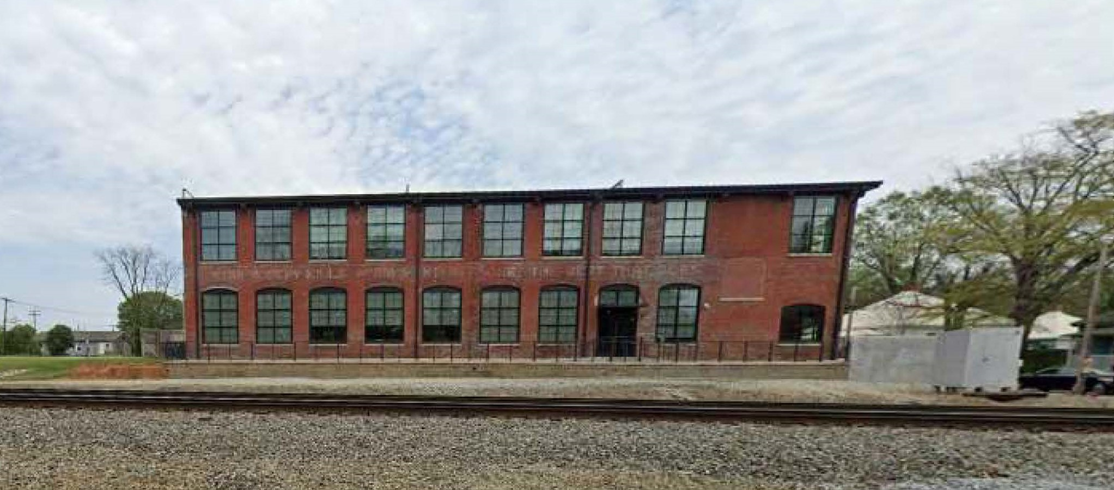
BAILEY BILL
(Old Star Mill)
BEFORE
AFTER

Slide 49
TEXTILE MILL CREDITS
South Carolina Code of Laws § 12-65-10
Purpose:
  Create an incentive for rehabilitation, renovation and redevelopment of abandoned textile mill sites
  Abandoned textile mills pose safety concerns

Slide 50
TEXTILE MILL CREDITS
Abandoned – 80% of textile mill has been closed to business or otherwise nonoperational as a textile mill for a period of at least 1 year prior to Notice of Intent to Rehabilitate
Textile Mill – facility or facilities that were initially used for textile manufacturing, dying or finishing operations and for ancillary uses to those operations

Slide 51
TEXTILE MILL CREDITS
Ancillary Uses – related uses consisting of sales, distribution, storage, water runoff, wastewater treatment and detention, pollution control, landfill, personnel offices, security offices, employee parking, dining and recreation areas and internal roadways or driveways directly associated with such uses
Textile Mill Site – textile mill together with land and other improvements on it which were used directly for textile manufacturing operations or ancillary uses

Slide 52
TEXTILE MILL CREDITS
For expenses associated with a textile mill site to qualify for the credit, the textile mill and buildings on the textile mill site must be either renovated or demolished
Rehabilitation expenses that increase square footage of the building in excess of 200% do not qualify
If taxpayer owned textile mill site when site was operational and immediately prior to its abandonment – not eligible for the credit

Slide 53
TEXTILE MILL CREDITS
Types of Credit:
  Income Tax Credit – 25% of actual rehabilitation expenses made at the textile mill site
    If actual rehabilitation expenses exceed 125% of the estimated expenses in Notice of Intent to Rehabilitate, credit is limited to 125% of estimated expenses
  Property Tax Credit - 25% of total rehabilitation expenses
    Limit 75% of real property taxes up to 8 years

Slide 54
TEXTILE MILL CREDITS
Municipality or County can certify the abandoned building site by ordinance or binding resolution
Certification must provide the following:
  Textile mill site was a textile mill
  Textile mill site has been abandoned
  Geographic area of site was a textile mill site

Slide 55
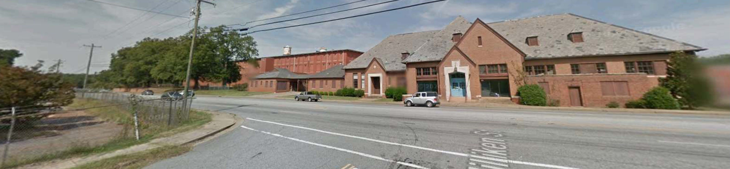
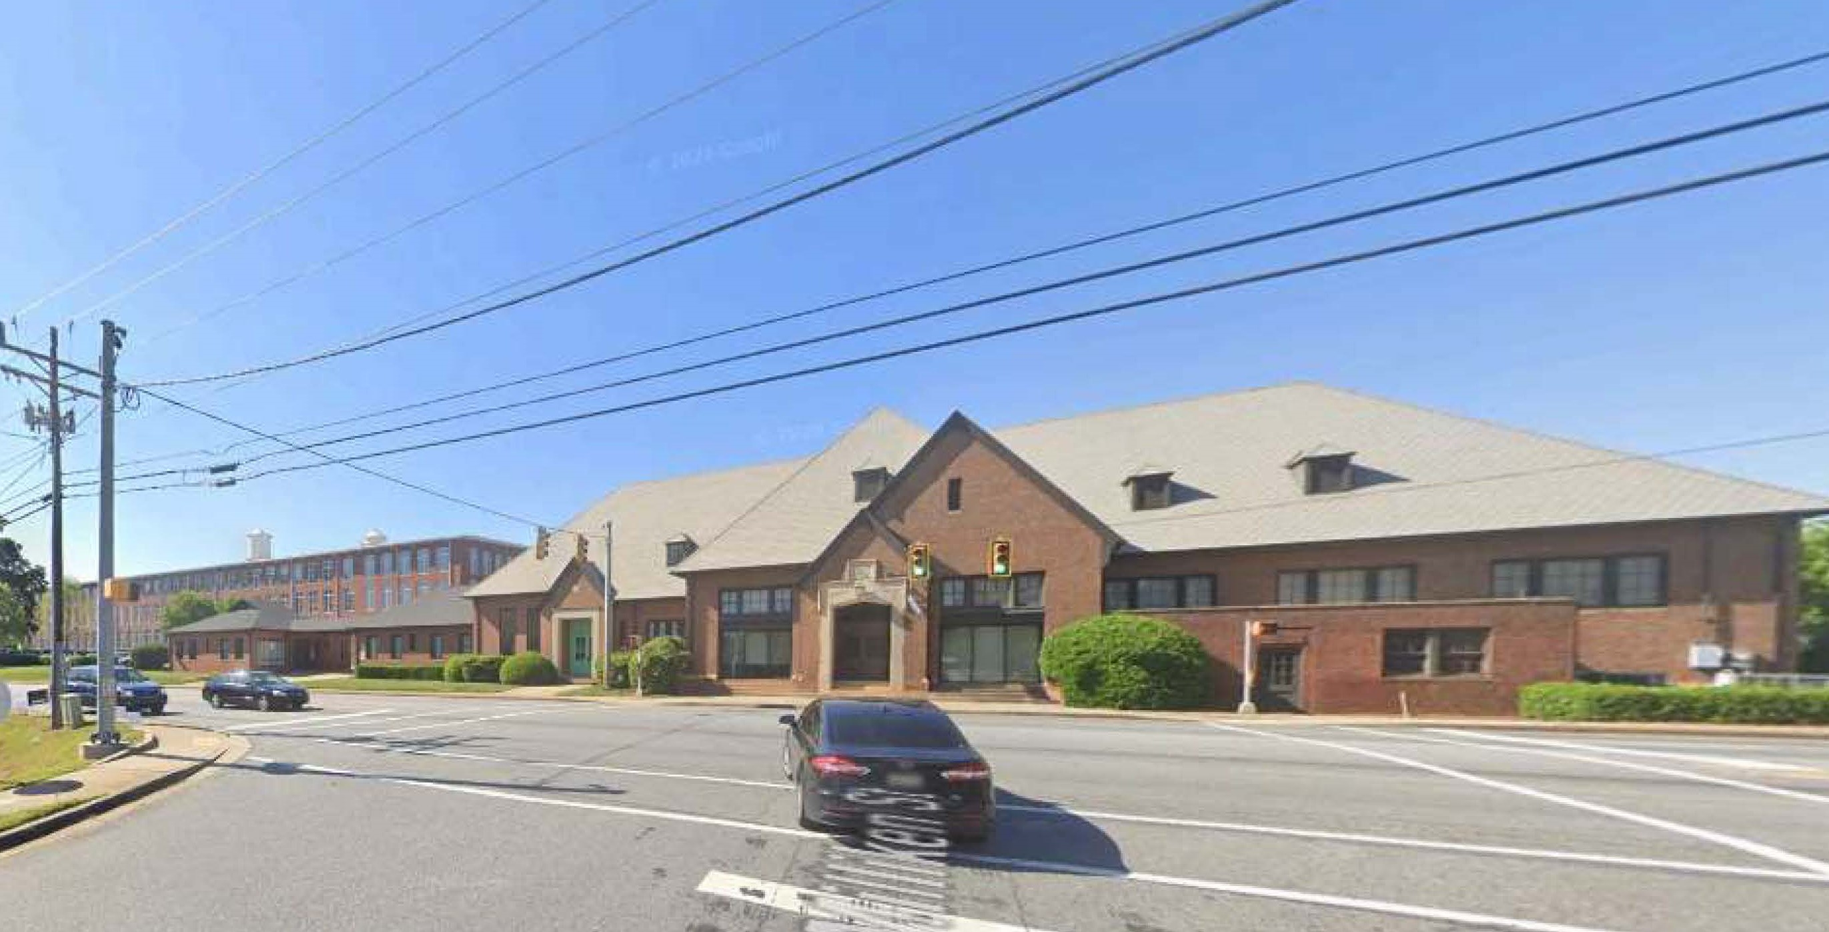
TEXTILE MILL CREDITS
(Drayton Mill c. 1902)
BEFORE
AFTER

Slide 56
ABANDONED BUILDING CREDITS
South Carolina Code of Laws § 12-67-100
Purpose:
  Create an incentive for rehabilitation, renovation and redevelopment of abandoned buildings
  Important as abandoned buildings pose safety concerns

Slide 57
ABANDONED BUILDING CREDITS
Abandoned building – building or structure, at least 66% of space has been closed continuously to business or nonoperational for income producing purposes for at least 5 years prior to Notice of Intent to Rehabilitate
  Single-family residence does not qualify
State-owned abandoned building – aggregate size greater than 50,000 square feet

Slide 58
ABANDONED BUILDING CREDITS
Building site – abandoned building and land immediately surrounding building used for parking and other similar purposes
Rehabilitation expenses that increase square footage of the building in excess of 200% do not qualify
Minimum Rehabilitation Expenses:
  250,000 persons --> $250,000
  1,000 to 25,000 persons --> $150,000
  Less than 1,000 persons --> $75,000

Slide 59
ABANDONED BUILDING CREDITS
Types of Credit:
  Income Tax Credit – 25% of eligible rehabilitation expenses
    Limit $700,000 per tax year (2024 amendment)
  Property Tax Credit – 25% of total rehabilitation expenses
    Limit 75% of real property taxes up to 8 years

Slide 60
ABANDONED BUILDING CREDITS
Municipality or County can certify the abandoned building site by ordinance or binding resolution
Certification must provide the following:
  (1) Abandoned building site was an abandoned building
  (2) Geographic area of site was a building site

Slide 61
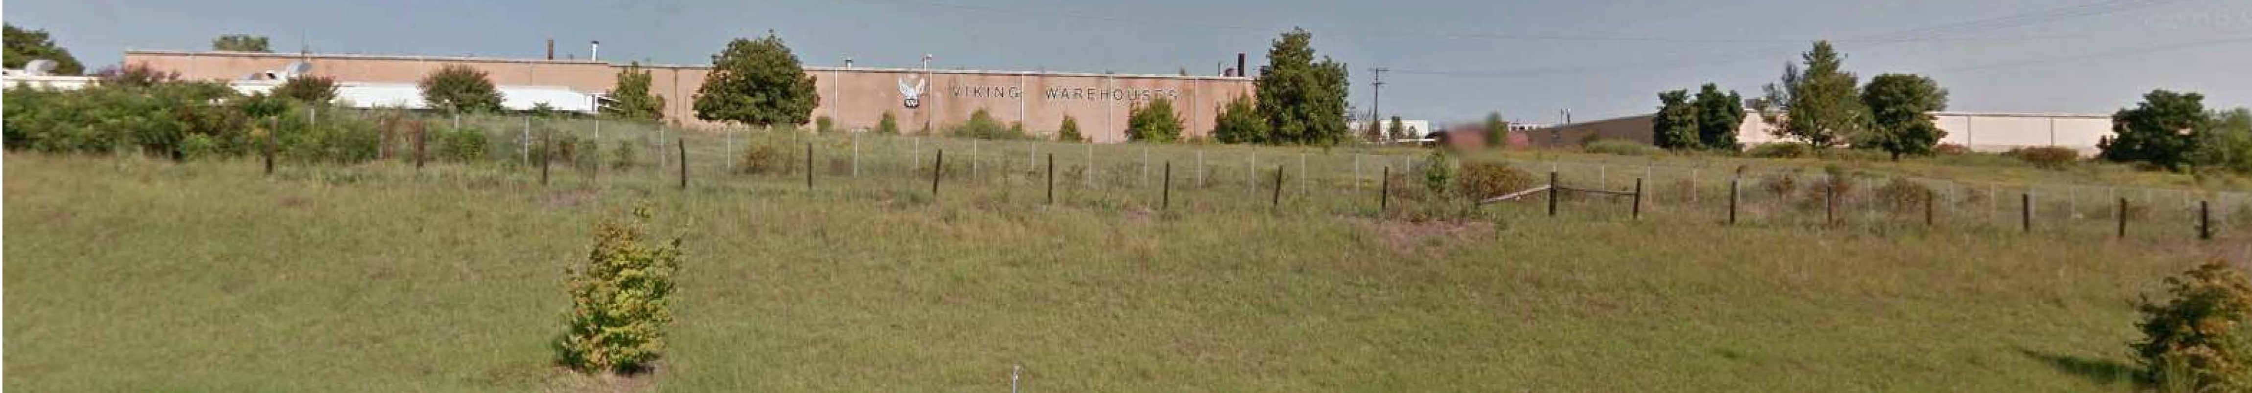

ABANDONED BUILDING CREDITS
(Viking Warehouses c. 1968)
BEFORE
AFTER

Slide 62
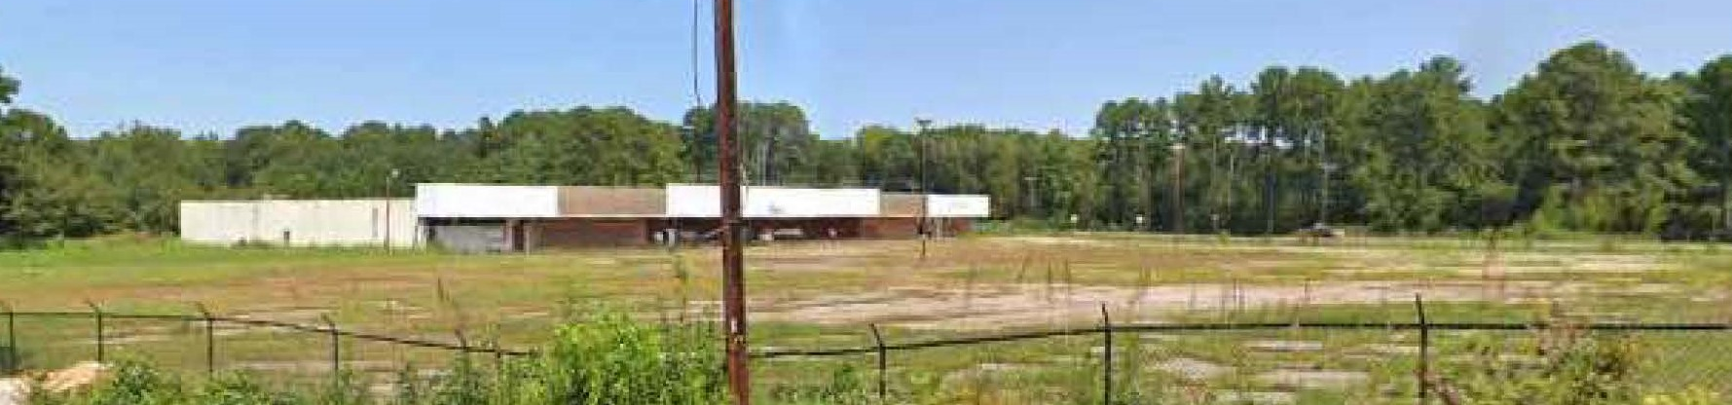

ABANDONED BUILDING CREDITS
(former grocery store & retail c. 1974)
BEFORE
AFTER

Slide 63

Panel Discussion
Bob Coler
John Harris
Todd Okolichany, AICP (moderator)
Source: Alex Hicks Jr./Spartanburg Herald-Journal

