Slide 1







Ethics Cases of the Year: 2024
APA National Panning Conference – April 13, 2024
Minneapolis, MN
Prepared by the Ethics Committee of the American Institute of Certified Planners

Slide 2

Agenda
Refresher on Planning Ethics
Overview of 2023 Case/Inquiry Activity
Ethical Scenarios
  Conflict of Interest/Responsibility to Employer
  Planners in Difficult Positions
  Planners as Community Volunteers
  Gentrification/NIMBY
Q & A

Slide 3

Test Question!
What sector do you work in?

Slide 4

Disclaimer
This session has been created to provide general education regarding the AICP Code of Ethics.
Although ethical scenarios and question-and-answer sessions are an important part of illustrating the application of the Code’s provisions, all certified planners should be aware that only the AICP Ethics Committee is authorized to give formal advice on the propriety of a planner’s proposed conduct.
If you have a question regarding a situation in your own professional practice, you are encouraged to seek informal advice from the AICP Ethics Officer, Ralph Willmer, FAICP (ph: 312-786-6360; email: ethics@planning.org).

Slide 5
AICP Code of Ethics Pledge
This AICP Ethics Code certificate is available for downloading from planning.org/ethics.

Slide 6

A Few Ethical Questions
As posed by Michael Schur, creator of “The Good Place” TV series
What are we doing?
Why are we doing it?
Is there something we could do that’s better?
Why is it better?

Slide 7
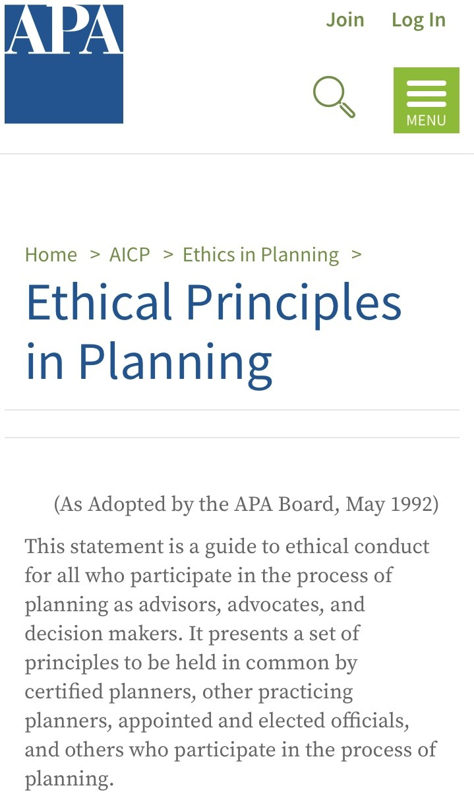
APA’s Ethical Principles in Planning
Adopted in 1980 by the American Planning Association; rev. 1992
Guidelines for advisors, advocates, and decision makers in the planning process
1. Serve the public interest
2. Maintain high standards of integrity and proficiency
3. Improve planning competence

Slide 8
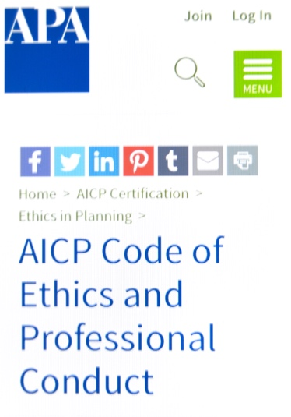
AICP Ethics Code
Adopted in 1948 by the American Institute of Planners; rev. 1959, 1970, 1978, 1991, 2005, 2016, 2022
GRAB YOUR PHONE. GO TO: www.planning.org/ethics/ethicscode
A. Aspirational Principles
B. Rules of Conduct
C. Advisory Opinions
D. Complaints of Misconduct
E. Discipline of Members

Slide 9
Aspirational Principles
Section A of the AICP Ethics Code
People who participate in the planning process shall:
1. Continuously pursue and faithfully serve the public interest
2. Do so with integrity
3. Work to achieve economic, social, and racial equity
4. Safeguard the public trust
5. Improve planning knowledge and increase public understanding of planning activities

Slide 10
Rules of Conduct
Section B of the AICP Ethics Code
The 24 Rules of Conduct—to which certified planners can be held accountable—have been revised and reorganized under these headings:
1. Quality and Integrity of Practice
2. Conflict of Interest
3. Improper Influence/Abuse of Position
4. Honesty and Fair Dealing
5. Responsibility to Employer
6. Discrimination/Harassment
7. Bringing and Cooperating with an Ethics Charge

Slide 11
Key Aspects of the 2022 Code Update
Equity and social justice become a foundational principle of the Code
A. Aspirational Principles
  Re-organized
  Equity, social, and racial equity as foundational
  Discrimination/harassment explicit
  Ethics investigation clarified
  Responsibility for promoting ethics
B. Rules of Conduct
  Re-organized
  Cultural biases removed
  Equity as foundations of plans
  Claiming credit (plagiarism) clarified

Slide 12
Adjudication of Complaints of Misconduct
Section D of the AICP Ethics Code
D6a: Only current members of AICP may appeal a determination of the Ethics Officer.
This revision with the 2022 update eliminates the ability of non-AICP planners to contest the ruling of the Ethics Officer through a time-consuming appeal process and protects planners from frivolous complaints.
However, non-AICP planners can still file an appeal by having an AICP planner do so on their behalf.

Slide 13

Glossary
September 2022
A new feature to assist planners in understanding the language and the intent of the AICP Code of Ethics and Professional Conduct, as related to Diversity, Equity, and Inclusion.

Slide 14

Ethical Misconduct Cases in 2023
108 inquiries for informal advice
28 new complaints filed
42 Resolved and Ongoing Misconduct Cases
17 cases under various states of review
18 cases dismissed by the Ethics Officer
  No justification to file a charge or planner not AICP

Slide 15
Ethical Misconduct Cases in 2023
8 Cases Resolved (including carryovers from 2022)
Cease and desist letters issued (3 cases) for misuse of the AICP credential
Preliminary Determination that a violation occurred for inappropriate references to indigenous populations in presentation at NPC23 (Rules 1 & 20)
Confidential Letters of Admonition (3 cases) for:
  plagiarism – Rule 16
  inappropriate postings on social media (Rules 6 & 20)
  comments made at an APA-sponsored meeting (Rule 20)
Public Letter of Admonition and Revocation of FAICP credential (1 case) for sexual harassment upheld on appeal to the Ethics Committee

Slide 16
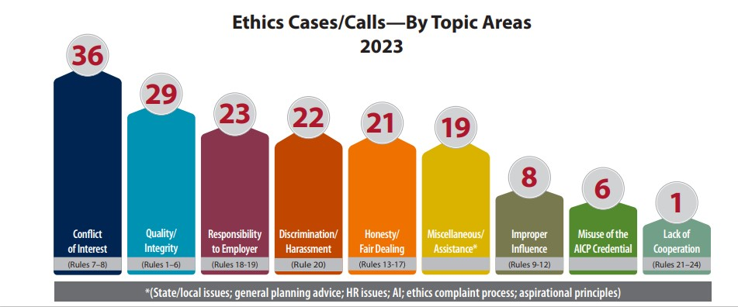
Ethics Topics in 2023

Slide 17
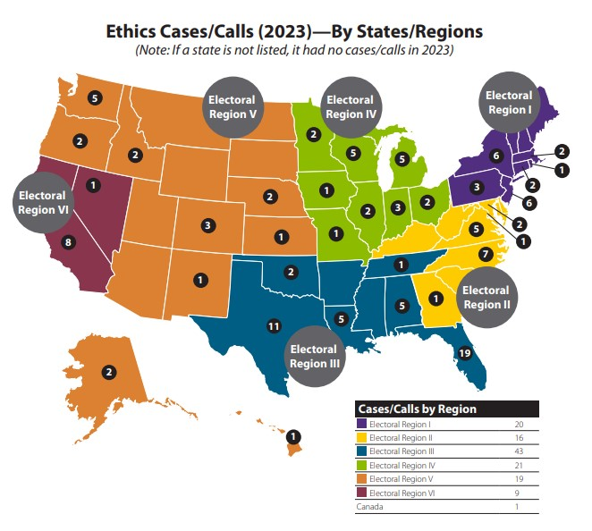
Cases/Inquiries of the Year
The following scenarios were based on misconduct complaints or informal inquiries reviewed by the Ethics Officer and the Ethics Committee in 2023.
Although the scenarios are based on real-life situations, all of the names, details, and locations are fictional.

Slide 18
Scenario 1: Conflict of Interest/Responsibility to Employer

Slide 19
Scenario 1
Marijuana & Conflict of Interest
Odilia, AICP, is a planning consultant living in the Town of Suarez.
Accused of working two jobs without notifying her employer at the time, the Town of Suarez.
Also charged with conflict of interest because she had a contract with a marijuana company
Notes:
Odilia is a planning consultant living in the Town of Suarez.
A concerned resident accused Odilia of working two jobs without notifying her employer at the time, the Town of Suarez.
The resident further charged that because she had a contract with a marijuana company, she had a conflict of interest.

Slide 20
Scenario 1
Marijuana & Conflict of Interest – cont’d.
Odilia explained that she was a consultant for Suarez and not a fulltime employee.
Did not approve permits, just worked as a Zoning Official
Provided guidance on keeping the zoning code consistent with the comprehensive plan.
Was hired by the marijuana company to site a retail store in the Town.
Only a 2-month overlap of her clients.

Slide 21

Scenario 1
Ethical Issues
A. Aspirational Principles
  4.5. Avoid a conflict of interest or even the appearance of a conflict of interest in accepting assignments from clients or employers

Slide 22
Scenario 1
Ethical Issues
B. Code of Conduct
    7. We shall not, as public officials or employees, accept from anyone other than our public employer any compensation, commission, rebate, or other advantage that may be perceived as related to our public office or employment.
    18. We shall not, as employees, undertake other employment in planning or a related profession, whether or not for financial remuneration, without having made full written disclosure to the employer who furnishes our pay … In no case shall a planner engage in any outside work that would create a conflict of interest.

Slide 23
Scenario 1: Question
Did Odilia have a conflict of interest because of her work for a marijuana business and consulting with the Town?

Slide 24
Scenario 1: Question
Does the time period of overlap in the two clients matter?

Slide 25

Scenario 1
Real Life Outcome
In this real-life case, on which this scenario is based, the EO dismissed the charge after evidence was presented that she was a consultant and not a direct employee of either the Town or the marijuana company. Further, she was not writing new zoning code on behalf of the the marijuana business.

Slide 26
Scenario 2: Planners in Difficult Positions

Slide 27
Scenario 2: Planners in Difficult Positions
John, AICP, is a Senior Planner in Bluesville. He has been tasked with conducting a review of a large development project and preparing a staff report.
Identifies several issues and includes them in the staff report
Developer asks Yoko, AICP, the Bluesville Planning Director, to remove some of the recommended changes and conditions.
Yoko asks John to make those changes.
John is reluctant to do so since his name is on the report.
Yoko insists that John makes the requested changes.
John asks that his name be removed from the report.
Notes:
John is a Senior Planner in Bluesville. He has been tasked with conducting a review of a large development project and preparing a staff report to go to the Planning Commission.
John identifies a number of issues and includes them in the staff report that includes input from other staff but bears his name.
Developer asks Yoko, the Bluesville Planning Director, to remove some of the recommended changes and conditions from the staff report. Yoko asks John to make those changes.
John is reluctant to do so since his name is on the report. Yoko insists that John makes the requested changes. John asks that his name be removed from the report.

Slide 28
Scenario 2: Ethical Issues
A. Aspirational Principles
  2.1. Provide timely, adequate, clear, accessible, and accurate information on planning issues to all affected persons, to governmental bodies, to the public, to clients and to decision makers.
  2.2. Facilitate the exchange of ideas and ensure that people have the opportunity for meaningful, timely, and informed participation in the development of plans and programs that may affect them.
  4.2. Exercise fair, honest, skilled, informed and independent professional judgment.

Slide 29

Scenario 2: Ethical Issues
B. Code of Conduct
  1. We shall not deliberately fail to provide adequate, timely, clear and accurate information on planning issues.
  5. We shall not direct or pressure other professionals to make analyses or reach findings not supported by available evidence.
  9. As public officials or public employees, we shall not engage in private communications with planning process participants if the discussions relate to a matter over which we have authority to make a binding, final determination.
  10. We shall not engage in private communications with decision makers in the planning process in any manner prohibited by law or by agency rules, procedures, or custom

Slide 30

Scenario 2: Real Life Outcome
Ethics Officer advised John to work with his supervisor to incorporate necessary comments and conditions to the staff report in order to accurately address outstanding issues. He could also talk to the Town Attorney to express concern regarding potential liability (ADA was one of the issues involved). He could also document his actions in a memo to the file in case someone filed an ethics complaint against him. Ultimately his name remained on the report but some of his concerns were addressed.

Slide 31
Scenario 2: Questions
How should John respond if he was given orders by Bluesville’s Mayor (not AICP) to change the report with the possibility of losing his job if he did not comply?
How should John address his concerns if he was a junior level planner without a direct supervisor either because he is a one-person planning department or due to a vacancy at the Planning Director level?

Slide 32
Scenario 3: Planners as Community Volunteers

Slide 33
Scenario 3: Planners as Community Volunteers
Catherine, AICP, lives in the City of Bauer where she is a planner. She has been asked by the mayor to serve on the Habitat for Humanity Affordable Housing Committee as a city representative.
Ethel, AICP, lives and works for the City of Elmerwoods and is concerned about a zoning proposal regarding setbacks and dimensional requirements being presented at a public hearing in her neighborhood.

Slide 34
Scenario 3: Ethical Issues
A. Aspirational Principles
  4.2. Exercise fair, honest, skilled, informed and independent professional judgment.
  4.5. Avoid a conflict of interest or even the appearance of a conflict in accepting assignments from clients or employers.
  4.6 Disclose to the public all personal and pecuniary interests, considered broadly…
  5.6. Contribute time and effort to our communities, particularly to those groups lacking in adequate planning resources, through pro bono planning activities.

Slide 35

Scenario 3: Ethical Issues
Code of Conduct
  7. We shall not, as public officials or employees, accept from anyone other than our public employer any compensation, commission, rebate, or other advantage that may be perceived as related to public office or employment.
  17. We shall not fail to disclose the interests of our client or employer when participating in the planning process.

Slide 36
Scenario 3: Questions
Should Catherine accept an appointment to the affordable housing committee?

Slide 37
Scenario 3: Questions
Should Ethel comment on the zoning proposal at the public hearing in her town?

Slide 38

Scenario 3: Real Life Outcome
The Ethics Officer advised:
Catherine, AICP, that her appointment to the affordable housing committee was acceptable with proper written disclosure when applicable and recusal when there is a conflict with a project she is working on for the city.
Ethel that it was best to avoid commenting on the proposal especially if she is involved in the process. Planners are also residents of their communities so if there is a disclosure and approval from her supervisor, she might be allowed to speak but should disclose her position at the outset.
Notes:
The Ethics Officer advised Catherine, AICP, that her appointment to the affordable housing committee was acceptable with proper written disclosure when applicable and recusal when there is a conflict with a project she is working on for the city.
The Executive Officer advised Edith that it would be best to avoid commenting on the proposal whether for or against especially if she is involved in the process. Planners are also residents of their communities so if there is a disclosure and approval from her supervisor, she might be allowed to speak but should disclose her position at the outset.

Slide 39
Scenario 4: Gentrification vs. NIMBY

Slide 40
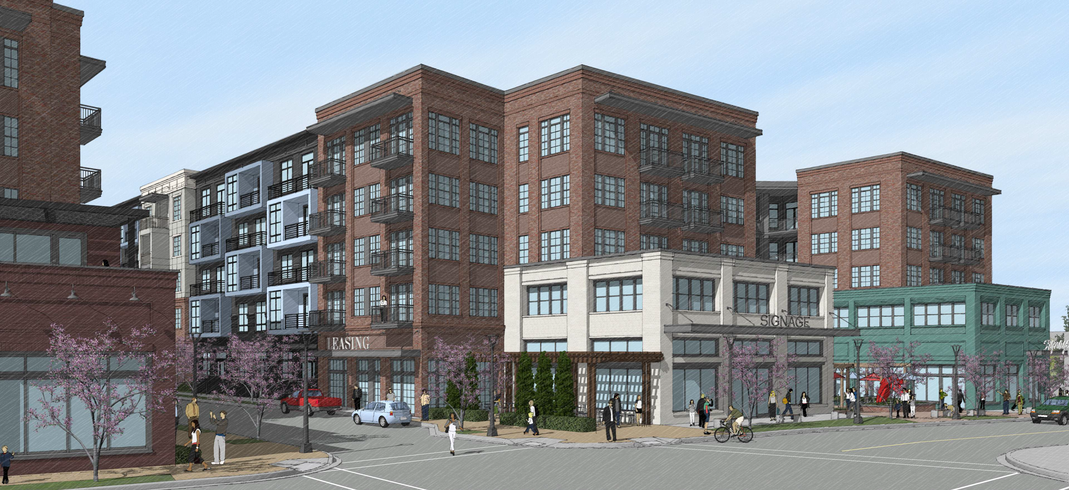
Scenario 4: Gentrification vs. NIMBY
Fannie is an AICP planner in the City of Williams.
She receives an application for a mixed-use development:
254 rental units with 10% affordable units at 80% AMI
30,000 sq. ft. of commercial space, of which 10% will be leased at below market rates
a public park and infrastructure improvements
Over the course of 2 years, there were nearly 15 public meetings held by the neighborhood groups, the city council, and the county council.
Fannie faces strong political pressure from both opponents and supporters to recommend for their position on the proposal.

Slide 41
Scenario 4: Planning Challenges
Proposed development is consistent with recently adopted comprehensive plan
Gentrification arguments in a tight housing market when NIMBY is the real issue
Balance issues in the public interest:
  Need for affordable housing
  Consistency with local plans
  Scale of development
Equity and public trust
  Perceptions of racism
  Perceptions of impacts on adjacent Black neighborhoods
  Viewpoints: residents vs. business interests
  City and county interests

Slide 42
Scenario 4: Ethical Issues
A. Aspirational Principles
  1.2. Be conscious of the rights of others. Develop skills that enable better communication and more effective, respectful, and compassionate planning efforts…
  2.1. Provide timely, adequate, clear, accessible, and accurate information on planning issues to all affected persons, to governmental bodies, to the public, to clients and to decision makers.
  3.1. Create plans that ensure equitable access to resources and opportunities…Recognize our unique responsibility to eliminate historic patterns of inequity tied to planning decisions …
  4.1 Deal fairly with all participants in the planning process.

Slide 43

Scenario 4: Ethical Issues
B. Code of Conduct
1. Provide clear, timely, and accurate information
6. Do not deliberately commit any wrongful act
9. Do not engage in private communications with planning process participants
10. Do not engage in private communication with decision makers
13. Do not disclose information gained in a professional relationship
14. Do not deliberately misrepresent the qualifications, views, or findings of other professionals

Slide 44
Scenario 4: Real Life Outcome
  The project was approved by the Williams City Council by a vote of 4-3.
  The final project provides more affordable housing, promotes development in the area, and increases the amenities above what was originally proposed.
  Provide a “high bar” for planning boards and councils to make good decisions based on the AICP Code of Ethics and Professional Conduct.
  Carol Barrett’s (FAICP) words of wisdom:
  Make it simple for boards and councils to act with a clear list of reasons
  Provide a narrative that supports a recommendation and decision
  Include technical, substantive, and other relevant issues
  Always remember that tradeoffs are inevitable
Notes:
Fannie was relieved that her efforts to explain the project carefully and to fully engage the public resulted in approval by the Williams City Council by a vote of 4-3. Further, the final project provides more affordable housing, promotes development in the area, and increases the amenities above what was originally proposed. Construction is to begin in 2024.
Provide a “high table” for planning boards and Councils to make good decisions based on the AICP Code of Ethics and Professional Conduct. Carol Barrett’s (FAICP) words of wisdom:
Make it simple for boards and councils to act with a clear list of reasons
Provide a narrative that supports a recommendation and decision
Include technical, substantive, and other relevant issues
Always remember that tradeoffs are inevitable

Slide 45

Further Discussion

Slide 46
Final Note
For informal advice regarding ethical conduct, please contact the AICP Ethics Officer at 312-786-6360 or ethics@planning.org. For more information about ethics, please visit planning.org/ethics
AICP Ethics Committee
Robert L. Barber, FAICP Kimberley Mickelson, FAICP, JD
Carol Barrett, FAICP Barry Nocks, PhD, FAICP
Anna Breinich, FAICP Erin Perdu, AICP, Co-Chair
Staron Faucher, AICP, Co-Chair Robin Scholetzky, AICP, LEED AP ND
Arlova Vonhm, AICP

